Slide 1
Biology at Middle Valley – open discussion
Endeavour Workshop (12-14 Nov 2024)
Fabio C. De Leo
Senior Staff Scientist, ONC
Department of Biology, UVic
Notes:
MAIN OBJECTIVE here is to draw attention to the the community for this observatory expansion at Middle Valley, which was already originally planned from the original NEPTUNE proposal
Gather an input from the community on what types of relevant research questions and interest exist on the seafloor ecosystems in the area.
Most information I gathered from Joan, Amanda and Sheryl

Slide 2
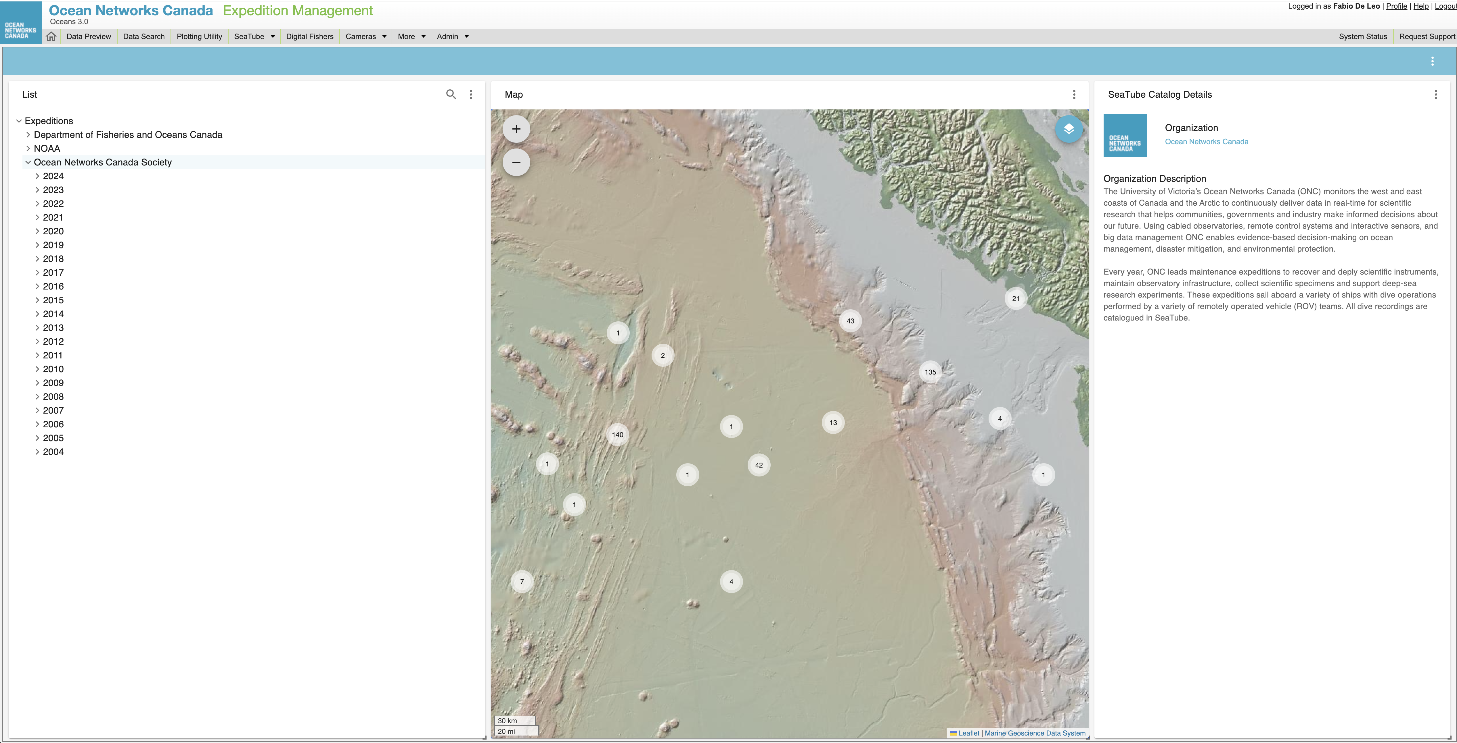
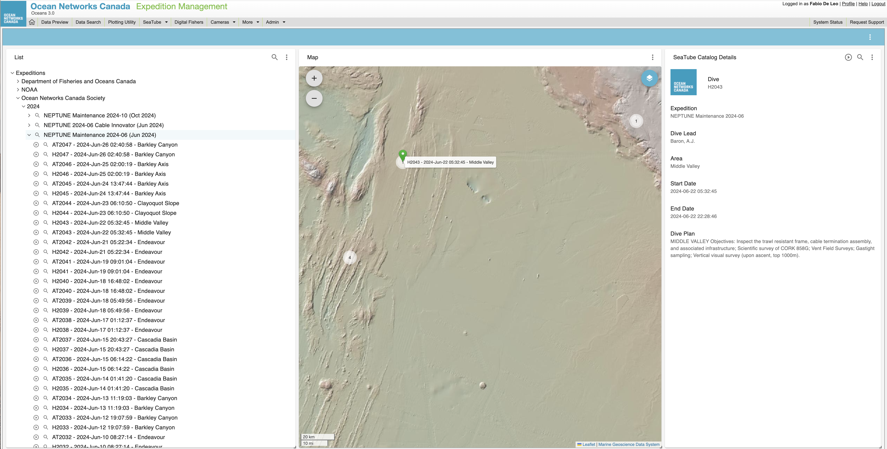
Disclaimer: ONC ROV video archives (only 2 dives in the past 20 years!)
Middle Valley
Notes:
DISCLAIMER (ONC has only 2 dives at Middle Valley in the last 15 years or so)
Very little is available from the literature as well. So my presentation will cover some of the very few studies done

Slide 3
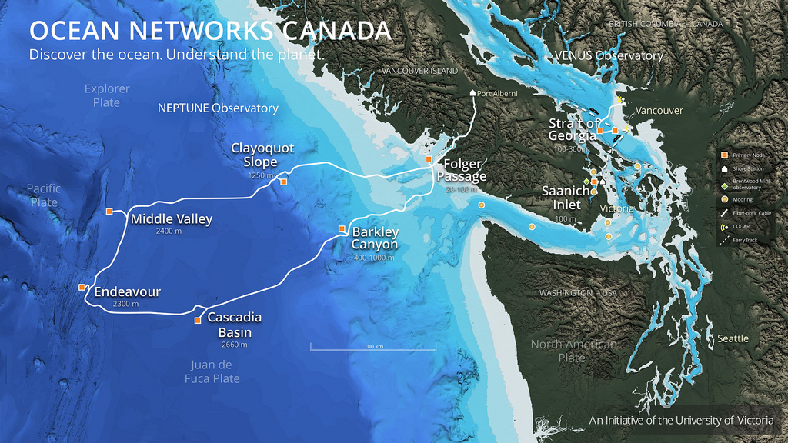
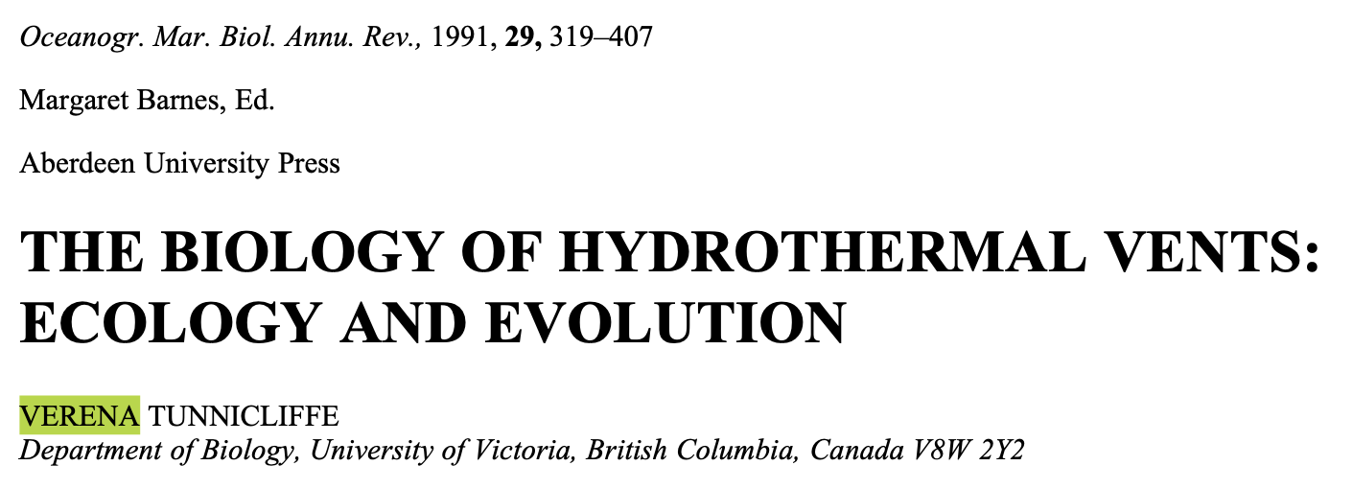
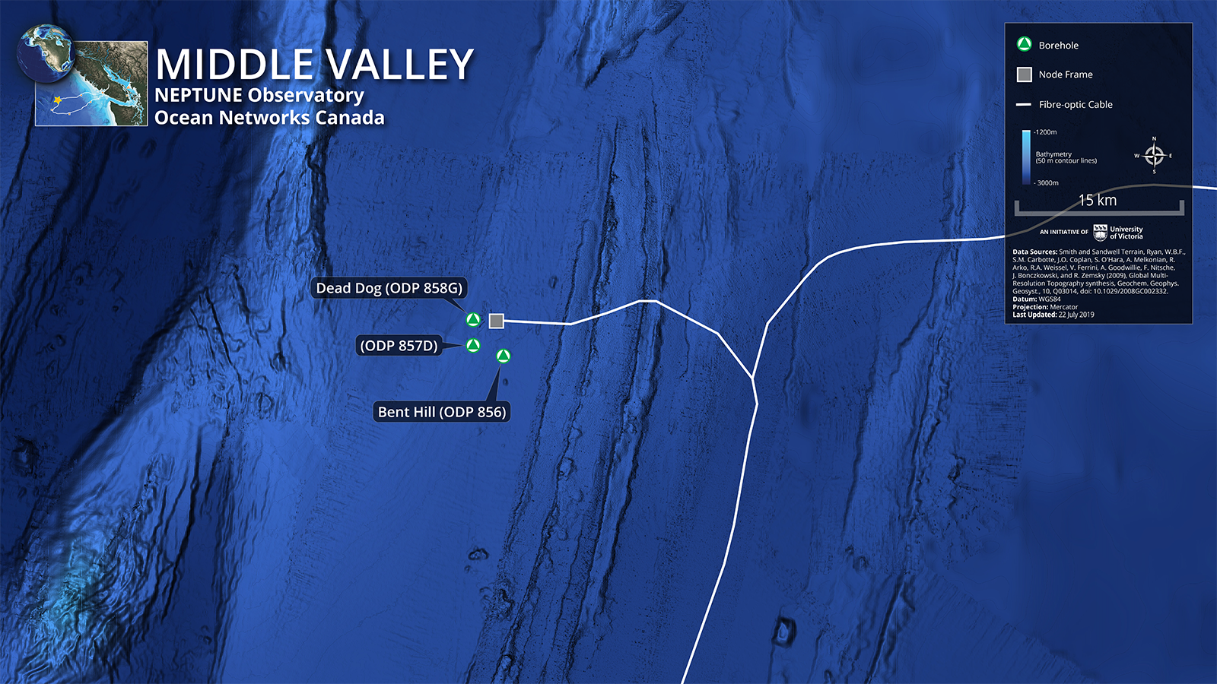
Background
Parallel and to the East of Endeavour is a “failed rift” know as Middle Valley
Holds a tick deposit of turbidites that overlie several large sulphide mounds
ODP selected sites (#856, 857, 858)
1990 Alvin cruise – 280ºC black smokers observed on sulphide mounds
Sparse diffusive vents in surrounding sediments (packed with bivalves)

Slide 4
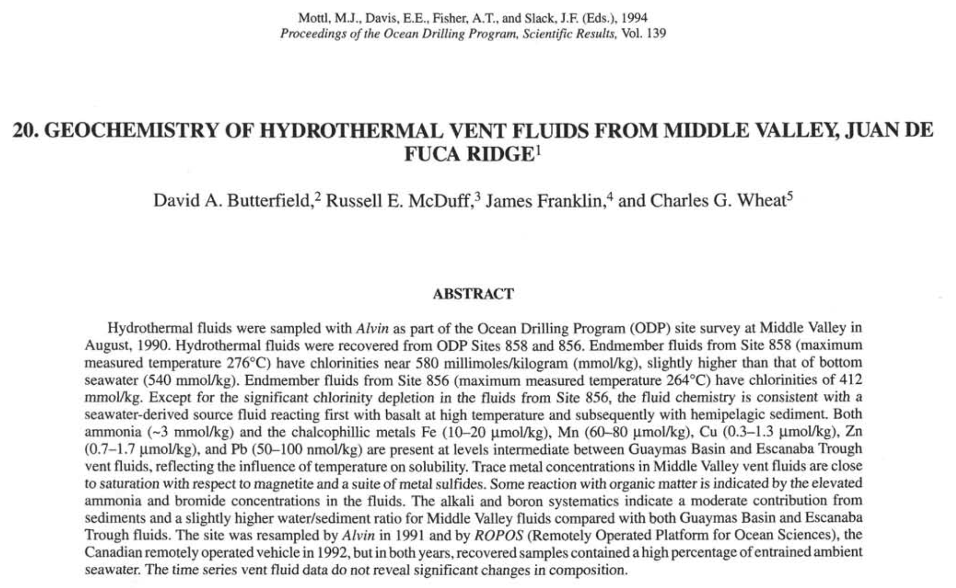
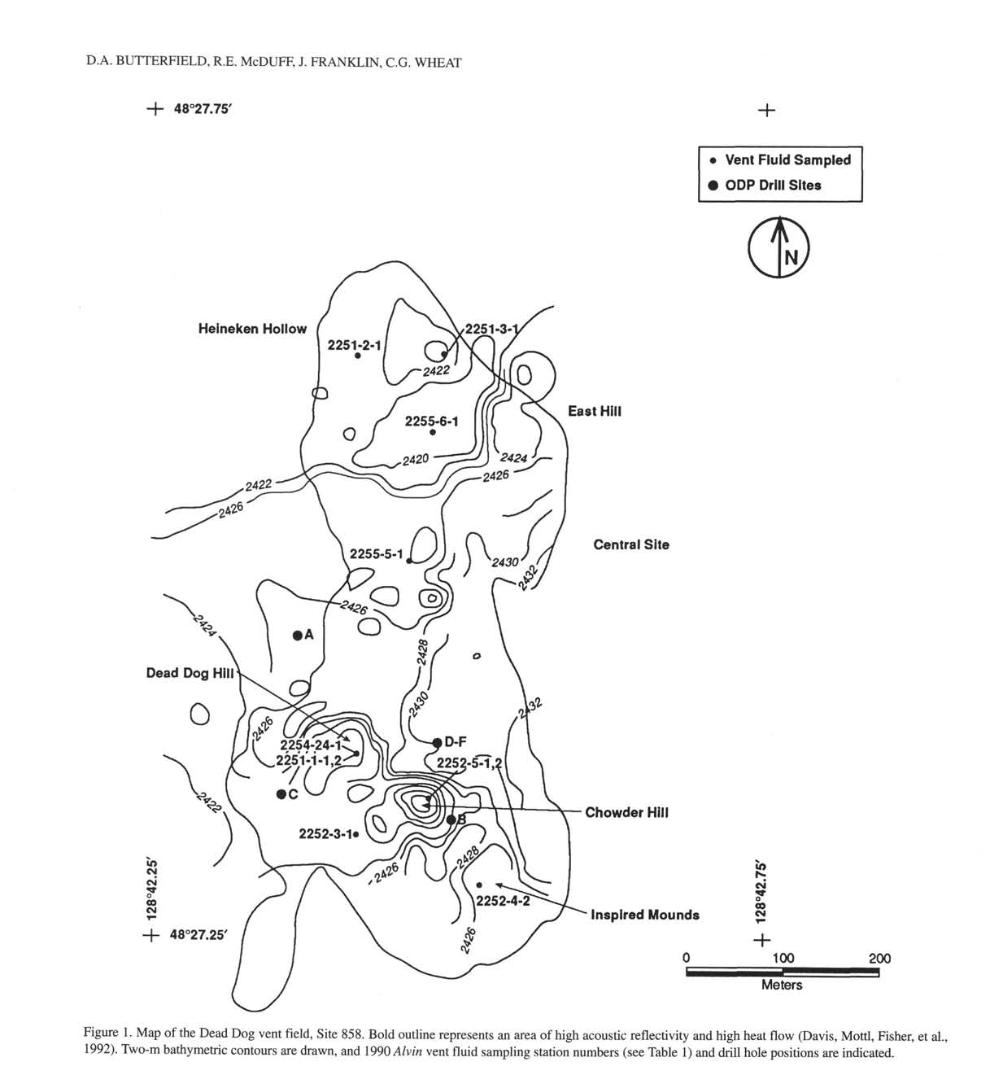
Background
“Middle Valley is an axial rift valley at the northern extreme of the Juan de Fuca Ridge near the intersection with the Sovanco fracture zone. The valley is completely filled with Pleistocene turbiditic sediments, ranging in thickness from a few hundred meters in the southern portion to near 2 km in the north.”
Geochemical characterization from ODP sites from Alvin hydrothermal fluid samples
858 (Max temp 276ºC) 856 (Max temp 264ºC)
Presence of OM (indicated by elevated ammonia and bromide)
Notes:
Geochemical caractherization

Slide 5
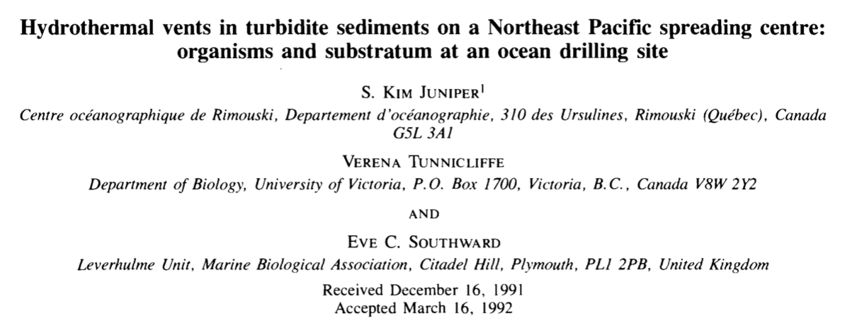
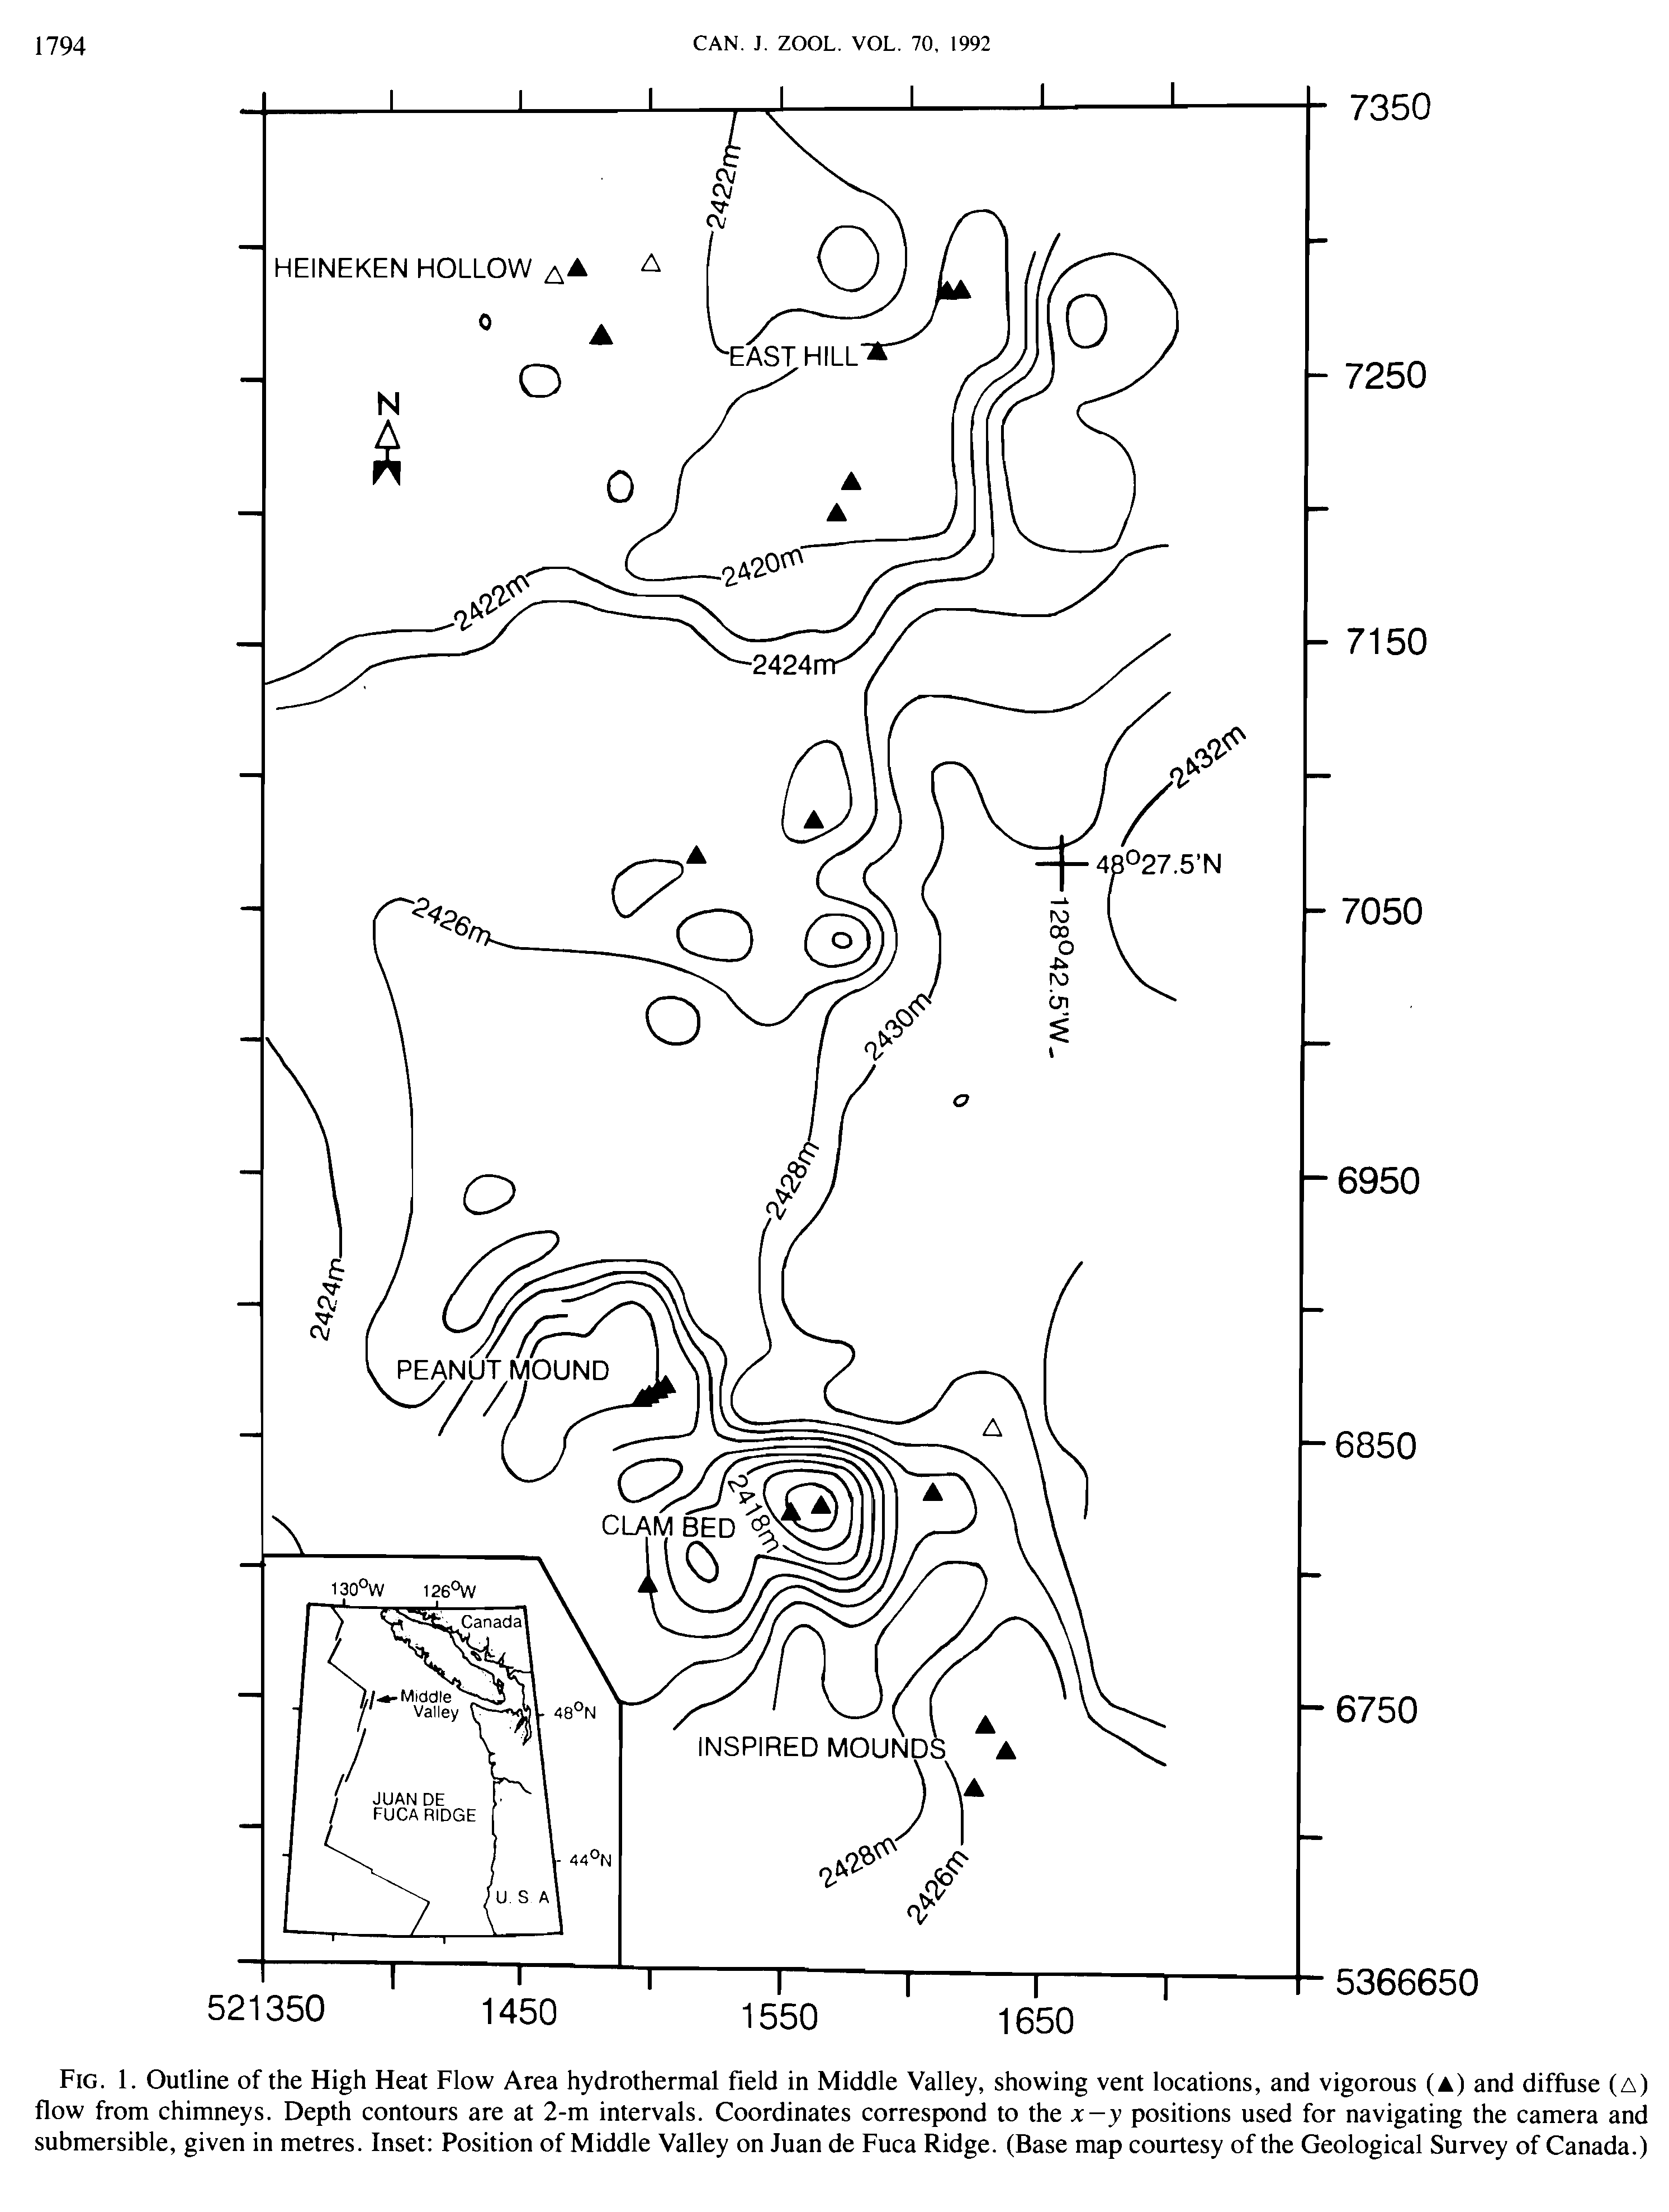
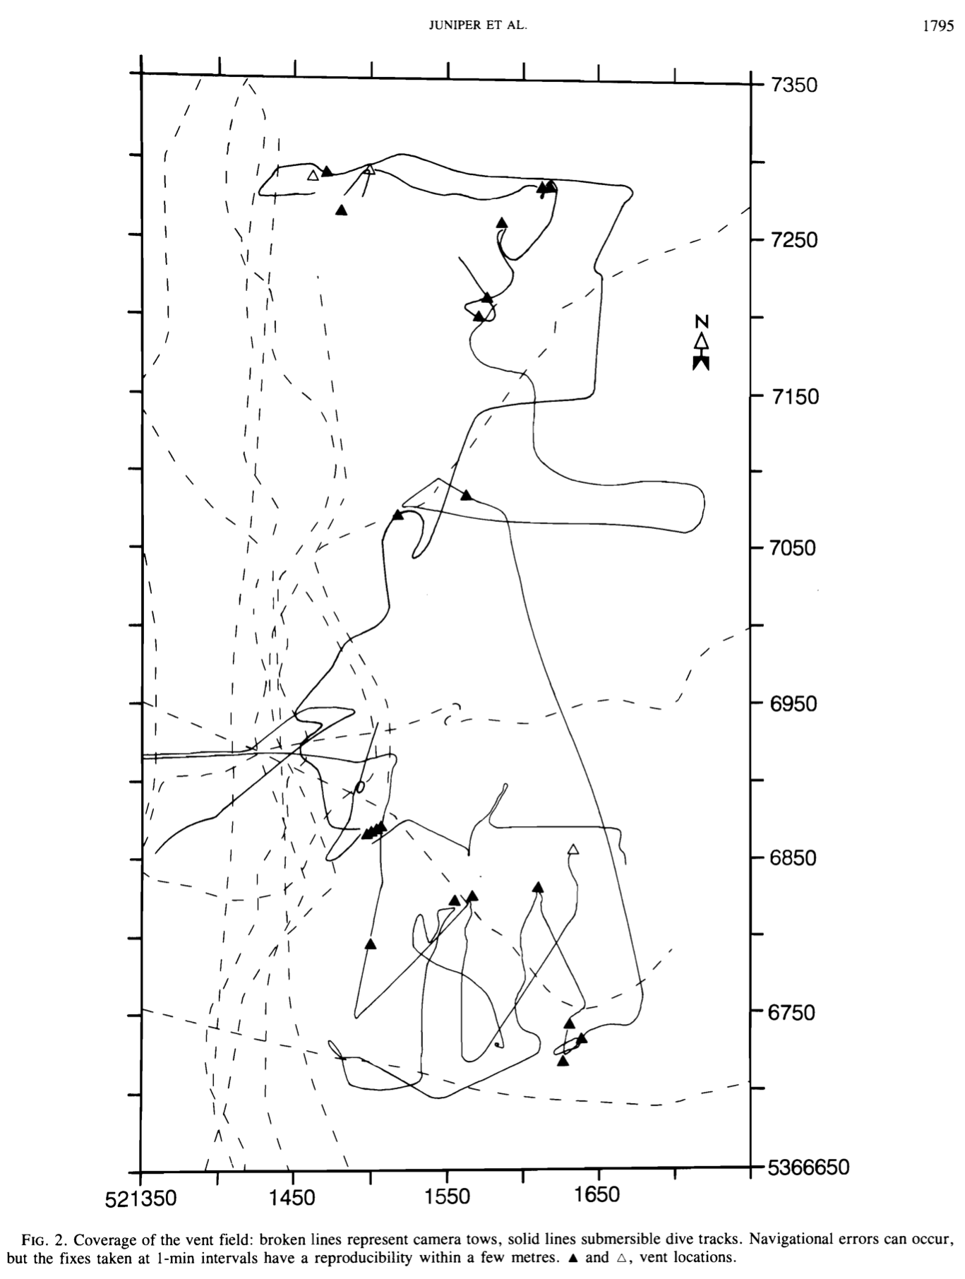
Background
Unique setting = venting through turbidite sediments
300 X 800 m high heat flow area (HHFA)
10-15 m sulphide mounds topped with active chimneys
Video and photographic surveys with Alvin and a towed camera
Remarkably specious (18 vent species new to the JFR)
Abundant vesicomyid clams and mussels on sediments
Close proximity of vent- and non-vent organisms
High diversity – precautionary measures to the 1991 drilling program.
Heat flow area (HHFA)
Alvin and towed camera
Juniper, Tunnicliffe, Southward 1992 Can J. Zool.
Notes:
- Solid tracks Alvin, dashe, towed camera system

Slide 6
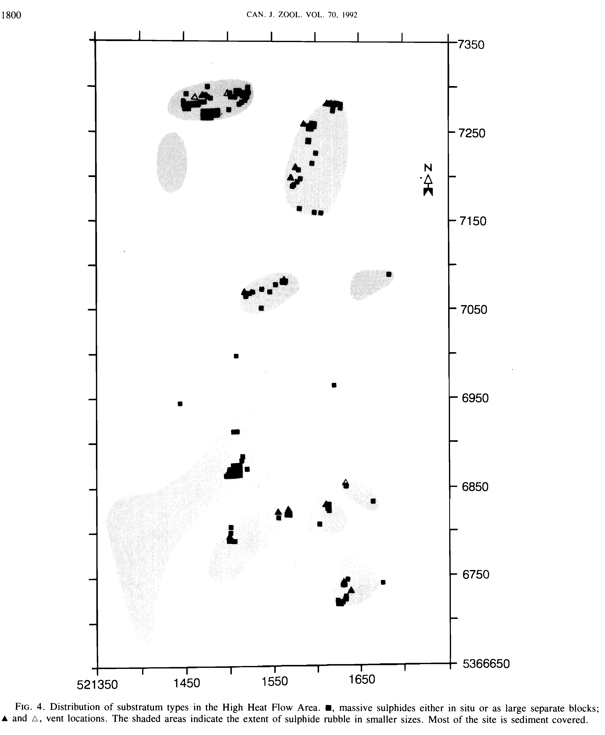
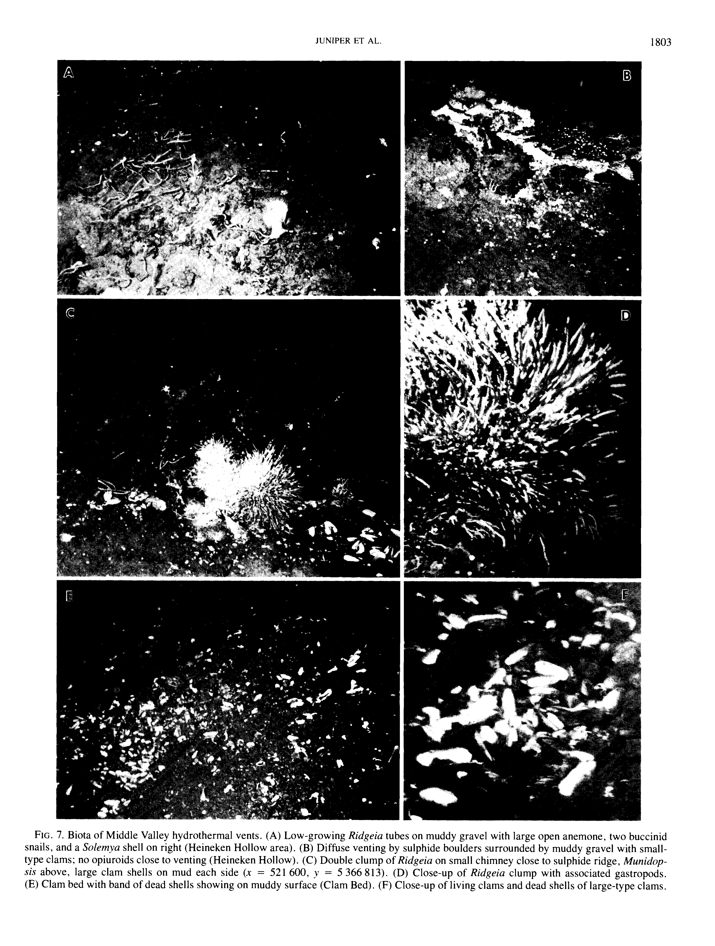
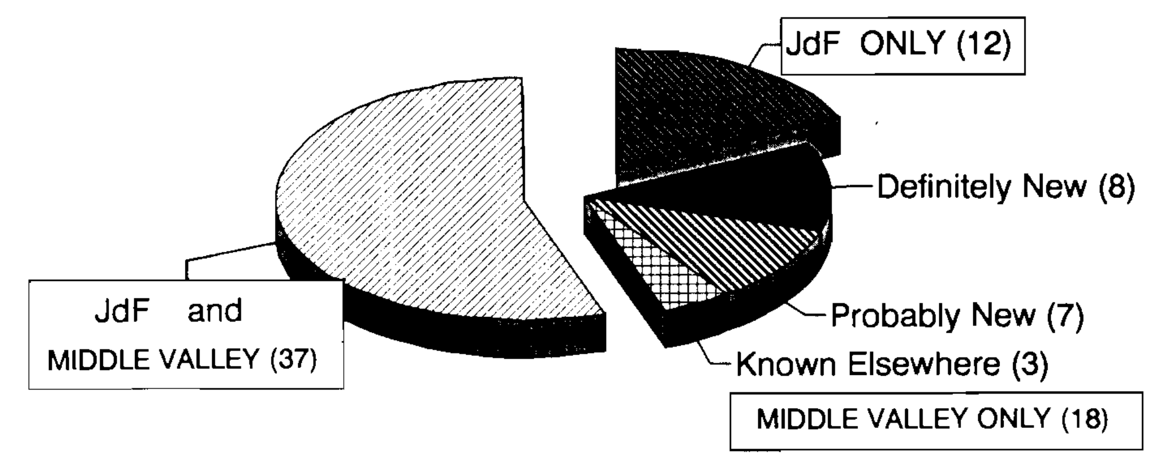
Background
Side-scan targets in the vicinity suggests limited hydrothermal activity in the area
Chimneys no higher than 2 m
Some sulphide outcrops
Key species (90%): Ridgeia sp, limpet Lepetodrillus fucensis, two snails Depressigyra globulus, Provanna variabilis
56 species, 18 new JDR records (collected from tubeworm clumps)
Substratum types
Biota at Middle Valley
Massive sulphide
structures
Sulphide rubble
Juniper, Tunnicliffe, Southward 1992 Can J. Zool.

Slide 7
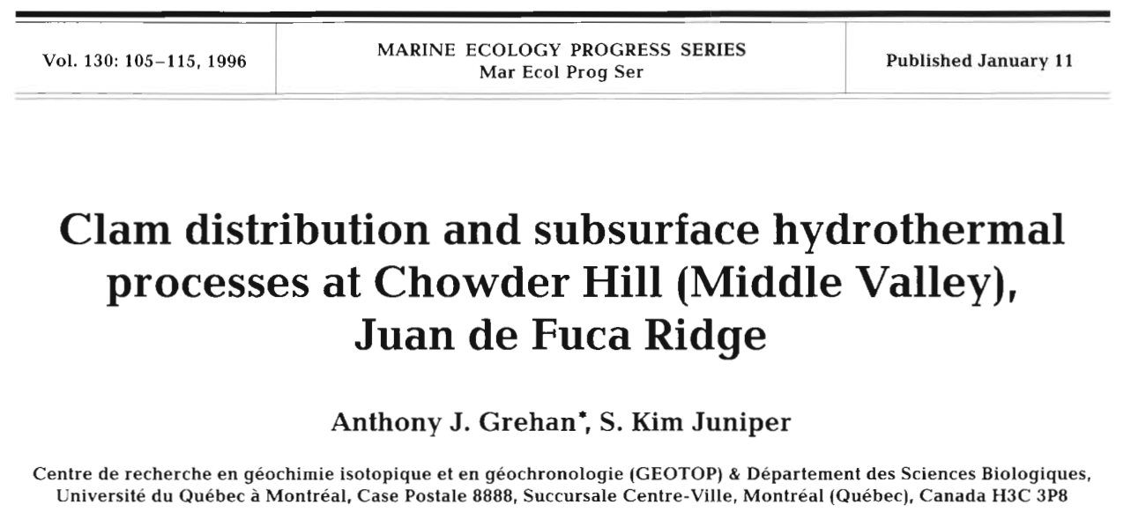
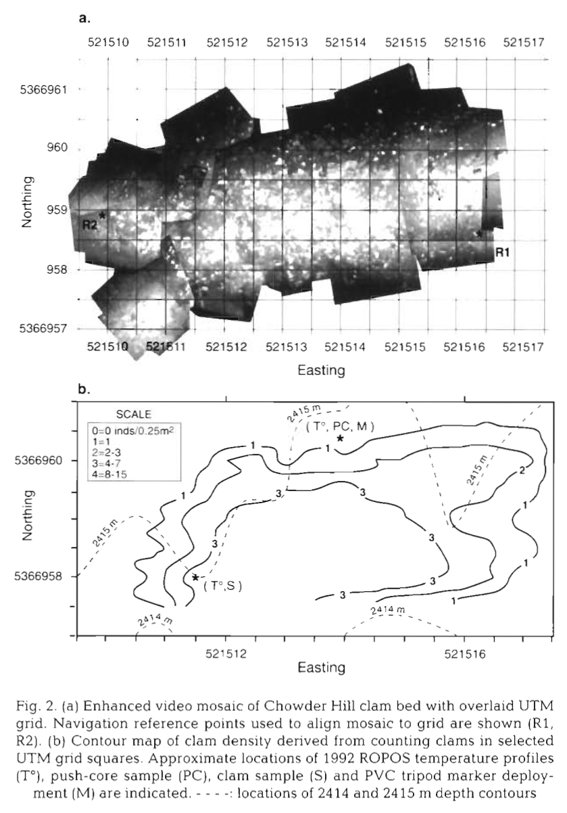
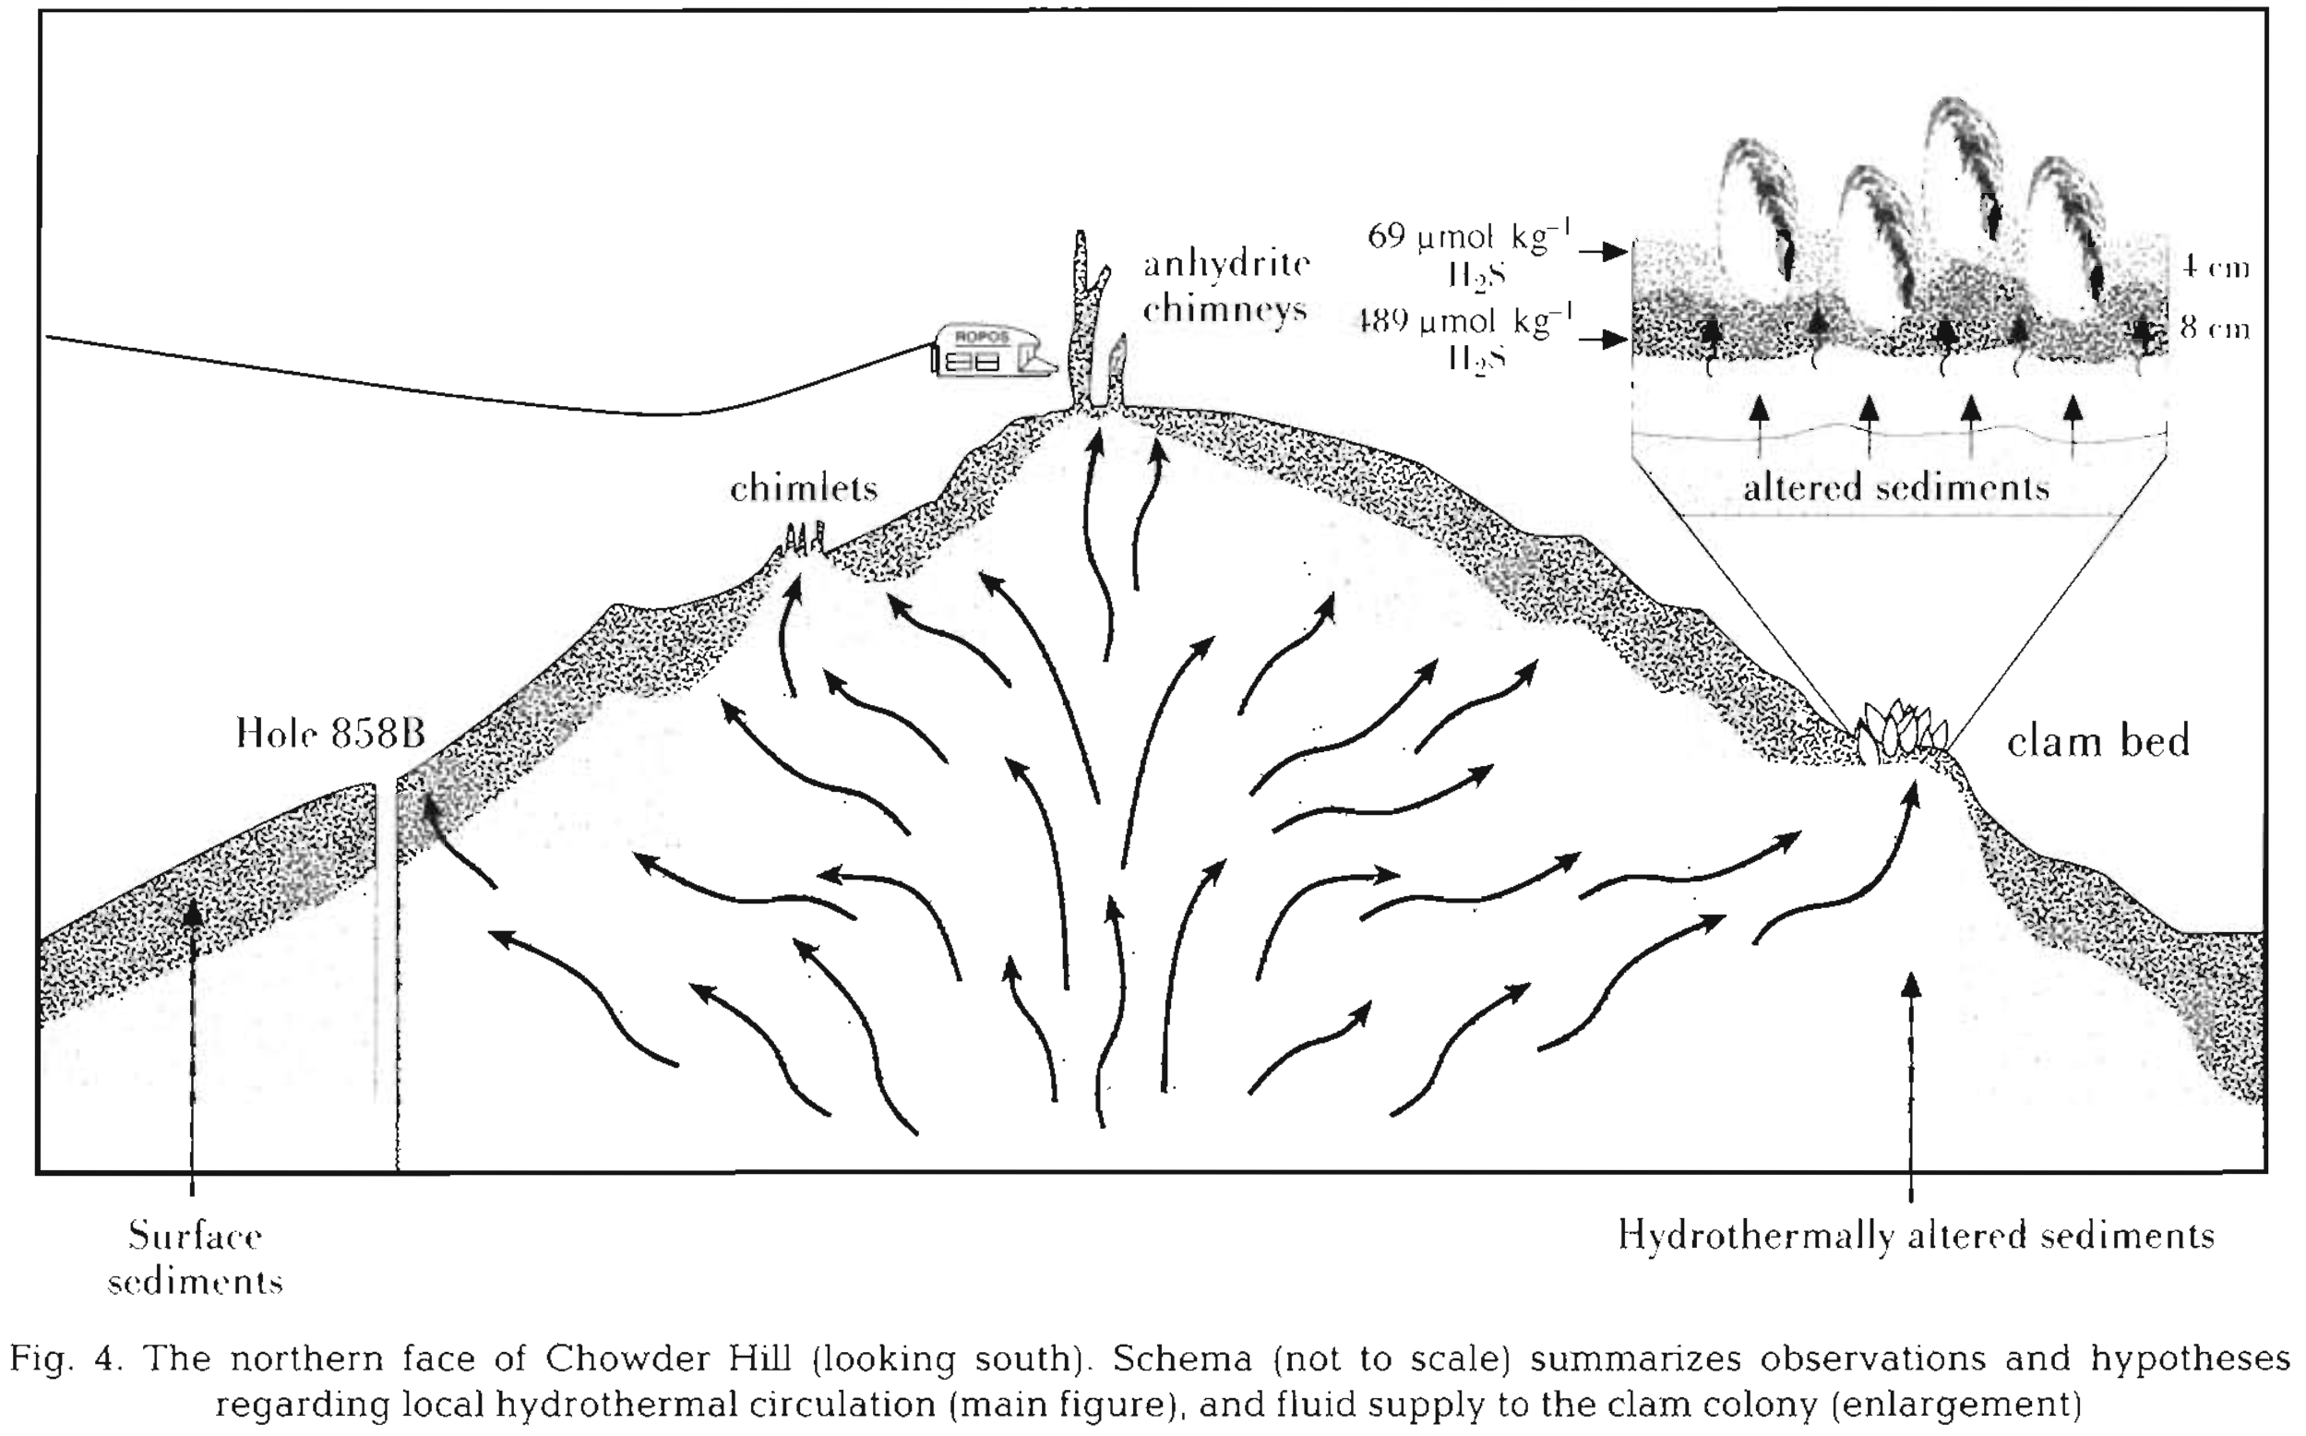
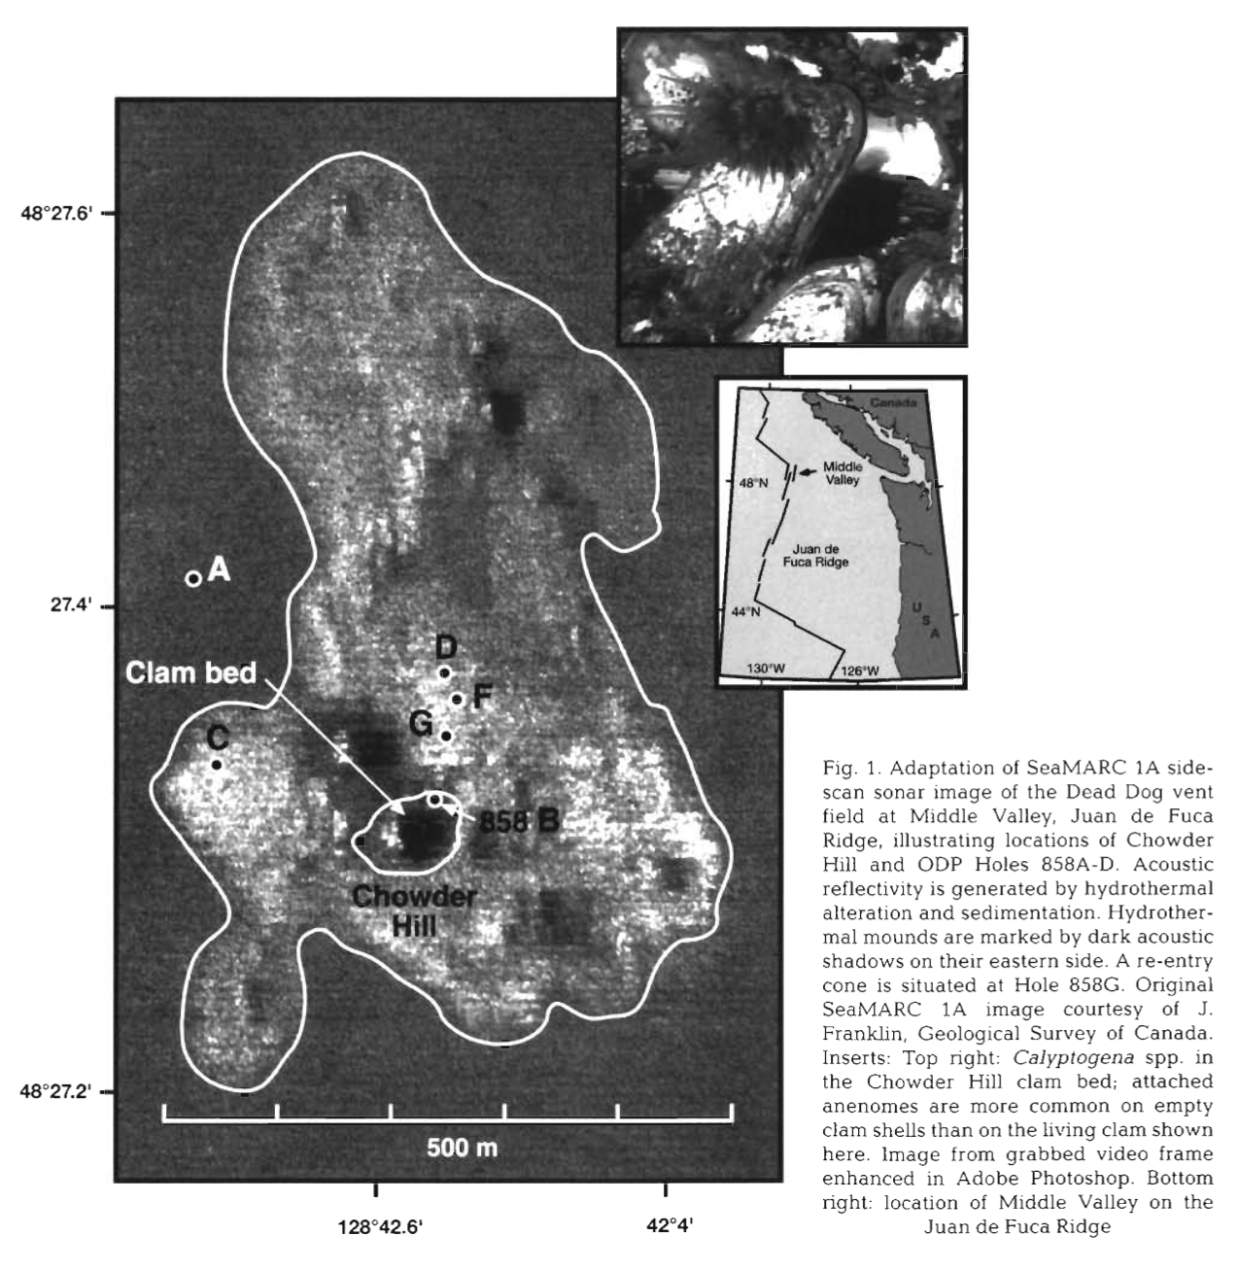
Background
Clam beds with respect to variable venting
Video survey/mosaicking (ROPOS)
Organism distribution and productivity
Highest clam density on a slightly raised area in upper-central of clam bed matching higher temp. suggesting higher hydrothermal flux
Erosion of low-permeability surface sediments critical for fluids to escape
Sediment temp. and pore-water H₂S profiles aided estimated 250 mol m⁻² yr⁻¹ H₂S flux
Grehan and Juniper 1996 MEPS

Slide 8
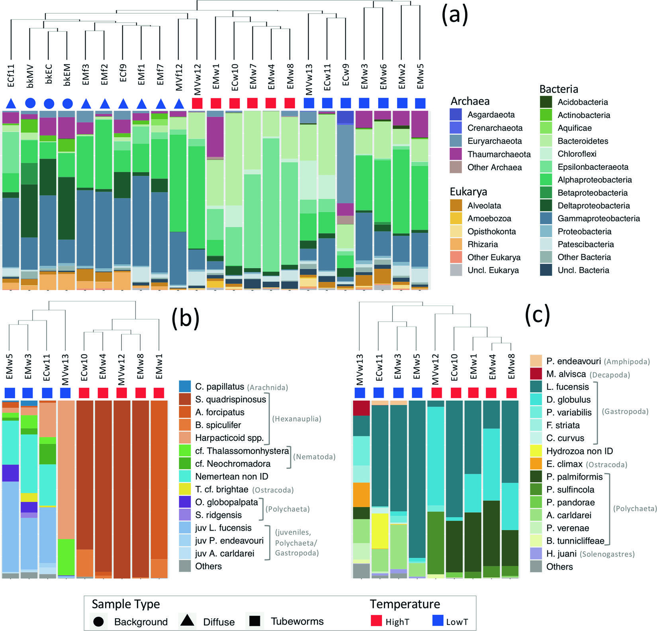
More recent work
Unique microbial communities at Middle Valley
Both taxonomically (more hydrocarbon degraders) and functionally (the different carbon fixation pathway)
Micro
Meiofauna
Macrofauna
Murdock et al 2021 ISME

Slide 9
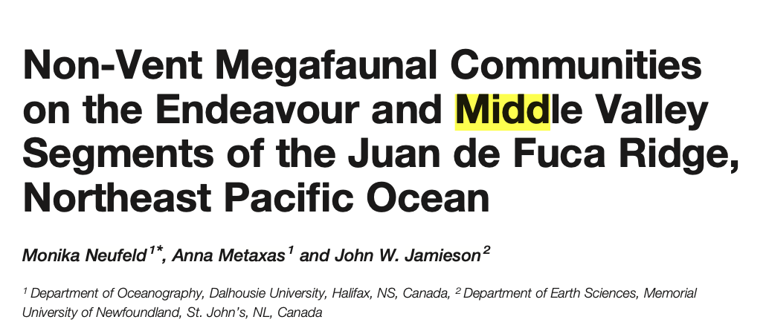
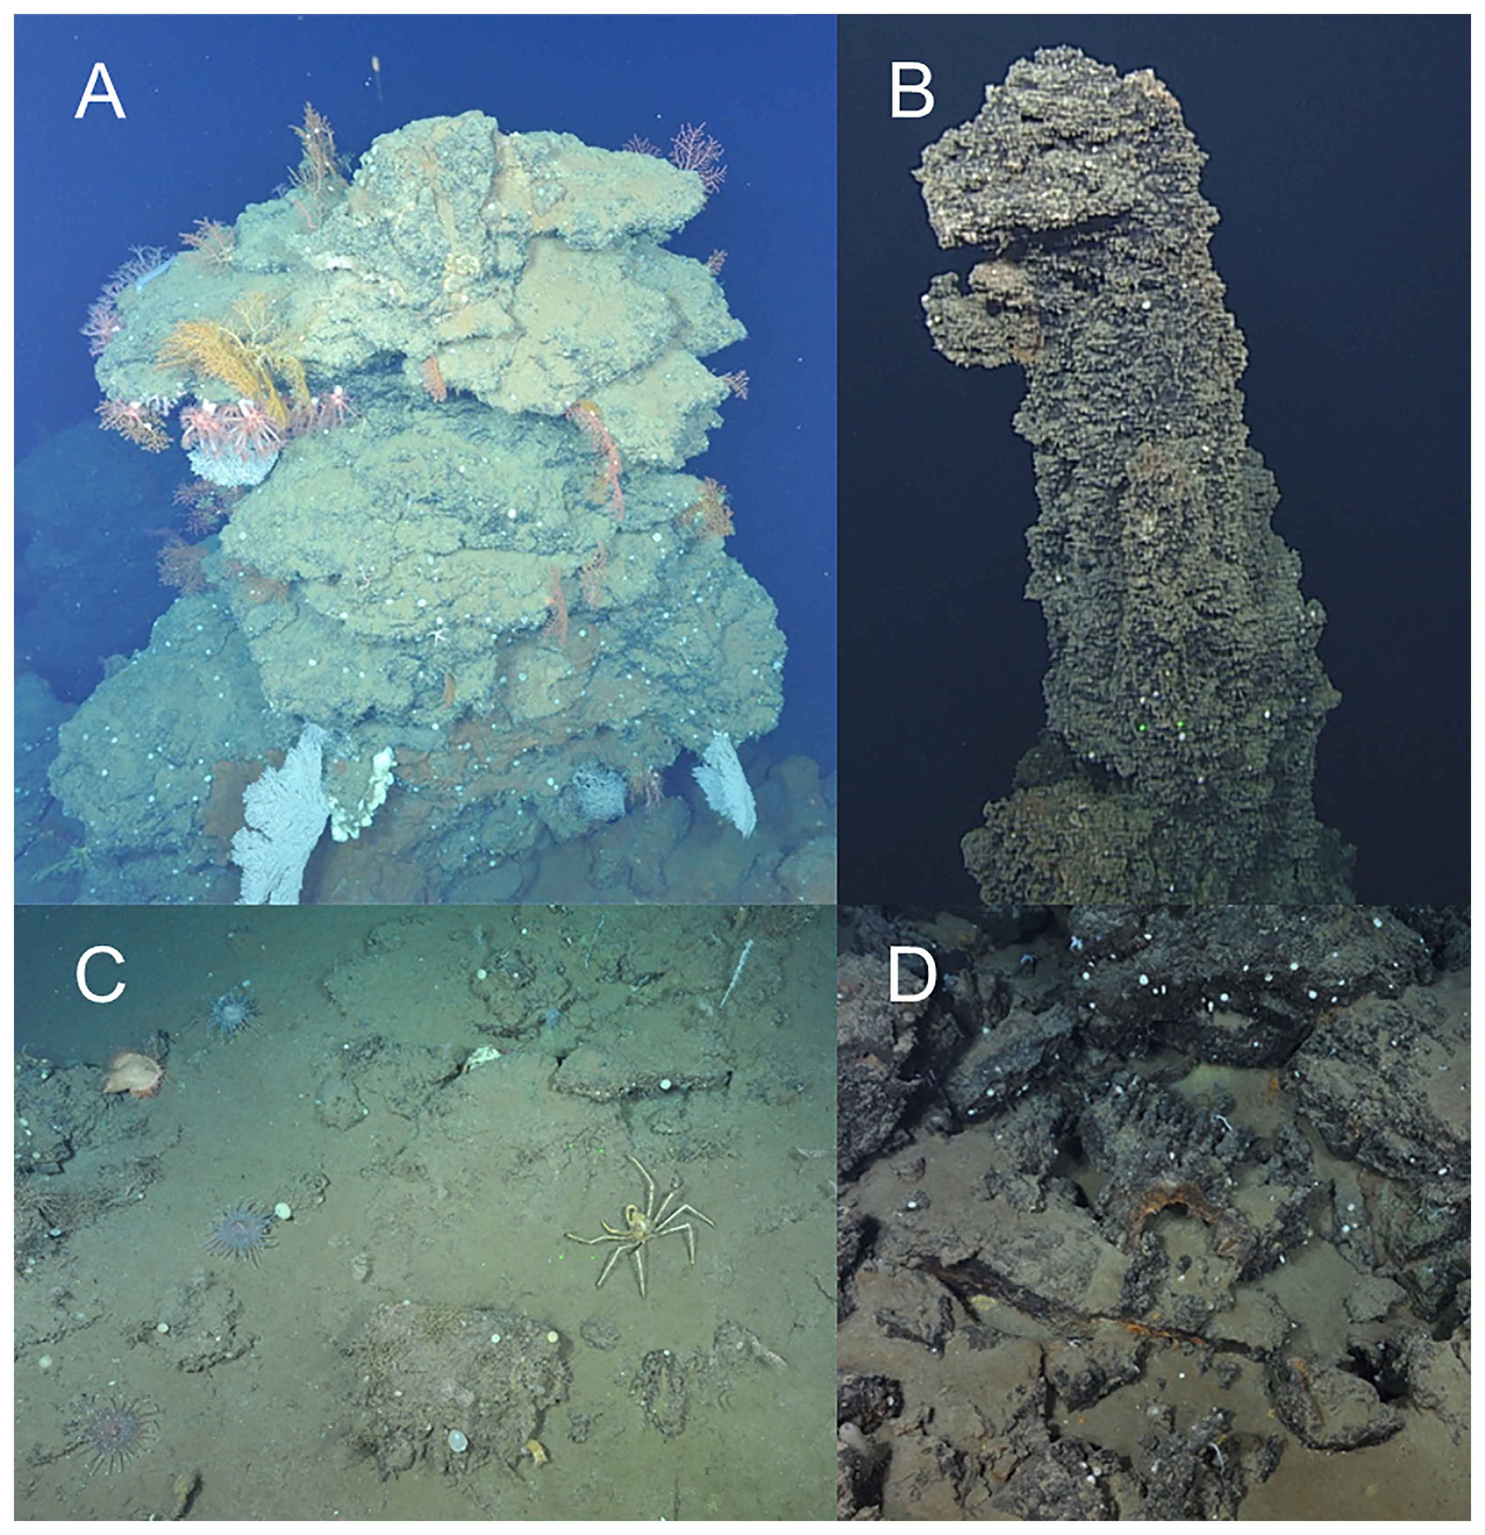
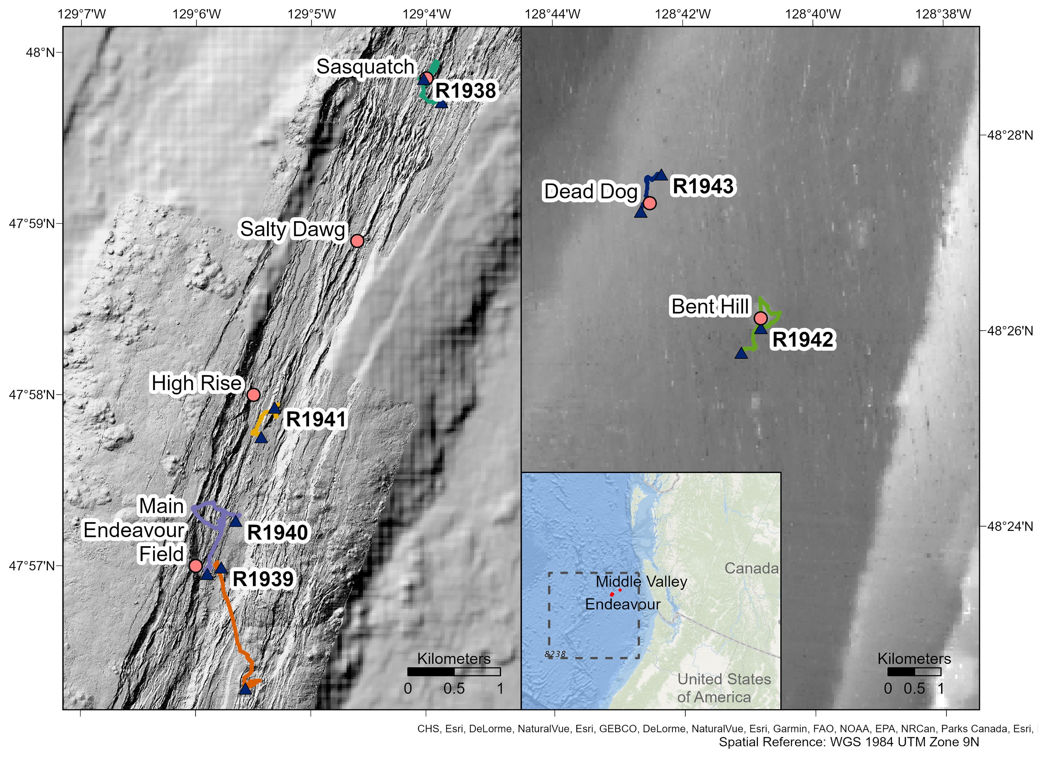
More recent work
Develop baseline in the context of deep-sea mining interests in inactive venting sites
Abundance patterns of non-vent megafauna
Neufeld et al 2023 FMAS

Slide 10
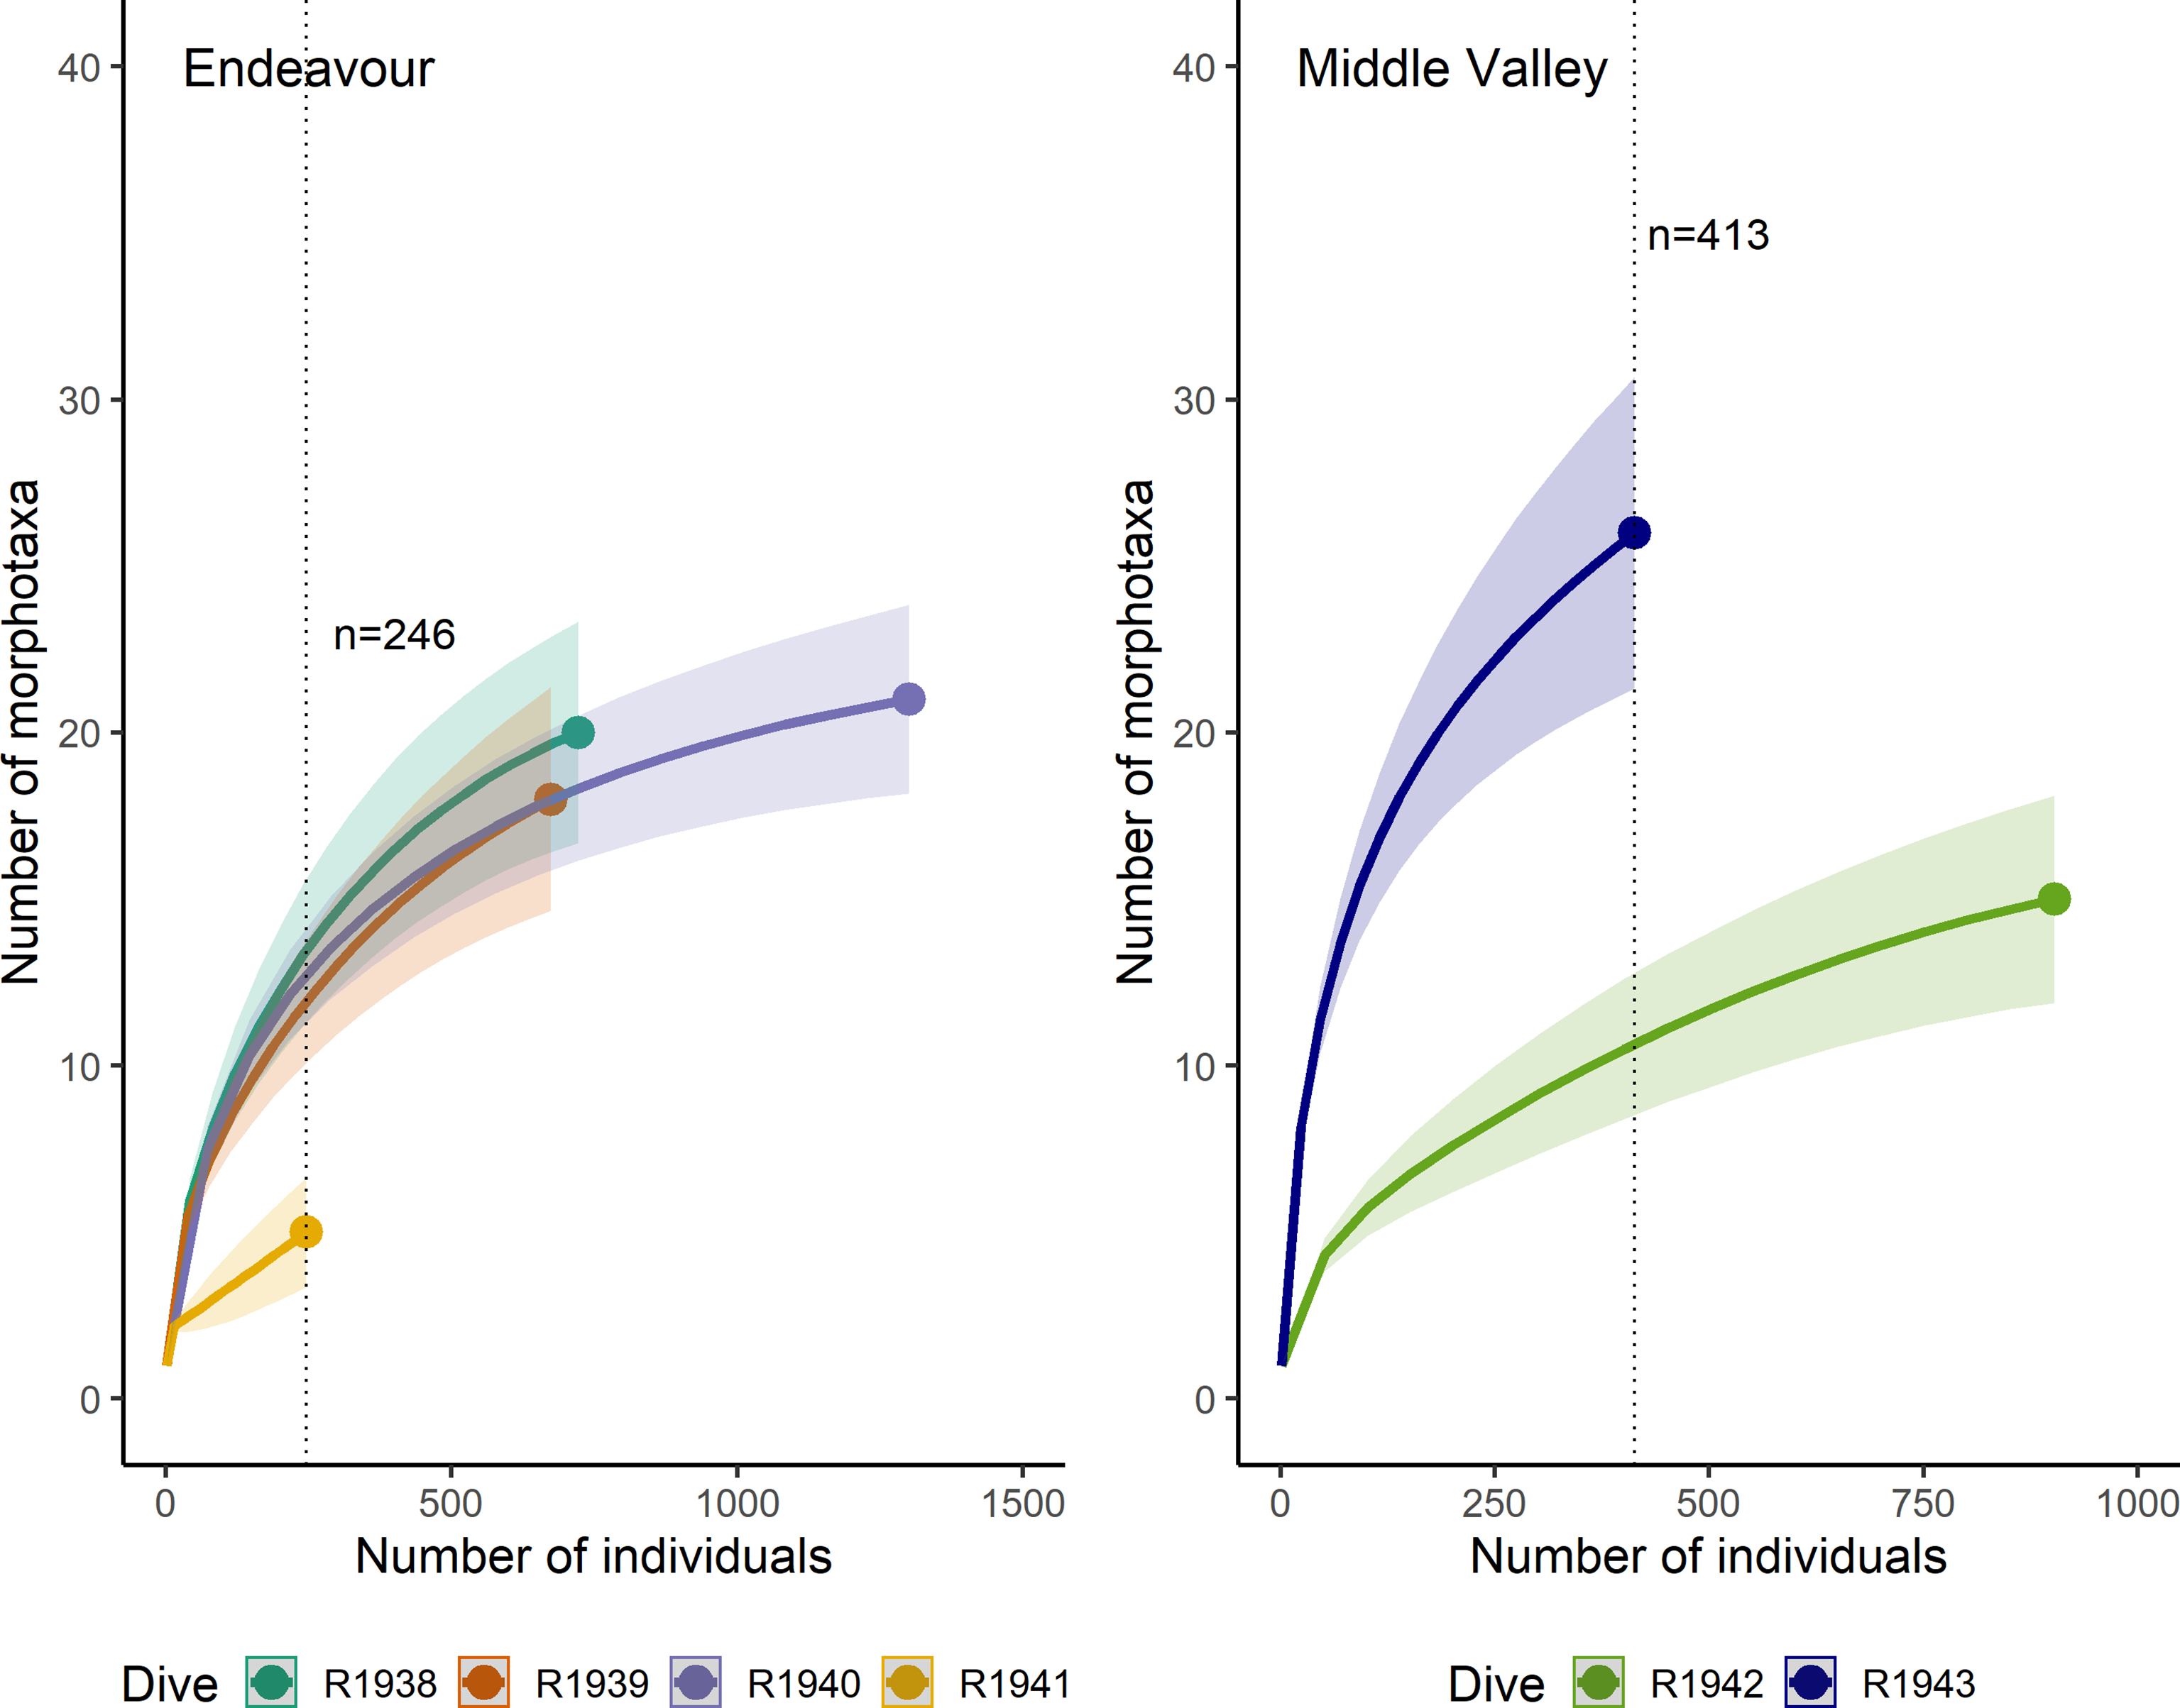
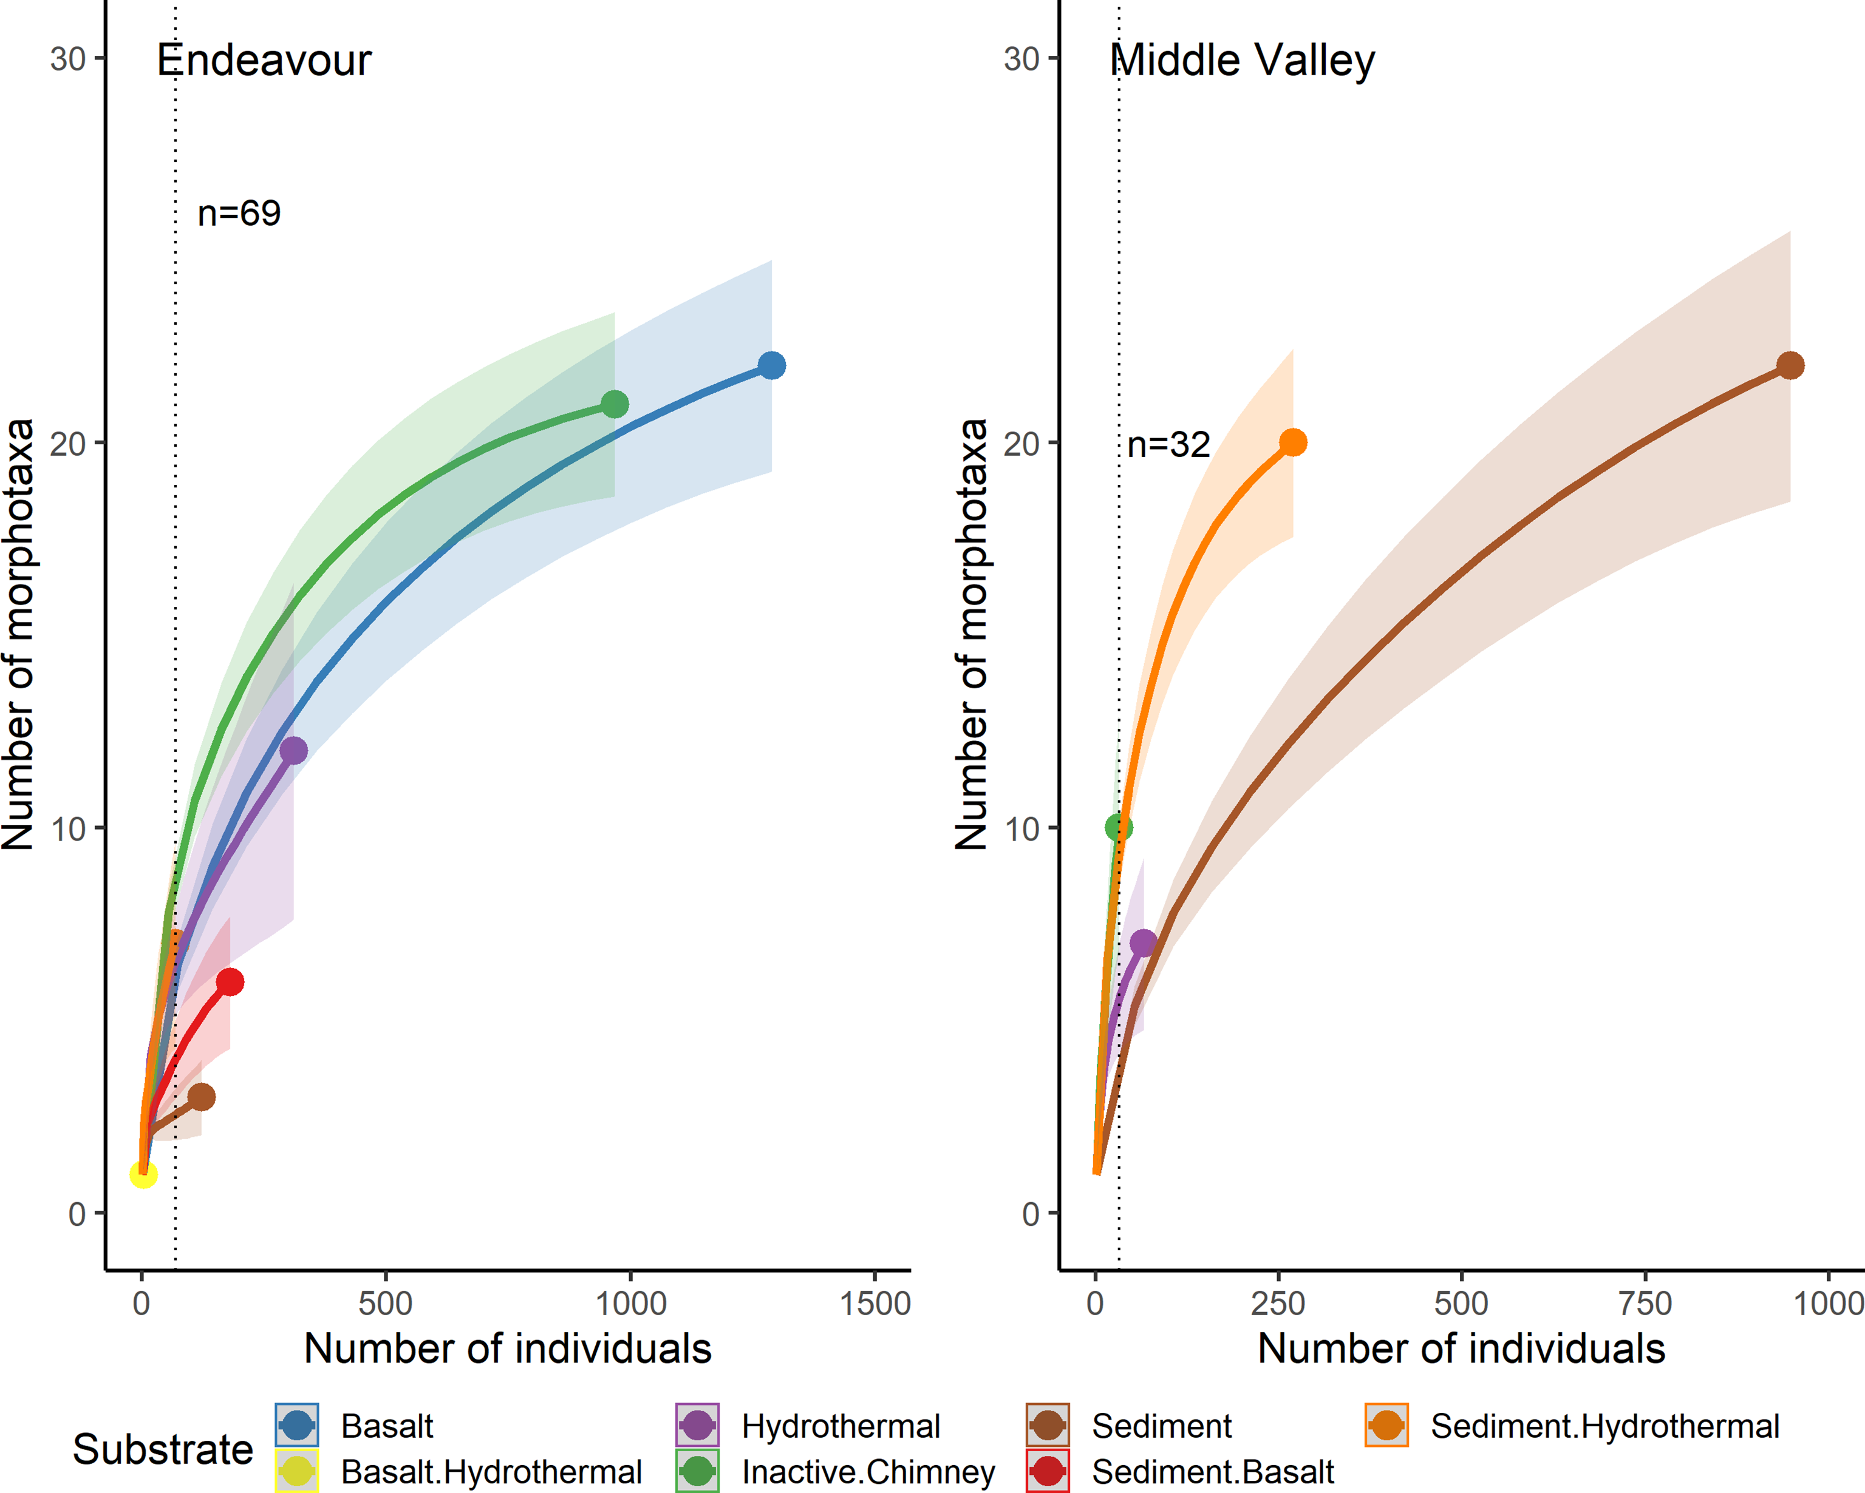
More recent work
Higher species diversity at Middle Valley!
Habitat/substrate
Dead dog
Neufeld et al 2023 FMAS
Notes:
- Indvidual-based rarefaction curves

Slide 11
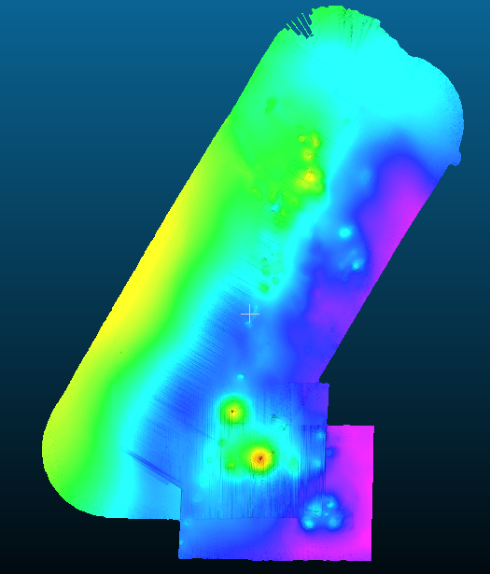
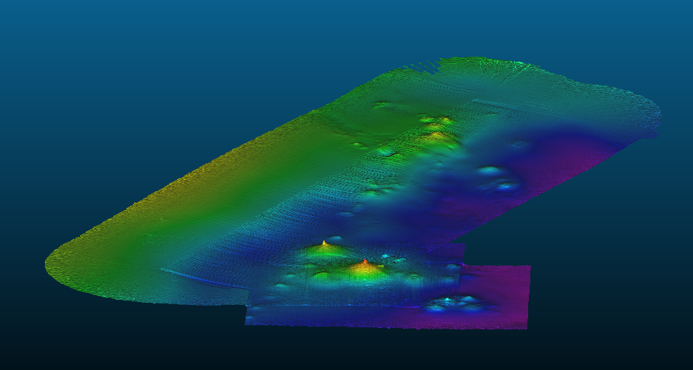
2024 ROV Hercules Norbit sonar survey
Chowder Hill

Slide 12
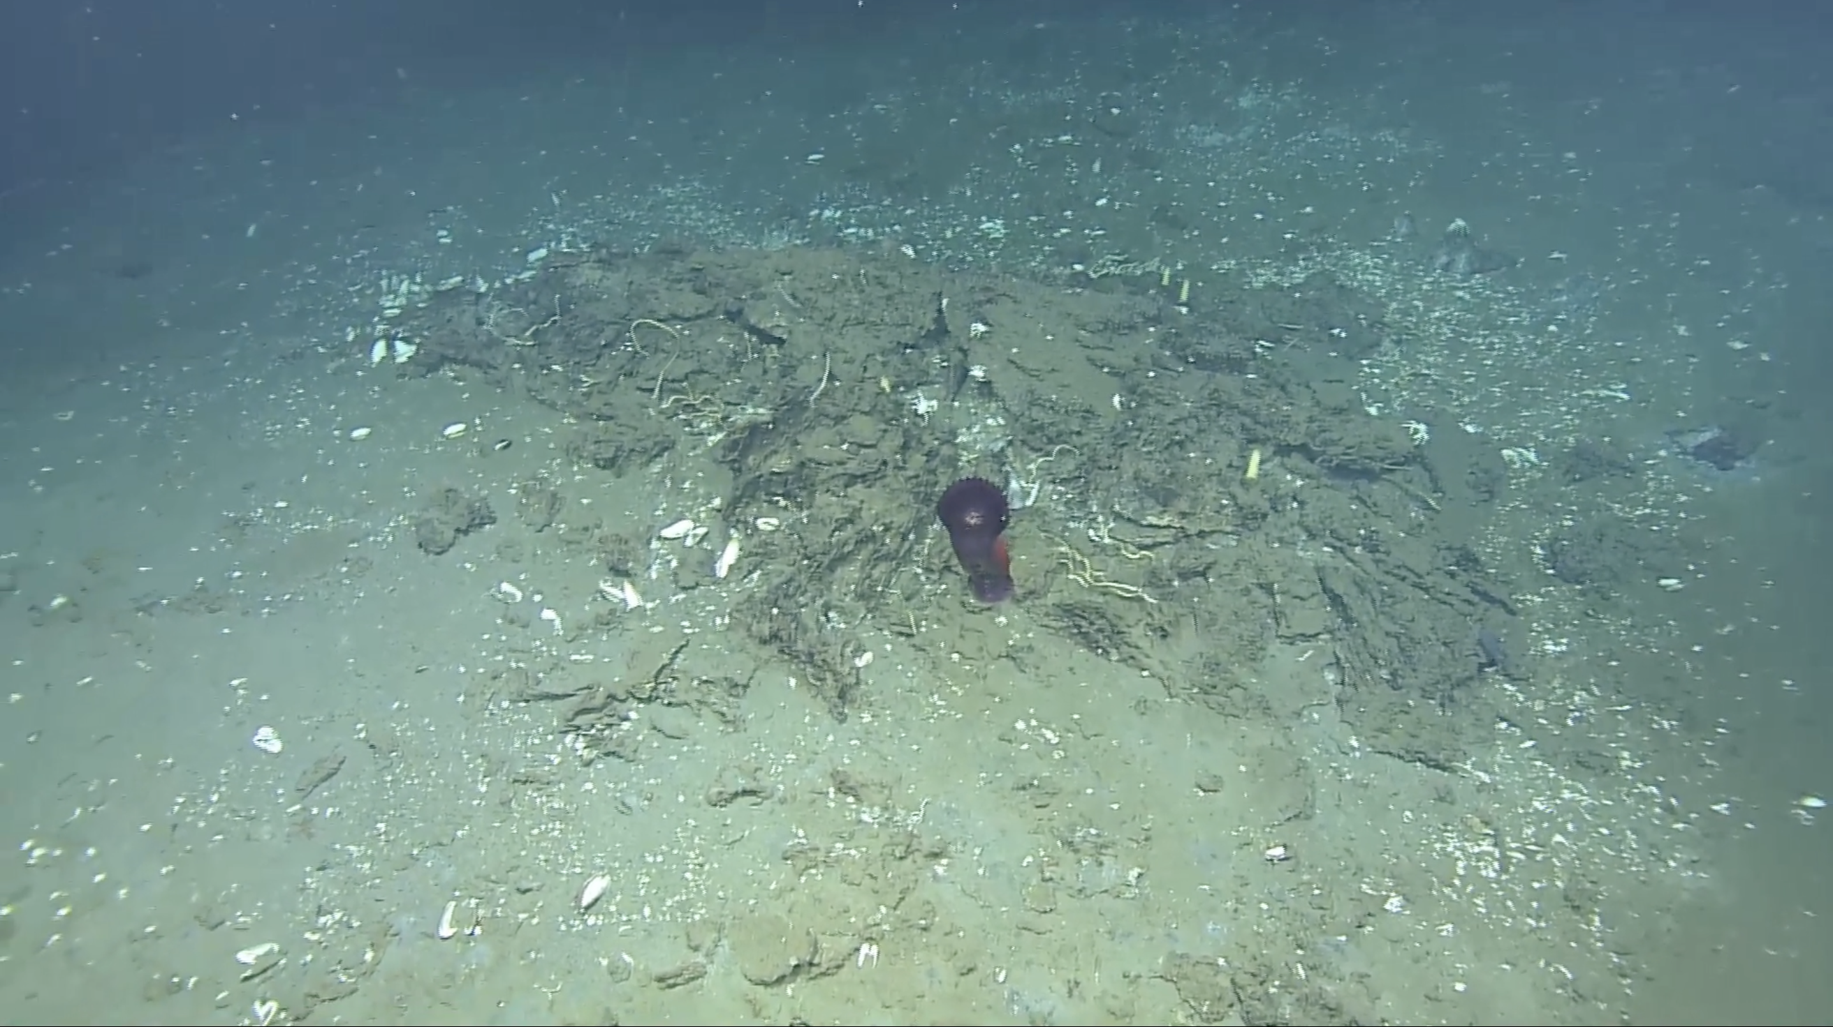
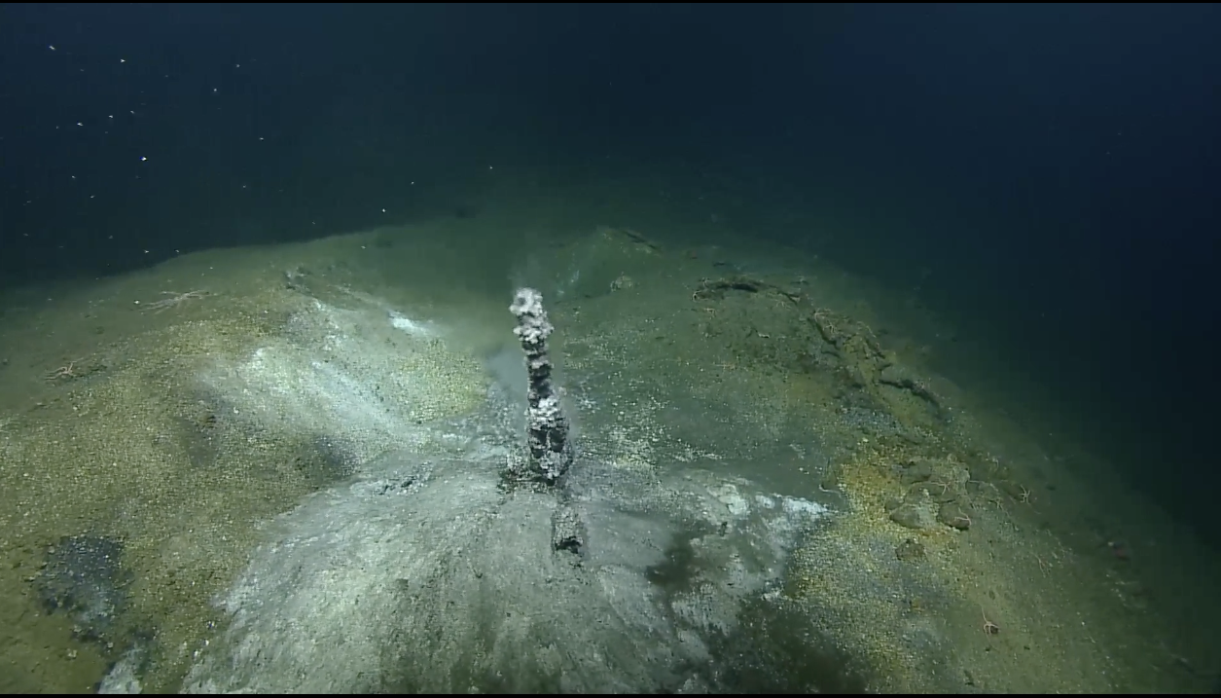
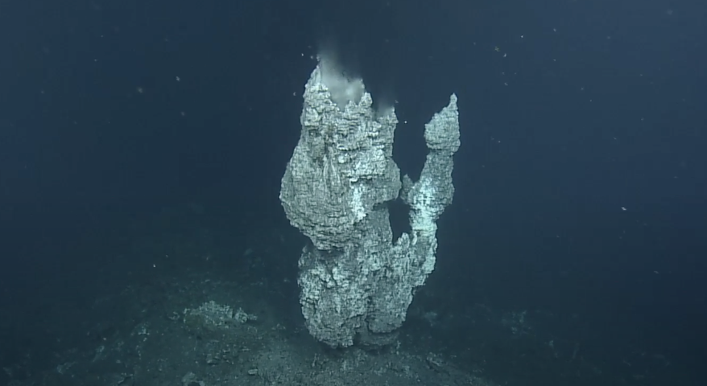
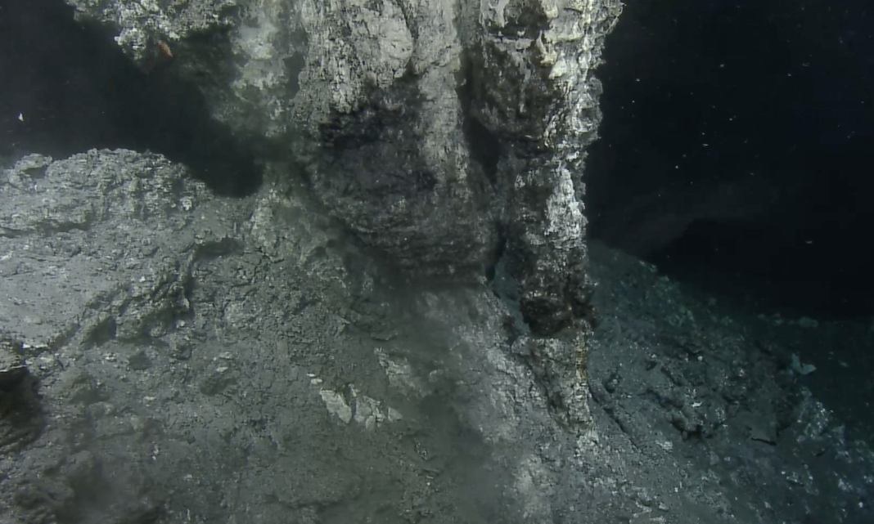
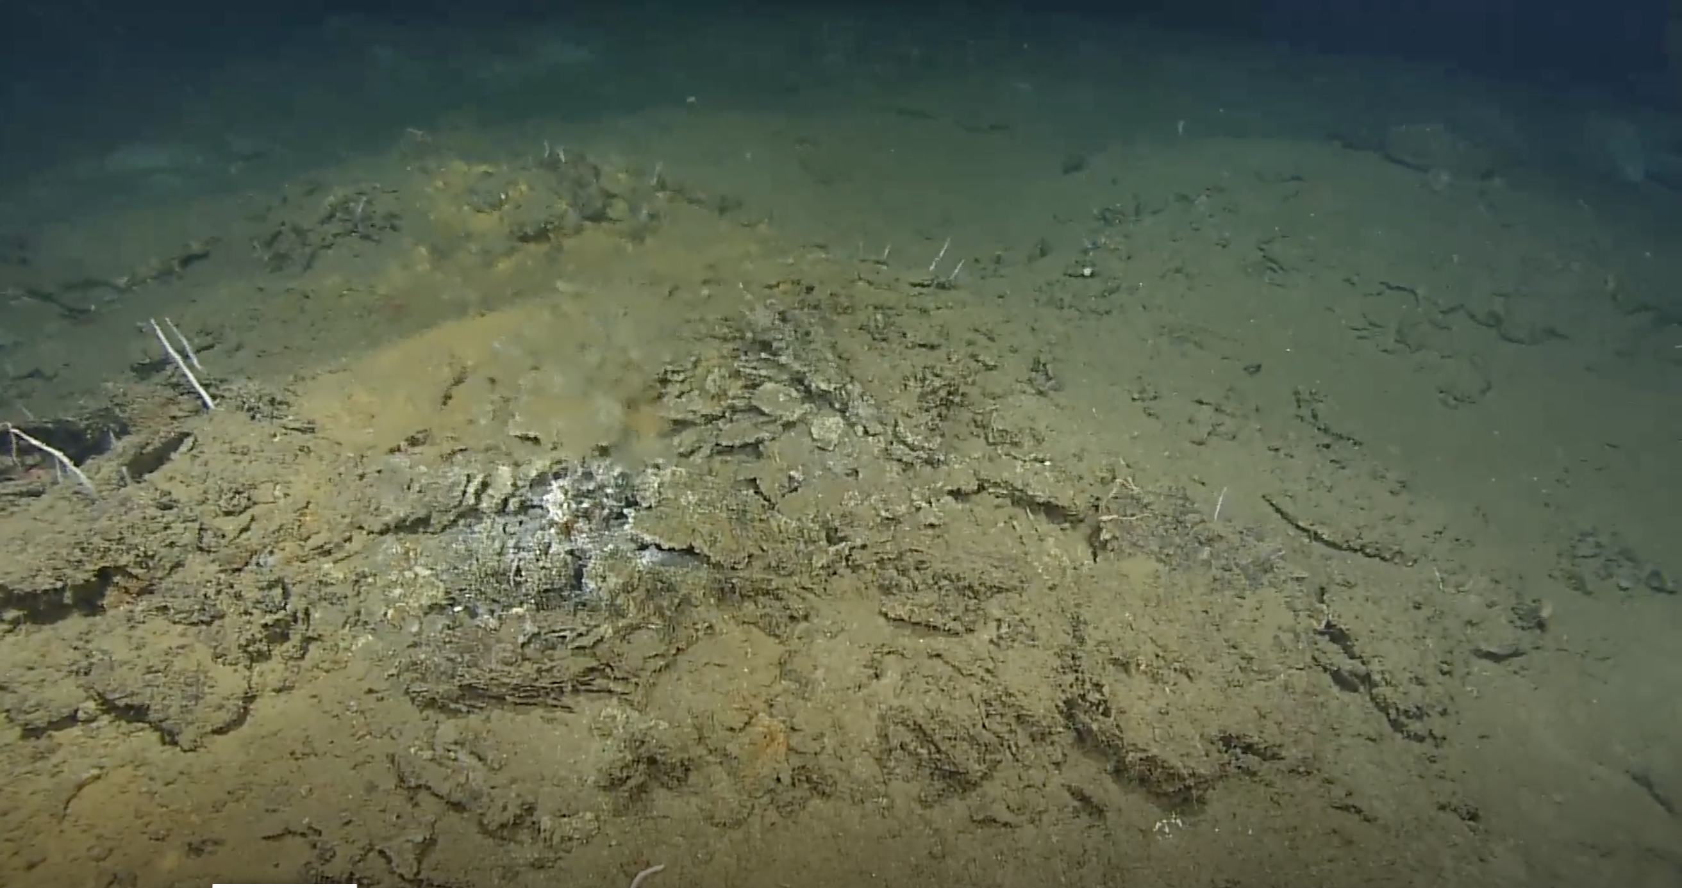
2024 ROV Hercules video surveys
Chowder Hill

Slide 13
Biological interest - highlights
Unique venting system with very few know parallels (e.g. Guayamas Basin)
Enhanced habitat heterogeneity with multiple seafloor habitat types (Beta-diversity)
Large number of inactive venting sites (interest from the deep-sea mining perspective). Possibility to conduct controlled disturbance experiments
Unique fluid discharge through sediments forming a ‘seep-like’ environment (without accumulated OM – no methane seepage!)
Effect of ODP borehole 30 years after – some Mid-Atlantic Ridge borehole sites sites have witnessed major effects on the vent fauna after drilling took place

