Slide 1
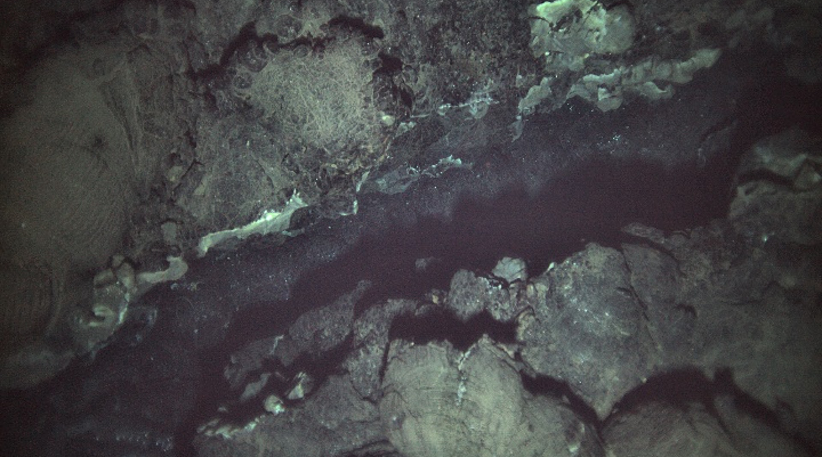
Insights into hydrothermal plumes using Mn and Fe speciation: Case study along the SEPR
Laura Moore and Jess Davis

Slide 2
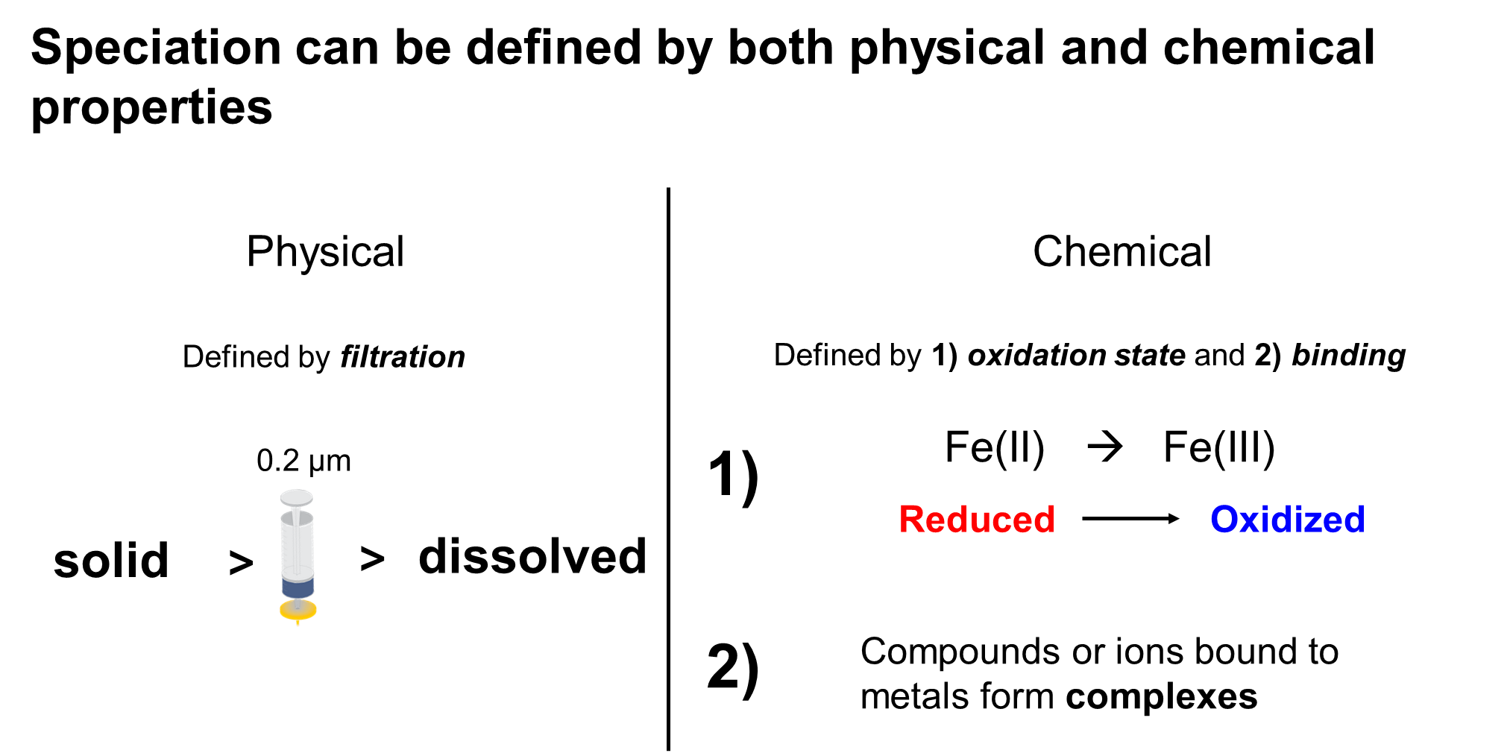

Slide 3
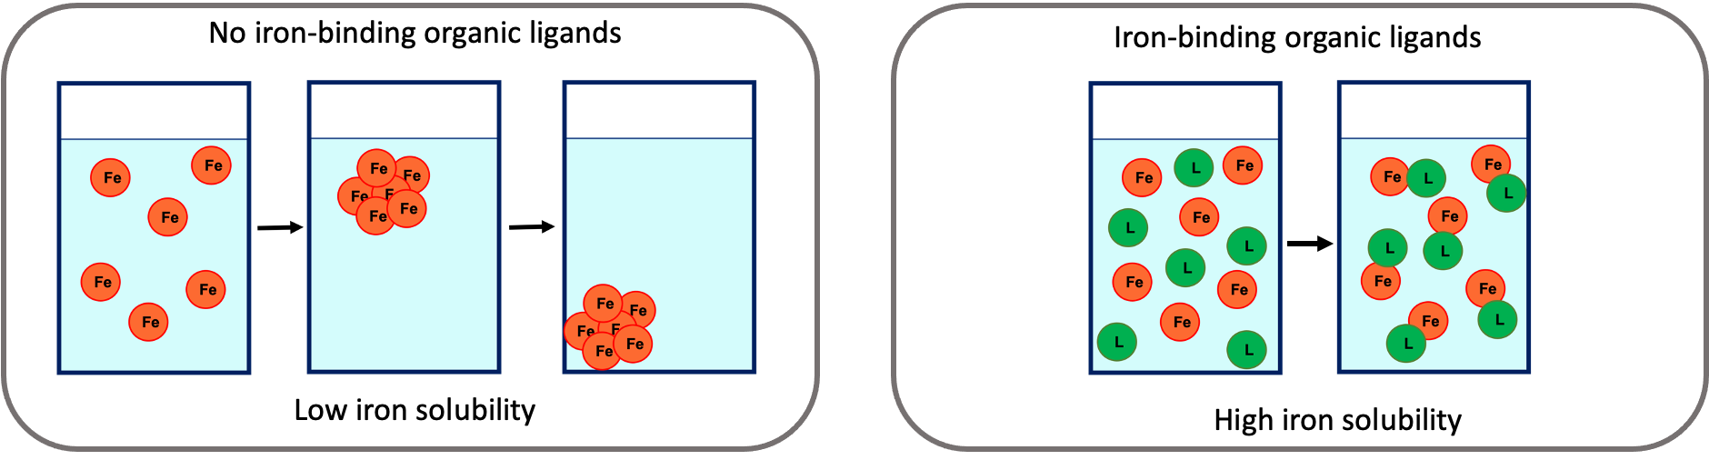
Solubility of dissolved metals in seawater is controlled by ligand availability
“Ligand” is a broad class of organics that can bind to metals, with varying strengths and sizes

Slide 4
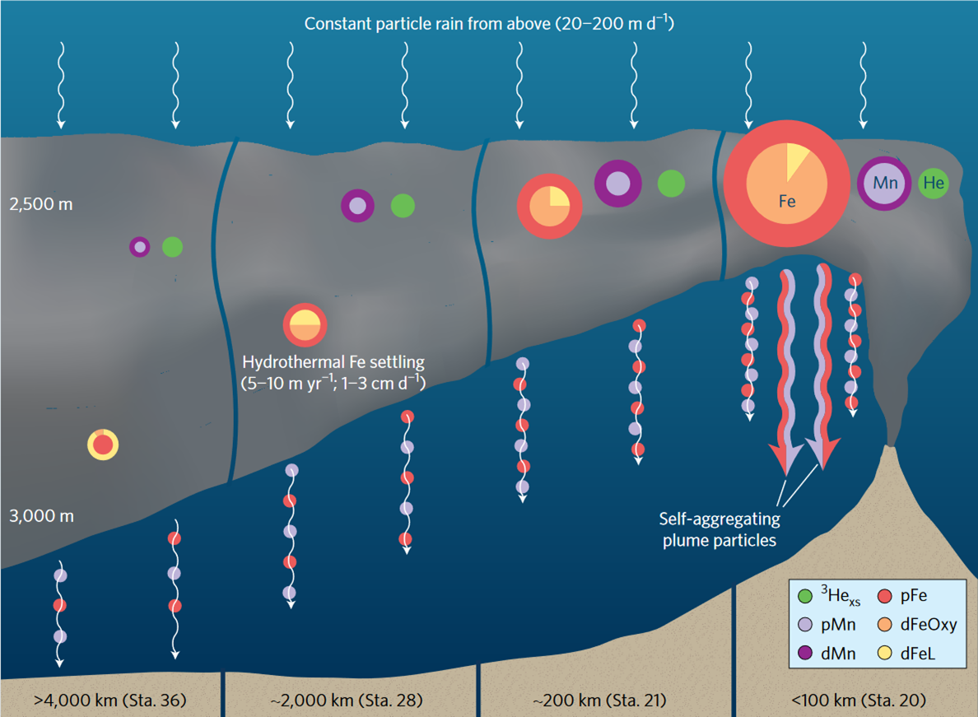
Fe and Mn speciation changes along-plume in the SEPR
Fitzsimmons et al., 2017

Slide 5
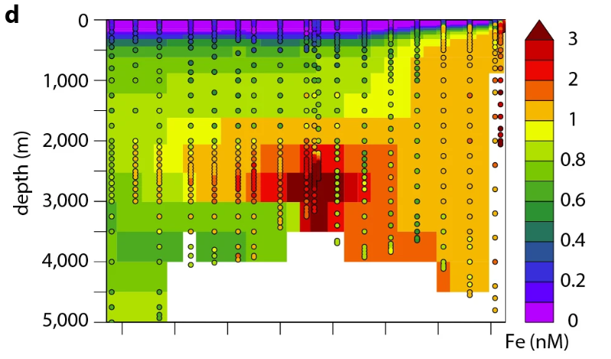
Dissolved Fe distribution better reproduced in the SEPR when ligands included in modelling effort
Resing et al., 2015

Slide 6
Ligand questions at Endeavour
How does ligand stabilization impact the inventory and export of dissolved Mn and Fe in the hydrothermal plume pre-eruption?
How does ligand stabilization differ between discrete hydrothermal sites?
Does ligand stabilization of Mn and Fe change during an eruption event?

Slide 7
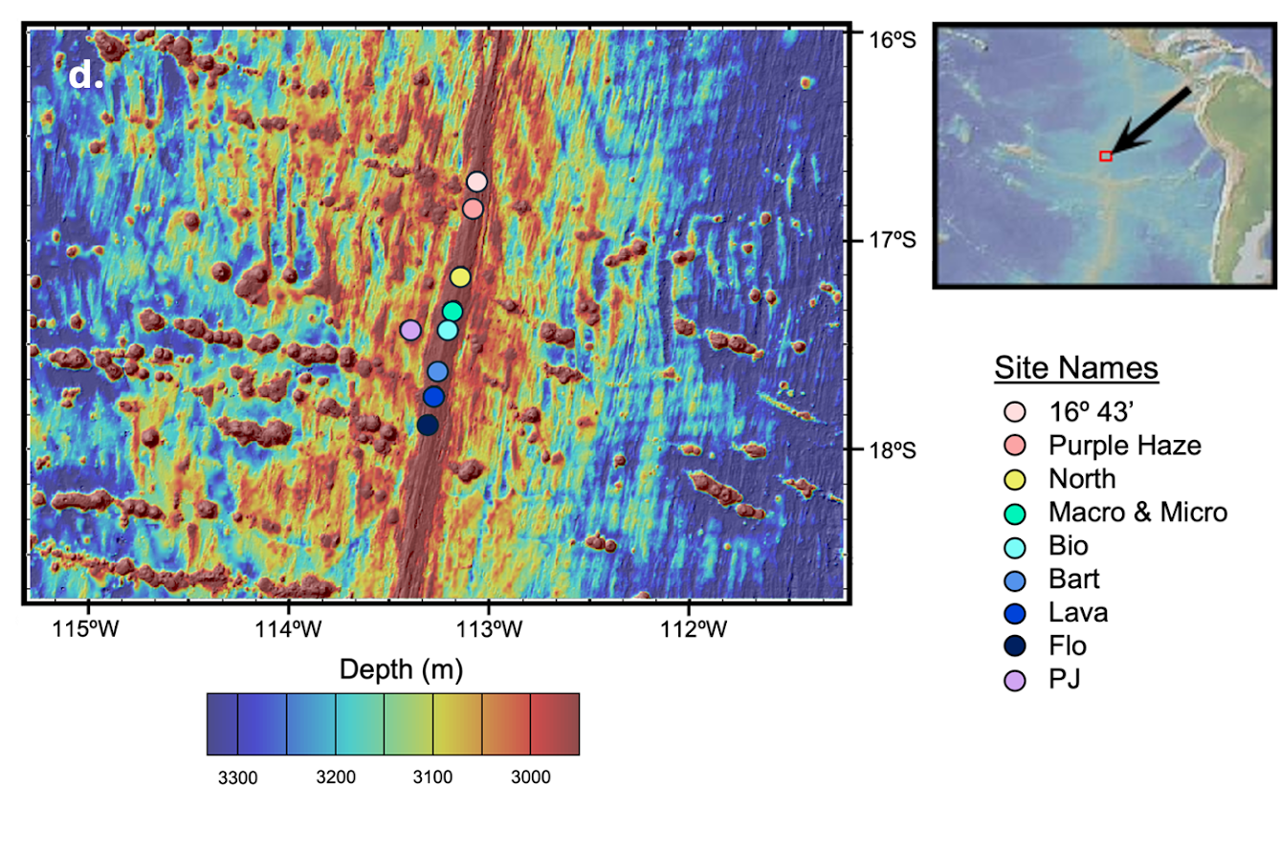
Study region: Southern East Pacific Rise
Ultrafast spreading ridge
High density of hydrothermal features
Near continuous plume along axis

Slide 8
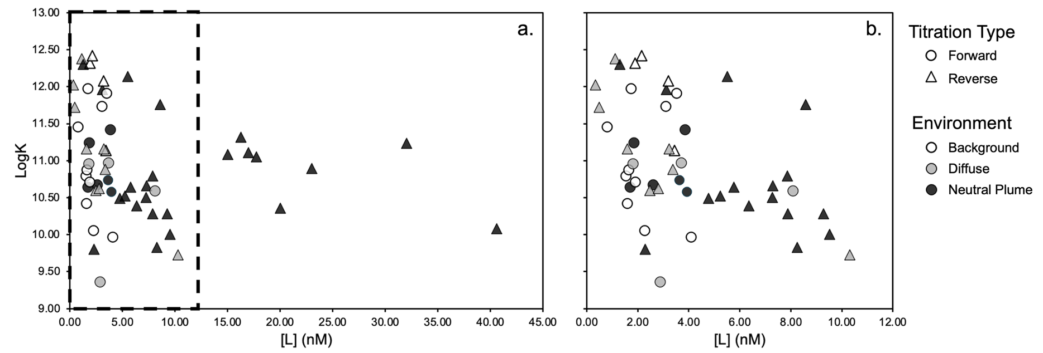
Fe-binding ligands ubiquitous across hydrothermal features

Slide 9
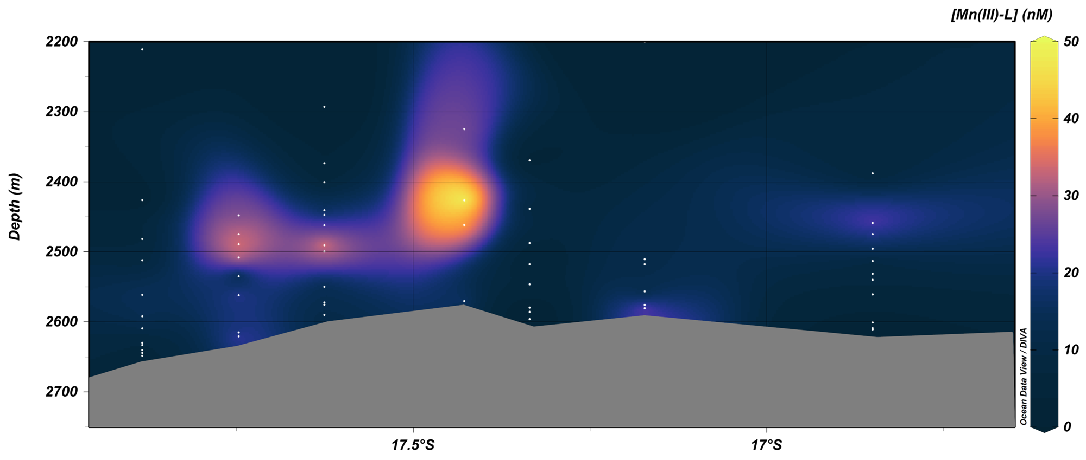
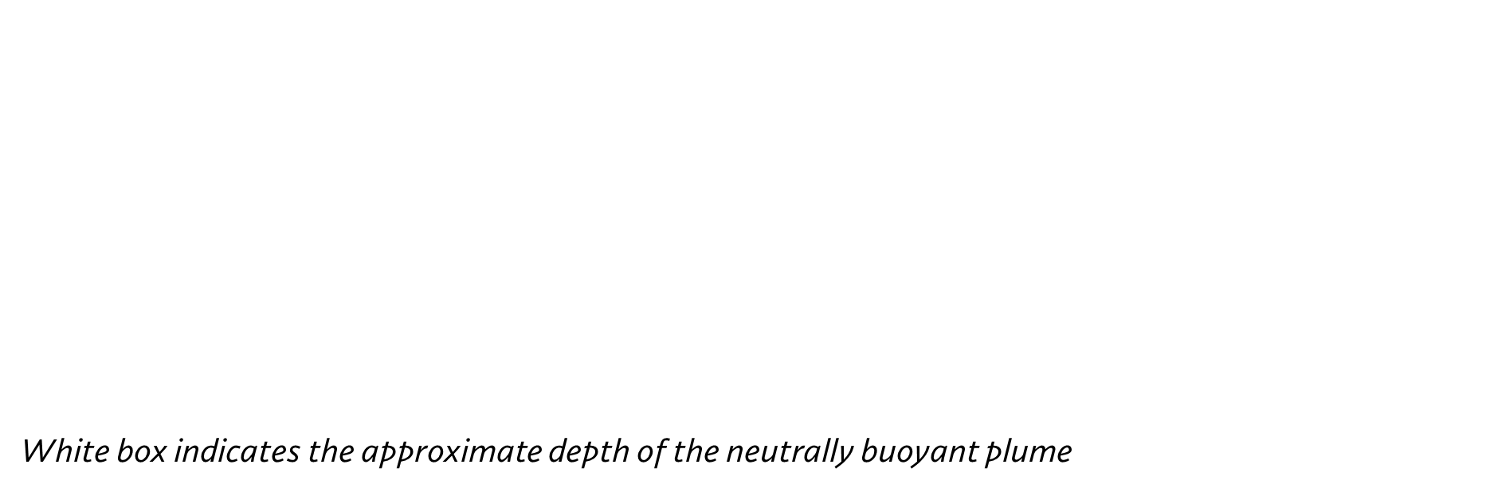
Ligand stabilization of dissolved Mn is ubiquitous across hydrothermal features

Slide 10

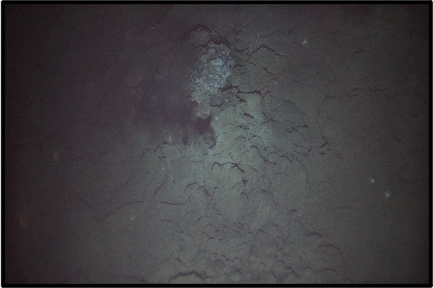
Three example study sites:
Purple Haze
Lava
PJ
On-axis
Low-temperature venting
On-axis
High-temperature venting
Off-axis
No seafloor feature

Slide 11
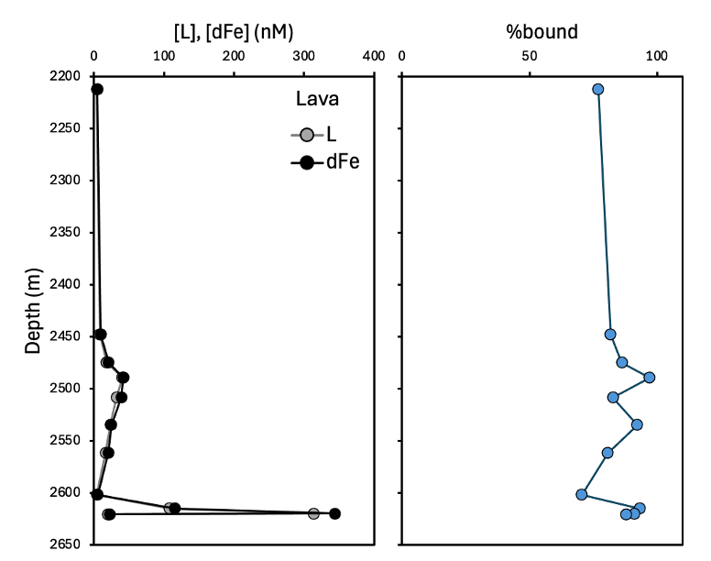
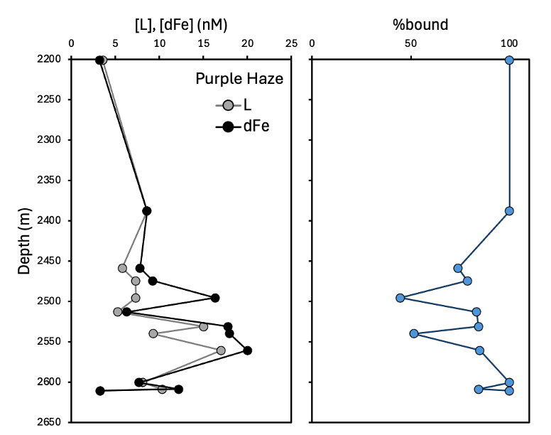
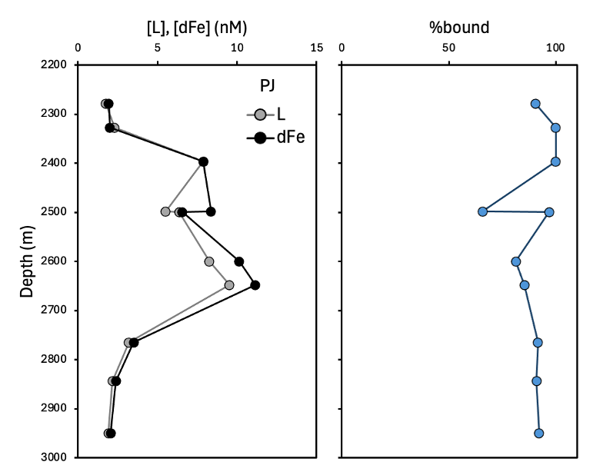
Ligand and dissolved Fe concentrations highly variable between sites

Slide 12
Ligands stabilize most (but not all) dissolved iron

Slide 13
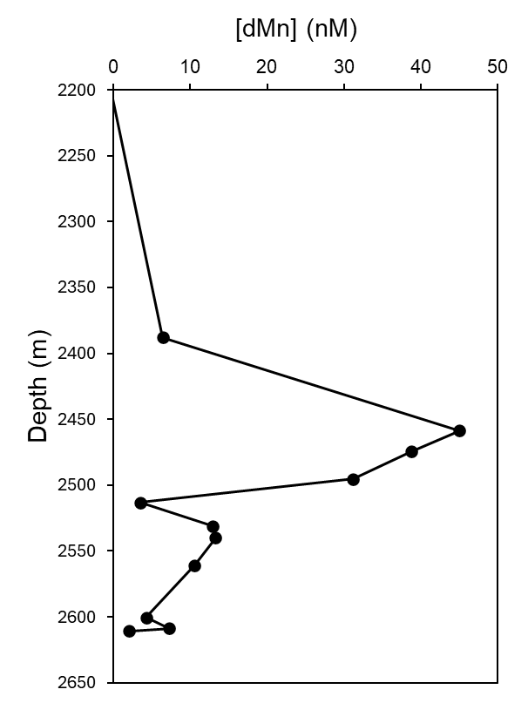
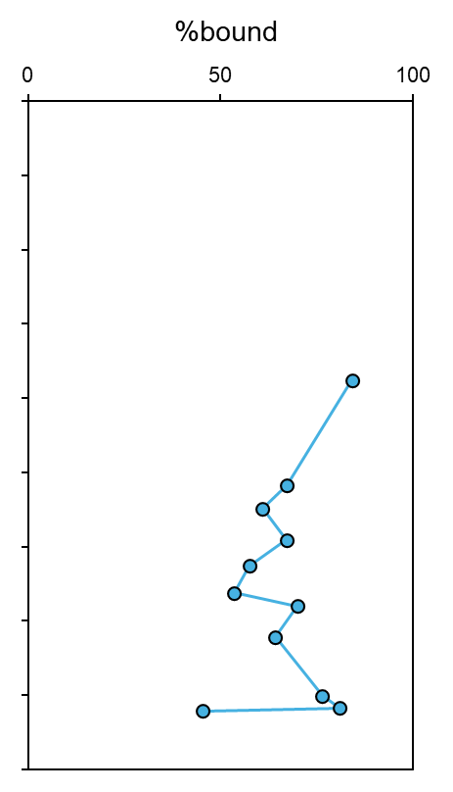
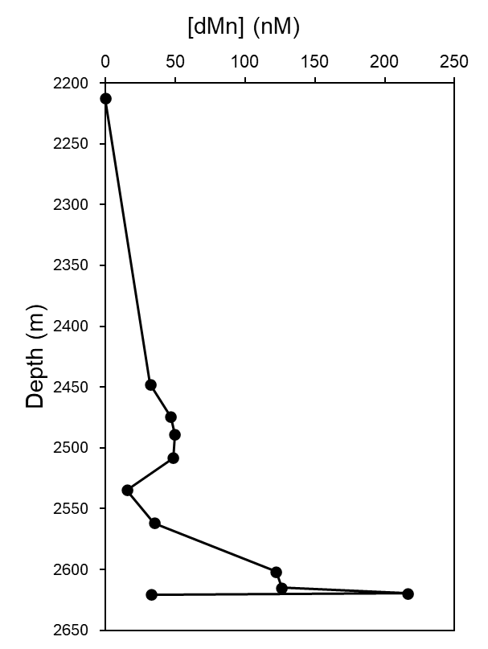
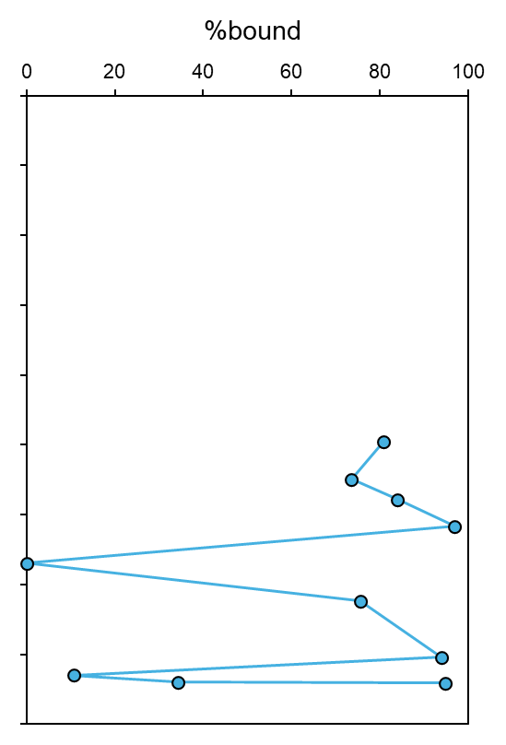
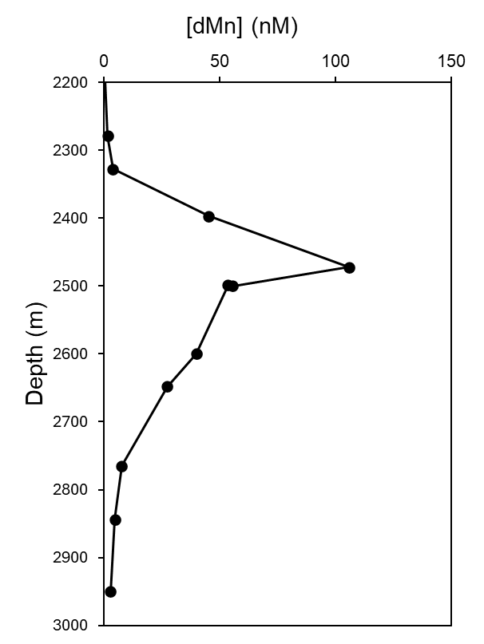
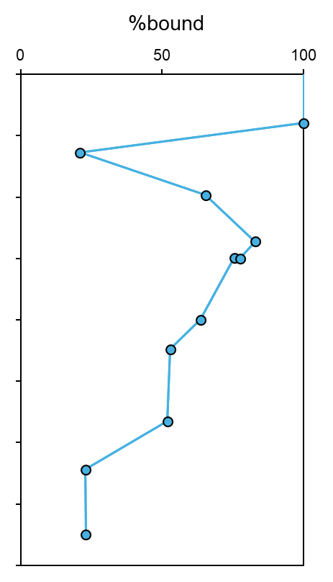



…and they stabilize more dissolved manganese than expected

Slide 14
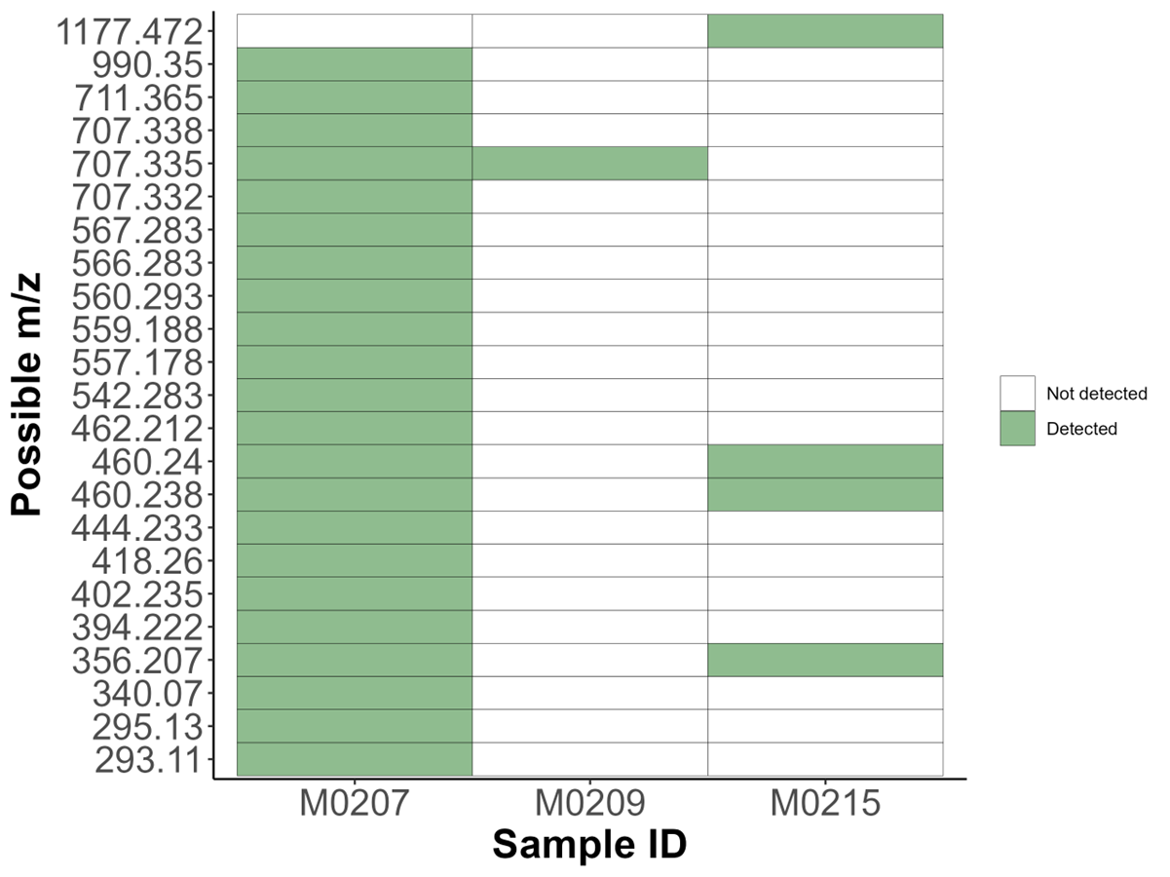
Several Mn-binding mass candidates identified at SEPR
Subset of samples at Station Flo worked up suggests different classes of ligands present across different hydrothermal systems

Slide 15
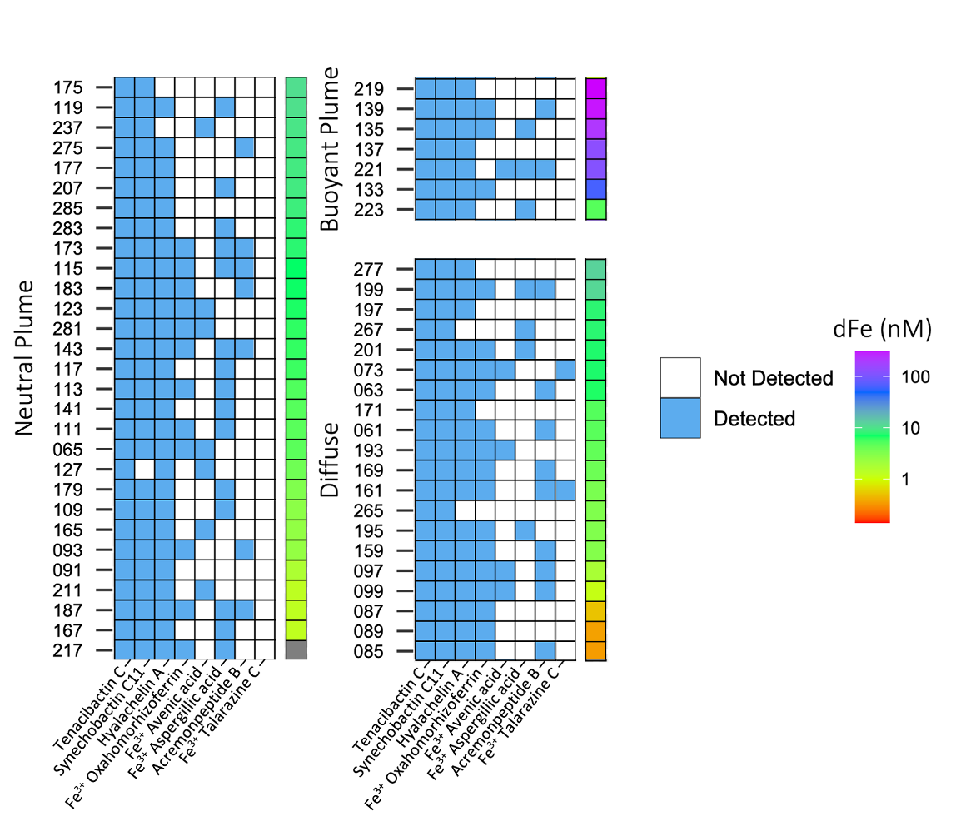
Discrete iron binding ligands can be identified in hydrothermal systems
Fe-binding ligands known as siderophores identified in:
Multiple hydrothermal environments
Large range of Fe concentrations
May allow us to tie metal speciation more closely to biological community

Slide 16
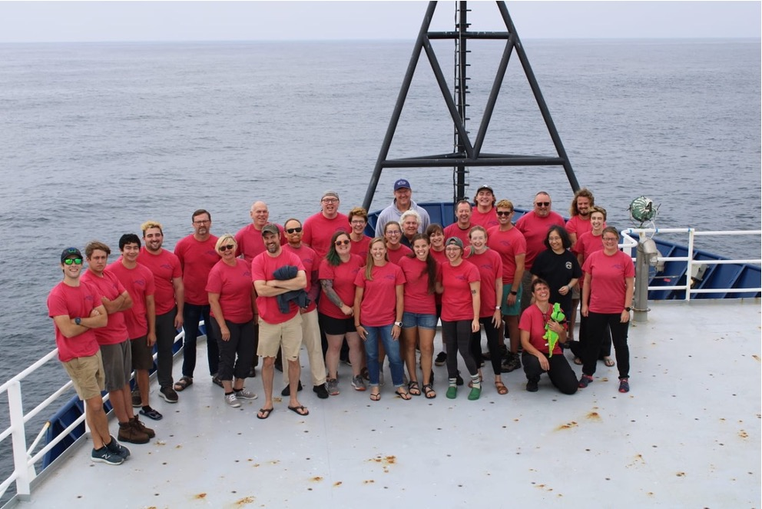

Acknowledgements
PLUME RAIDERS team
Nathan Buck
Bundy Lab
Lydia Babcock-Adams
AUV Sentry team
Chris German

Slide 17
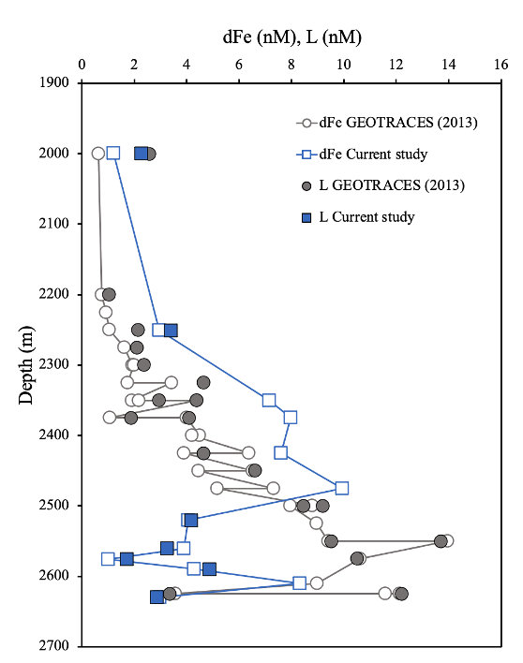
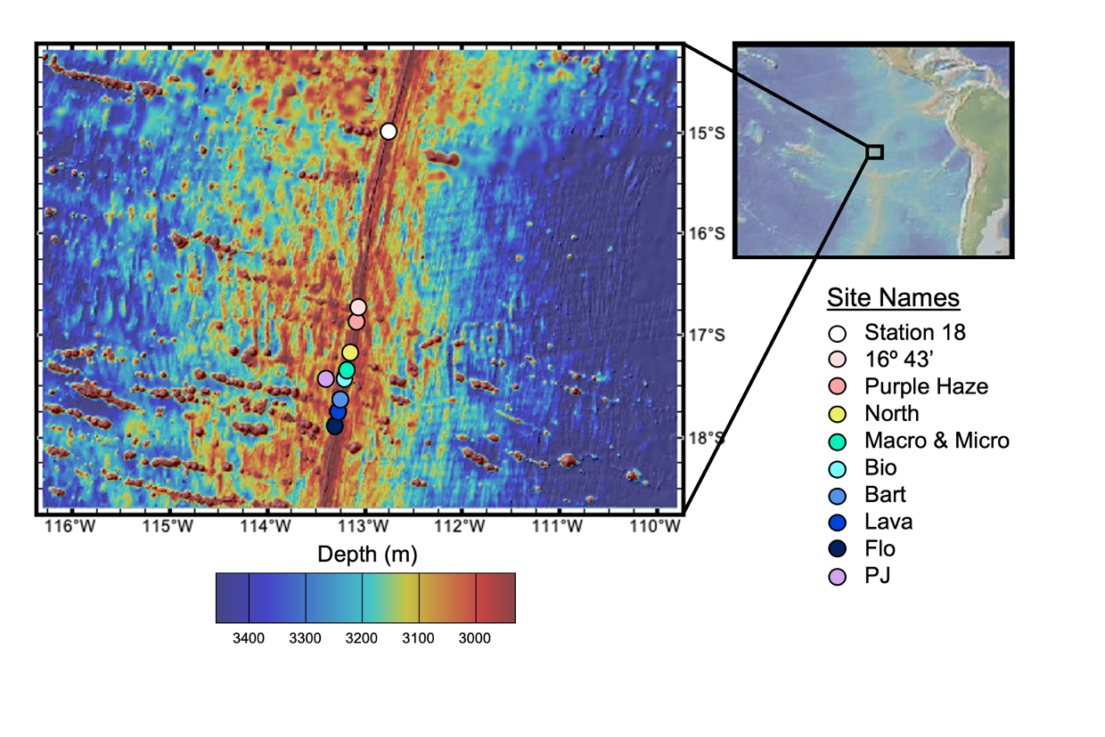
Ligand stabilization of Fe in 1-month aged plume stable over 8-year period
Station 18 (15ºS) visited in 2013 and 2021
1-month estimated plume age in 2013
No indication of eruptive event during either station visit
2013 data from Buck et al. 2018

