Slide 1
Collaborative Canadian-US OBS experiment
EXTension on the ENDeavour Segment (EXTEND): Illuminating the seafloor spreading cycle
William Wilcock & Marine Denolle, University of Washington
Miao Zhang, Mladen Nedimović & Alexandre Plourde, Dalhousie U.
Martin Heesemann, Steve Mihaly & Jesse Hutchinson, ONC
Laurence Coogan, U. Victoria
(many contributions from Zoe Krauss)
Endeavour Workshop, 2024
Victoria
Nov 12-14, 2024

Slide 2
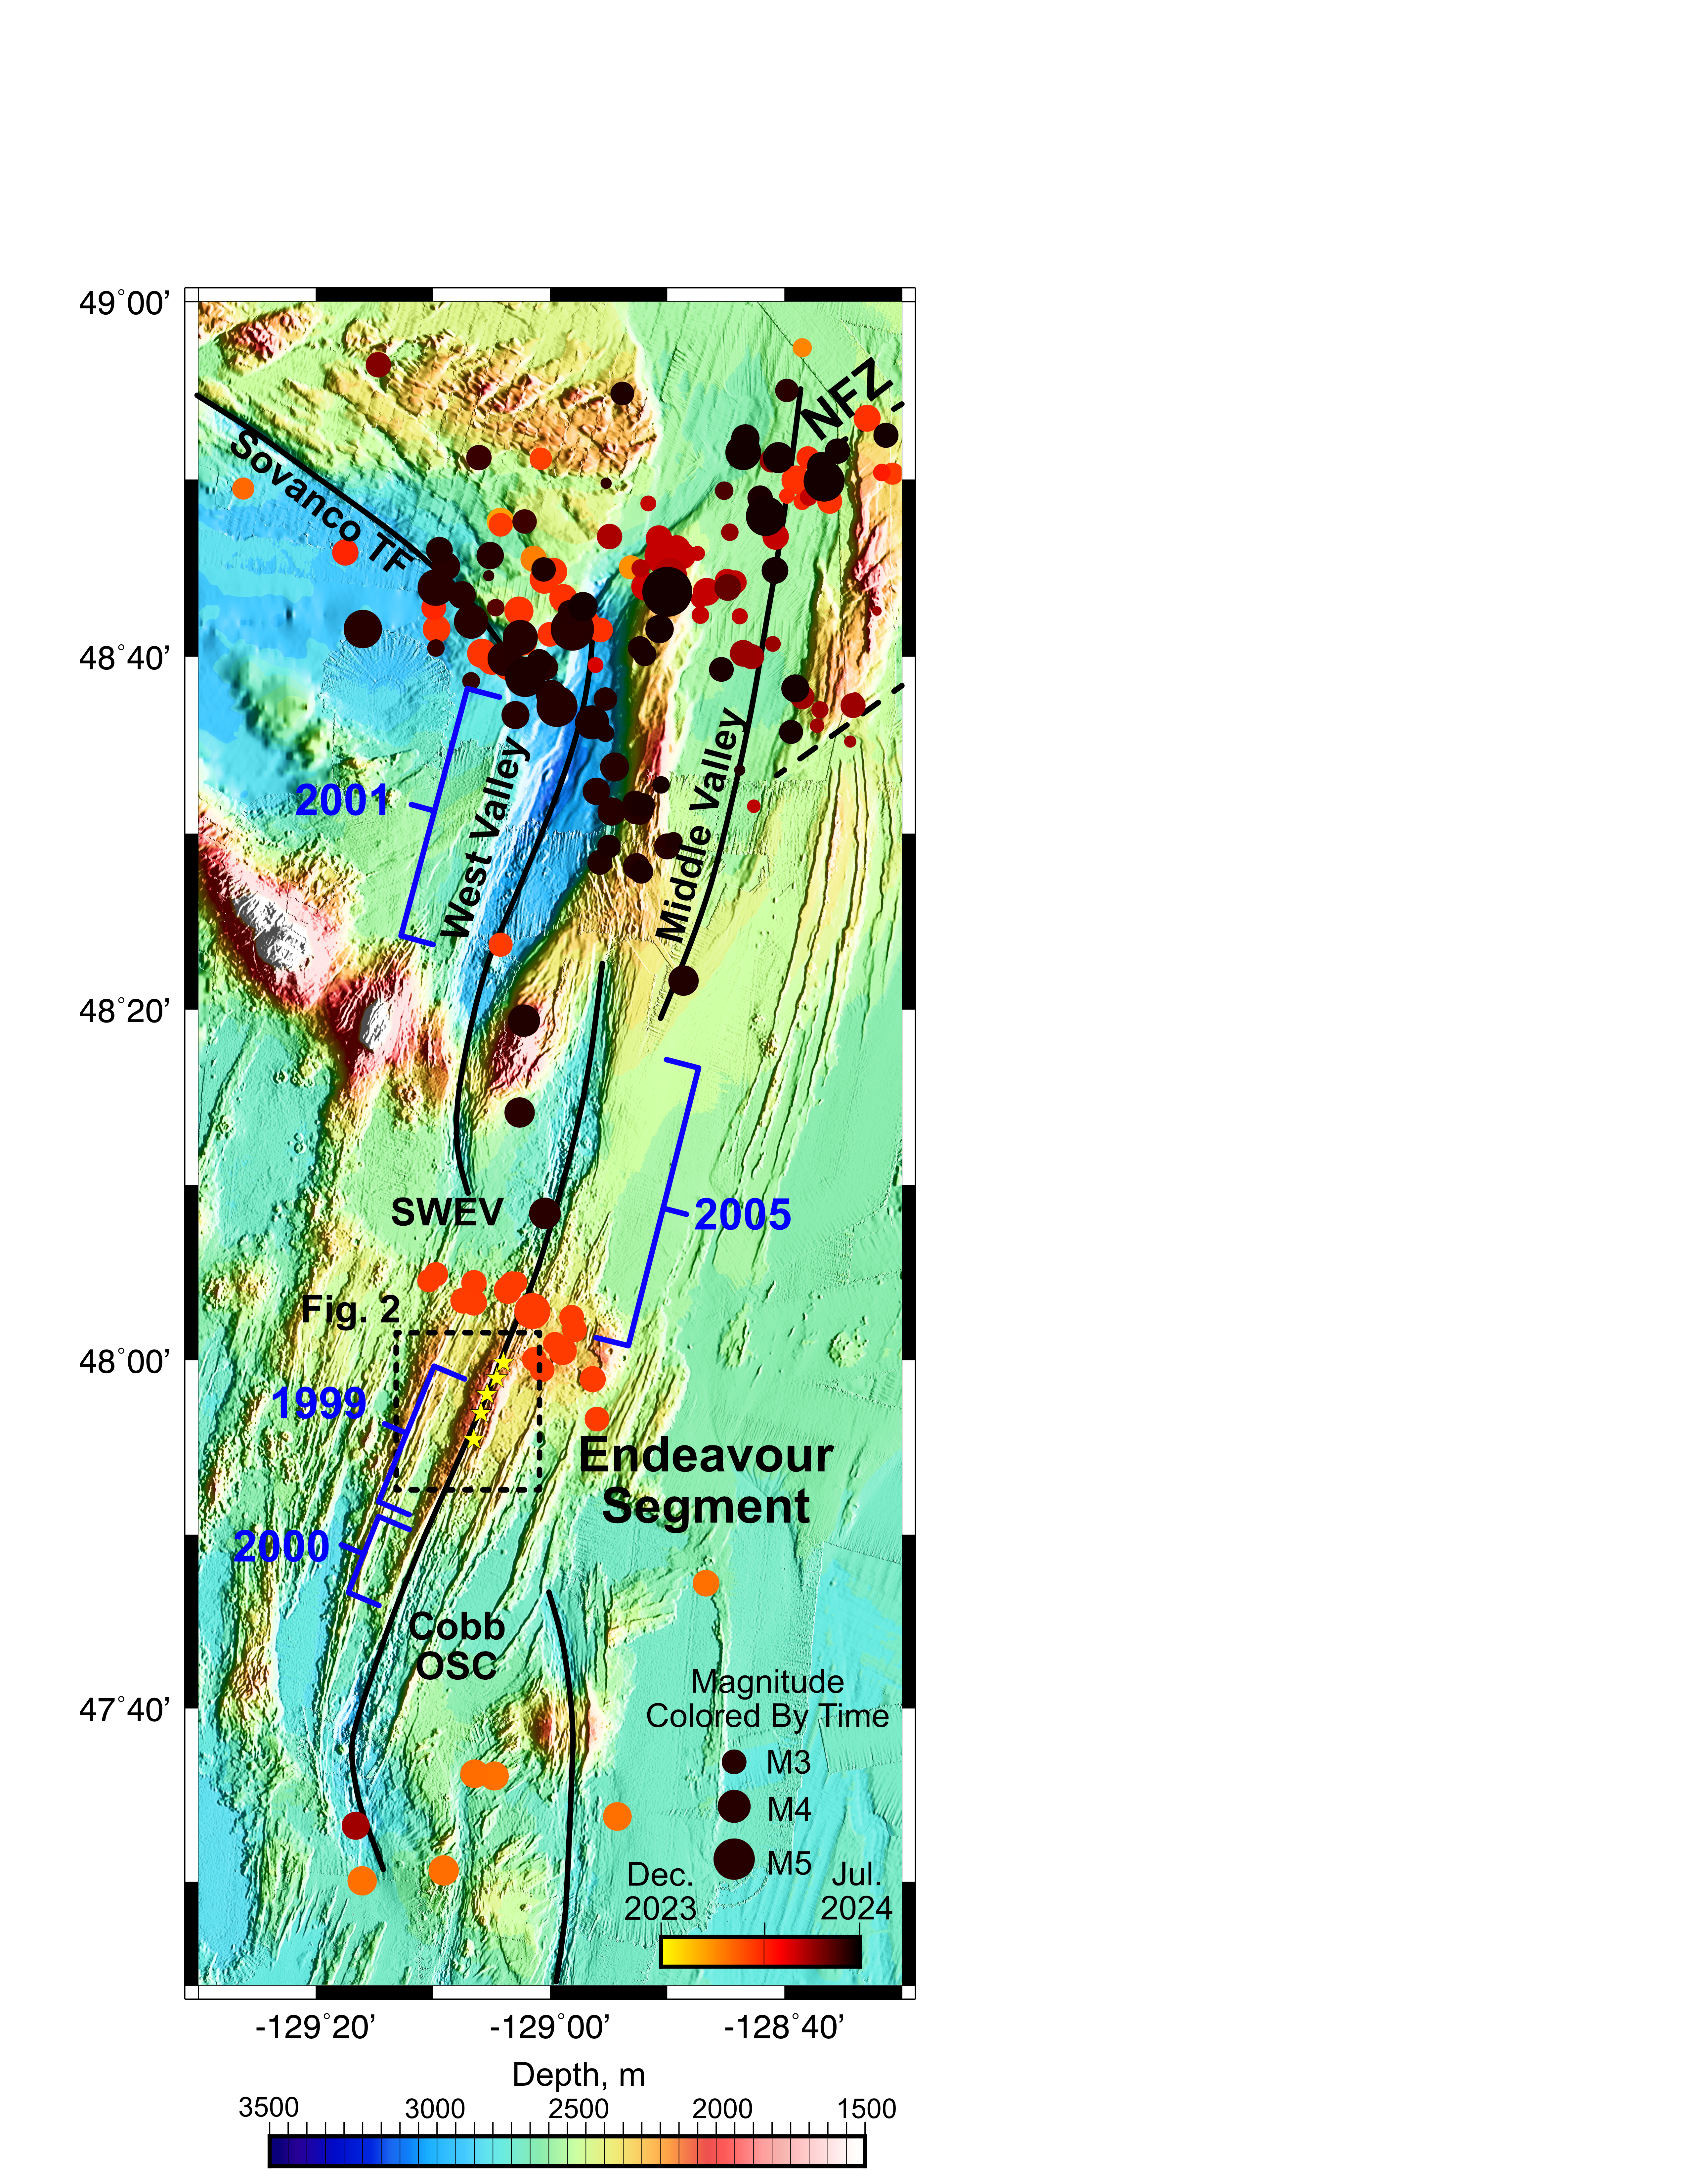
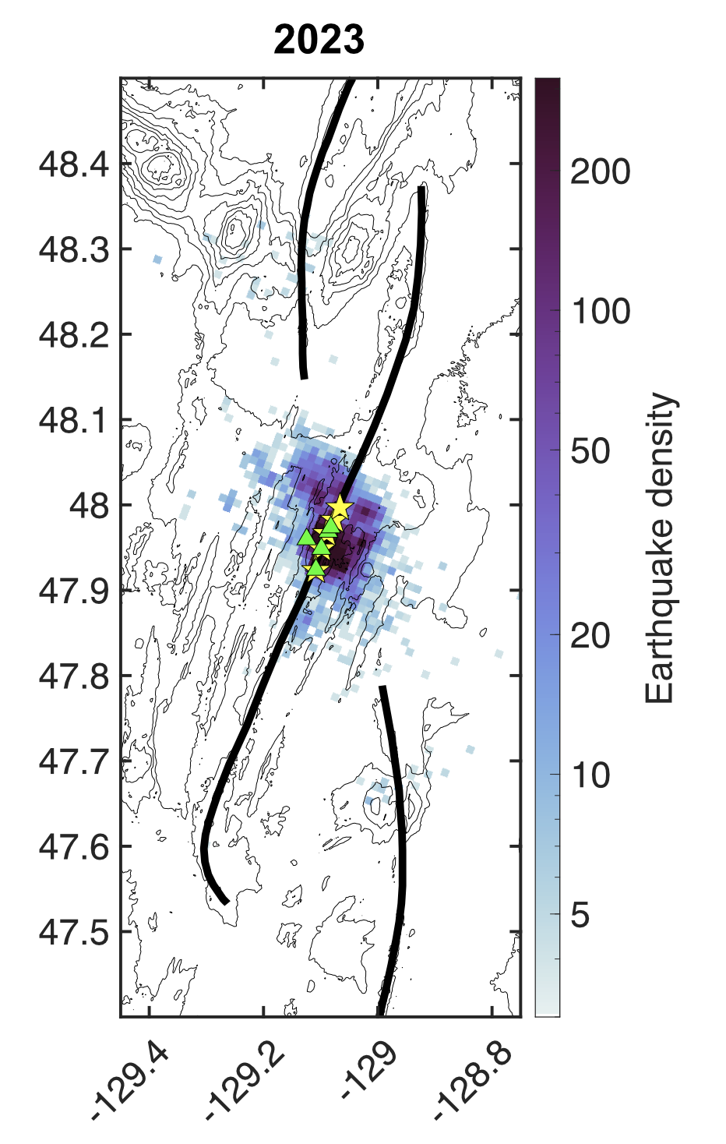
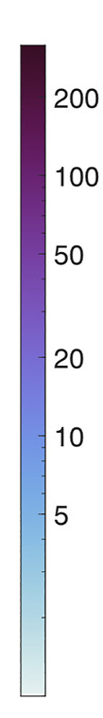
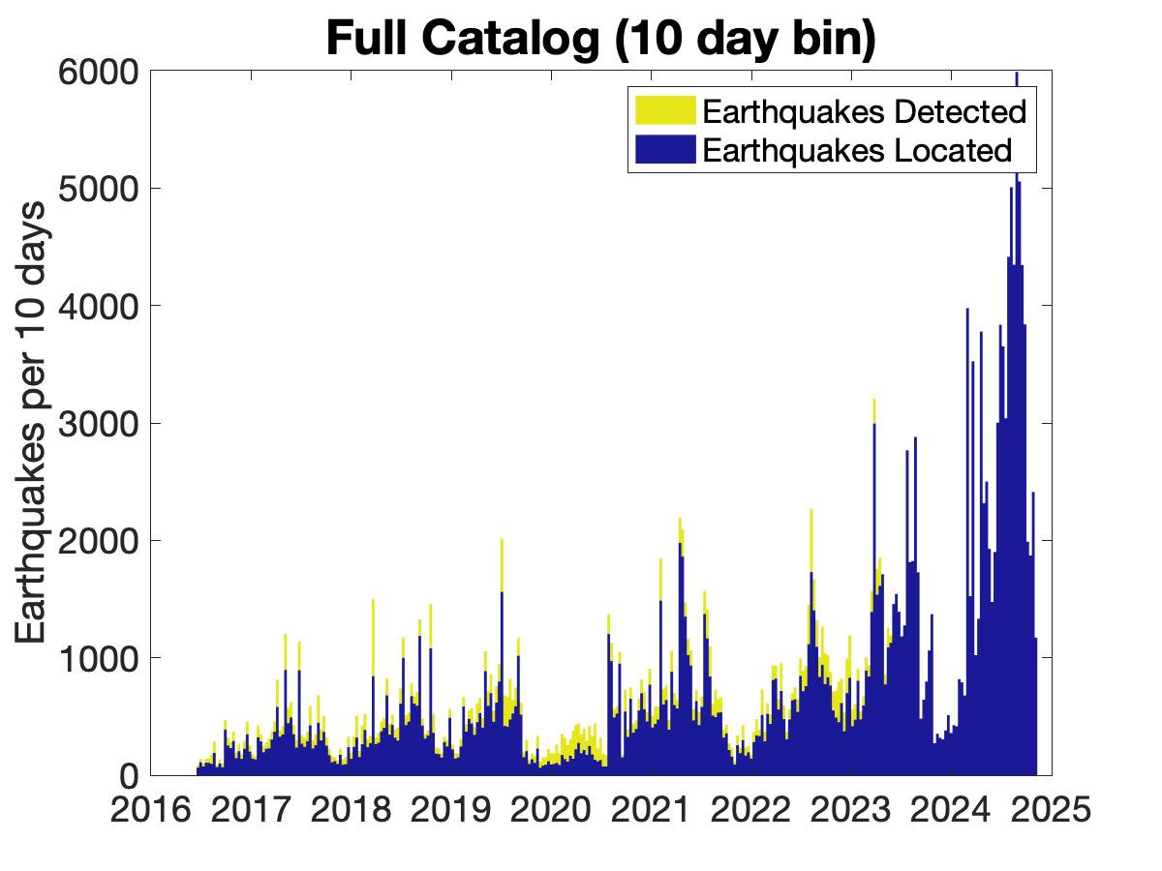
Current State of Seismicity
Canadian Earthquake Catalog
Dec 2023-Jul 2024
UW Catalog (Krauss et al.)
2023
Earthquake Density, km⁻² yr⁻¹
UW Catalog (Krauss et al.)

Slide 3
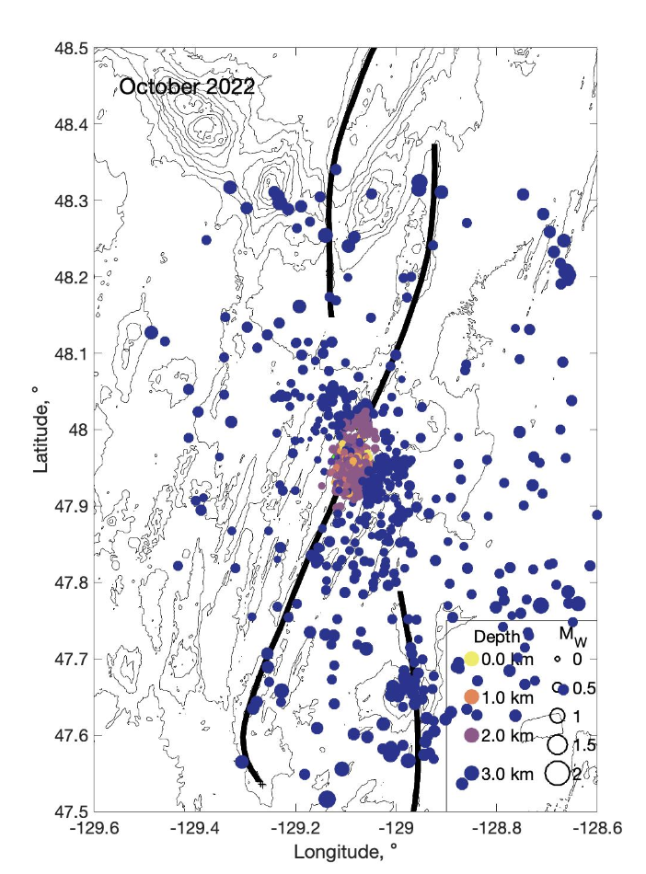
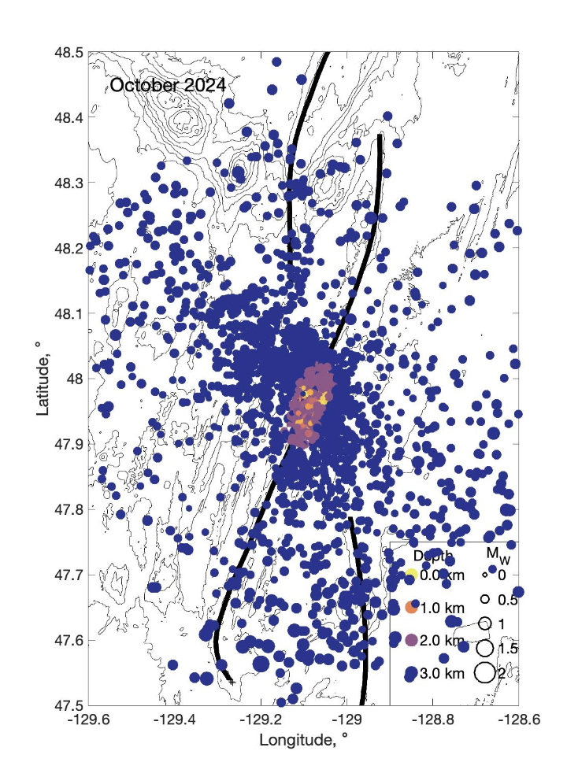
Rapidly Increasing Seismicity
Signs of impending rupture:
Exponentially increasing seismicity rates
More on-axis seismicity outside of the central segment
Which portion will rupture first?
Central/Southern?
Probably! But anything could happen.
2022
2024
Slide courtesy Zoe Krauss

Slide 4
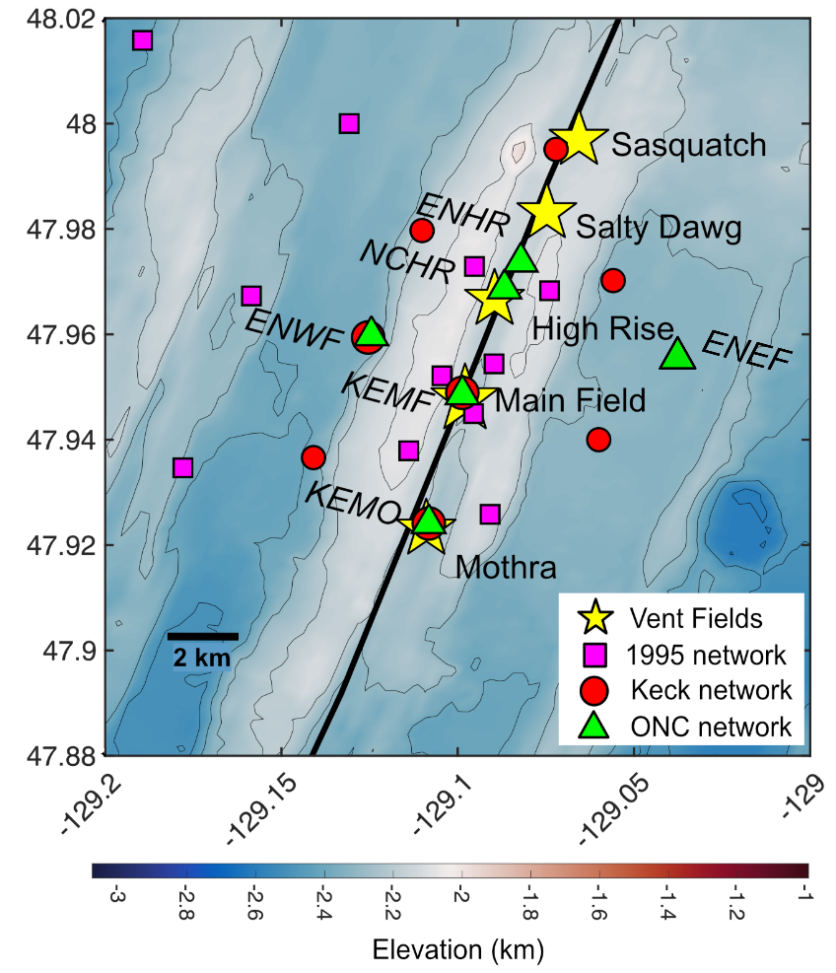
Cabled Network
Advantages
Sustained
Real Time
Limitations
Small size & spatial footprint
  Earthquake depths
  Focal mechanisms
figure courtesy Zoe Krauss

Slide 5
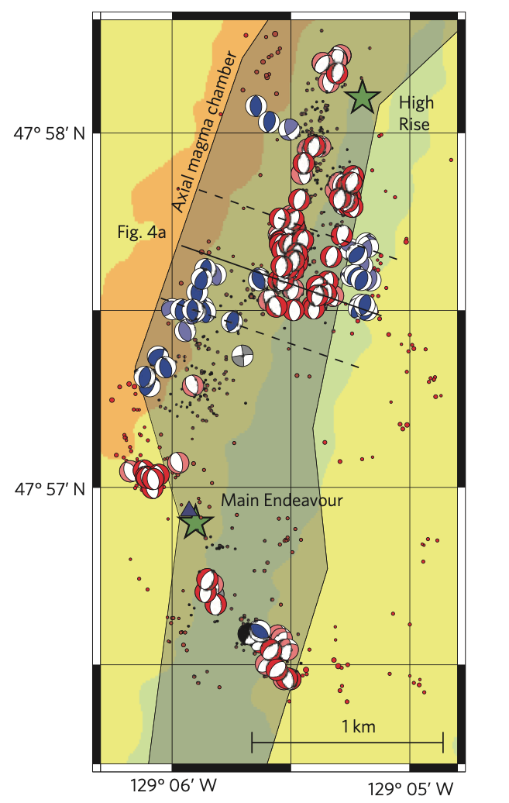
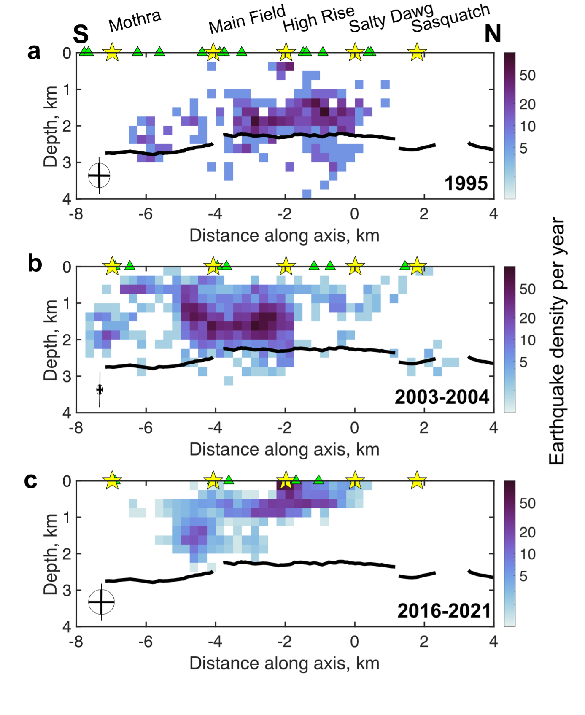
Importance of earthquake depths & focal mechanisms
Earthquakes Near the Axial Magma Chamber
Magmatic Inflation
Hydrothermal Cooling
Tectonic Extension
Shallow Earthquakes
Tectonic Extension
Focal Mechanisms
Can distinguish cause of seismicity
Krauss et al., 2023

Slide 6
Science Questions for an Expanded Network
Are diking events at the Endeavour triggered by extensional stresses, or magmatic pressures from a centralized source?
Do temporal changes in seismicity & seismic velocity show evidence for precursory aseismic strain before diking or ridge extension events?
Is CO₂ exsolution linked to off-axis seismicity at the Endeavour?
Is the permeability beneath the Endeavour hydrothermal vent fields enhanced by the nearby propagating rifts?

Slide 7
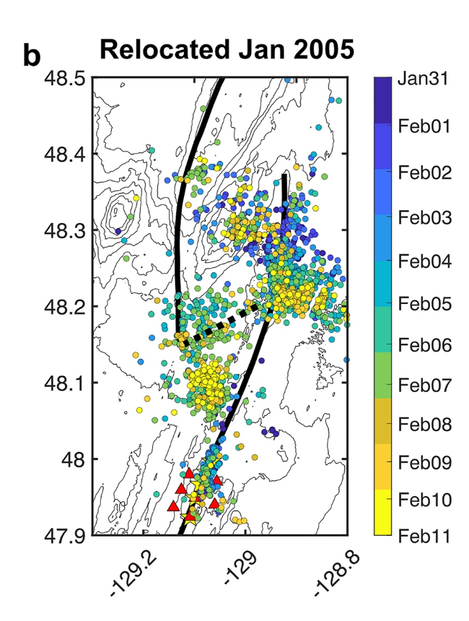
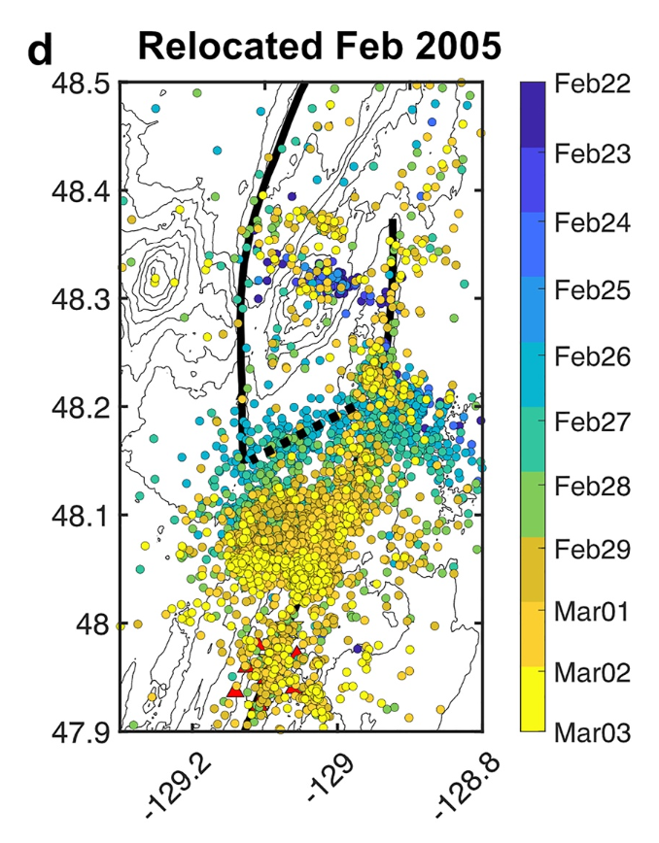
Nearly 20 years since the last rupture, we can begin to anticipate a subsequent event.
What should we be looking for?
North segment rupture Jan-March 2005: 1000s of earthquakes migrating 10s of kilometers south
Ruptured in 2005
Ruptured in 1999
Ruptured in 2000
Krauss et al., 2023, JGR
*non-extrusive magmatism!
Slide courtesy Zoe Krauss

Slide 8
Science Questions for an Expanded Network
Are diking events at the Endeavour triggered by extensional stresses, or magmatic pressures from a centralized source?
Do temporal changes in seismicity & seismic velocity show evidence for precursory aseismic strain before diking or ridge extension events?
Is CO₂ exsolution linked to off-axis seismicity at the Endeavour?
Is the permeability beneath the Endeavour hydrothermal vent fields enhanced by the nearby propagating rifts?

Slide 9
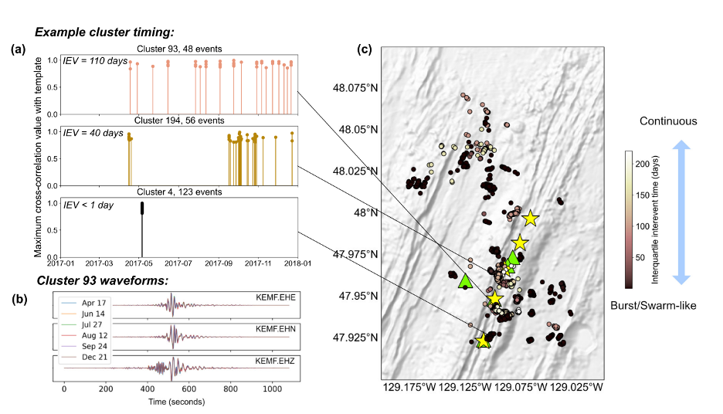
Repeating Microearthquakes: Fault Creep & Fluid Processes
figure courtesy Zoe Krauss

Slide 10
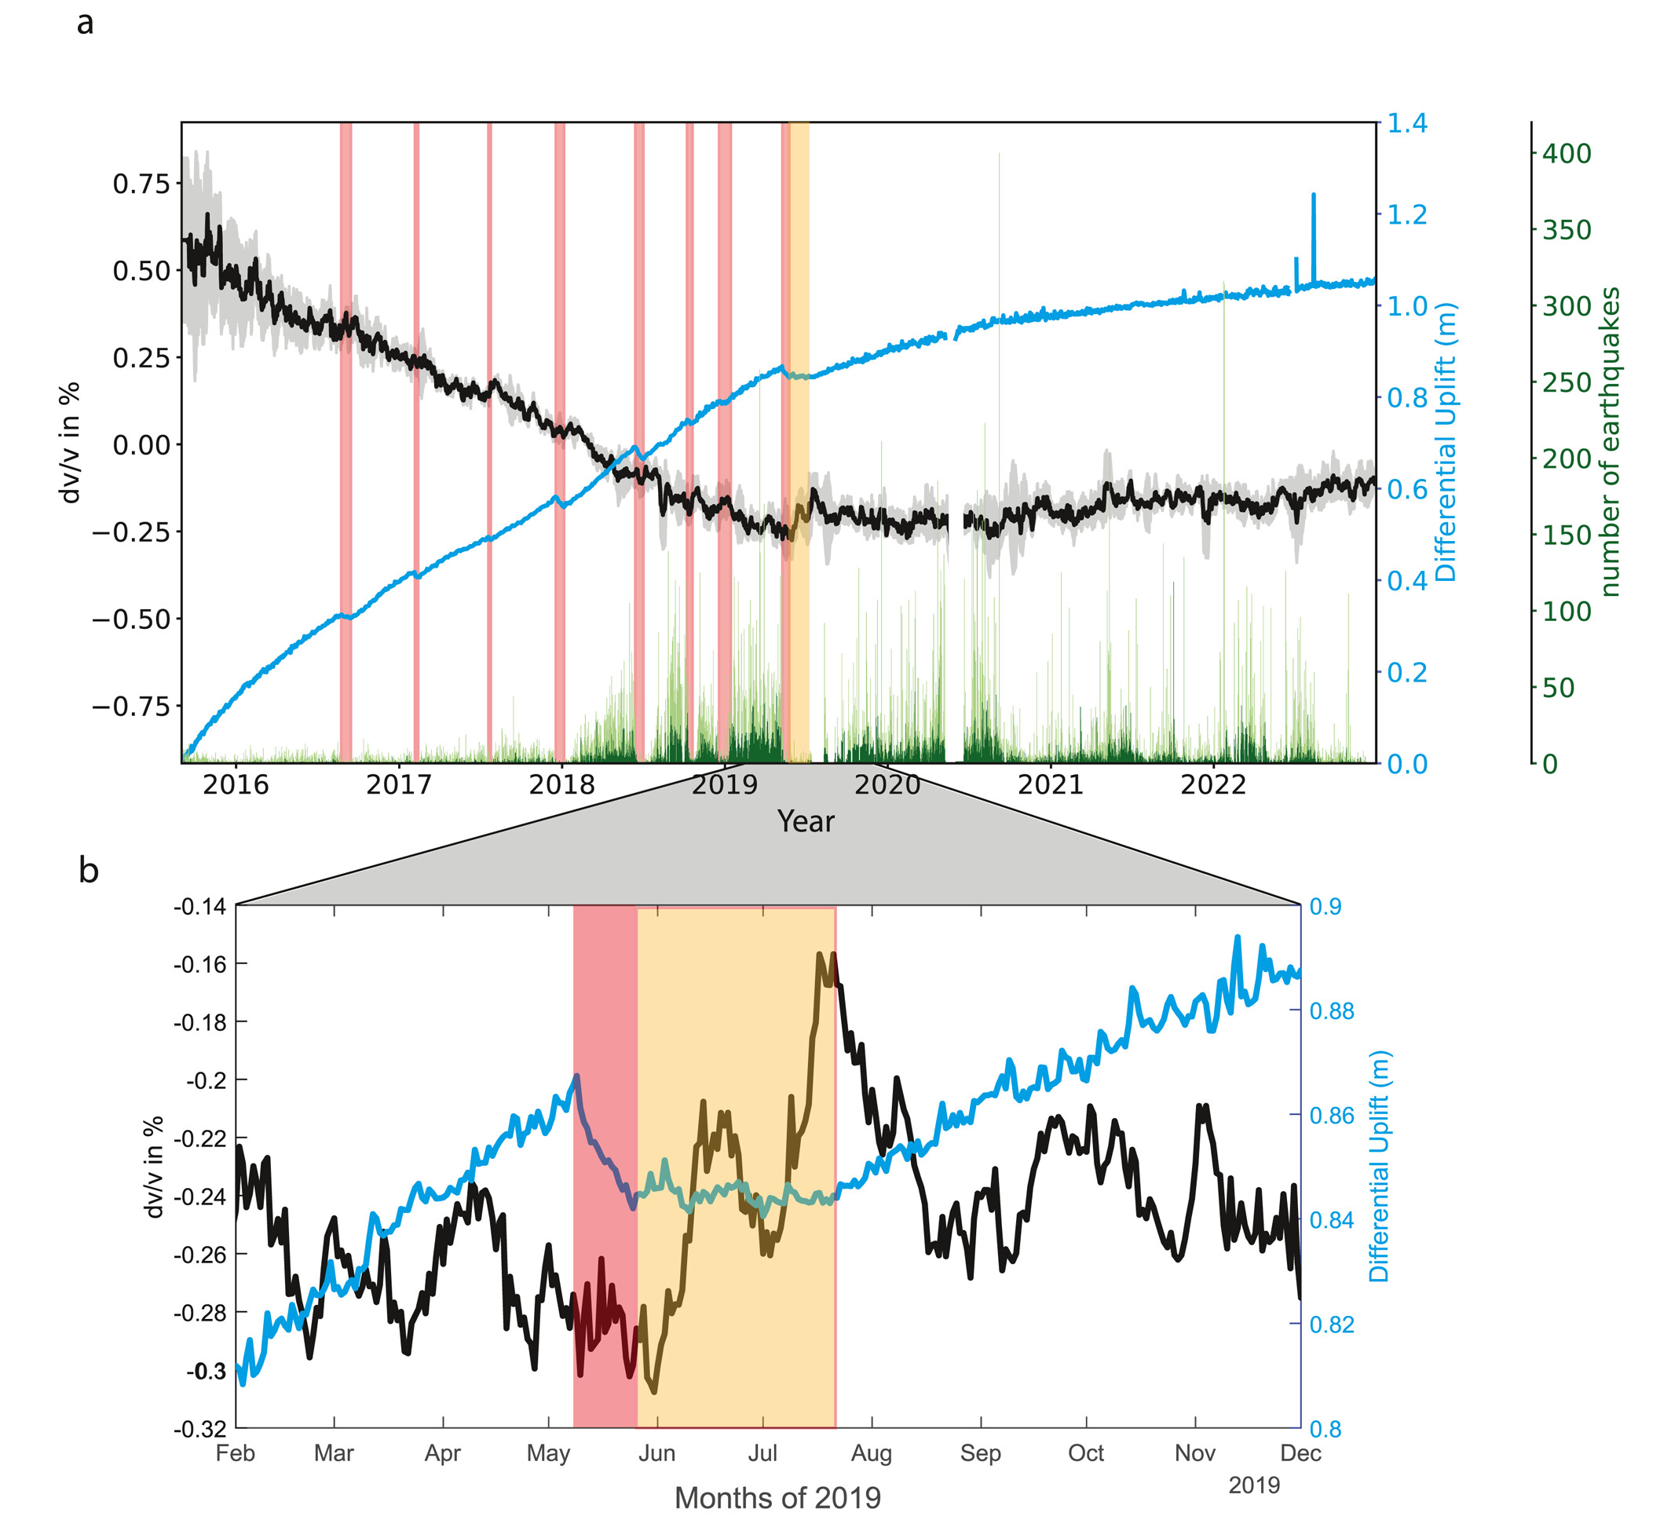
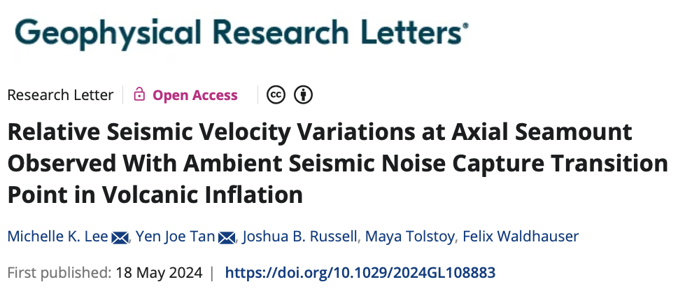
Ambient Noise Cross-Correlation
Relative Seismic Velocity Variations at Axial Seamount Observed With Ambient Seismic Noise Capture Transition Point in Volcanic Inflation
Cross-correlating seismic noise between two stations creates a two-sided seismic record that reproduces the propagation from one station to the other
Works for different channels on the same station.

Slide 11
Science Questions for an Expanded Network
Are diking events at the Endeavour triggered by extensional stresses, or magmatic pressures from a centralized source?
Do temporal changes in seismicity & seismic velocity show evidence for precursory aseismic strain before diking or ridge extension events?
Is CO₂ exsolution linked to off-axis seismicity at the Endeavour?
Is the permeability beneath the Endeavour hydrothermal vent fields enhanced by the nearby propagating rifts?

Slide 12
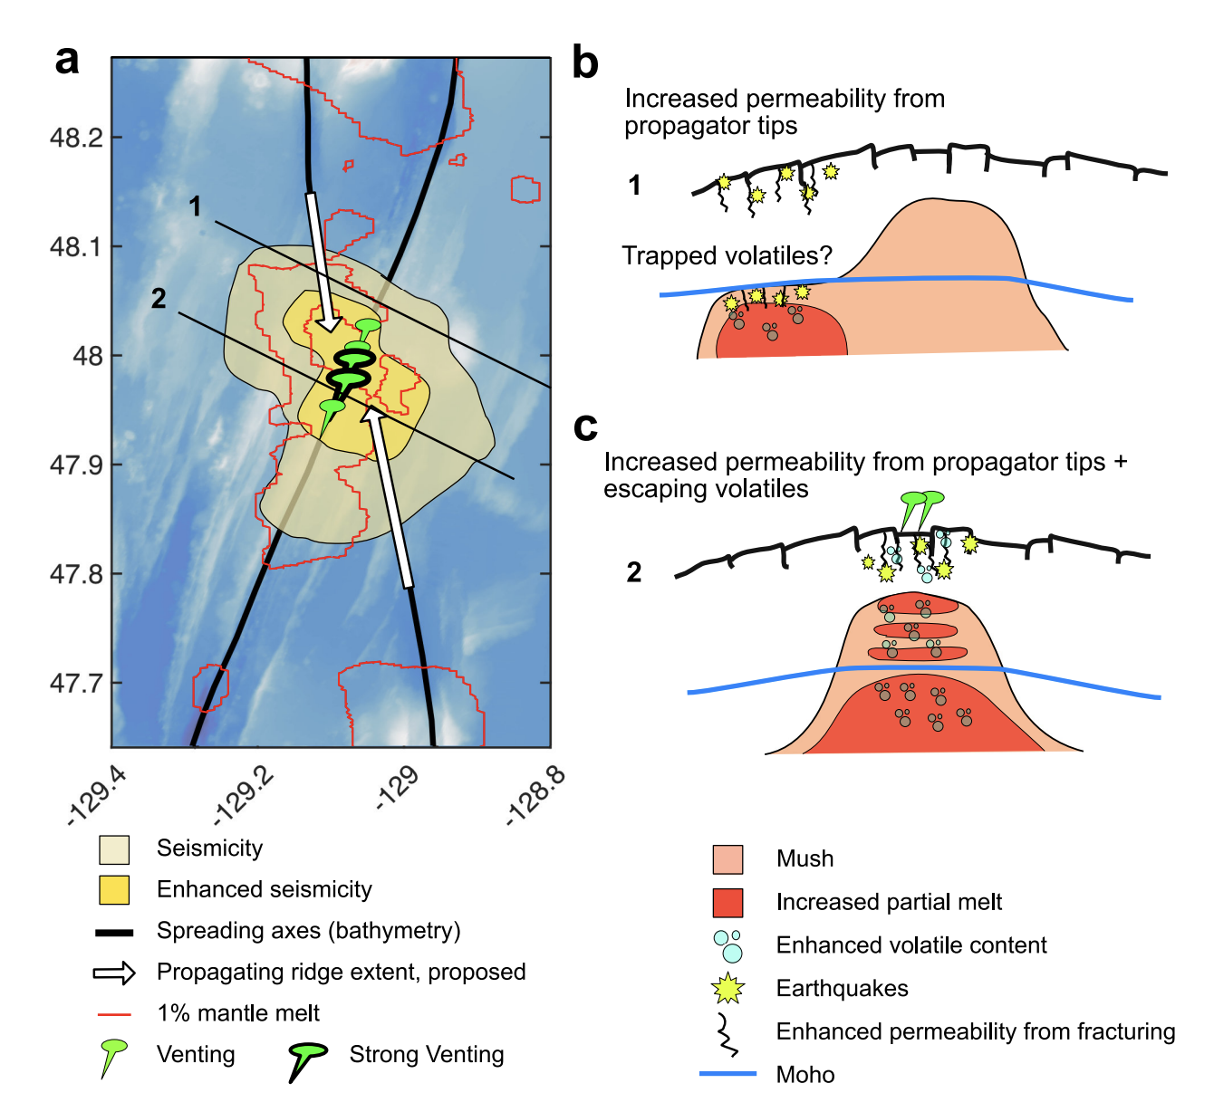
Role of CO₂ in controlling magmatic systems
Magma Plumbing Model (Toomey et al., 2007)
Mantle melt supply and crustal magmatic systems aligned
  Magmas oversaturated in CO₂
  Weak crustal magmatic systems
  Frequent eruptions*
  Vigorous Hydrothermal sytems
Mantle melt delivered off-axis
  CO₂ degasses off-axis
  Weak crustal magmatic systems
  Feeble hydrothermal venting
Krauss et al., 2023

Slide 13
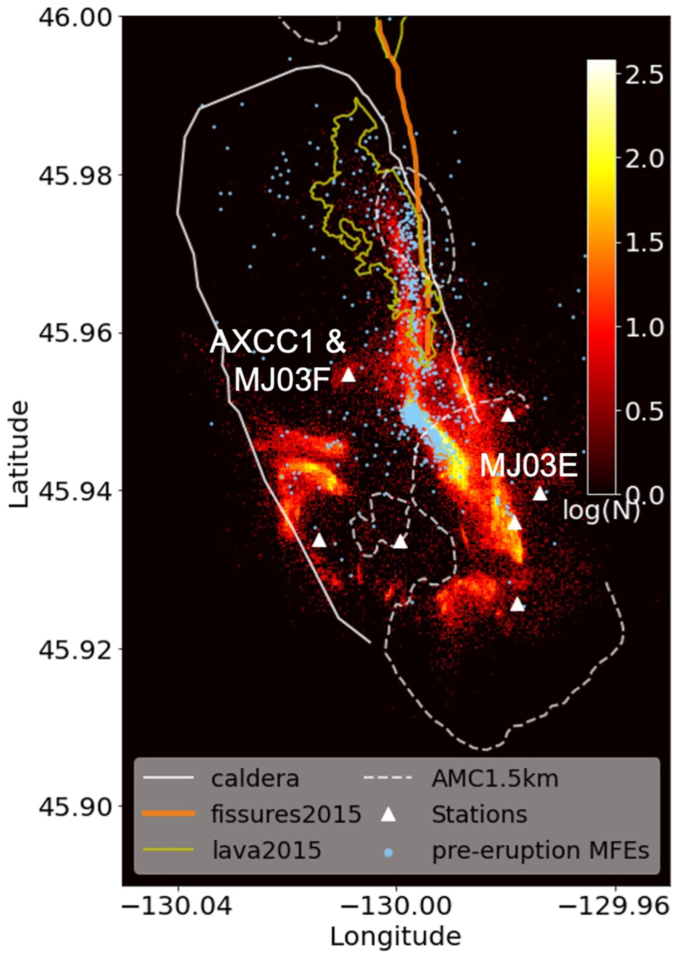
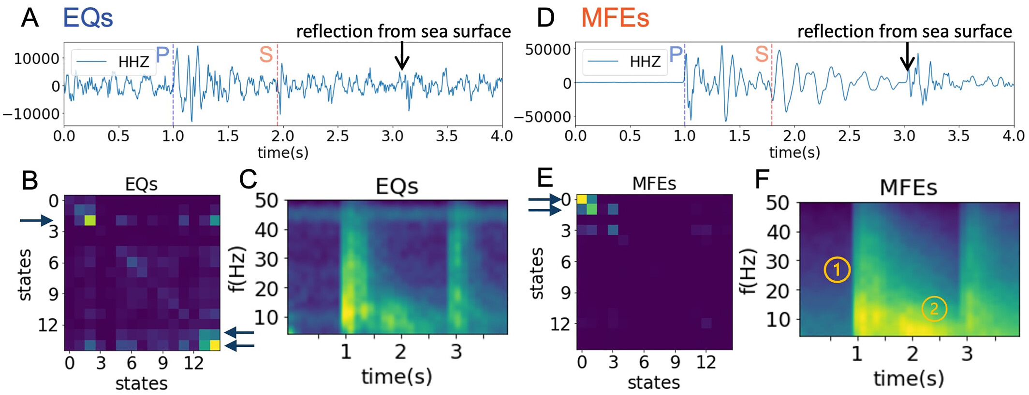

Seismic signature of CO₂ exsolution
Mixed-Frequency or Hybrid Events – Low frequency component from gas moving through the fault?

Slide 14
Science Questions for an Expanded Network
Are diking events at the Endeavour triggered by extensional stresses, or magmatic pressures from a centralized source?
Do temporal changes in seismicity & seismic velocity show evidence for precursory aseismic strain before diking or ridge extension events?
Is CO₂ exsolution linked to off-axis seismicity at the Endeavour?
Is the permeability beneath the Endeavour hydrothermal vent fields enhanced by the nearby propagating rifts?

Slide 15
Effects of the propagating rifts on the ridge axis
Hypothesis
Propagating rifts influence the ridge axis creating intersecting fault patterns at depth that enable CO2 loss from Axial magma chamber that prevents the magmas from erupting
Predictions
Focal Mechanisms
Mixed Frequency Earthquakes
Krauss et al., 2023

Slide 16
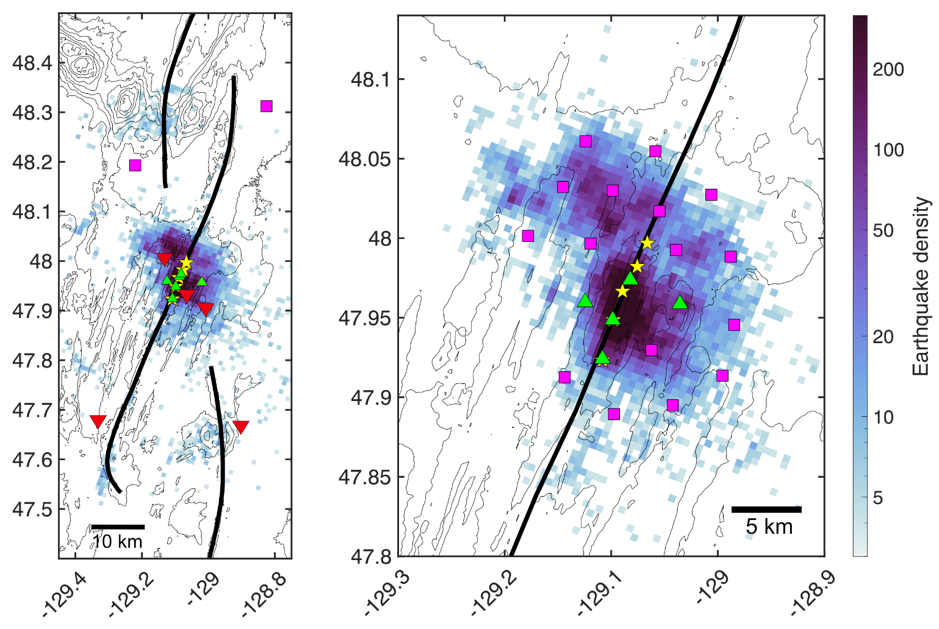
Experiment Design
2024-5
2026-9
2025-2026
NFSI OBSs
2024-2025
5 OBSs
2025-2026
20 OBSs
2026-2029
5 OBSs

Slide 17
Logistics
2024
  OBSs deployed by ONC
  ONC funded OBS drop fees
2025
  Working to secure Canadian ship time
  US funding for OBS drop fees
2026
  US Ship Time Secured
2027-2029
  Planning in progress

Slide 18
Data Analysis
AI-aided Catalog Building
  Led by Miao Zhang
  Talk this afternoon by Jesse Hutchinson and Miao Zhang
Time Lapse Imaging of Structure
  Single station ambient noise cross-correlations
  Inter station ambient noise cross-correlations
Multiplet Earthquake Analysis
  Burst-type repeaters
  Continuous-type repeaters

