Slide 1
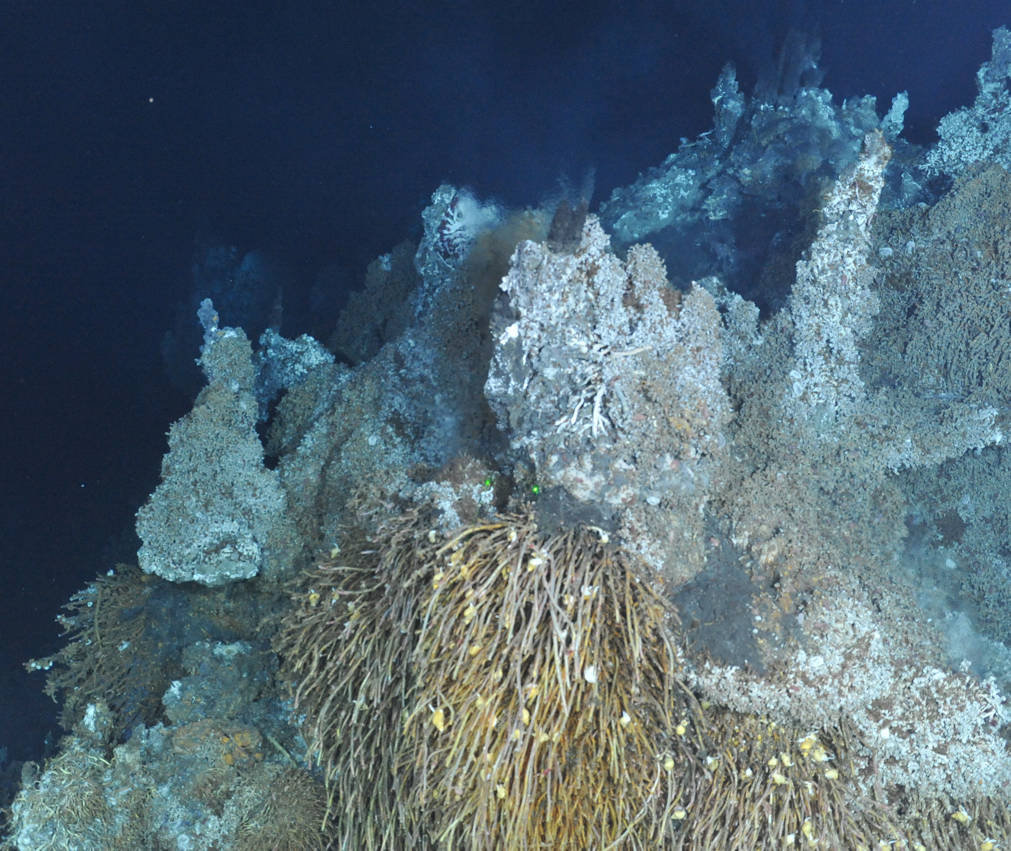
Microbial biogeochemical cycling at Endeavour
Sheryl Murdock
Arizona State University
sheryl.murdock@asu.edu
ONC Endeavour workshop
12-14 November 2024

Slide 2
Common areas of vent microbiology research:
Roles in element cycling (e.g. C, N, Fe, S)
Interactions with non-microbes
Novel taxa, metabolisms, enzymes
Most information from biogeochemical cycling by subsurface microbes
Notes:
1. locally (sources of energy), globally (budgets)
2. parasites, symbionts, modifying OM
by sampling diffuse fluids

Slide 3
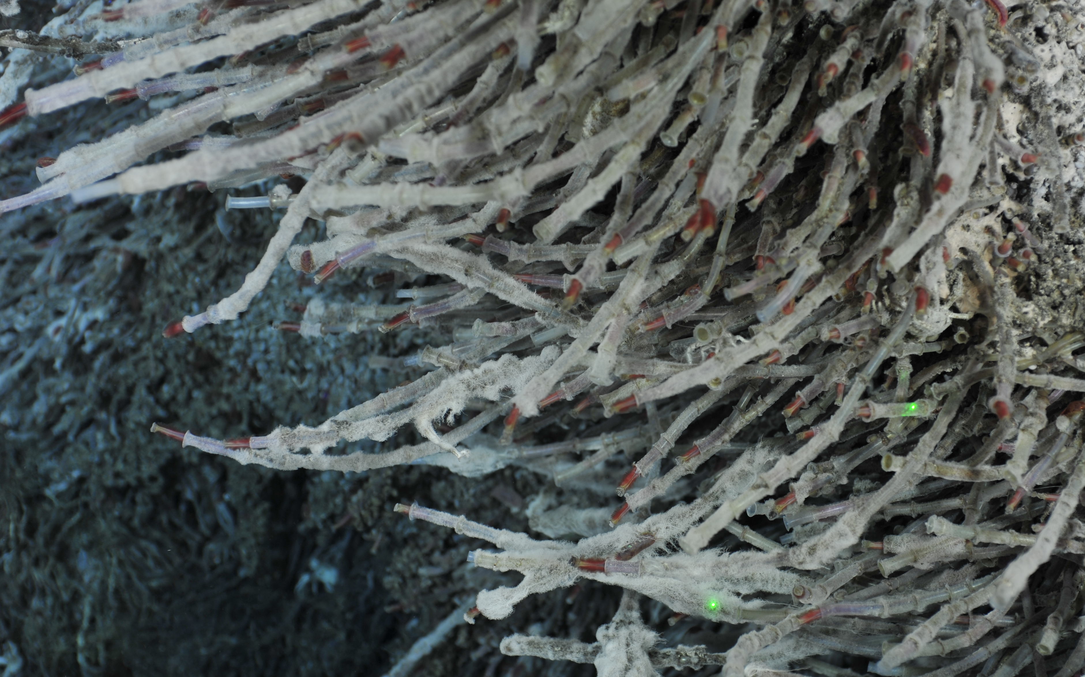
Non-symbiotic microbes in faunal assemblages
Overlooked vent microbial habitat
Increased surface area for microbes
Access to chemical fuel
Thermochemical gradients favor diverse microbial processes
Dick et al. 2019

Slide 4

Ridgeia piscesae – foundation species tubeworm
Two worm morphotypes
Distinct animal assemblages
Slows vent fluid dispersal
LowT assemblage
(fluids <25℃)
2016 Canadian Healthy Oceans Network
Characterized 13 assemblages from microbes to macrofauna
Greater microbial diversity in assemblages than fluids
HighT assemblage
(fluids 25-40℃)
Murdock et al. 2021
Murdock et al. 2021
Notes:
En. Pacific

Slide 5
Microbial functional capacity
Comparing capabilities of fluid and assemblage microbes
metagenomes
Diffuse fluids, LT assemblages
HT assemblages *
More N cycling in LowT assemblages
oxidative & reductive
N fixation
Mixed S patterns – may redox couple with C, N, Fe, etc.
Murdock et al. in prep

Slide 6
Nitrogen sources at vents
NH₄ and NO₂ -> high in vent fluid, low in seawater
NO₃ -> low in vent fluid, high in seawater
N loss dominates in diffuse fluid microbes (Bourbonnais et al 2012)
N loss: bioavailable N -> gaseous N
(NO₃, NO₂, NH₄) (NO, N₂O, N₂)
Notes:
Idea that gradients are more gradual in tubeworms

Slide 7
Nitrogen sources at vents
NH₄ and NO₂ -> high in vent fluid, low in seawater
NO₃ -> low in vent fluid, high in seawater
N loss dominates in diffuse fluid microbes (Bourbonnais et al 2012)
N loss: bioavailable N -> gaseous N
(NO₃, NO₂, NH₄) (NO, N₂O, N₂)
Reductive (N-loss) processes
denitrification, anammox
under anoxic conditions
Oxidative (N-recycling) processes
nitrification, DNRA
when oxygen is present
Mixing zone redox gradients favor BOTH!
Notes:
Idea that gradients are more gradual in tubeworms

Slide 8
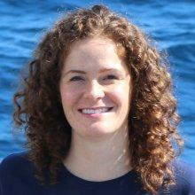
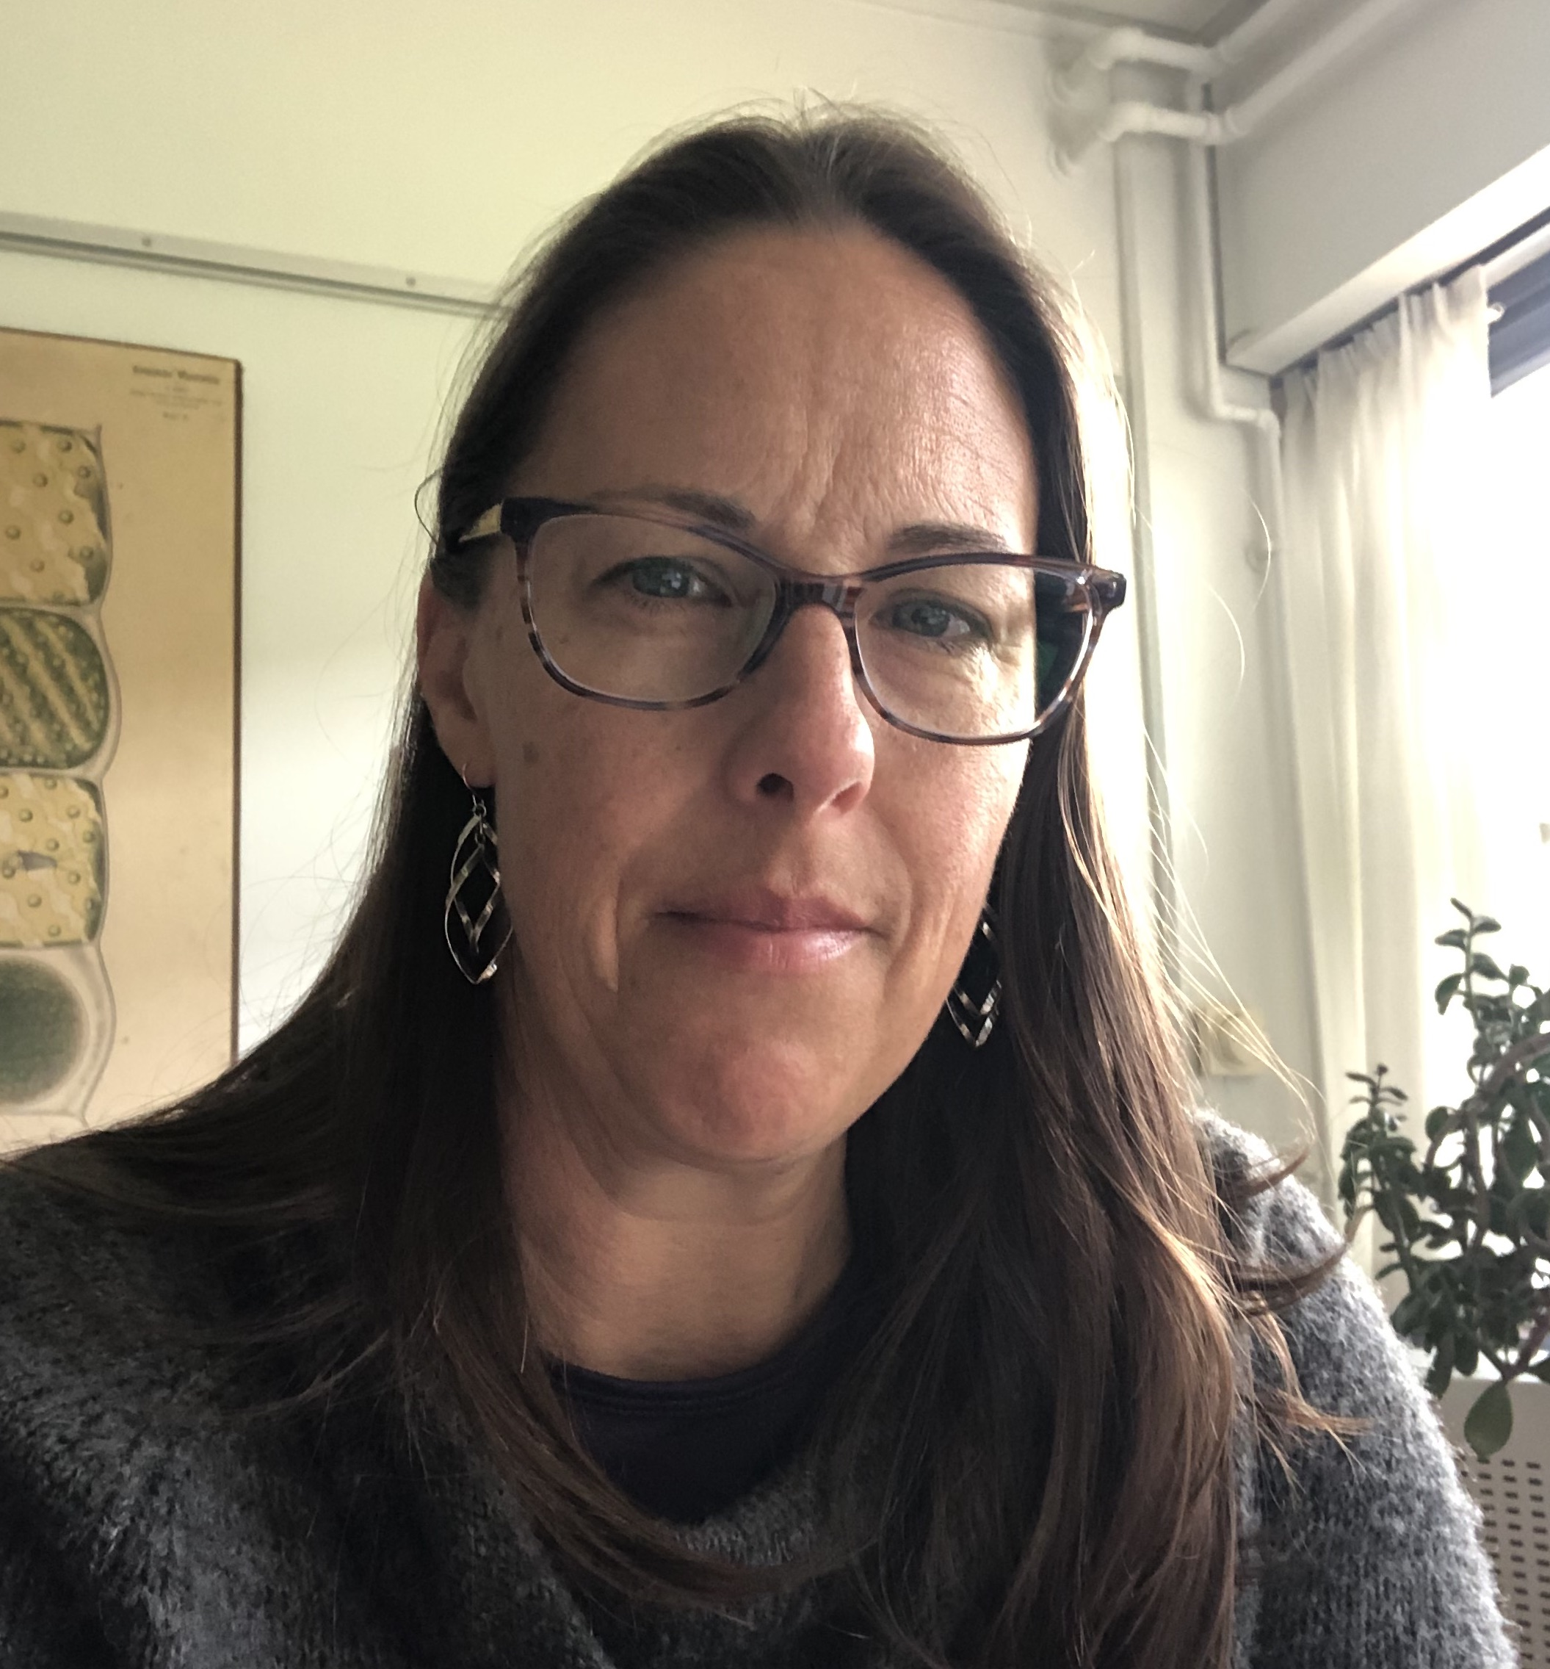
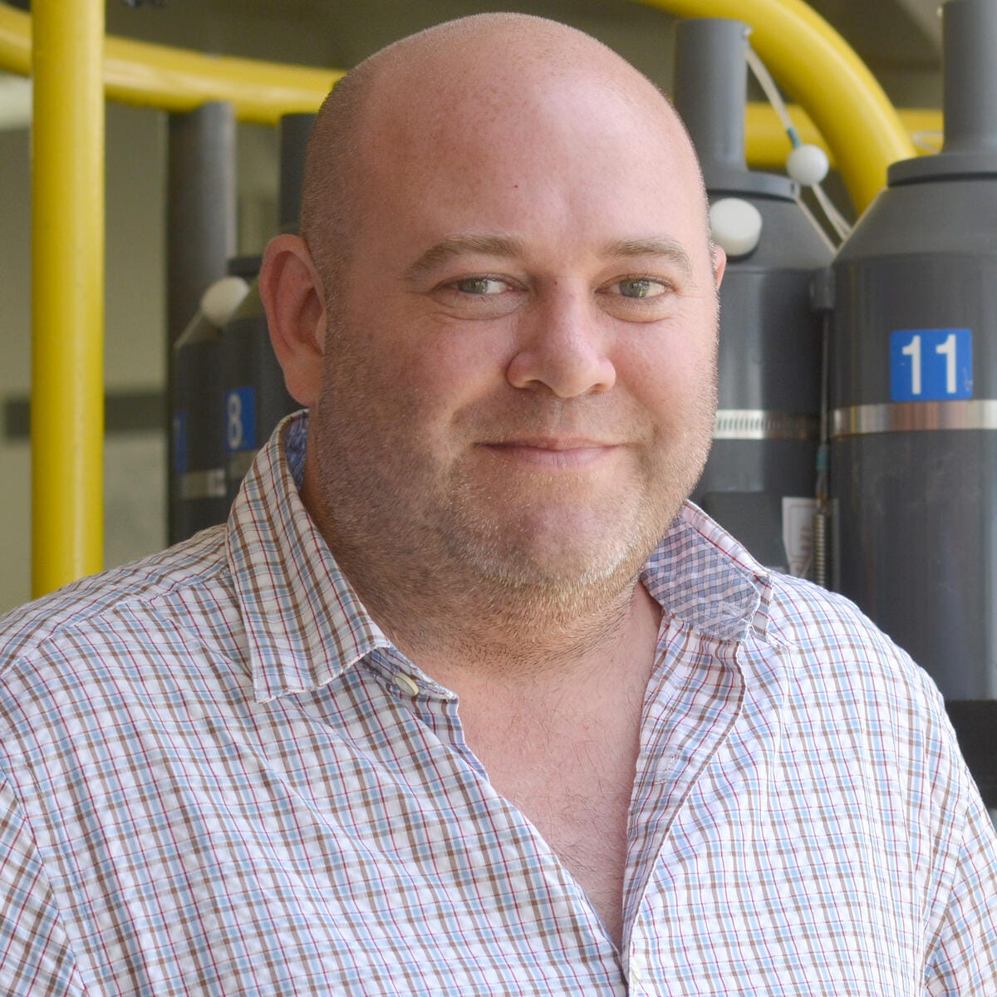

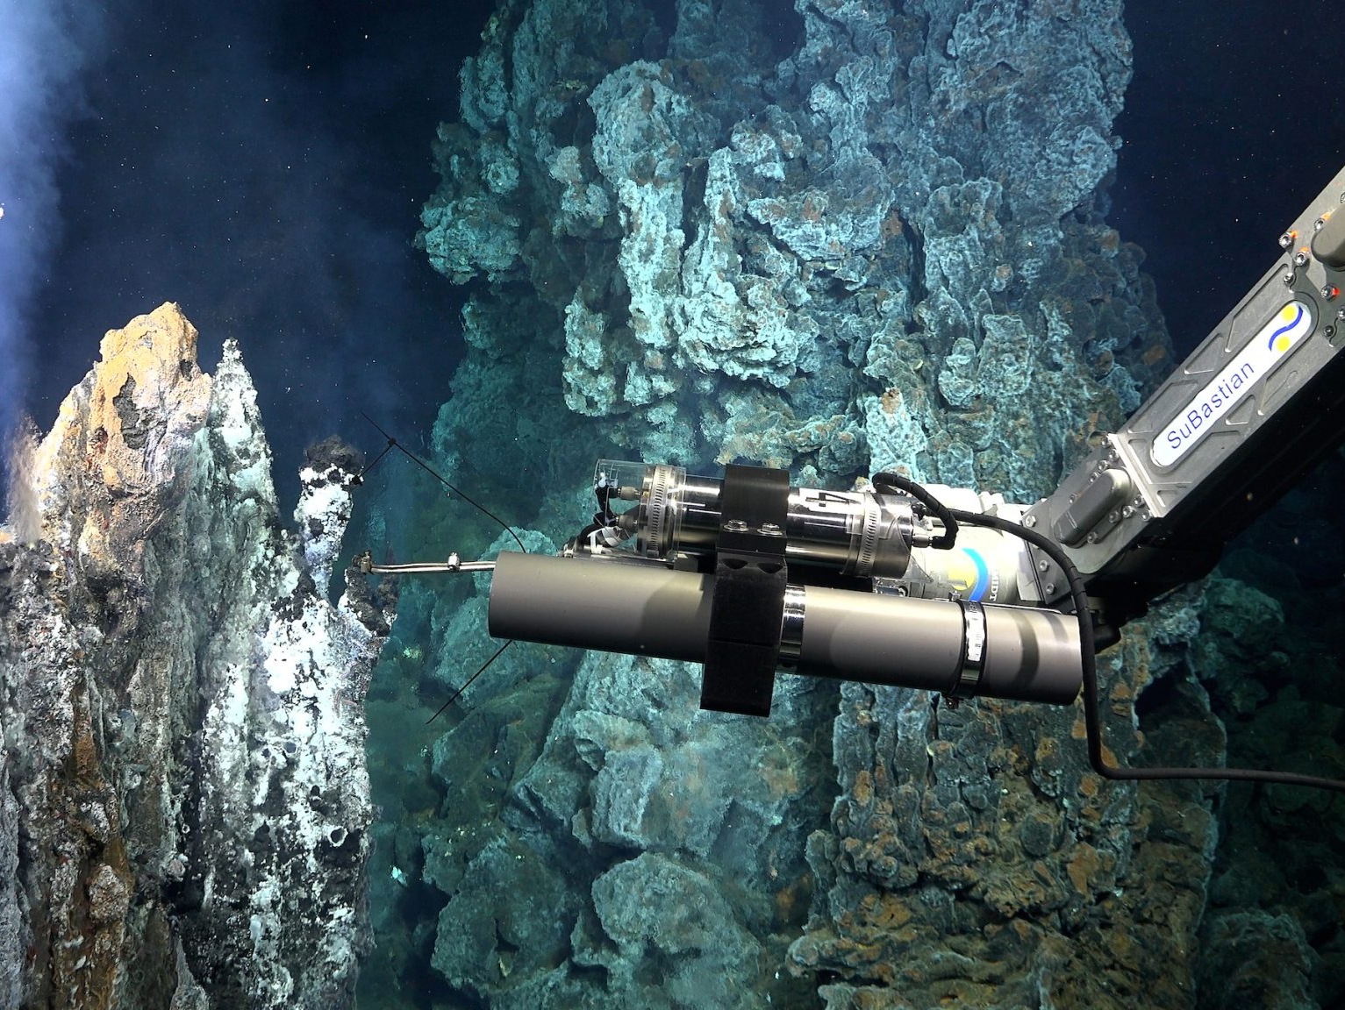
Endeavour Nitrogen Cycling Under Pressure
Explore nitrogen processes across different redox gradients
¹⁵N tracer experiments to measure N transformations and assimilation
Measure rates under in situ and atmospheric pressures
Jill McDermott
Sheryl Murdock
Damian Grundle
Elizabeth Trembath-Reichert
Isobaric Gas Tight Samplers

Slide 9
Upcoming Cruises
Possible addition of Sentry to map tubeworm coverage
2025 September 5–22, R/V Atlantis w/Alvin, 13 days on site
Objectives:
  Map the energy landscape <50℃, colonized and uncolonized (pH, sulfide, oxygen, NO₃, NO₂, NH_{4,} major ions, trace elements, gases)
  ¹⁵N tracer incubations
  Atmos: Primary focus, N-loss vs. N-recycling processes
  In situ: Limited, NH₄ production and oxidation
  Link with genomics and N assimilation (nanoSIMS)
2 berths for DFO MPA work (Cherisse Du Preez +1)
Include Middle Valley for sediment N work?
Clague et al 2020

Slide 10
Upcoming Cruises
Possible use of Sentry to map tubeworm coverage
2026 (dates TBD), ROV Jason requested, 18 days on site
Objectives:
  ¹⁵N tracer incubations
  Atmos: Limited
  In situ: Primary focus, measure all pathways of N transformation and assimilation
Pair incubations with gene expression (transcriptomics) profiles -> who is doing what?
Clague et al 2020

Slide 11
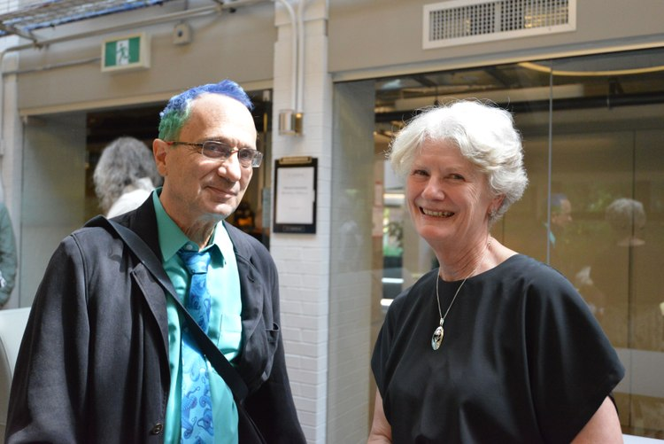
Upcoming Cruises
Possible use of Sentry to map tubeworm coverage
A few berths available…
sheryl.murdock@asu.edu
Thank you
Clague et al 2020

