Slide 1
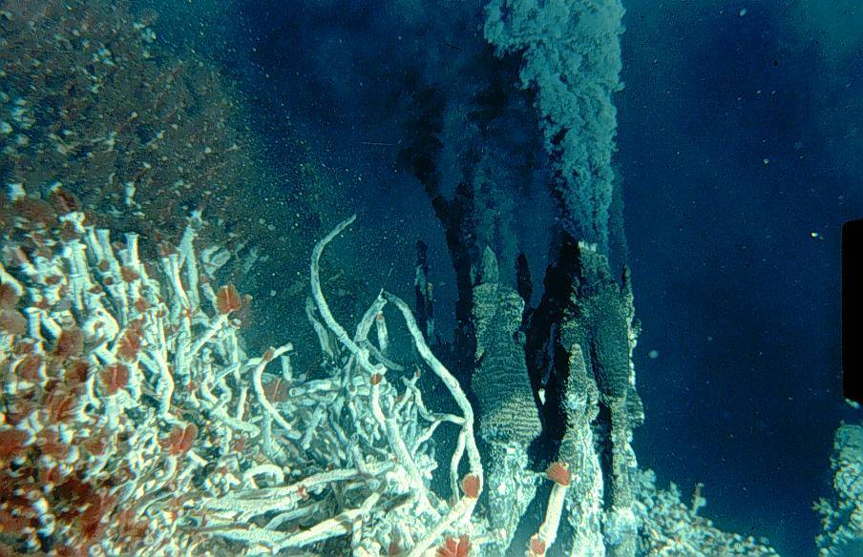
Chemosynthetically-driven Ecosystems:
Hydrothermal vent macrofauna
Amanda Bates (she/her)
Professor and Impact Chair
Ocean Ecosystem Change and Conservation
Department of Biology
University of Victoria, Canada
Photo Credit: V. Tunnicliffe
I acknowledge and respect the Lək̓ʷəŋən (Songhees and Esquimalt) Peoples on whose territory the university stands, and the Lək̓ʷəŋən and W̱SÁNEĆ Peoples whose historical relationships with the land continue to this day.
Notes:
Thank-you, I was delighted to be invited to share my research with to share highlights from my research on marine invertebrates from the intertidal to the deep-sea.

Slide 2
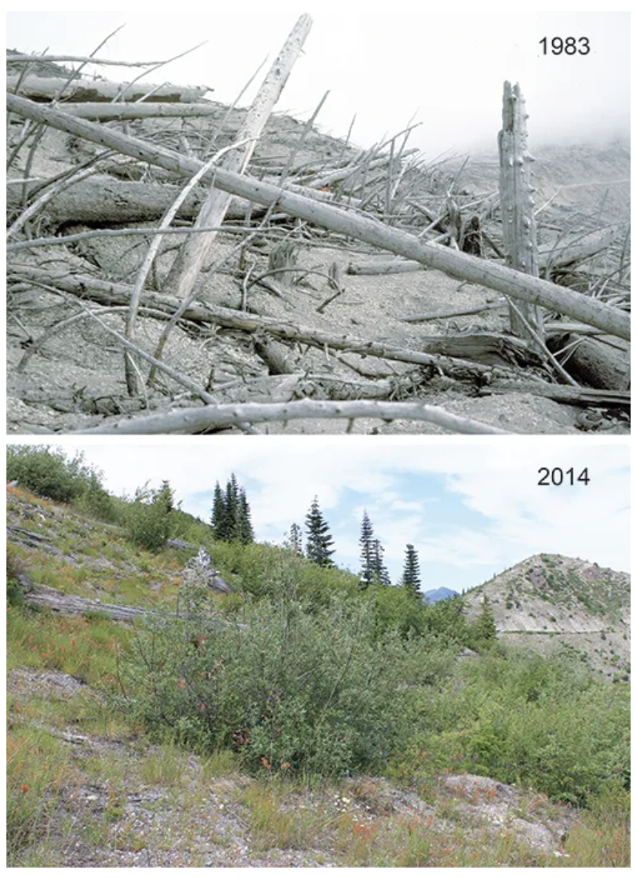
Long-term research on the biophysical responses at MSH has provided important new insights, challenged long-standing ideas, and provided many societal benefits.
“Develop an international volcano ecology and hydrology network—either informally or formally through scientific societies—to connect ecologists, hydrologists, and geomorphologists; facilitate information sharing; and identify key issues that arise in post-eruption landscapes.”
https://eos.org/features/lessons-from-a-post-eruption-landscape

Slide 3
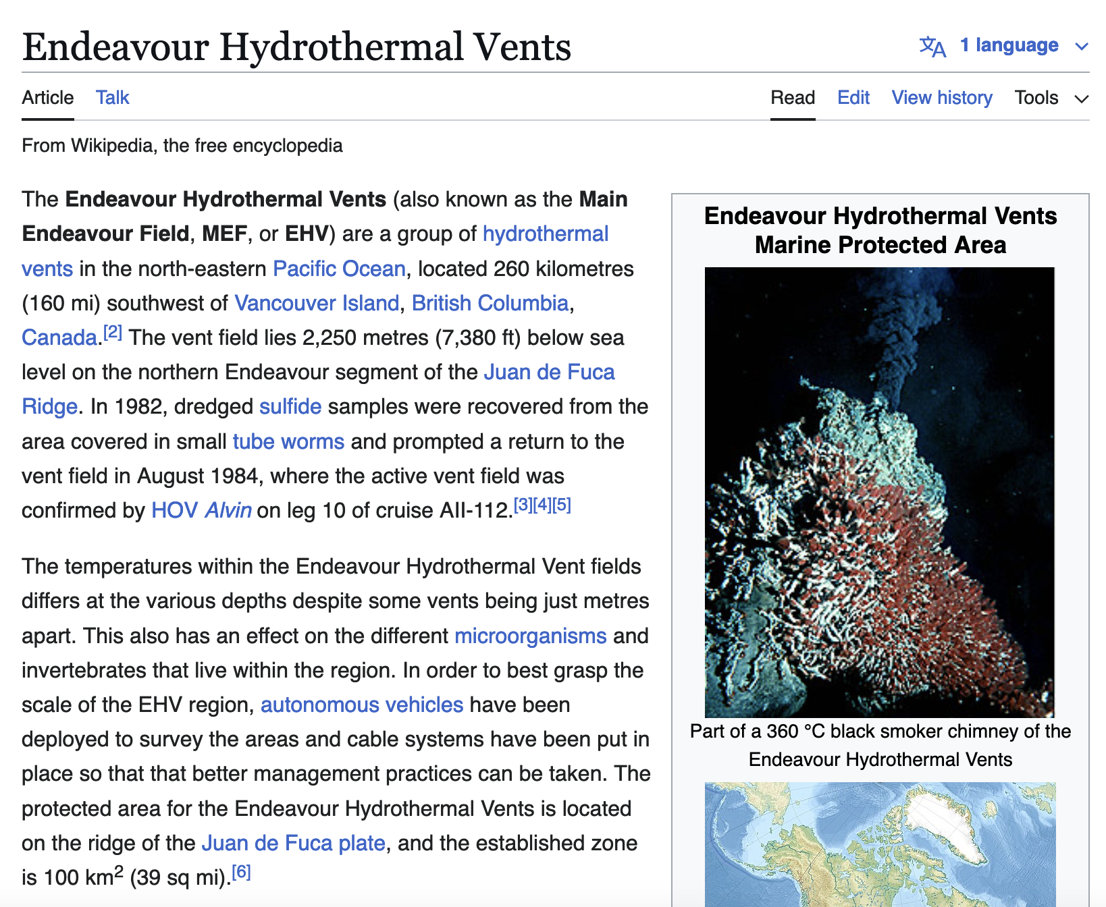

Slide 4
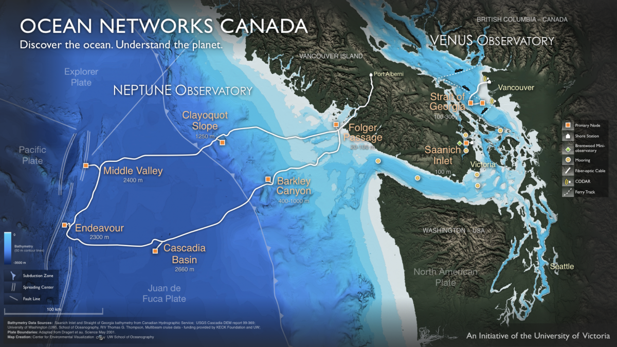
Vent movie clip
Notes:
When we get to the sea floor, this is what we see. This is by far my favorite vent shot. In the backgound are a series of chimney spires spewing out hot vent fluid. In the foreground is the JdFR tube worm species called Ridgeia piscesae. I’ll talk about the anatomy of this species in a few minutes, but obvious features that you can see here are the white tubes that the animal live in (made of chitin) and the bright red plume on the top. This plume are the ‘gills’ of the worm, and the red colour comes from it’s hemoglobin.
Notice that no animals are living on the chimney sides – likely because it’s too hot

Slide 5
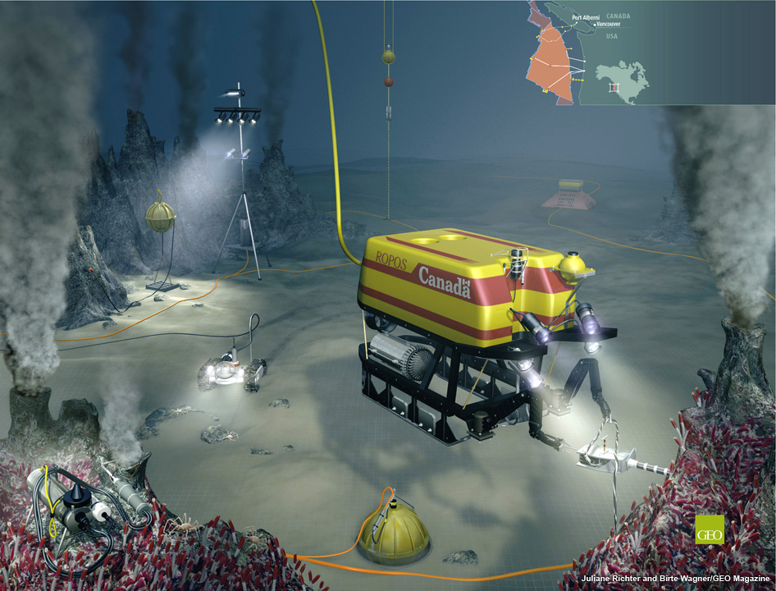

Slide 6
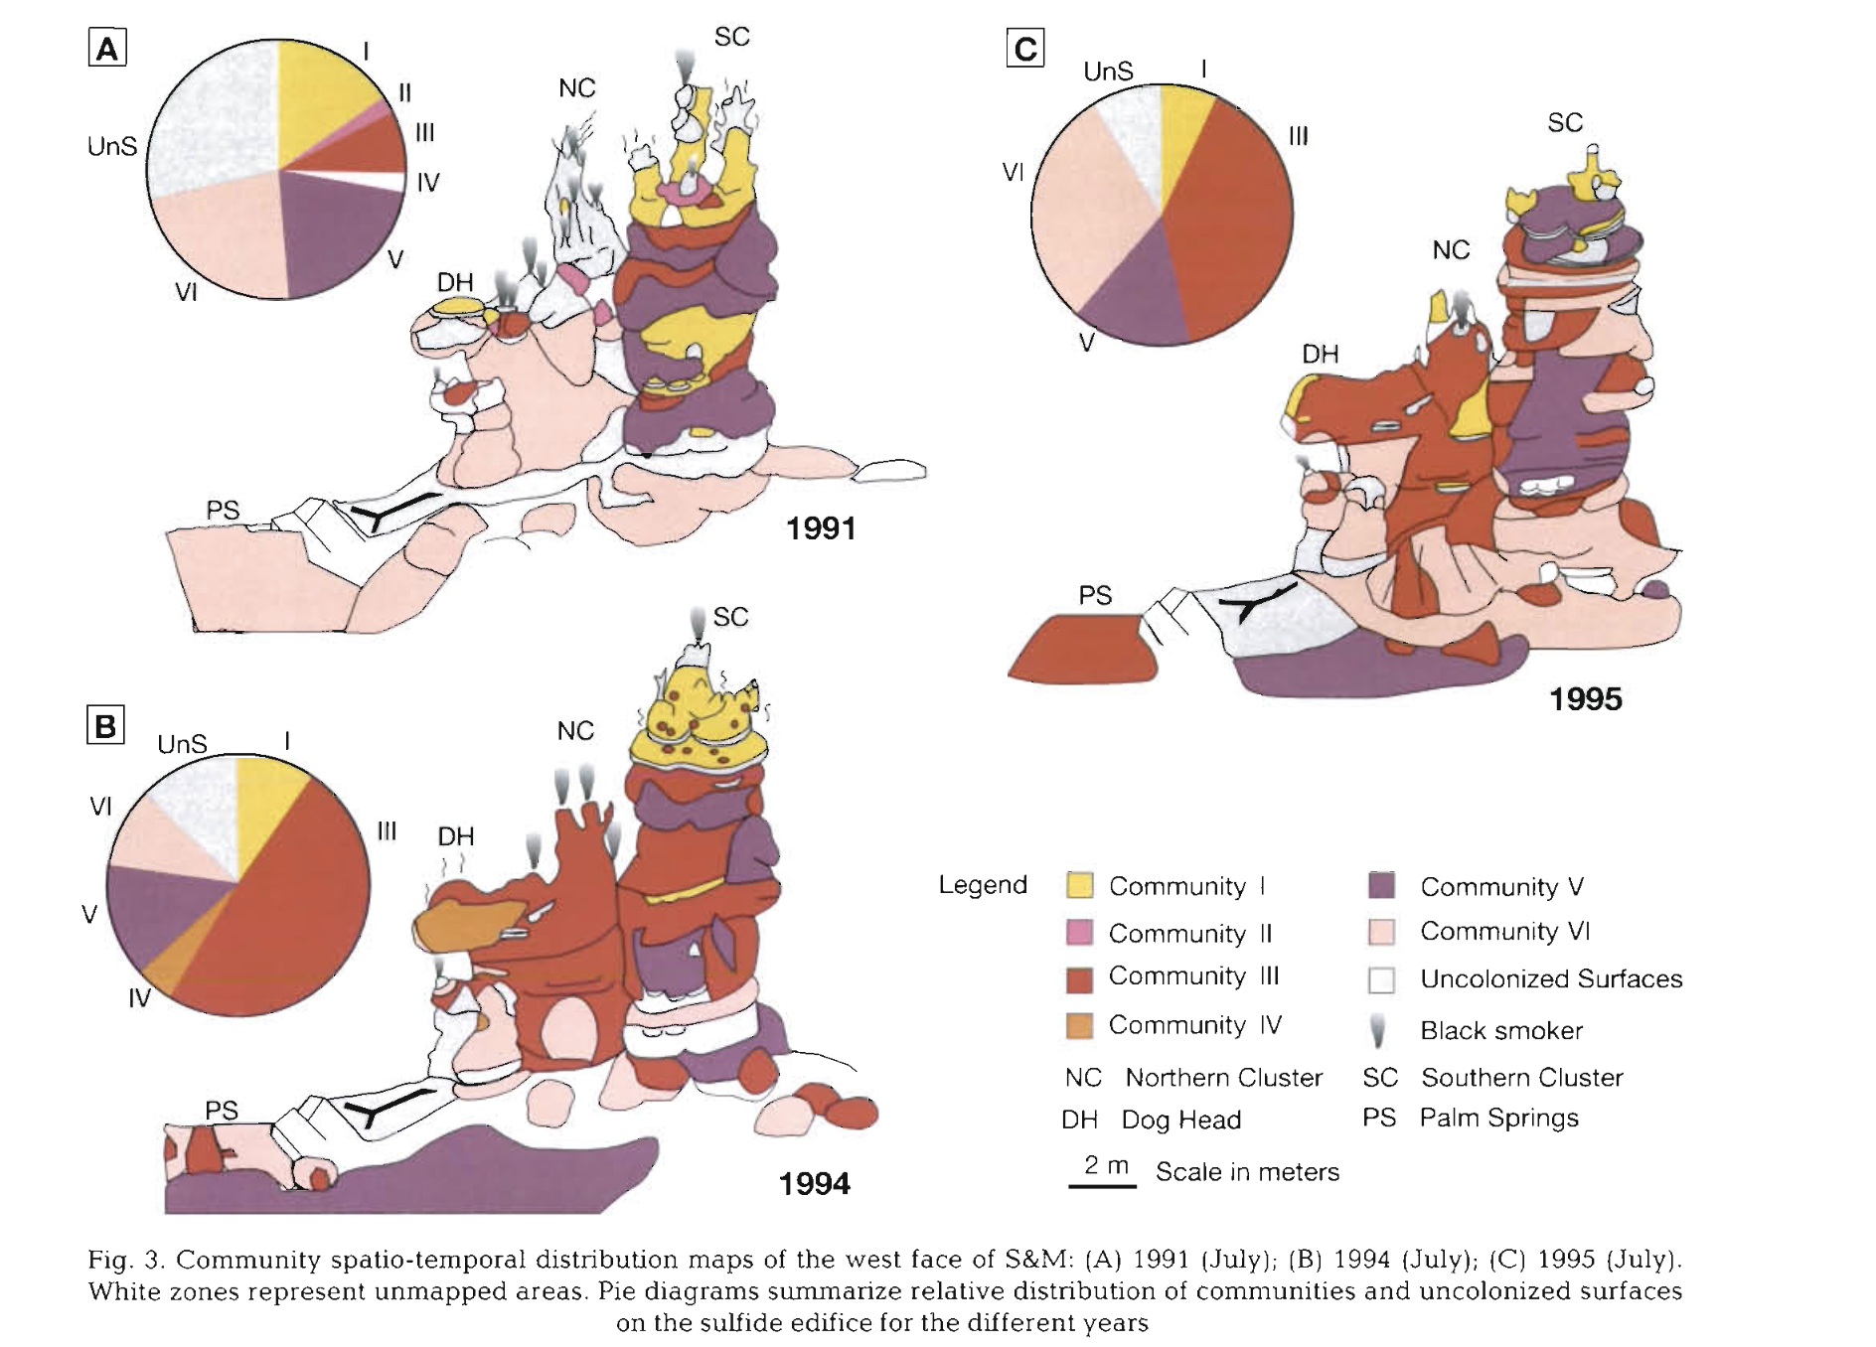

Slide 7
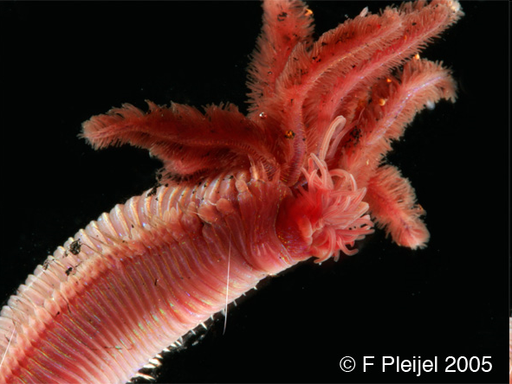
Community I
Phylum Annelida
Polychaeta
Paralvinella sulfincola

Slide 8
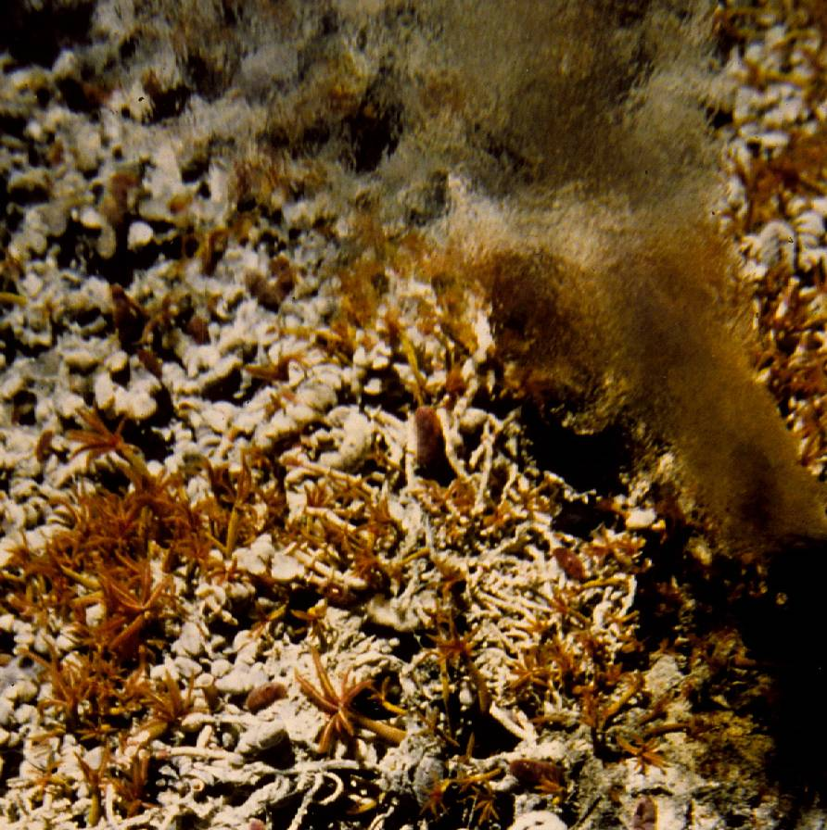
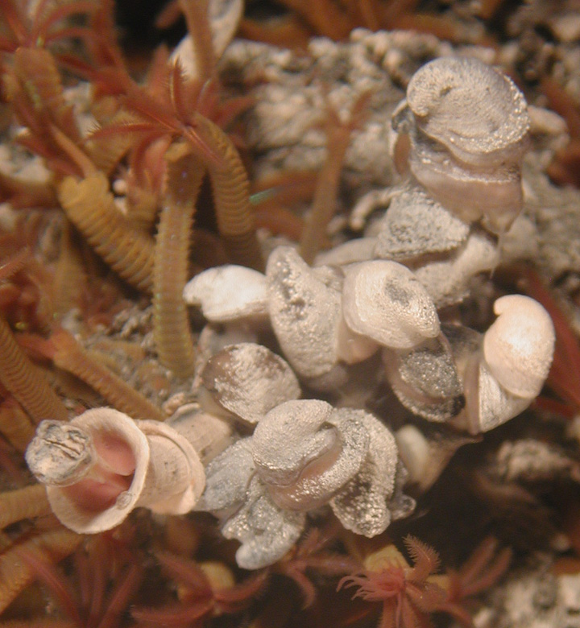
Community III
Paralvinella palmiformis & numerically dominant gastropods
Lepetodrilus fucensis
5 cm

Slide 9
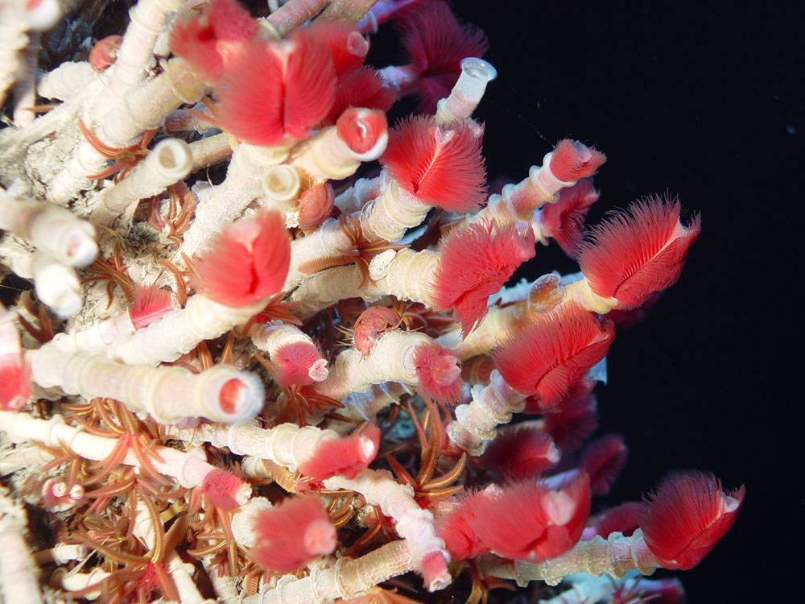
Phylum Annelida
Polychaeta
Ridgeia piscesae

Slide 10
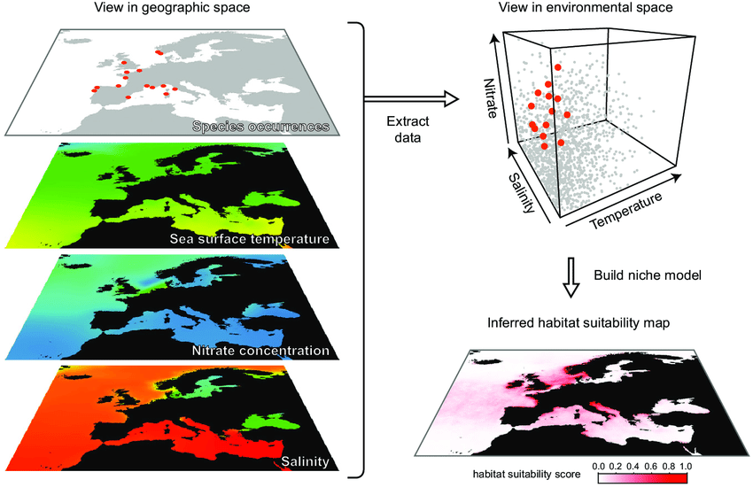
Elith and Leathwick (2009)

Slide 11
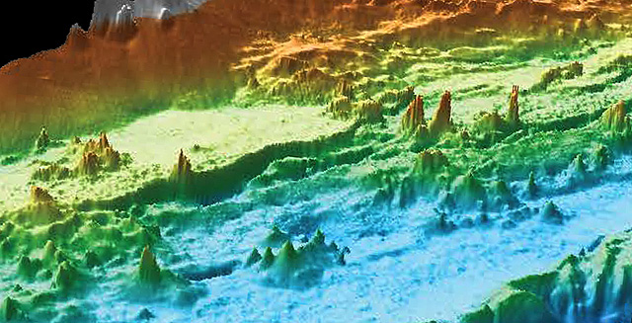
MBARI Research Institute - https://www.mbari.org/endeavor-hydrothermal-chimneys/
Scale (ecology)
Mapping (technology)
Links between heat, chemistry, microbes and fauna

Slide 12
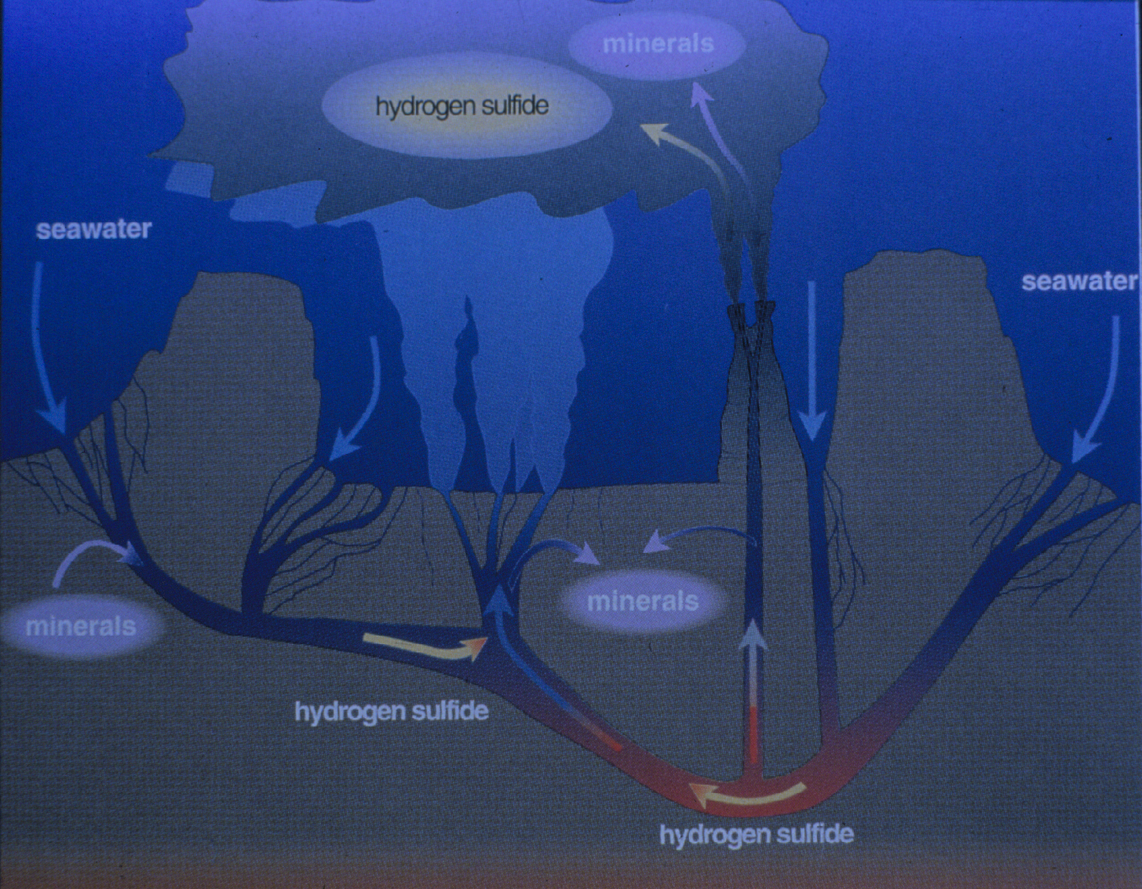
What happens during a perturbation?
Links between heat, chemistry, microbes and fauna
Image Credit: V. Tunnicliffe

Slide 13
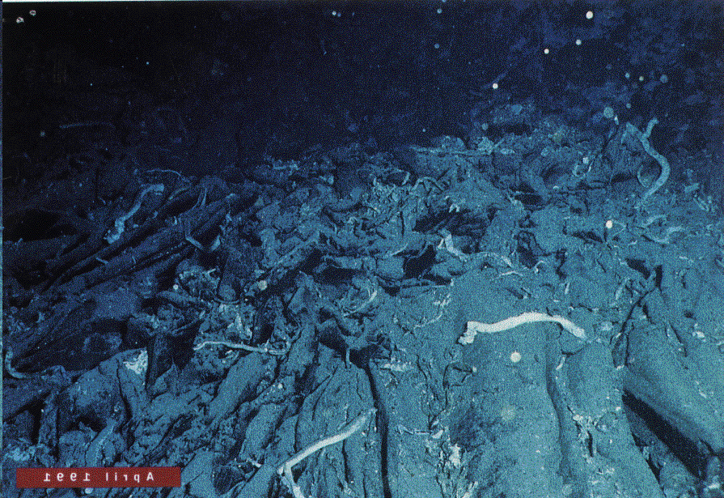
Tubeworm Barbeque
East Pacific Rise
© WHOI

Slide 14
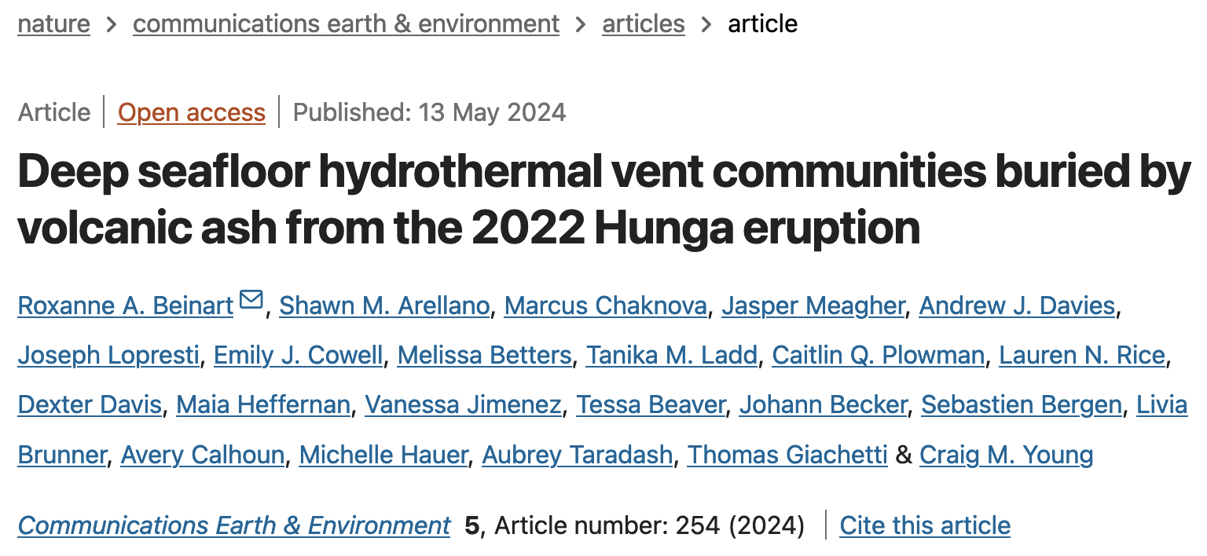

Slide 15
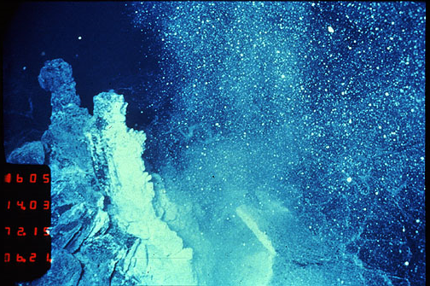
2. Succession patterns

Slide 16
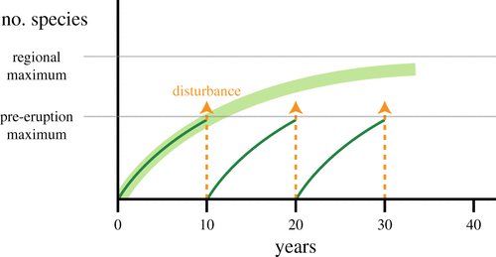
Figure 1. Conceptual framework for community recovery in frequently disturbed deep-sea hydrothermal vent systems. Increase in number of species following frequent disturbance events (thin curves), does not reach potential species number in a community subject to less frequent disturbance (thick curve).

Slide 17
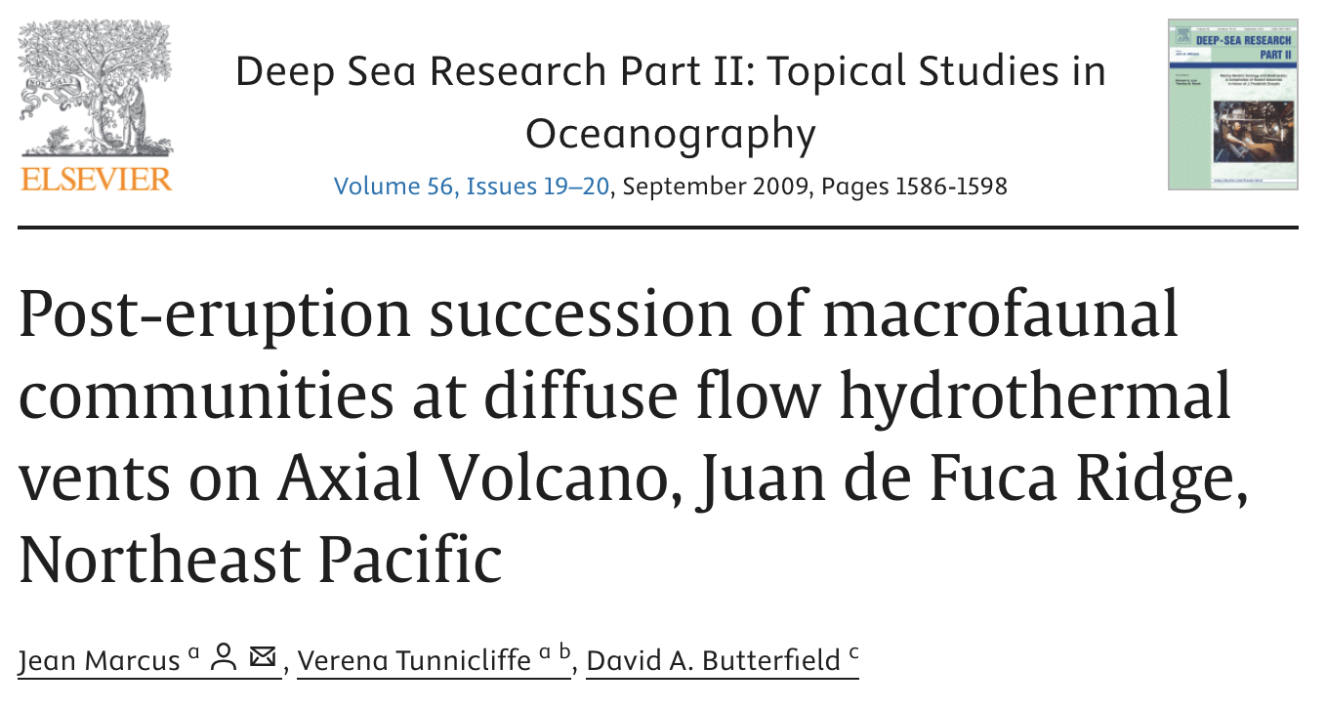

Slide 18
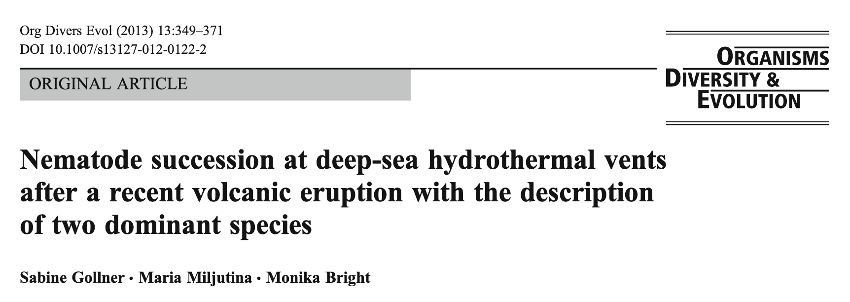

Slide 19
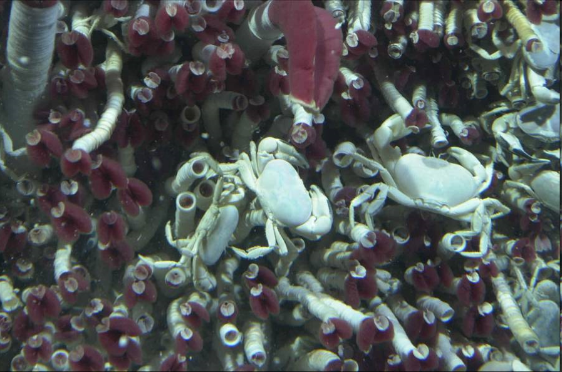
3. Testing Predictions of Resilience
Functional Traits of Species:
Predicts Sensitivity for Vulnerability Frameworks

Slide 20
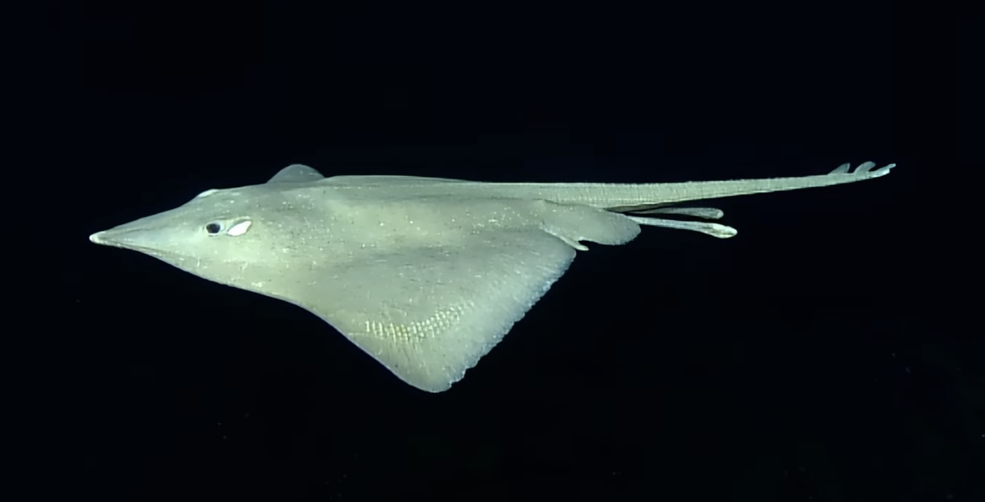
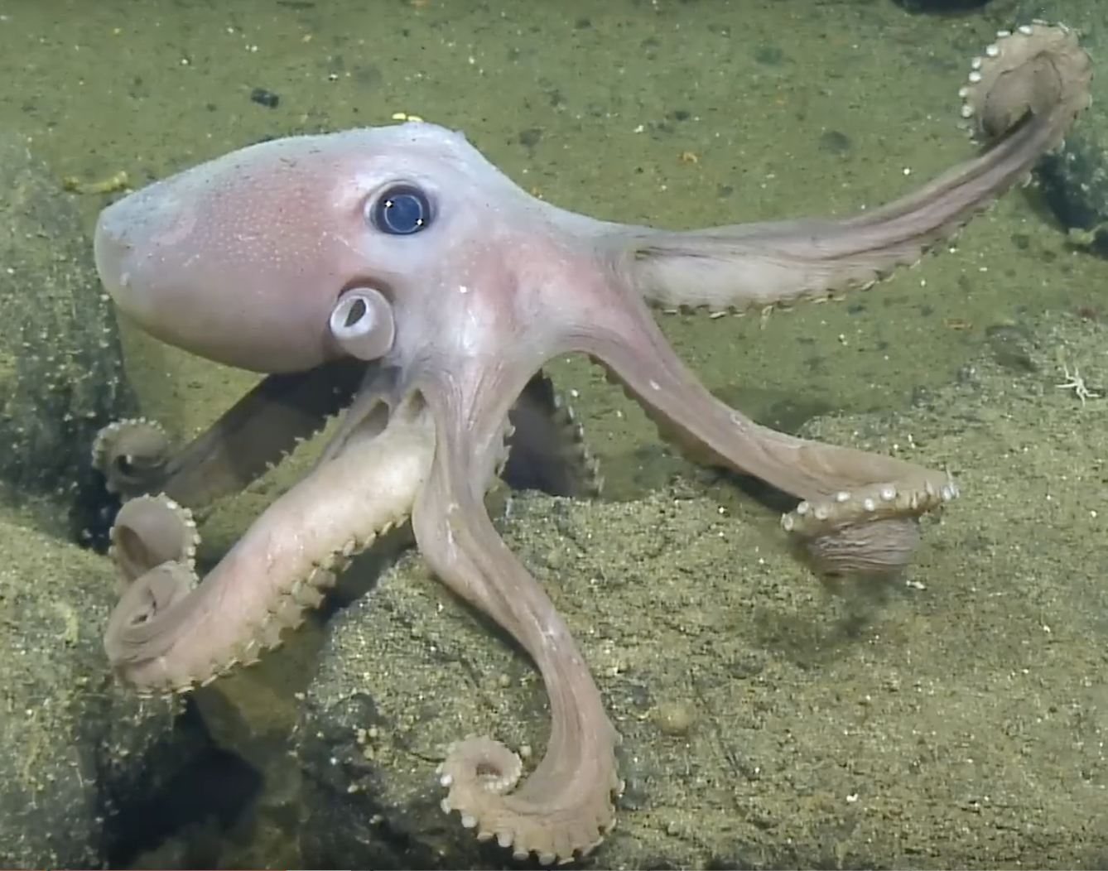
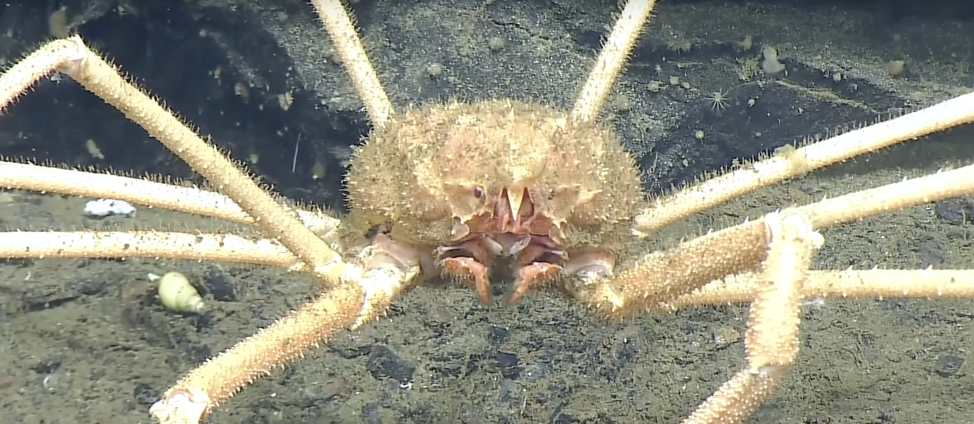
#ONCabyss NA161 expedition funded by Ocean Networks Canada
NA151 expedition to the waters of British Columbia, Ocean Exploration Trust is supporting ONC’s installation and maintenance of scientific sensors which help teams worldwide learn about this unique site and others along their NEPTUNE Observatory.

Slide 21
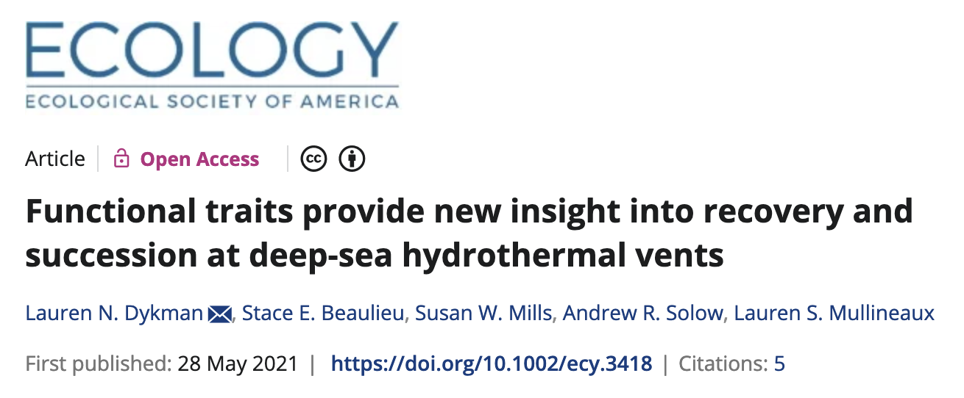

Slide 22
4. Connectivity

Slide 23
Because larval supply and colonization were being monitored
at the EPR ISS prior to the 2005–2006 eruptions, the most recent
eruptions provided a natural experiment to investigate the
role of larval supply in recolonization of the site.
The eruption seems to have removed the local sources of the previously dominant gastropods, enabling colonization by pioneer larvae.
https://cedar.wwu.edu/cgi/viewcontent.cgi?article=1013&context=shannonpoint_facpubs

Slide 24
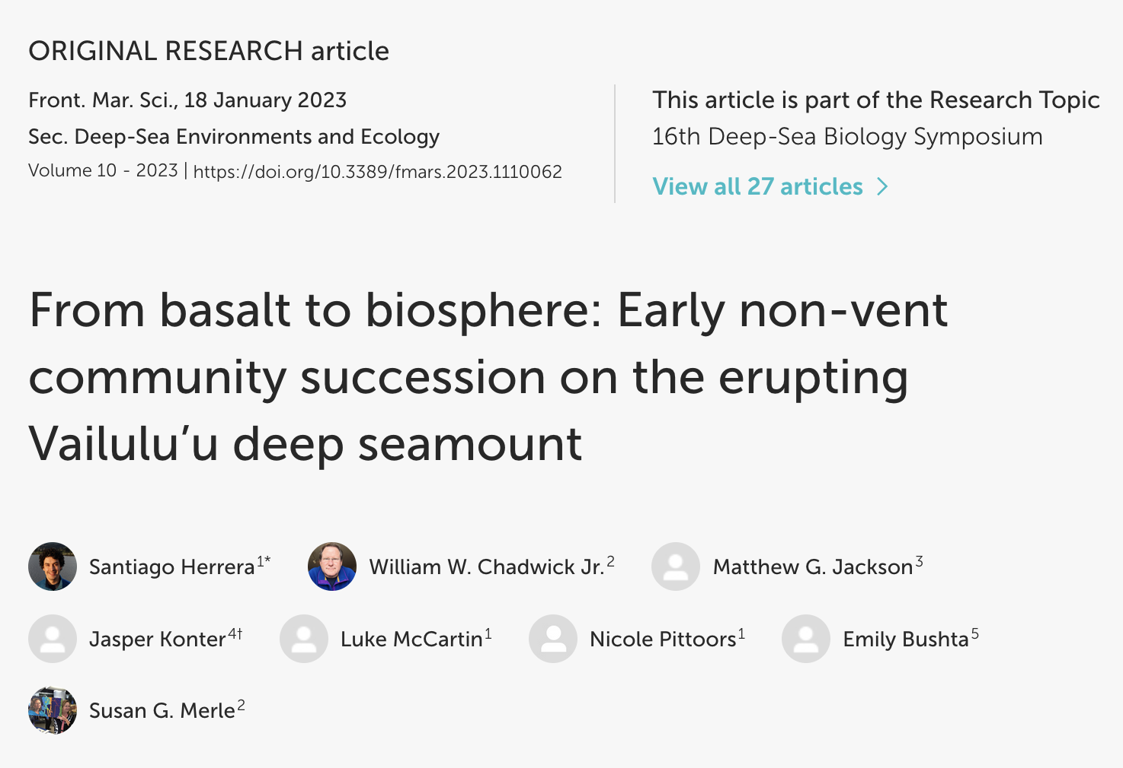
Notes:
Volcanic eruptions provide rare opportunities to witness the biological recolonization of areas covered by new lava flows by effectively resetting the ecological succession clock to zero. The role of submarine volcanic eruptions as disturbance events and the resulting patterns of ecological succession have mainly been studied in hydrothermal vent ecosystems. However, the effects of submarine volcanic eruptions as disturbance forces have rarely been studied in non-vent ecosystems, particularly on seamounts. Here, we document the early stages of ecological succession of non-vent benthic communities inhabiting the summit caldera of the active Vailulu’u submarine volcano in American Samoa. Sitting above the Samoan volcanic hotspot, Vailulu’u is the youngest volcano of the Samoan chain. Repeated mapping of Vailulu’u in 1999, 2005, 2006, 2012, and 2017 revealed the progressive growth of a new cone named Nafanua. In 18 years, the cone grew >300 meters in height from a starting depth of ~1000 meters below sea level (mbsl). The differential analyses of this time-series bathymetry dataset enabled the assignment of maximum age ranges to different portions of the new cone. High-definition ROV imagery collected in 2017 revealed patterns of community structuring consistent with ecological succession: newly erupted seafloor contained a subset of the benthic species found on older seafloor. Furthermore, individual animal sizes in the younger seafloor zones were smaller than in the older zones. This unusual interdisciplinary combination of geological and biological observations provides constraints on which deep-sea animals recolonize new seafloor after a major disturbance event and how quickly. This knowledge could be applied to identify signs and states of recovery from anthropogenic disturbances by a deep seamount ecosystem.

Slide 25
advanced fundamental understanding of how individual species and biological communities respond to large, intense disturbances
https://eos.org/features/lessons-from-a-post-eruption-landscape

Slide 26
advanced fundamental understanding of how individual species and biological communities respond to large, intense disturbances
keystone species were exceptionally important in recovery process
https://eos.org/features/lessons-from-a-post-eruption-landscape

Slide 27
advanced fundamental understanding of how individual species and biological communities respond to large, intense disturbances
keystone species were exceptionally important in recovery process
importance of biological legacies in promoting recovery
https://eos.org/features/lessons-from-a-post-eruption-landscape

Slide 28
advanced fundamental understanding of how individual species and biological communities respond to large, intense disturbances
keystone species were exceptionally important in recovery process
importance of biological legacies in promoting recovery
geomorphic and ecologic responses at MSH evolved jointly and interacted in important ways
https://eos.org/features/lessons-from-a-post-eruption-landscape

Slide 29
5. Scientific returns
Review of the literature to guide/prioritize directions
Compile information available for Endeavour and surrounding area matched with scale
Imaging versus collecting
Connections (biogeophysical & biogeochemical)
Seascape
……

