Slide 1
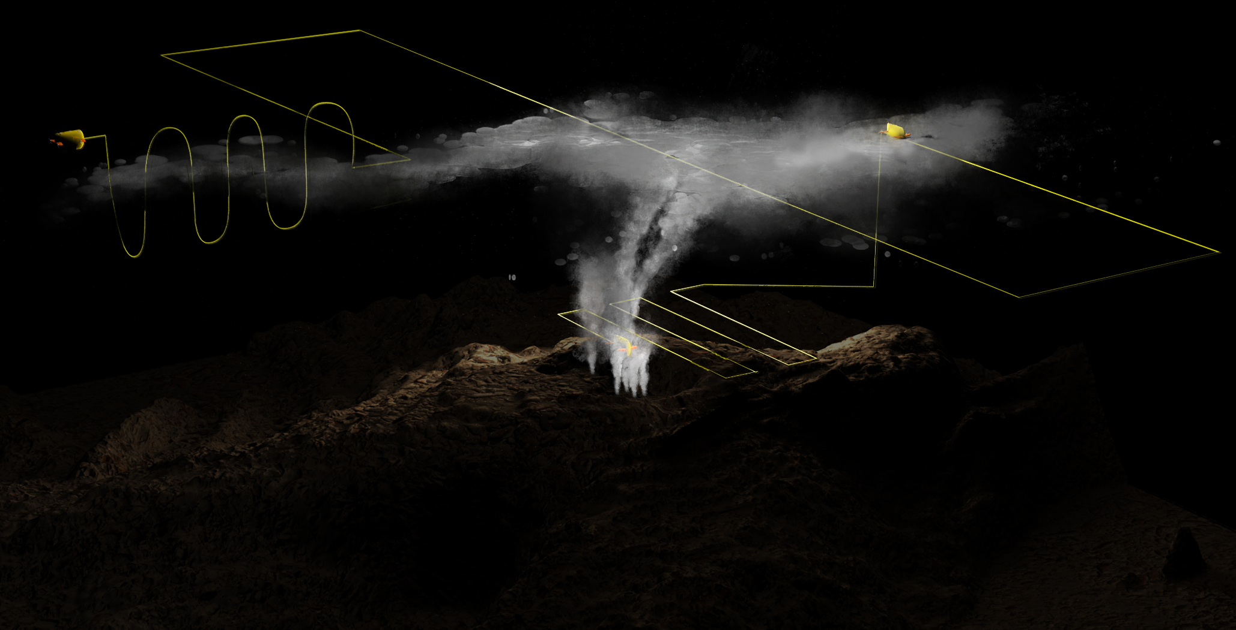

Hydrothermal Plume Dispersion at Endeavour Segment: Modeling and Observations from Expedition AT50-15 (Aug 24th-Sept 17th, 2023)
Guangyu Xu¹, Chris German², Victoria Preston³, Andrew Branch⁴, Mary Burkitt-Gray², Rudi Lien⁵
¹APL-UW, ²WHOI, ³Olin College, ⁴JPL-NASA, ⁵University of Oregon
Illustration by Natalie Renier (WHOI)

Slide 2
Hydrothermal Estuaries: What sets the flux of hydrothermal Fe & Mn to the Deep Ocean Interior?
CTD Yo-Yos at MEF and High Rise:
  plume heights
  Survey depth
Numerical modeling:
  plume dispersion forecasts
AUV Sentry:
  plume surveys, in-situ sampling
Collection of water samples
  Standard shipboard CTD
  Specialized trace-metal CTD.
ONC mooring data:
  model validation
  real-time near-field dispersion directions
Spatial Scale:
< 100 km
Hydrothermal Estuary
Illustration by Natalie Renier (WHOI)

Slide 3
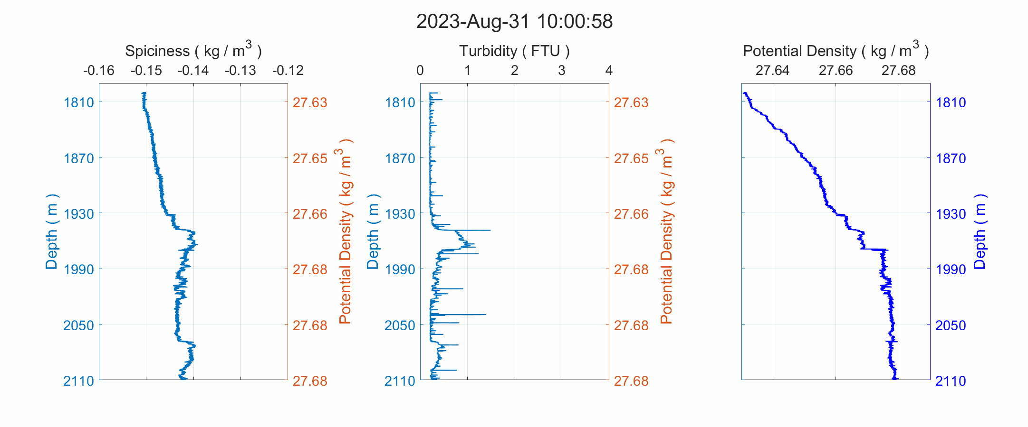
Plume Height Observations from CTD YoYo Cast at High Rise
Duration: ~ 13 hours; Start Time: 10 AM UTC on Aug 31st, 2023; Source Depth: 2176 m:
Max Height:
> 300 m
Neutrally buoyant plume fluid is ‘spicier’ (warmer and saltier) than seawater

Slide 4
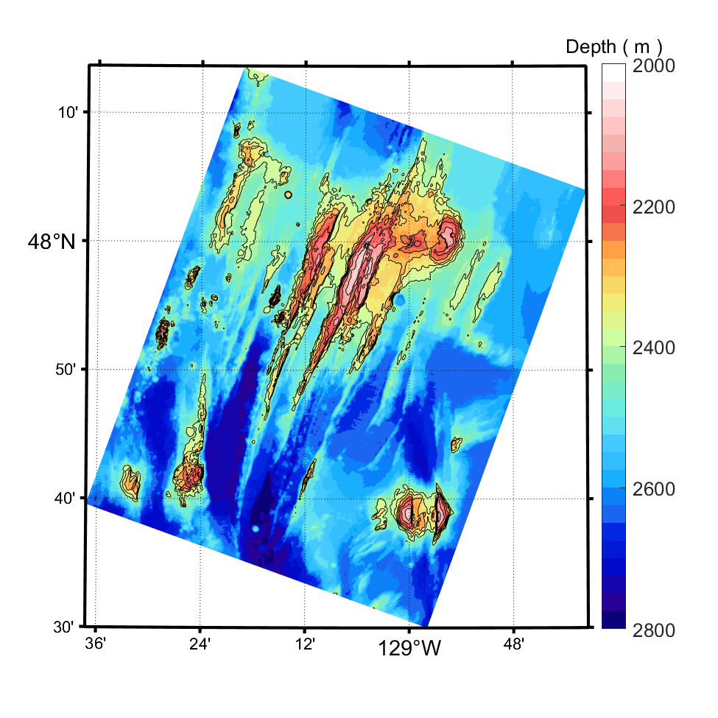
Numerical Modeling for Plume Dispersion Forecasts
Model: Regional Ocean Modeling System (ROMS).
Model forcing:
  Lateral boundaries:
    Non-Tidal: Global Ocean Physics Analysis and Forecast ( daily averages ) (https://doi.org/10.48670/moi-00016)
    Tidal: TPXO global tidal solution (Egbert and Erofeeva, 2002)
  Surface: ECMWF Forecasts
  Horizontal Resolutions: ~ 80 m
  Vertical Resolution: 64 layers, ~7 m near ridge crest
52 km
66 km

Slide 5
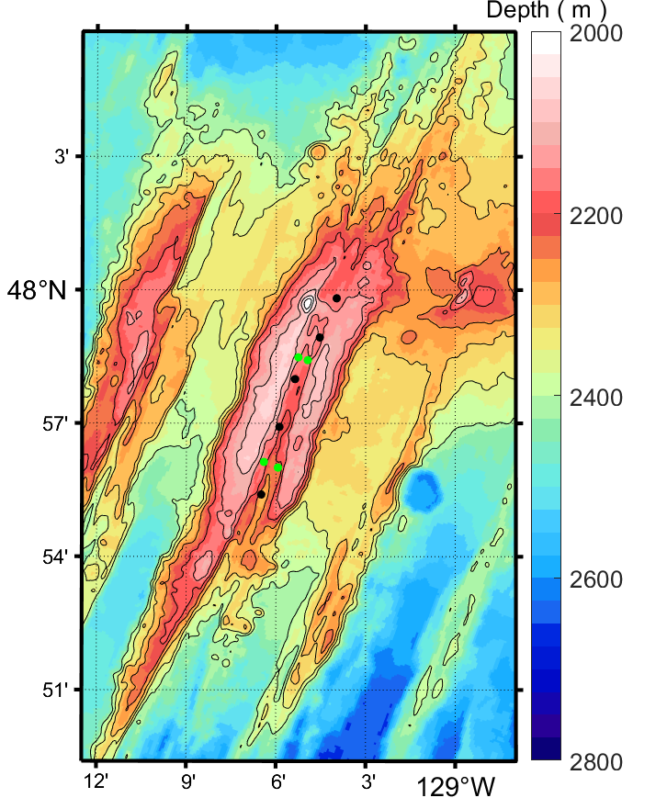
Modeling of Hydrothermal Venting
Bottom Heat Sources:
  Area: 3 by 3 cells, ~ 240 m by 240 m
  Heat transfer rate:
    135 MW ( Mothra ) ( Kellog 2011 )
    1500 MW ( MEF )
    1800 MW ( High Rise )
    68 MW ( Salty Dawg ) ( Kellog 2011 )
    4.5 MW ( Sasquatch ) ( Kellog 2011 )
  Heat transfers at MEF and High Rise determined from model-observation matching.
    Likely overestimated due to model’s limitations:
      Large, uniform plume source
      Hydrostatic approximation
ONC Moorings

Slide 6
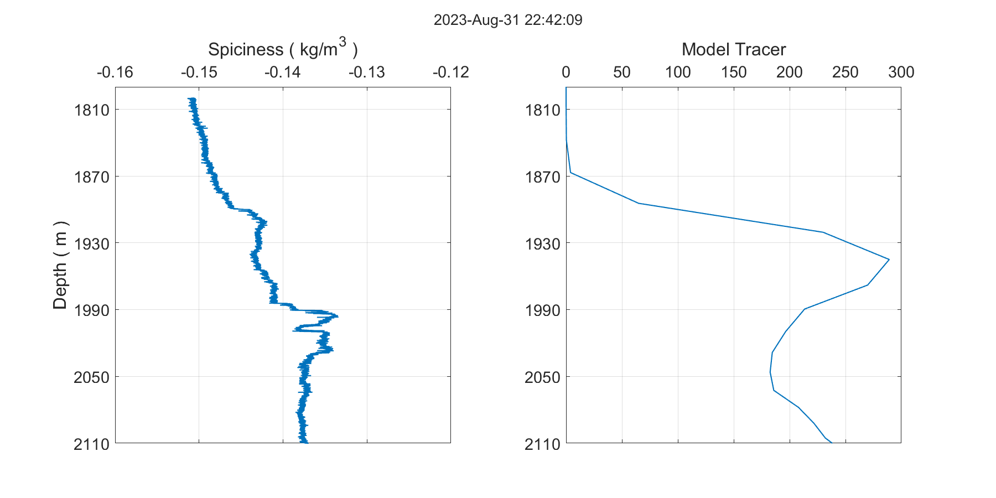
Plume Height at High Rise:
Model – Observation Comparison
Neutrally buoyant plume fluid is ‘spicier’ (warmer and saltier) than seawater

Slide 7
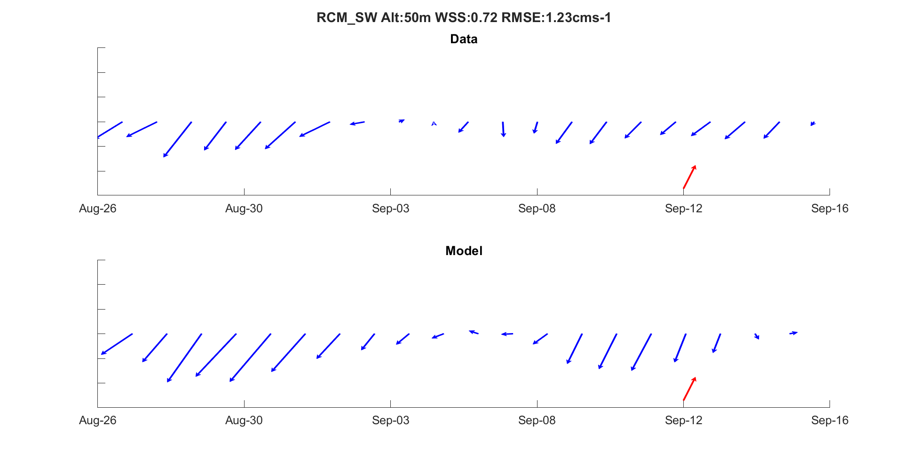
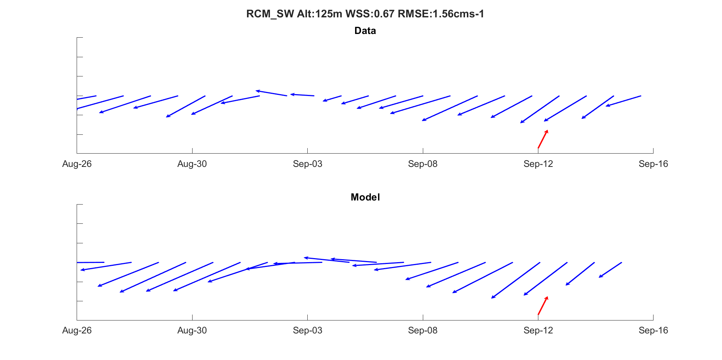
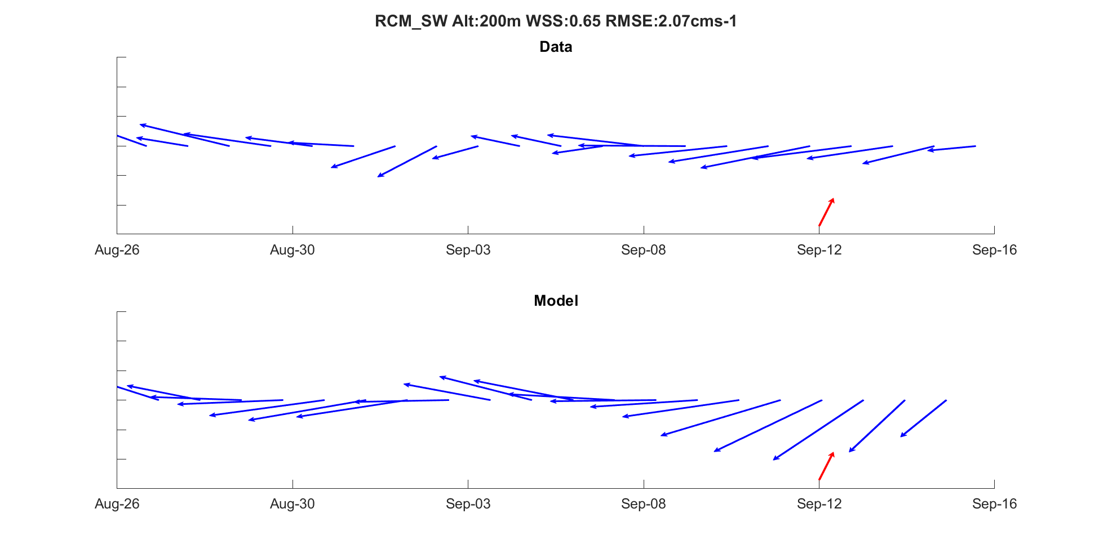
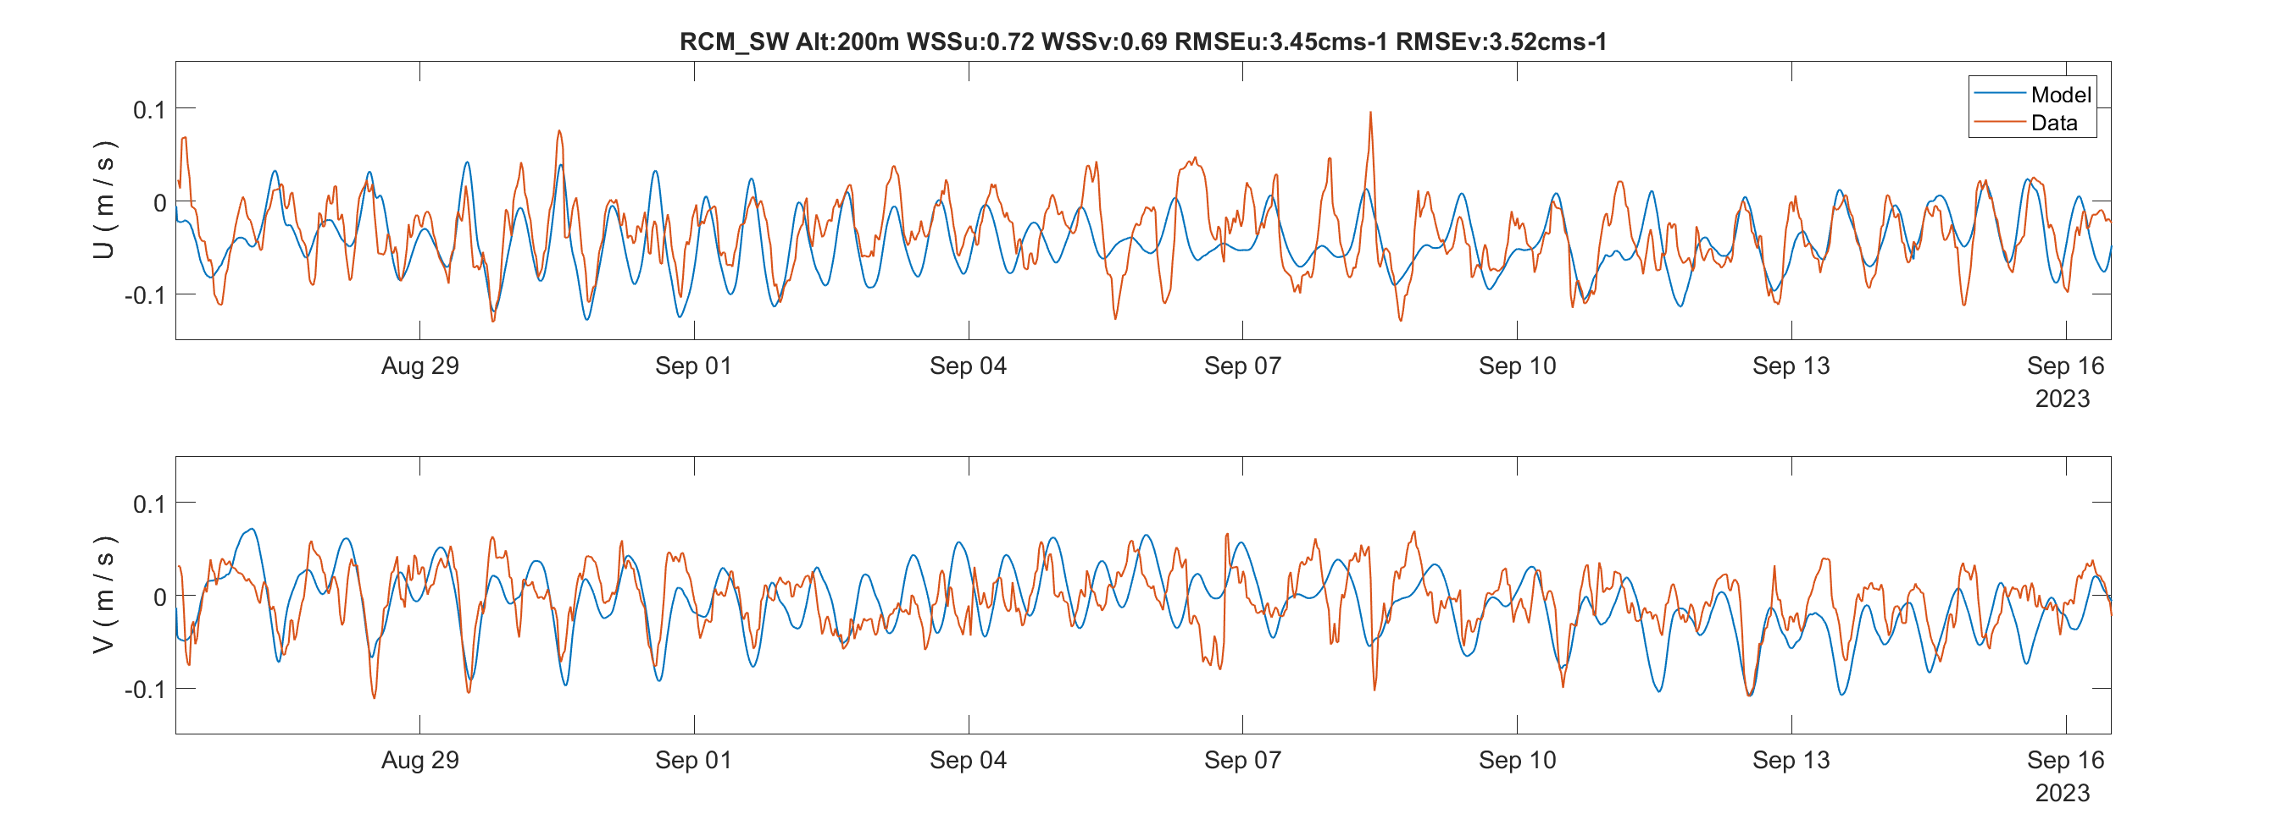
Flow Velocities at ONC RCM-SW:
Model – Observation Comparison
50 mab
Data
125 mab
Data
1.5 cm/s
1.5 cm/s
Model
Model
200 mab
Data
Eastward
200 mab
1.5 cm/s
Model
Northward
Model
Data

Slide 8
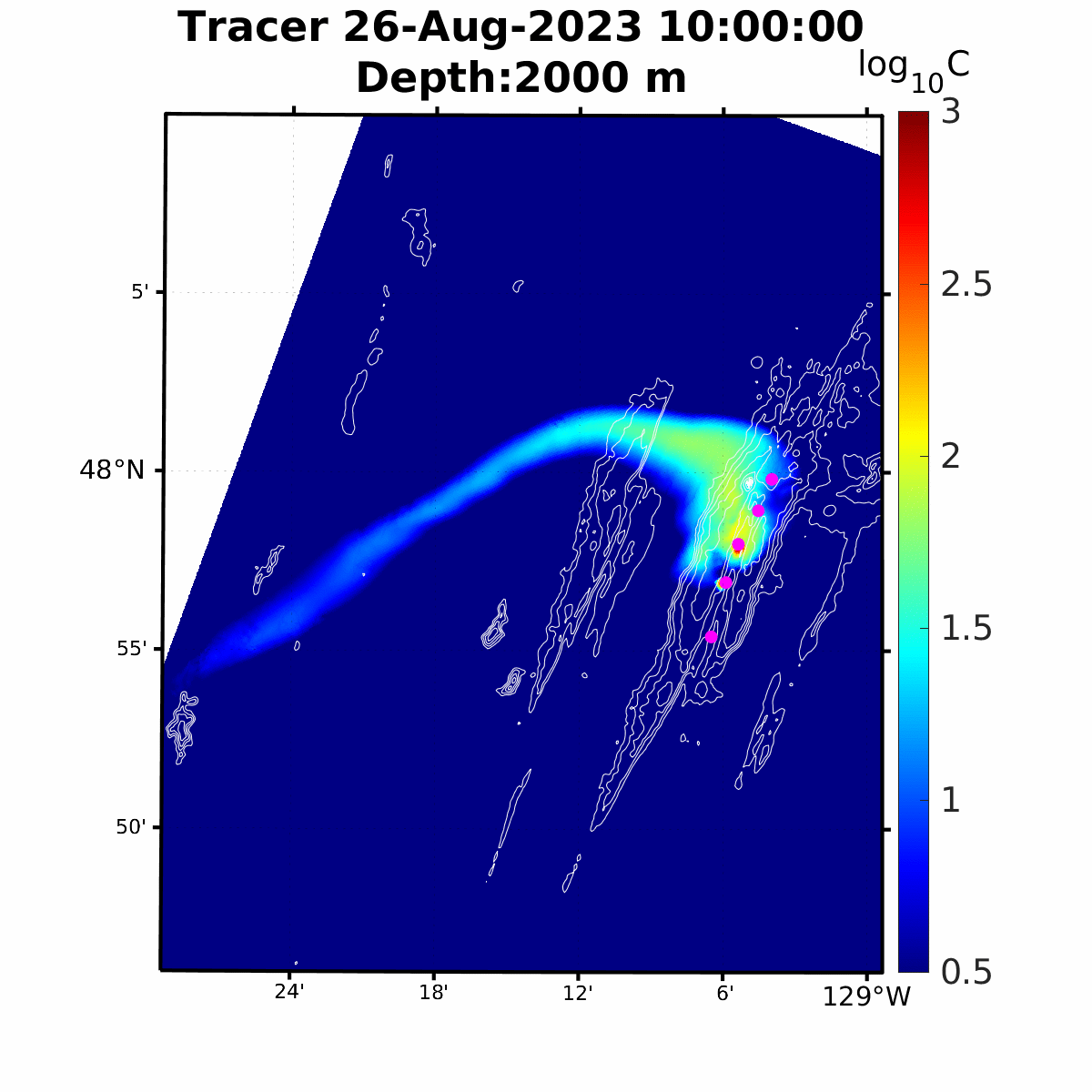
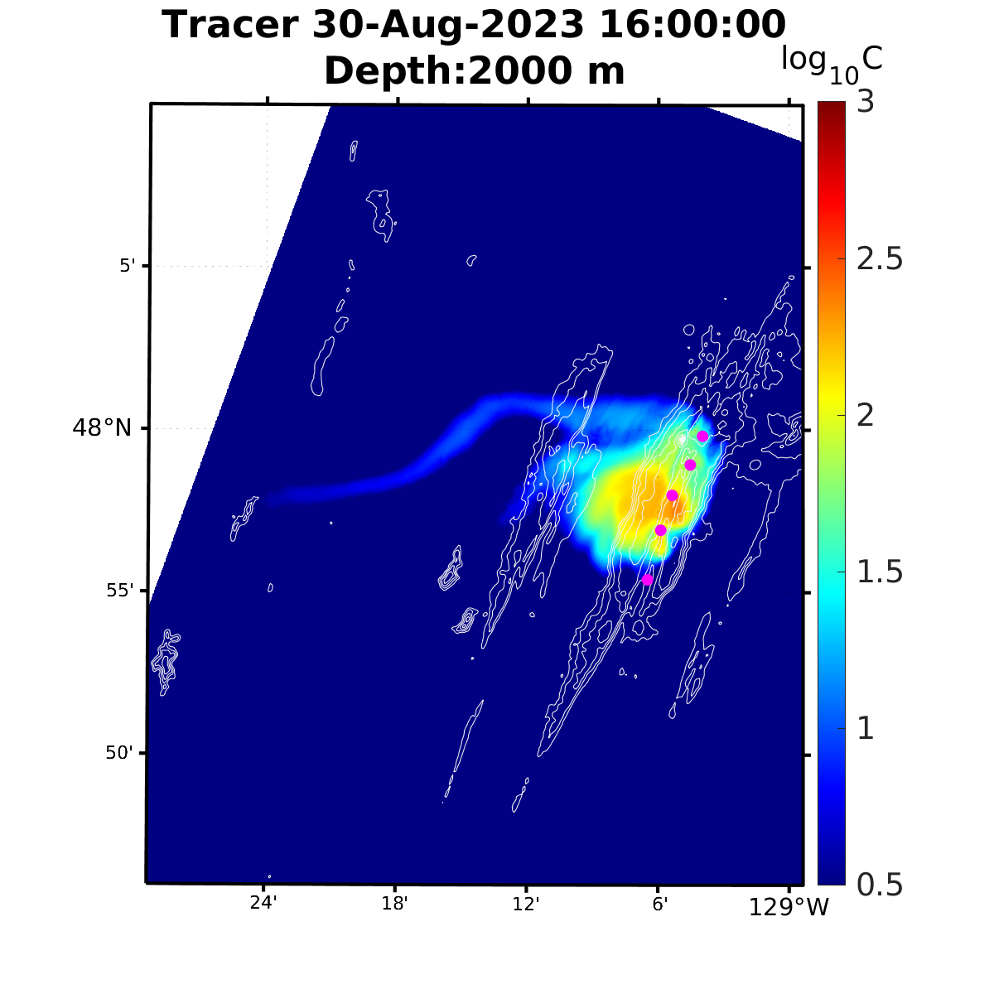
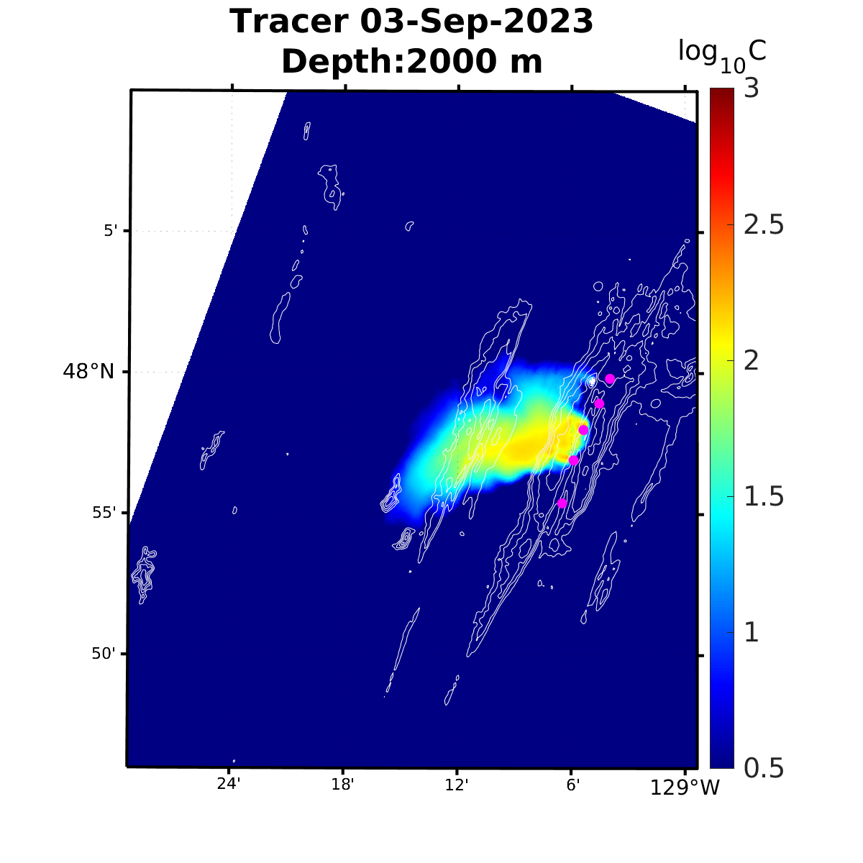
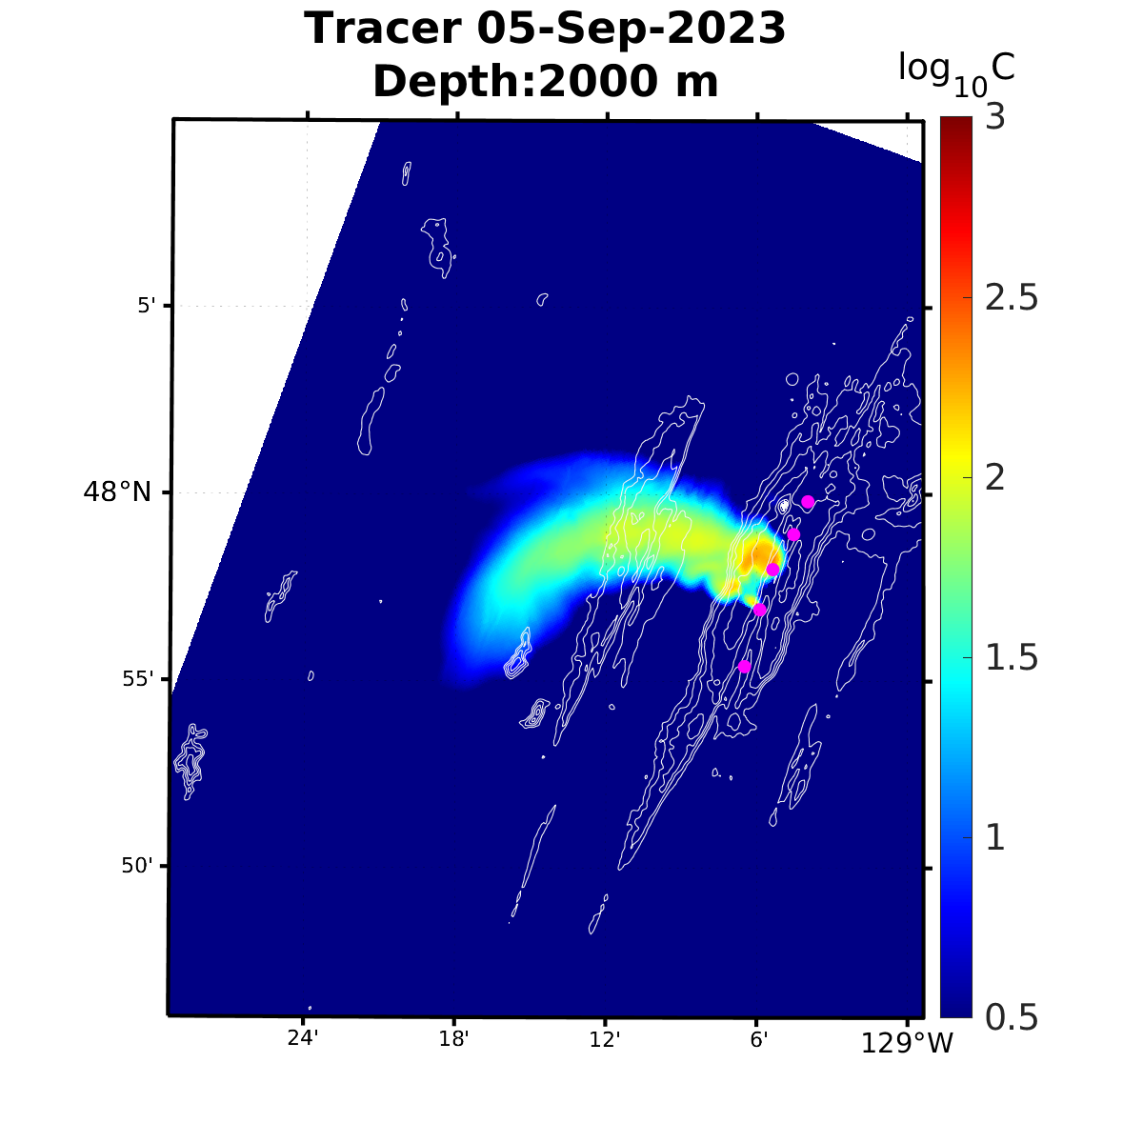
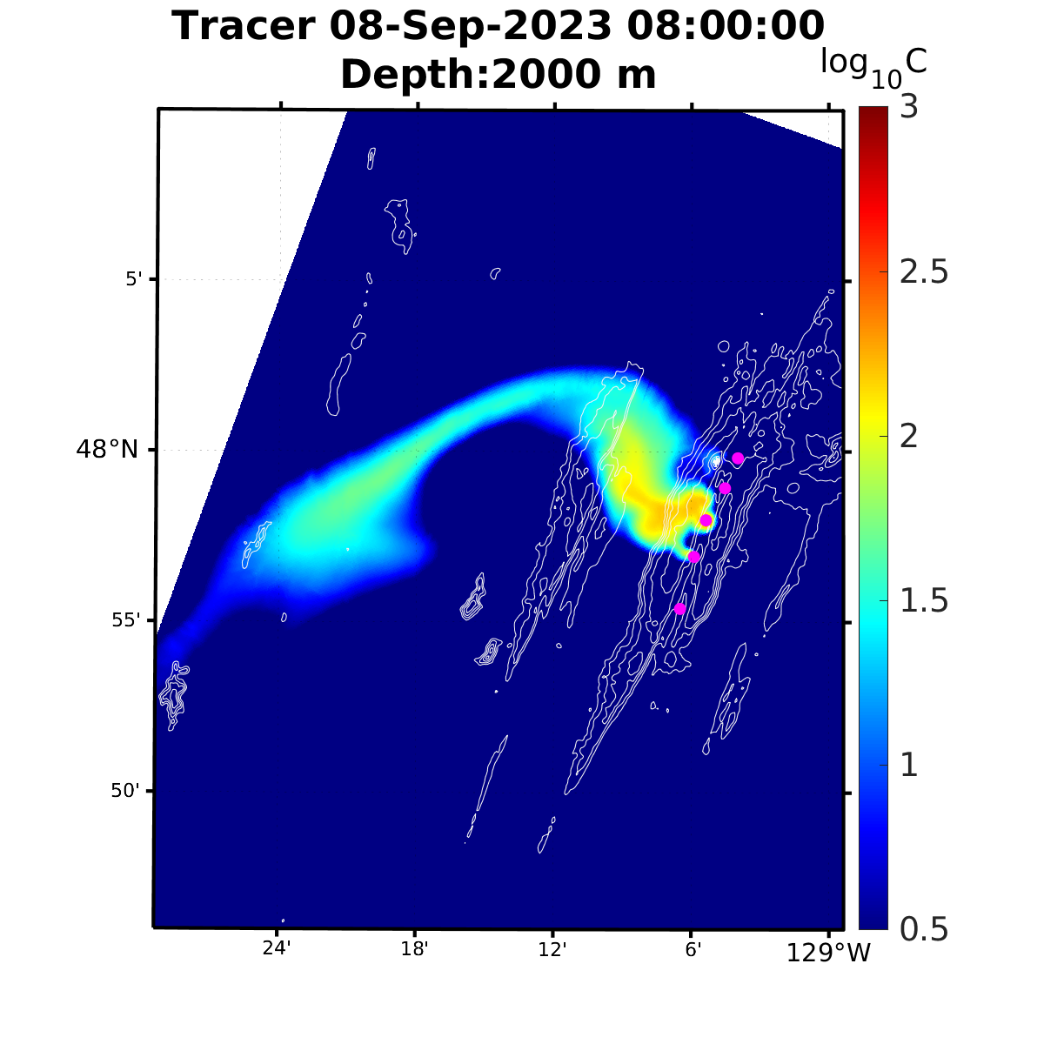
Simulated Plume Dispersion (Aug 26th to Sept 16, 2023)
Aug 30th
Sept 3rd
Sept 5th
Sept 8th

Slide 9
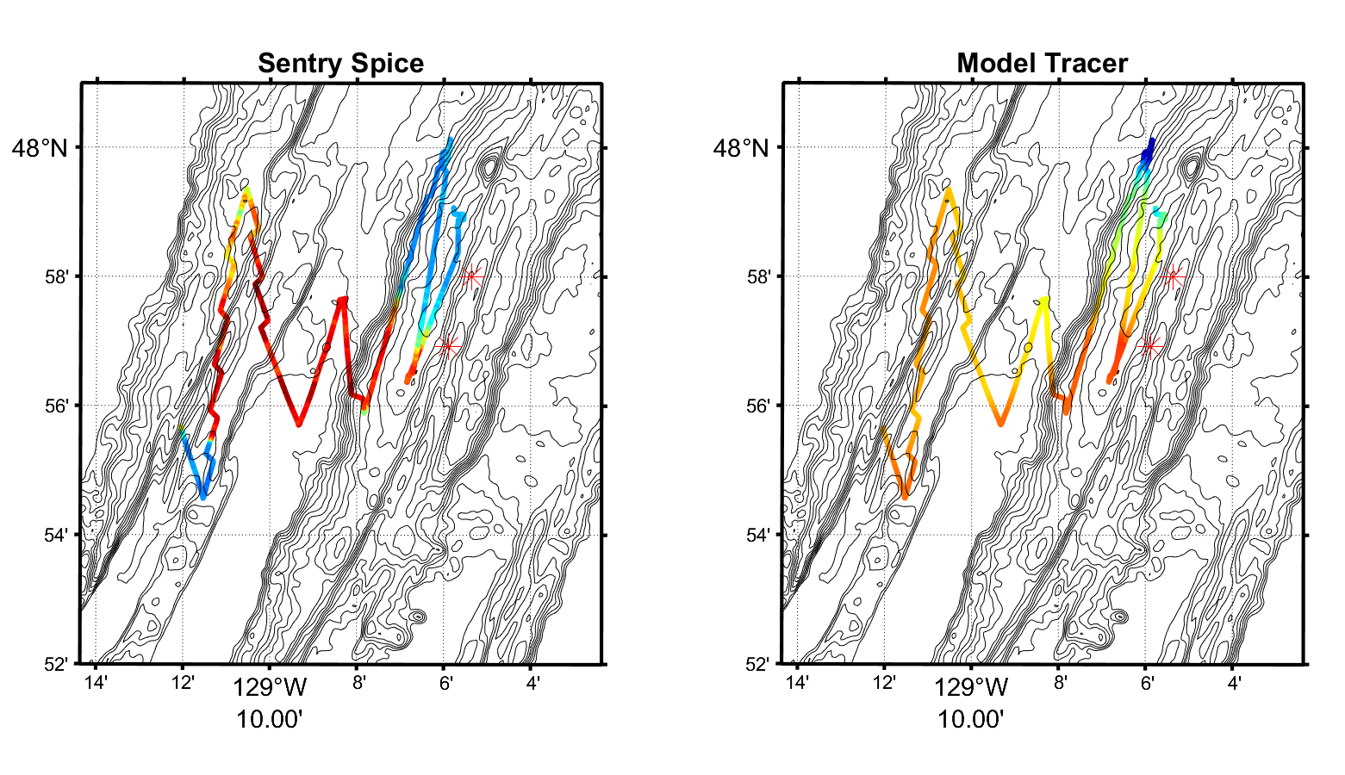
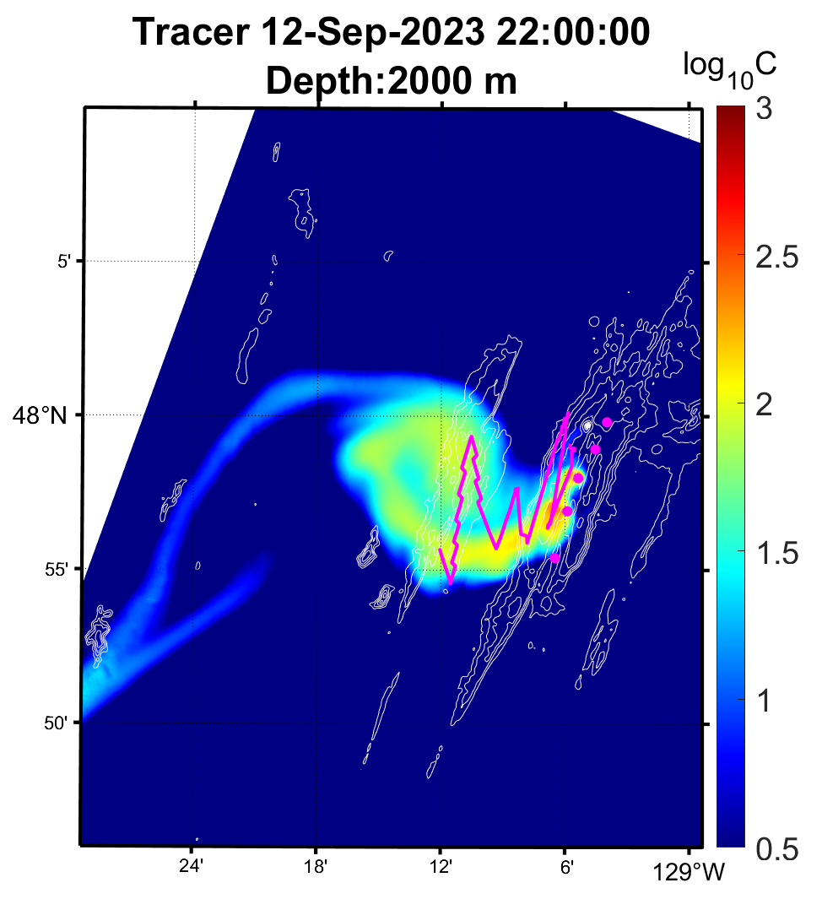
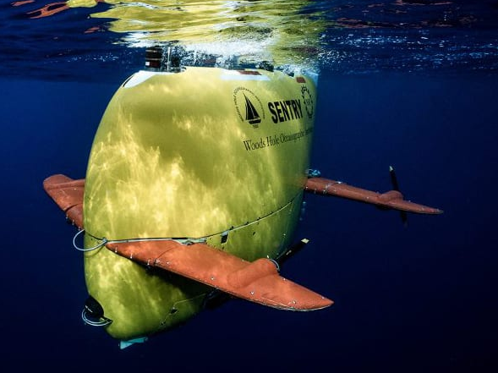
AUV Based Plume Surveys ( 12-Sep-2023 )
Target Depth: 2000 m
Observation
Model
Depth:
2000 m
Sentry
Simulated plume trajectory generally match observations.
Simulated plume shows a southward deviation compared to AUV observations.
Discrepancy likely due to model's overestimation of southward flow velocities.
Photo courtesy of NDSF

Slide 10
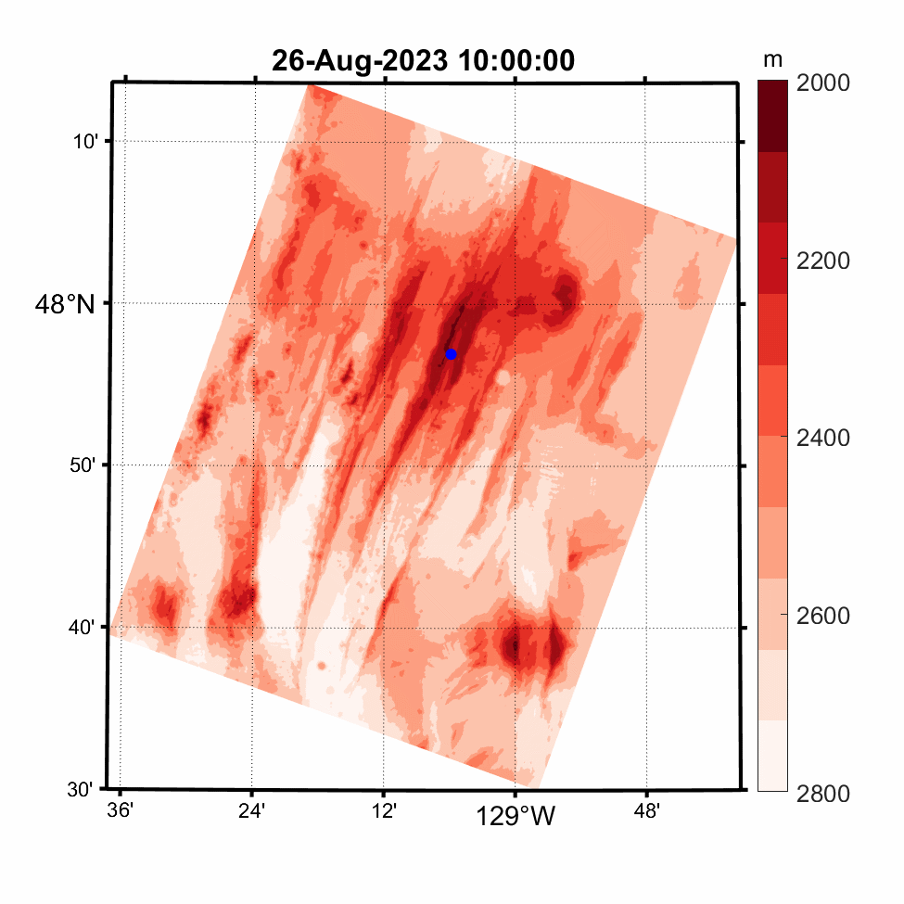
Dispersal of Plume Particles
MEF

Slide 11
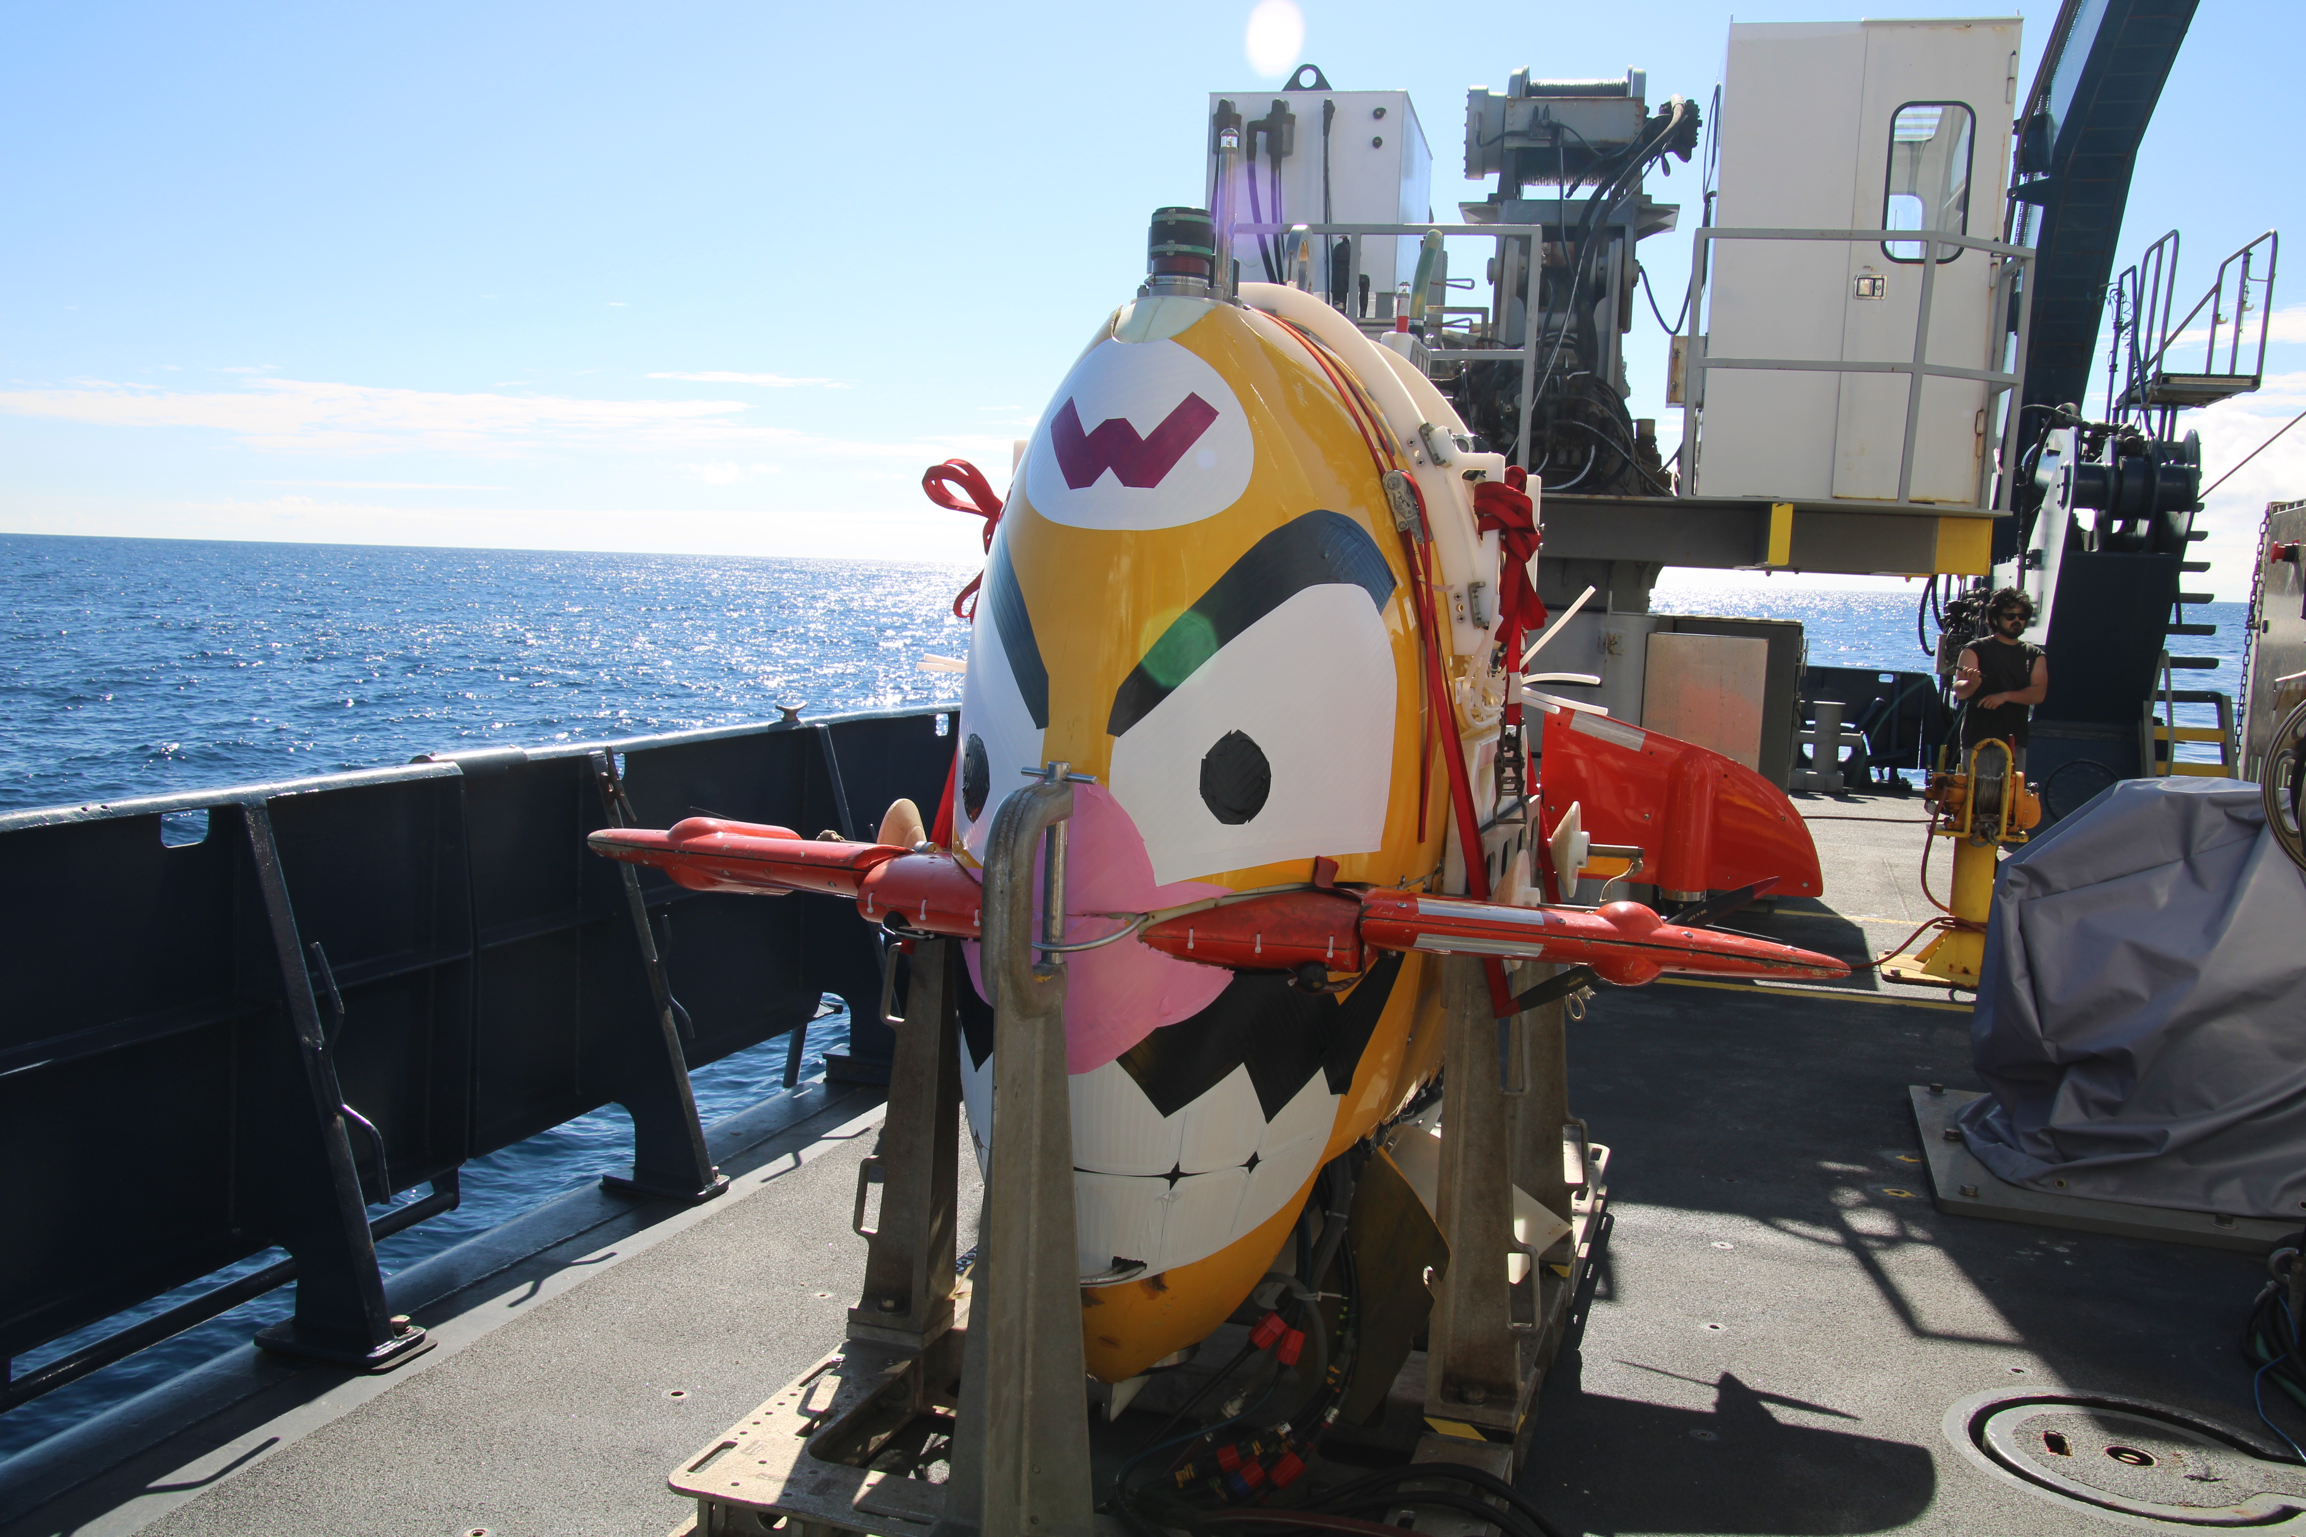
Acknowledgements
Atlantis AT50-15 crew members
Sentry team members
Thank you, Sentry!!!
Photo by Chris German

