Slide 1
Regulatory Context: Activity Plan Process for Research in Tang.ɢwan - ḥačxʷiqak - Tsigis Marine Protected Area (TḥT- MPA)
Presented at ONC ‘Endeavour Workshop 2024’ - November 12, 2024

Slide 2
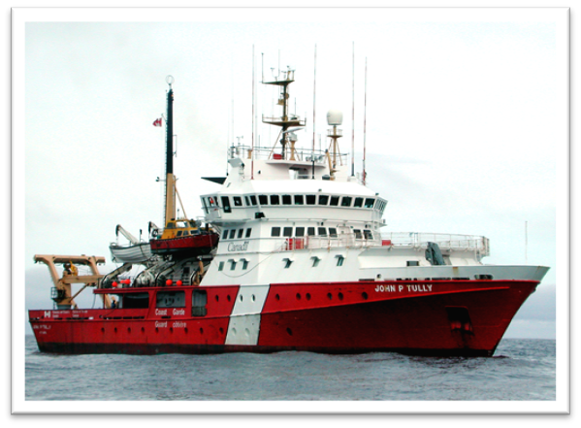
Overview
Background for Tang.ɢwan - ḥačxʷiqak - Tsigis Marine Protected Area (TḥT- MPA)
Regulatory Context:
  Oceans Act
  MPA Regulations
  Activity Plan
  MPA Protection Standard

Slide 3
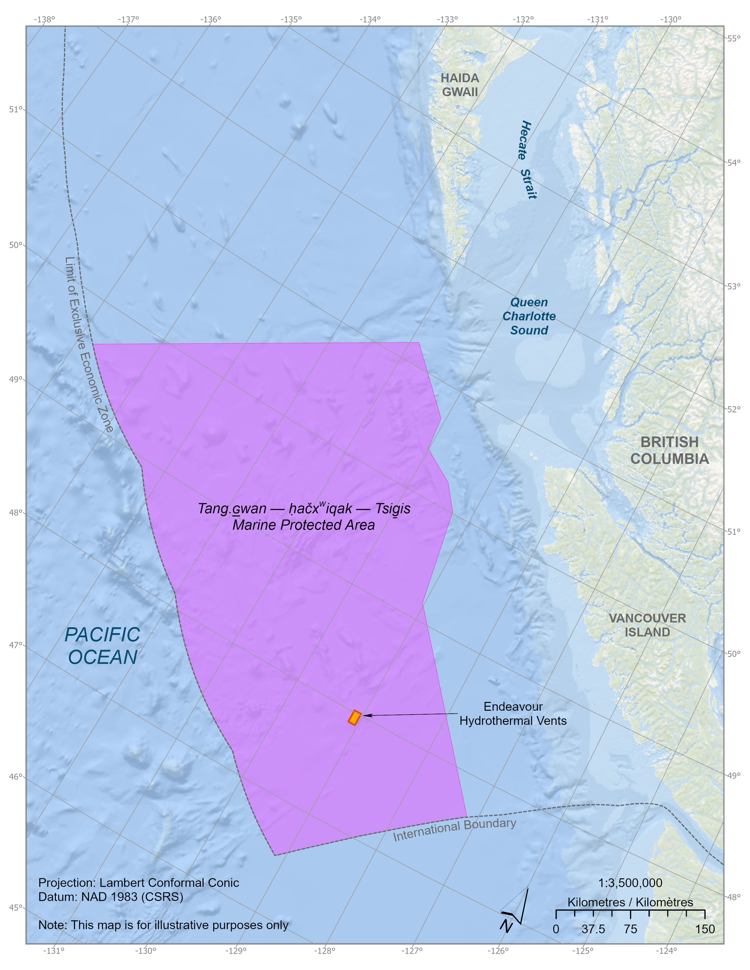
ThT MPA
Located in the EEZ, 133,017 km2
To conserve, protect and enhance understanding of unique seafloor features, including seamounts and hydrothermal vents, and the marine ecosystems they support.
Nuu-chah-nulth Tribal Council, Council of Haida Nation, Pacheedaht First Nation, and Quatsino First Nation co-manage the MPA with DFO

Slide 4
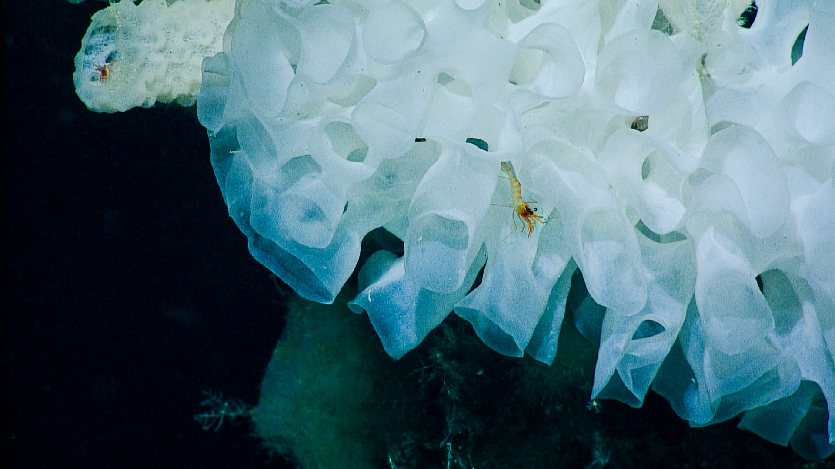
Tang.ɢwan - ḥačxʷiqak - Tsigis Meaning
The Indigenous part of the MPA name consists of:
  a Haida word meaning deep ocean (Tang.ɢwan; phonetic spelling: Tung – Gwun, where G is a voiced uvular stop),
  a Nuu-chah-nulth and Pacheedaht word meaning deepest part of the ocean (ḥačxwiqak; phonetic spelling: huch/khwi/kuk), and
  a Quatsino word referring to a monster of the deep (Tsigis; phonetic spelling: tsee-geese)

Slide 5
ThT MPA Regulations
Establish the boundaries and zoning of the Tang.ɢwan - ḥačxwiqak - Tsig̱is - MPA;
Set out a general prohibition, prohibiting activities that are likely to disturb, damage, destroy, or remove any living marine organism or any part of its habitat;
Identify specific exceptions to the general prohibition to allow for certain activities that do not compromise the conservation objectives identified for the MPA;
Define the criteria for Ministerial approval of research Activity Plans and educational activities in the MPA; and,
Repealed the Endeavour Hydrothermal Vents Marine Protected Area Regulations (SOR/2003-87) upon the designation of Tang.ɢwan - ḥačxwiqak - Tsig̱is MPA on June 19, 2024.

Slide 6
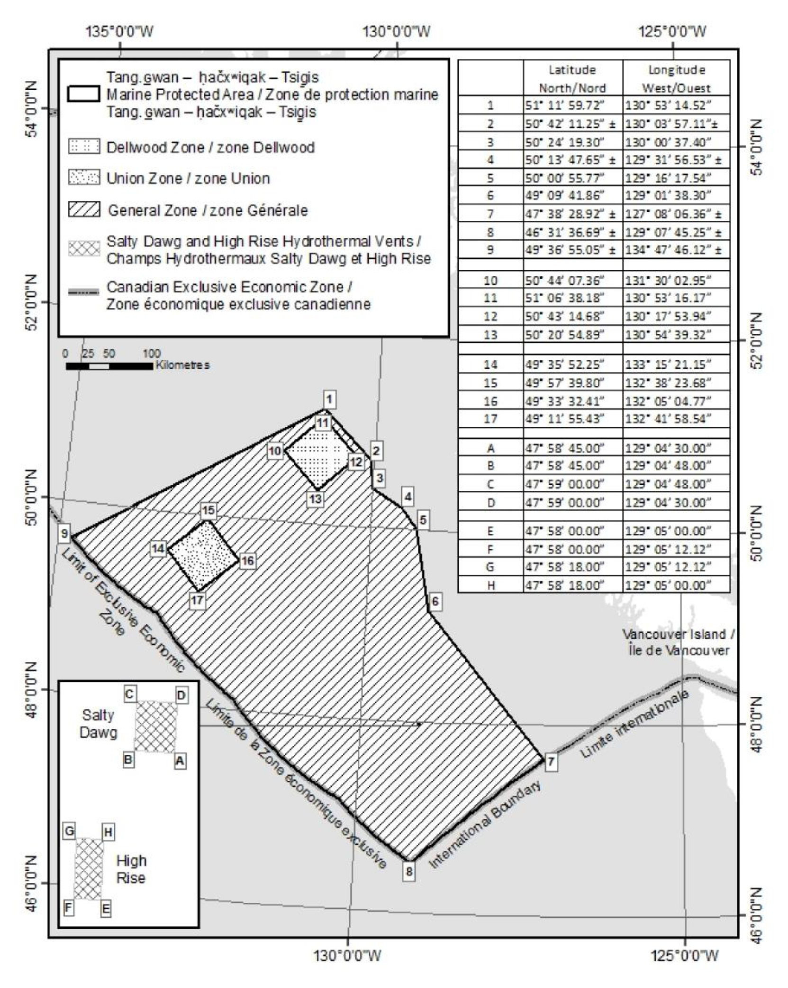
Additional Considerations
Hydrothermal vents of interest to domestic and foreign researchers
UNCLOS and Marine Scientific Research (MSR) requests
Hydrothermal vent fields subject to greater scrutiny:
  Salty Dawg
  High Rise

Slide 7
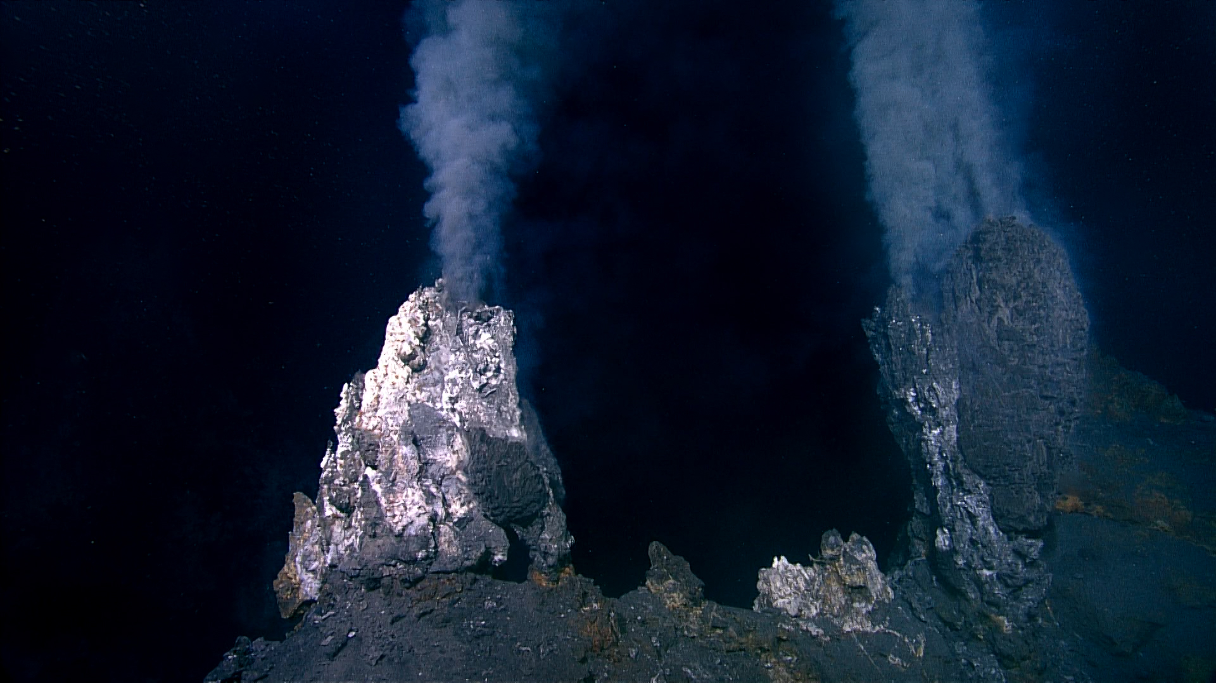
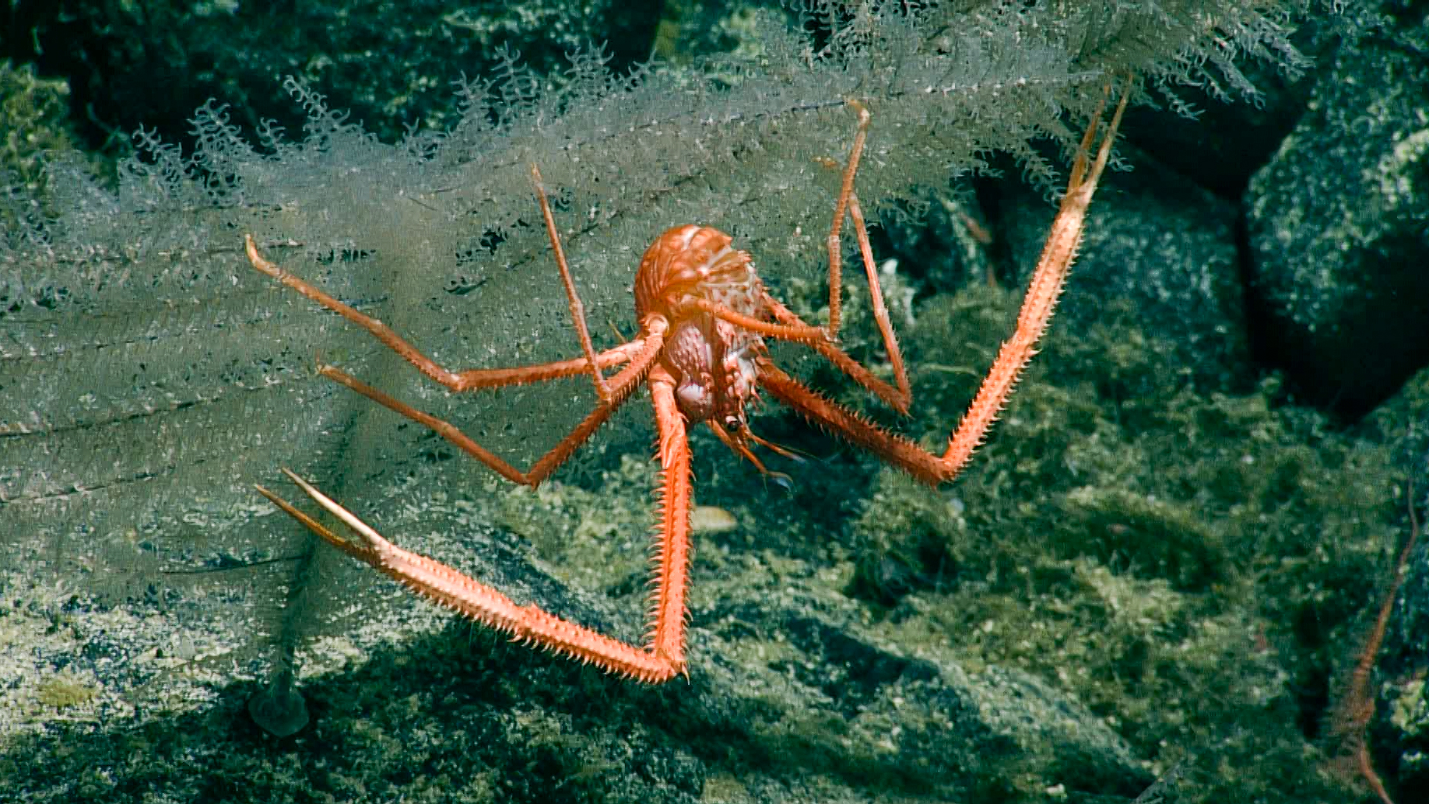
Activity Plans
      A Regulatory Requirement
      Specific to the Oceans Act MPA in which the work will be occurring
      Science that benefits knowledge or management of the MPA without compromising the conservation objectives
      Different than a Fisheries Act Section 52 Scientific License

Slide 8
3 Step Review / Approval Process
Information Requirements
  DFO MPA Management check the Activity Plan application is complete and contains all the required information
Regulatory Conditions
  MPA Management will assess whether the proposed activity meets the conditions set out in the MPA Regulations
Review & Recommendation
  MPA Management seek internal and co-management partner review and make final recommendation.

Slide 9
Step 1: Information Requirements
Activity Plan - Submission to Minister
6. A person who proposes to carry out a scientific research or monitoring activity or an educational activity in the Marine Protected Area must submit to the Minister an activity plan that contains the following information:
  the person’s name, address, telephone number and email address;
  if the activity plan is submitted by an institution or organization, the name of the individual who will be responsible for the proposed activity and their title, address, telephone number and email address;
  the name of each vessel that the person proposes to use to carry out the activity, its state of registration and registration number, its radio call sign and the name, address, telephone number and email address of its owner, master and any operator;
  a detailed description of the proposed activity and its purpose, the methods or techniques that are to be used to carry out the activity and the data to be collected;
  the geographical coordinates of the site of the proposed activity and a map that shows the location of the activity within the Marine Protected Area;
  the proposed dates and alternative dates on which the proposed activity is to be carried out;

Slide 10
Step 1: Information Requirements
6 Activity Plan - Submission to Minister continued..
  a list of the equipment that is to be used, the means by which it will be deployed and retrieved and the methods by which it is to be anchored or moored;
  a list of the types and quantities of samples that are to be collected;
  a list of any substances that may be deposited during the proposed activity in the Marine Protected Area — other than substances that are authorized under the Canada Shipping Act, 2001 to be deposited in the navigation of a vessel — and the quantity and concentration of each substance;
  a description of the adverse environmental effects that are likely to result from carrying out the proposed activity and of any measures that are to be taken to monitor, avoid, minimize or mitigate those effects;
  a description of any scientific research or monitoring activity or educational activity that the person has carried out or anticipates carrying out in the Marine Protected Area; and
  a general description of any study, report or other work that is anticipated to result from the proposed activity and its anticipated date of completion.

Slide 11
Step 2: Regulatory Conditions
Approval
7 (1) The Minister must approve an activity plan if
  the scientific research or monitoring activities set out in the plan are not likely to destroy the habitat of any living marine organism in the Marine Protected Area and
    will serve to increase knowledge of the habitat of any living marine organism in the Marine Protected Area or the ecosystems these habitats support in the Marine Protected Area, or
    will serve to assist in the management of the Marine Protected Area; and
  the educational activities set out in the plan
    are not likely to damage, destroy or remove from the Marine Protected Area any living marine organism or any part of its habitat, and
    will serve to increase public awareness of the Marine Protected Area; or
  the approval of the activity plan is necessary to be consistent with the United Nations Convention on the Law of the Sea, signed by Canada on December 10, 1982 or customary international law.

Slide 12
Step 2: Regulatory Conditions
Approval prohibited
7 (2) However, the Minister must not approve an activity plan under paragraph 1(a) or (b) if
  the scientific research or monitoring activities set out in the plan are likely to adversely affect the ecological integrity of
    the Salty Dawg hydrothermal vent, being the area of the sea depicted in the schedule that is bounded by a series of rhumb lines drawn from points A to D and then back to point A, or
    the High Rise hydrothermal vent, being the area of the sea depicted in the schedule that is bounded by a series of rhumb lines drawn from point E to H and then back to point E;
  any substance that may be deposited during the proposed activity is a deleterious substance as defined in subsection 34(1) of the Fisheries Act, unless the deposit of the substance is authorized under subsection 36(4) of that Act; or
  the cumulative environmental effects of the proposed activity, in combination with those of any other past and current activities carried out in the Marine Protected Area, are such that the activity is likely to
    destroy the habitat of any living marine organism in the Marine Protected Area, or
    adversely affect the biological, chemical or oceanographic processes that maintain or enhance the biodiversity, structural habitat or ecosystem function in the Marine Protected Area.

Slide 13
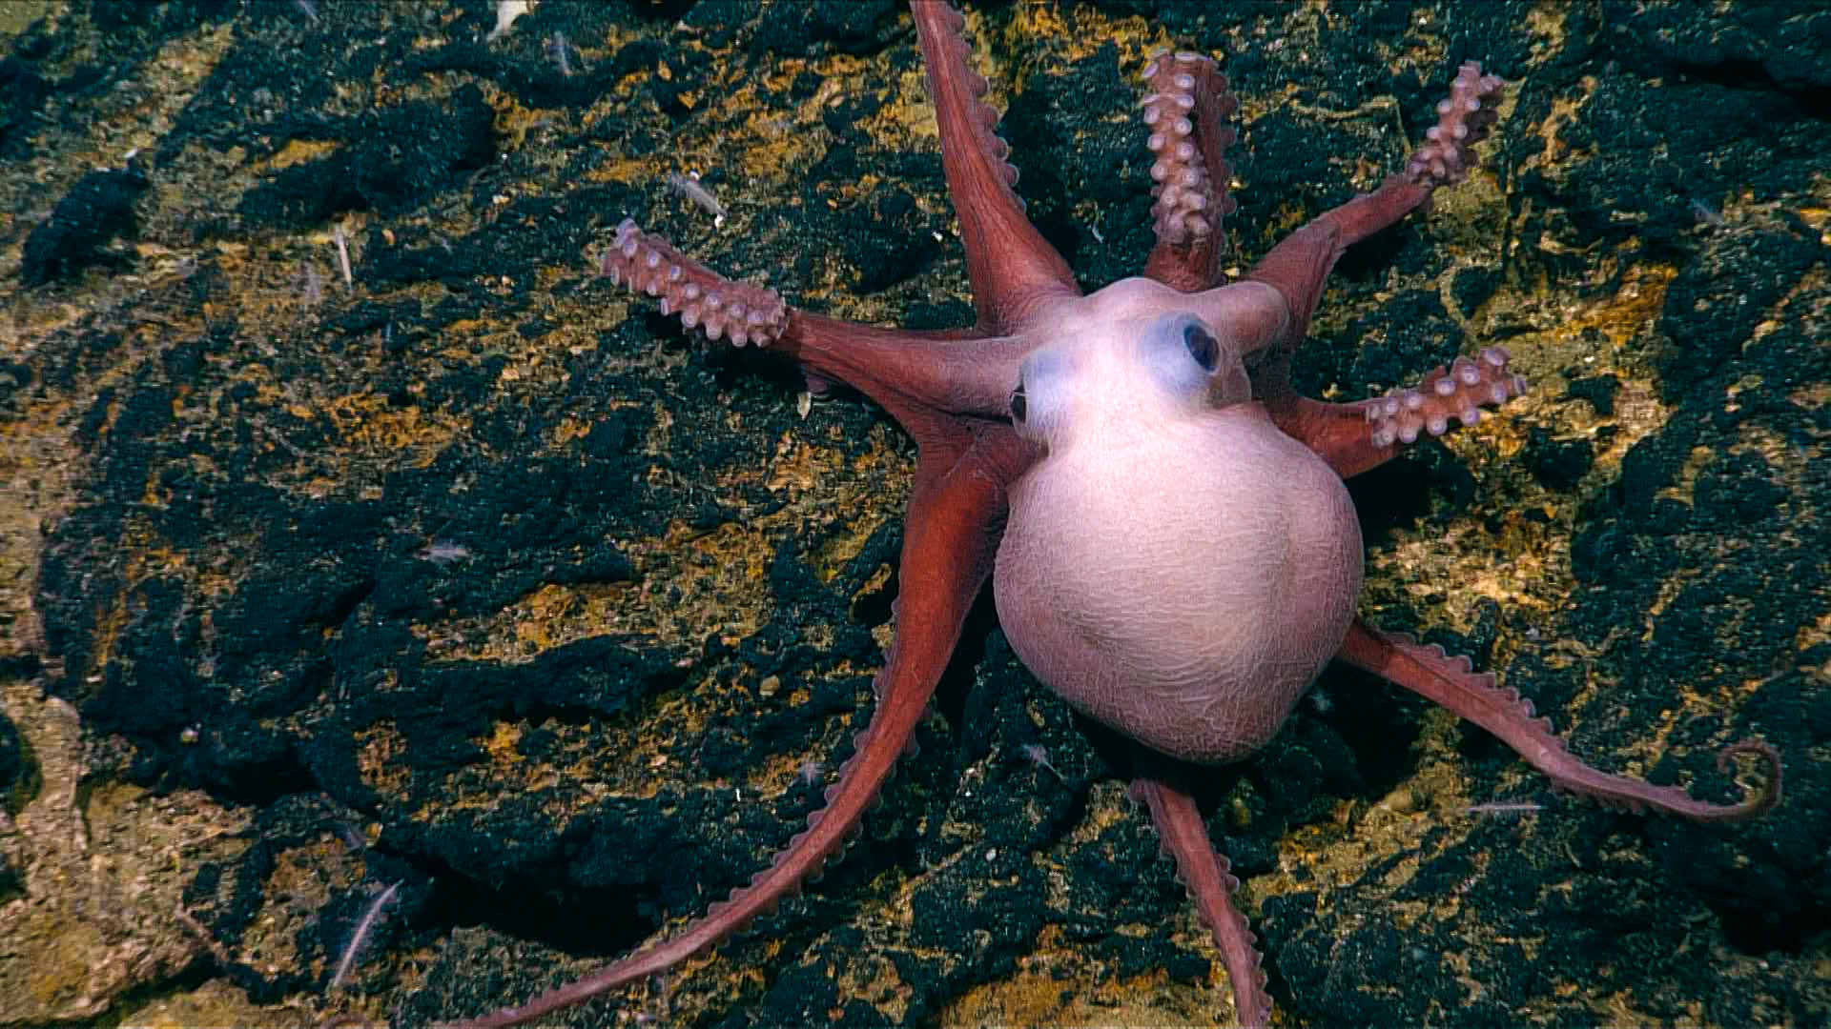
Step 3: Review and Recommendation
After our initial review, DFO MPA Management seek input from relevant DFO sectors and advice from the First Nations co-management partners
DFO MPA Management provide the formal recommendation for Ministerial decision
DFO MPA Management alert proponent of decision (approval / rejection) and other conditions

Slide 14
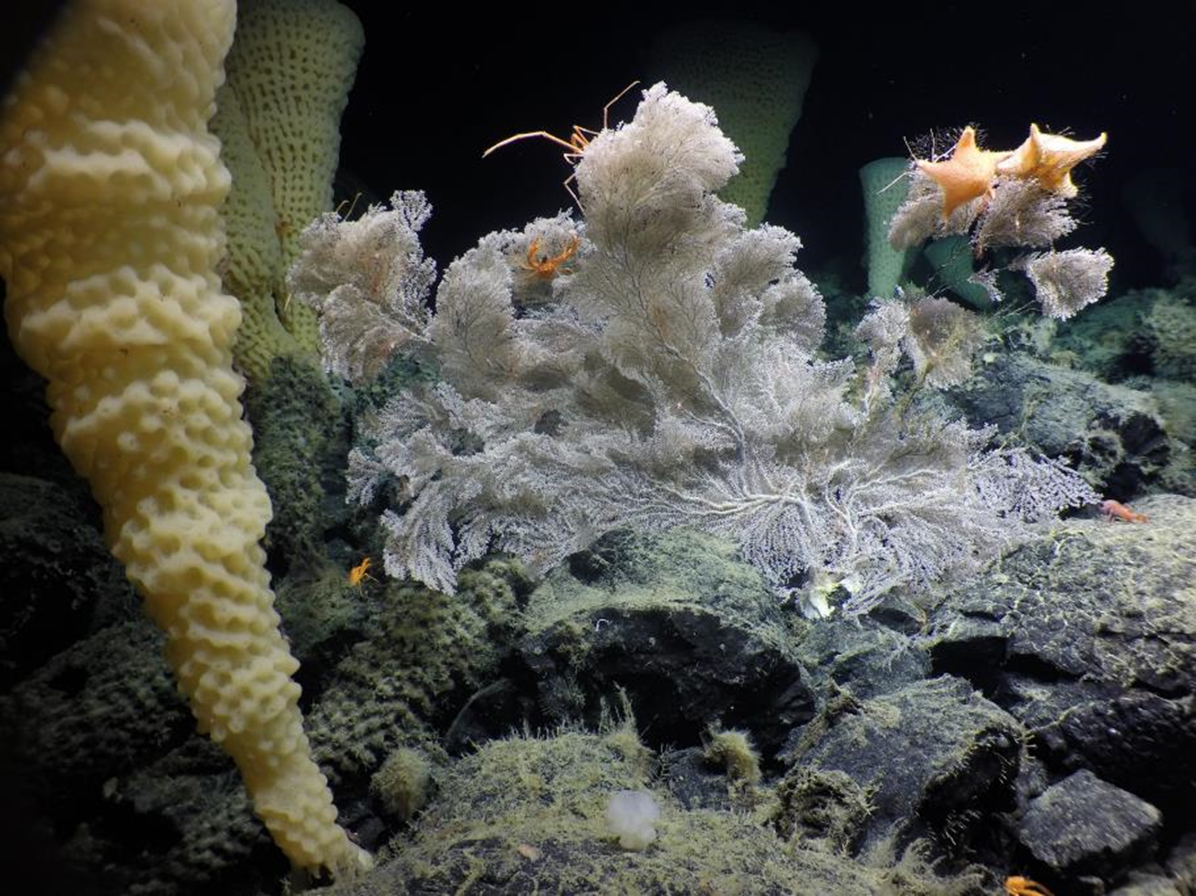
Timelines for ThT MPA Activity Plans
Timeline for approval of Activity Plan
3. The Minister’s decision must be made within:
(a) 90 days after the day on which the plan is received;
or
(b) if amendments to the plan are made, 90 days after the day on which the amended plan is received.
Fisheries and Oceans Canada, Northeast Pacific Seamount Expedition partners, and Ocean Exploration Trust

Slide 15
Activity Report
Activity Report
8 (1) If the Minister approves an activity plan, the person who submitted it must provide the Minister with an activity report within 90 days after the last day of the activity and the report must contain
  the data collected during the activity;
  the type and quantity of any sample that was collected, the date of collection and the geographic coordinates of the sampling site;
  an evaluation of the effectiveness of any measures taken to monitor, avoid, minimize or mitigate the adverse environmental effects of the activity; and
  a description of any event that occurred during the activity and that was not anticipated in the activity plan, if the event could result in the disturbance, damage, destruction or removal from the Marine Protected Area of any living marine organism or any part of its habitat.
Studies, reports or other publications
(2) The person must also provide the Minister with a copy of any study, report or other publication that results from the activity and is related to the conservation and protection of the Marine Protected Area. The study, report or other publication must be provided within 90 days after the day on which it is published.

Slide 16
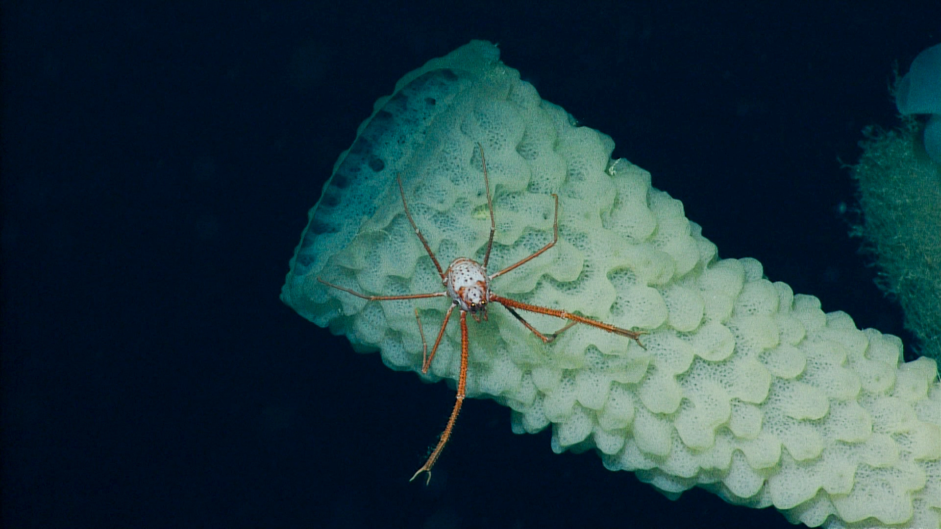

Helpful Reminders
Clearly describe proposed activities
Clearly describe risks and how they will be mitigated
Describe previous similar activities to assist with assessment of cumulative risks
Photos, schematics, drawings, maps are encouraged
  Reach out to us with questions!

Slide 17
Where to Find More Information
*ThT MPA Regulations*:
Canada Gazette, Part 2, Volume 158, Number 13: Tang.ɢwan {|mdash|} ḥačxwiqak {|mdash|} Tsig̱is Marine Protected Area Regulations
*ThT MPA website*:
Tang.ɢ̱wan – ḥačxwiqak – Tsig̱is Marine Protected Area (TḥT MPA) (dfo-mpo.gc.ca)
Oceans Act
Oceans Act (justice.gc.ca)
MPA Protection Standard:
Marine Protected Areas (MPA) Protection Standard (dfo-mpo.gc.ca)

Slide 18
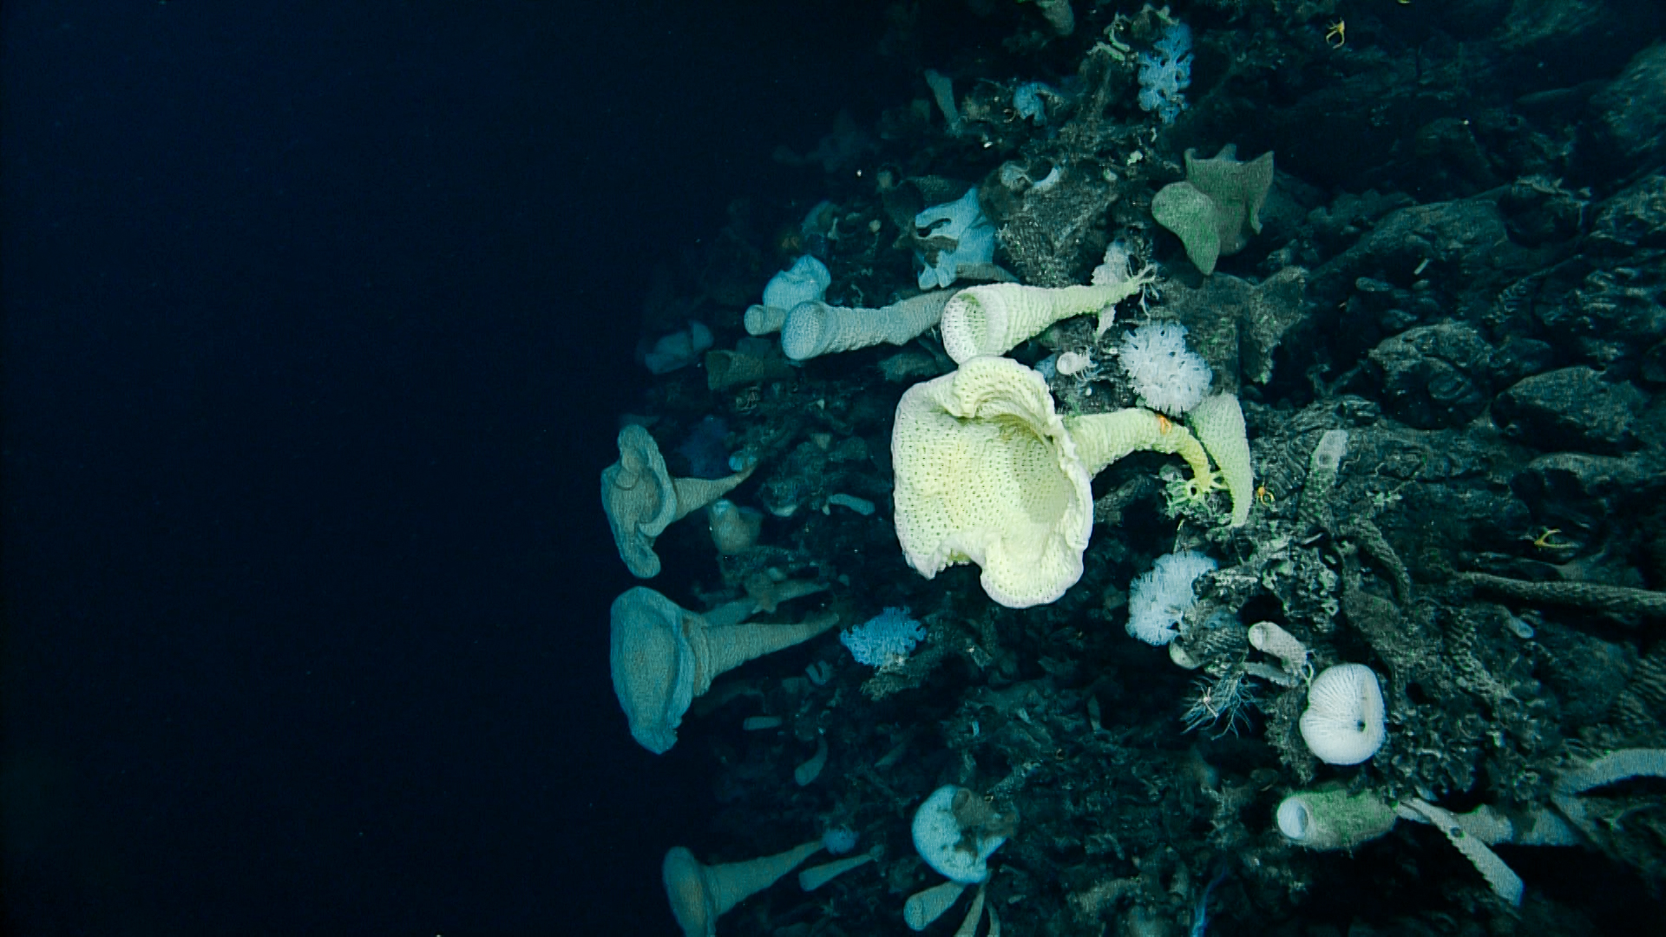
Contact Information
James Mortimor, A/ Manager – Marine Protected Area Management
  James.Mortimor@dfo-mpo.gc.ca
Holly McCullough, Senior Biologist
  Holly.McCullough@dfo-mpo.gc.ca

Slide 19
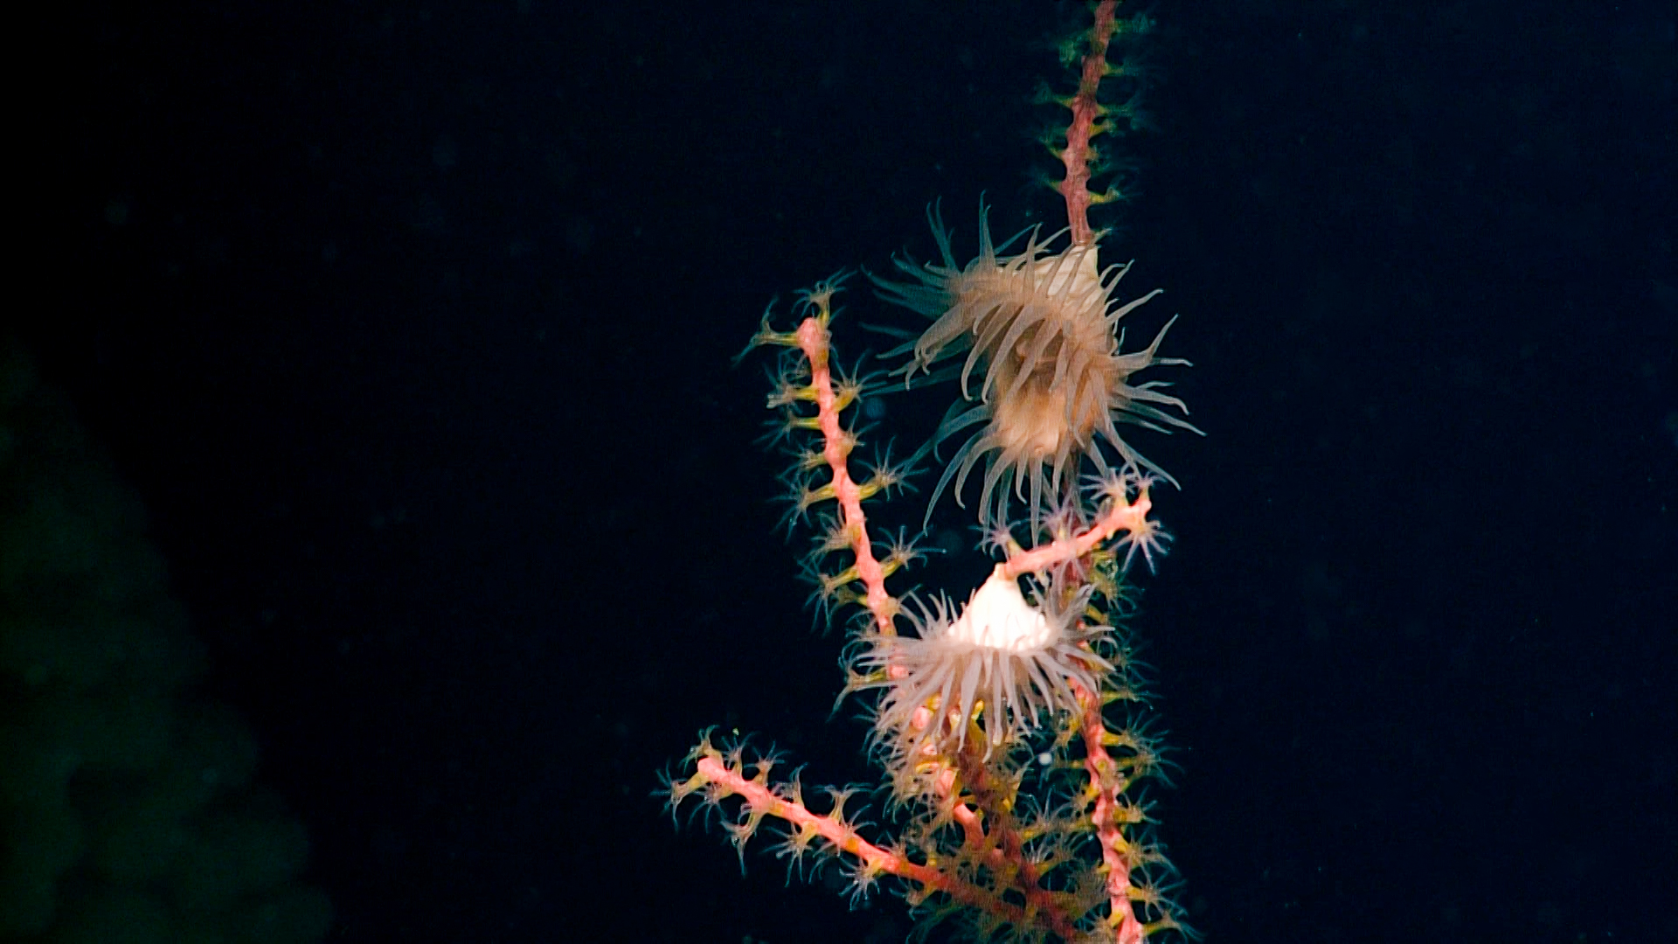
Questions?

Slide 20
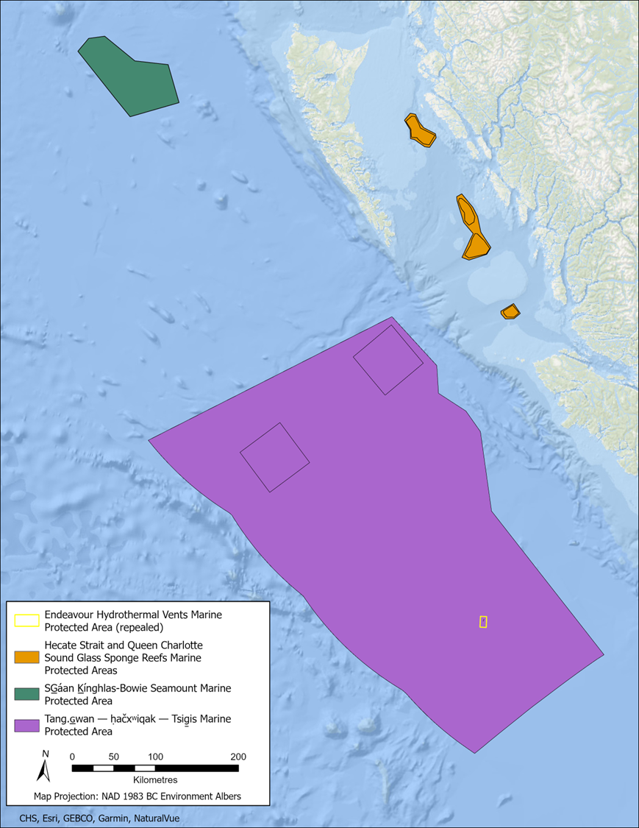
Pacific Region Oceans Act MPAs

