Slide 1
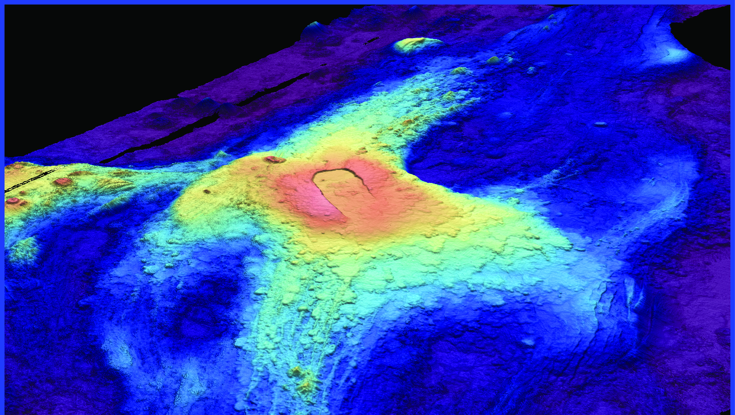
Predicting the volcanic cycle at Axial Seamount
Bill Chadwick, Oregon State University

Slide 2
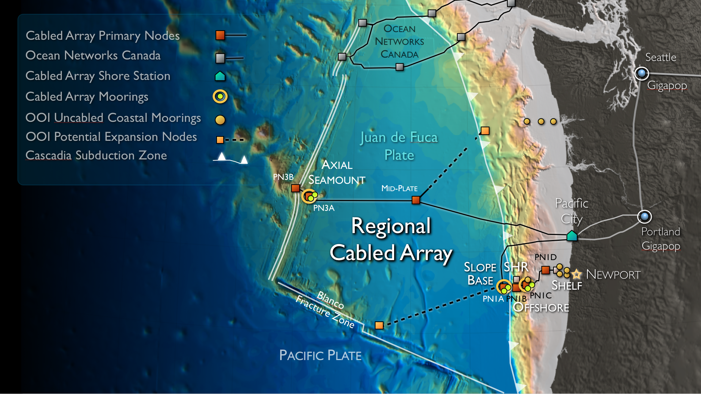

Slide 3
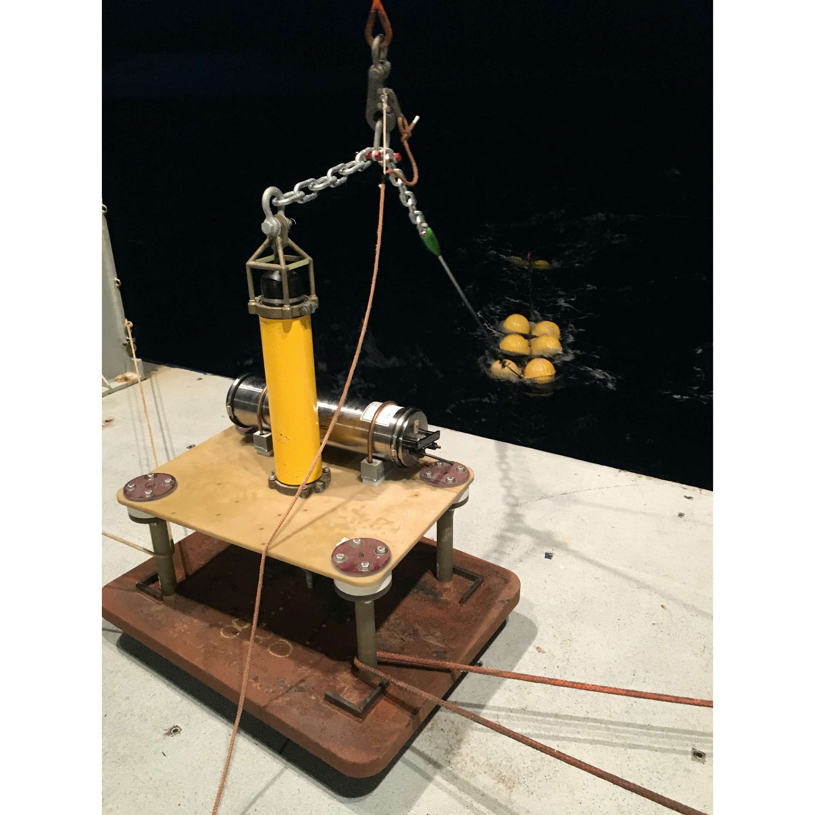
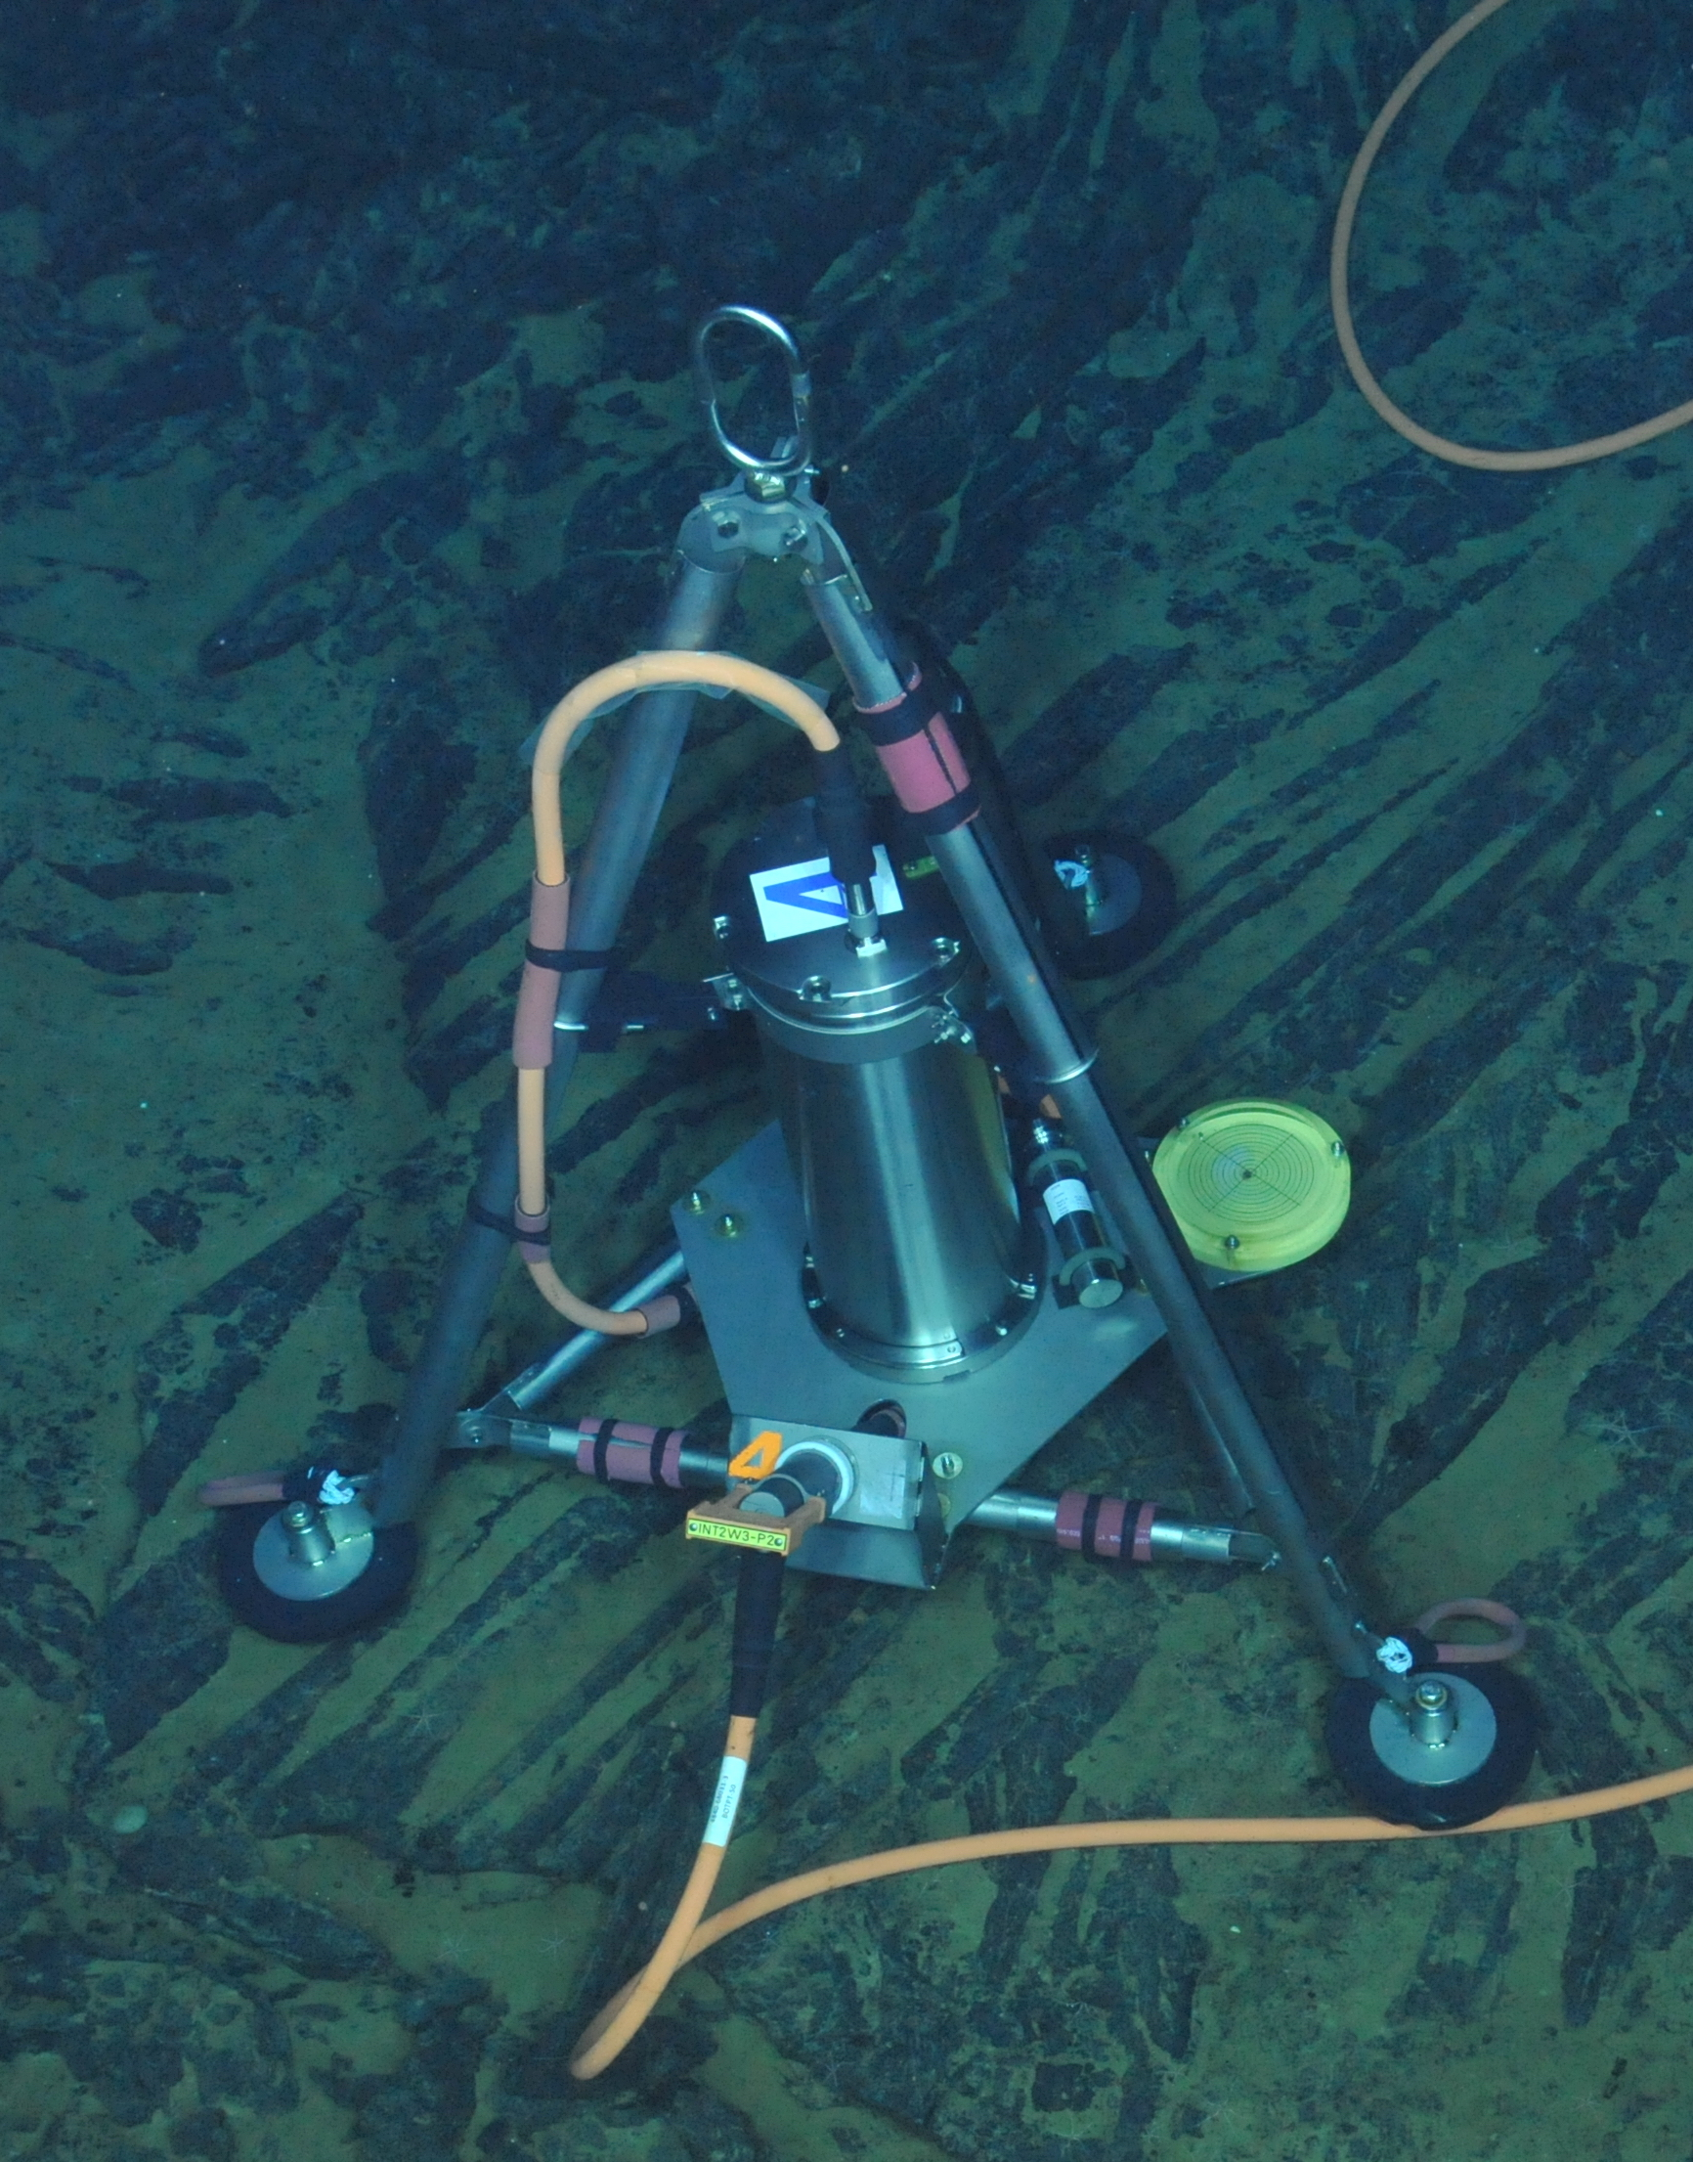
Autonomous BPRs (used since 1997)
Cabled BPRs (on the OOI-RCA since 2014)

Slide 4
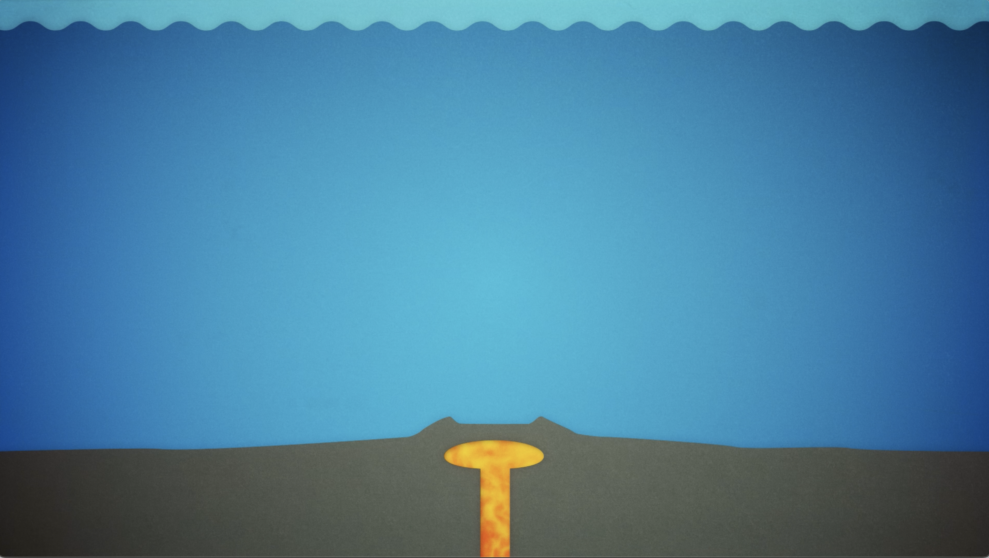
Bottom Pressure =
Geophysical signal
+
Instrumental drift
+
Tidal signals
+
Non-tidal oceanographic signals
+
Seasonal signals

Slide 5
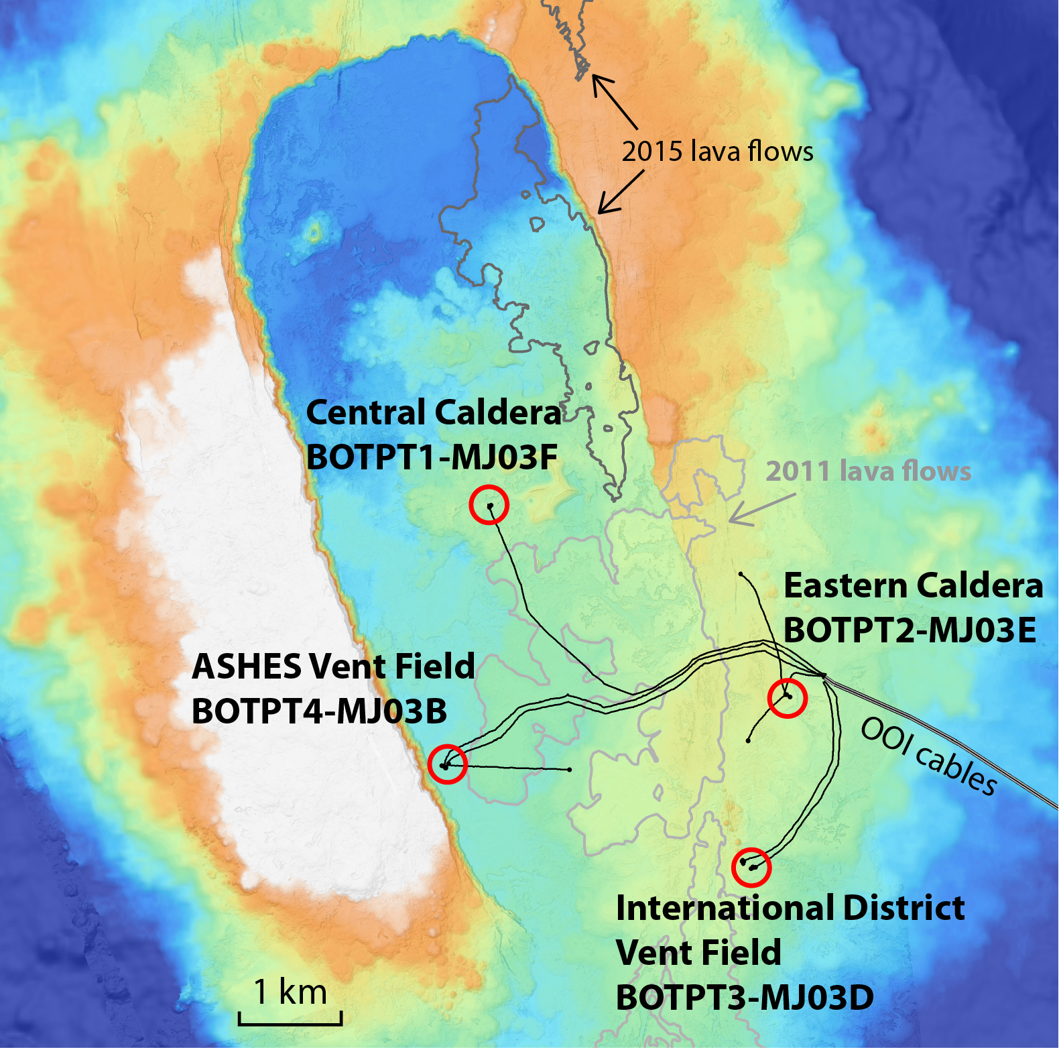
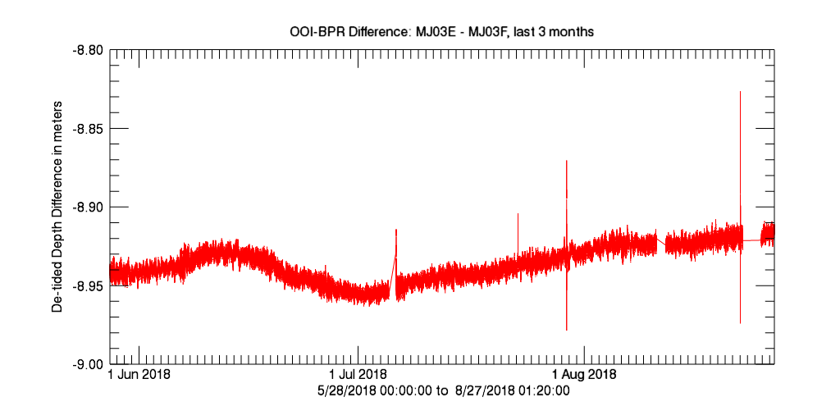
Differential BPR data increases the signal-to-noise of geophysical signals
5 cm
5 cm
5 cm

Slide 6
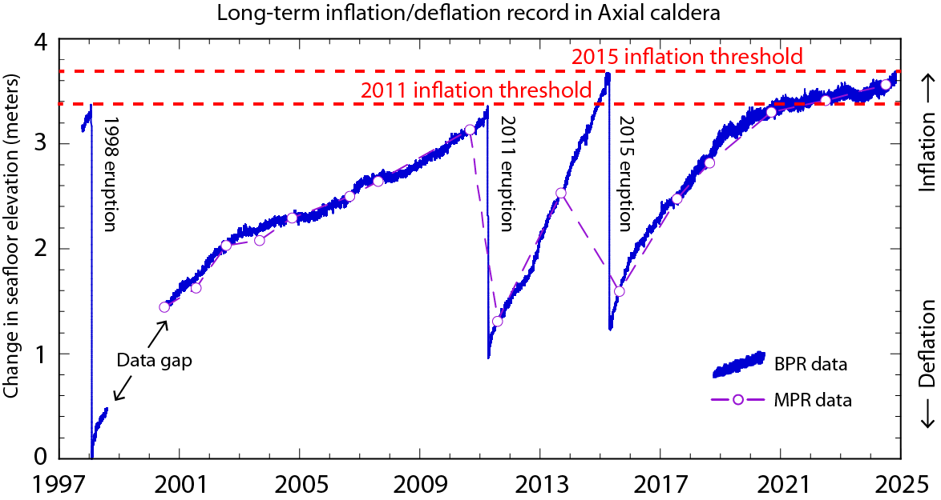
OOI-RCA

Slide 7
Key observations: 3 eruptions in last 30 years
OOI-RCA

Slide 8
Key observations: Big signals!
OOI-RCA

Slide 9
Key observations: cycle appears repeatable
OOI-RCA

Slide 10
Key observations: cycle appears repeatable … but not exact
OOI-RCA

Slide 11
Key observations: the rate of inflation has been highly variable vs time
OOI-RCA

Slide 12
Key observations: we are nearly at the 2015 inflation threshold!
OOI-RCA

Slide 13
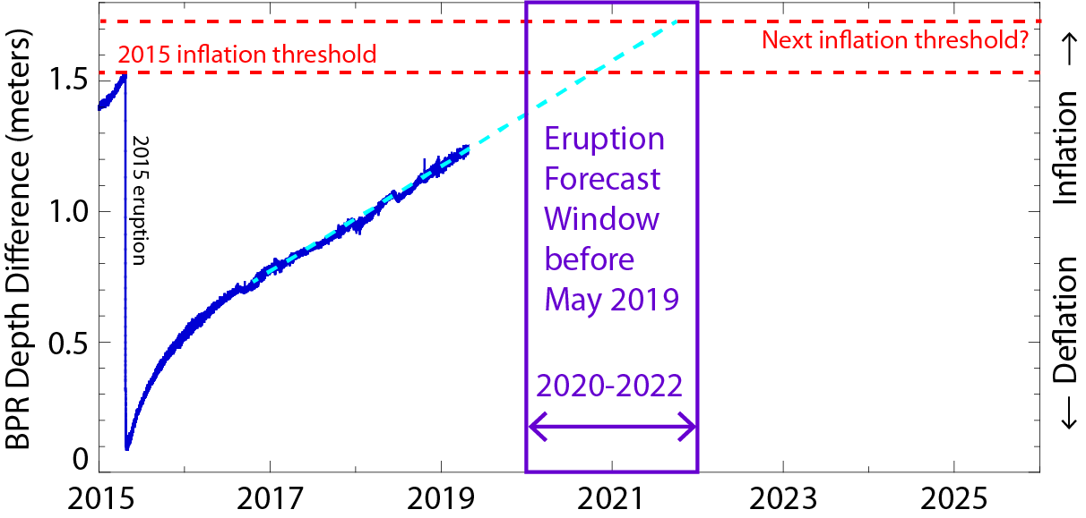
Eruption forecast window has changed with the rate of inflation…
Early
2019
~50 cm/yr

Slide 14
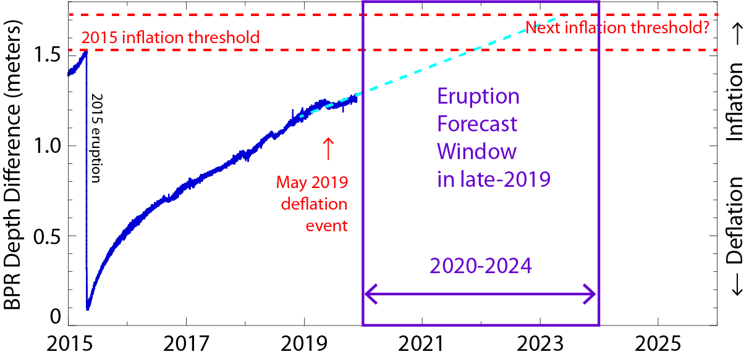
Eruption forecast window has changed with the rate of inflation…
Late
2019
~20 cm/yr

Slide 15
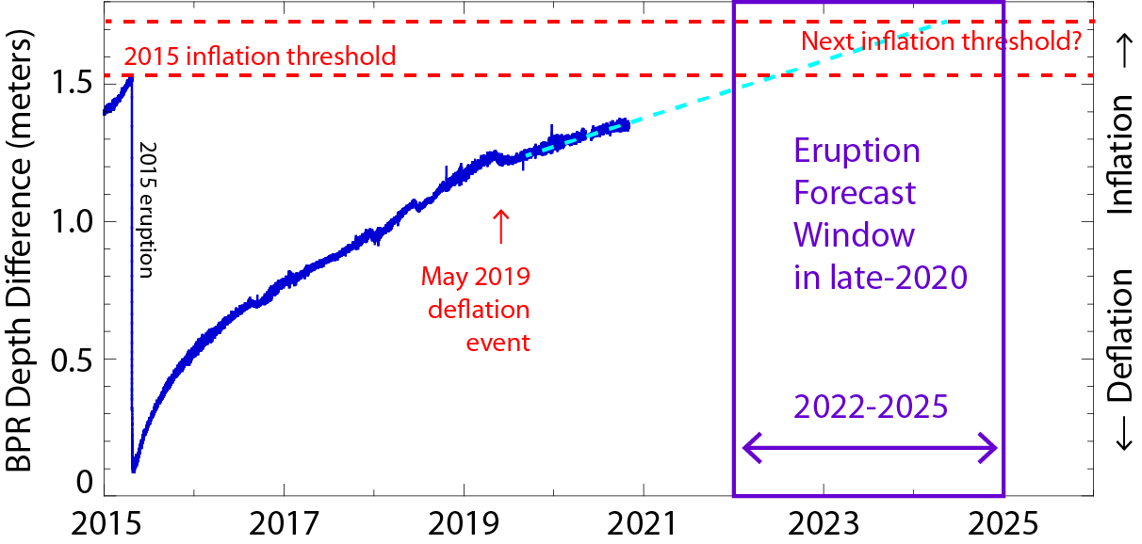
Eruption forecast window has changed with the rate of inflation…
Late
2020
~10 cm/yr

Slide 16
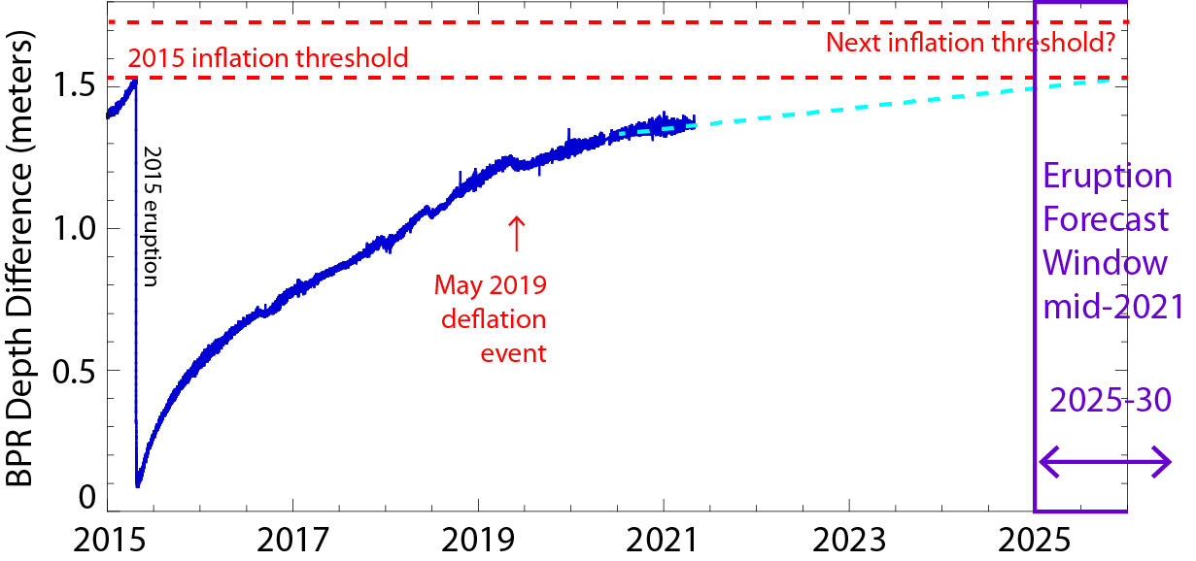
Eruption forecast window has changed with the rate of inflation…
Mid
2021
~5 cm/yr

Slide 17
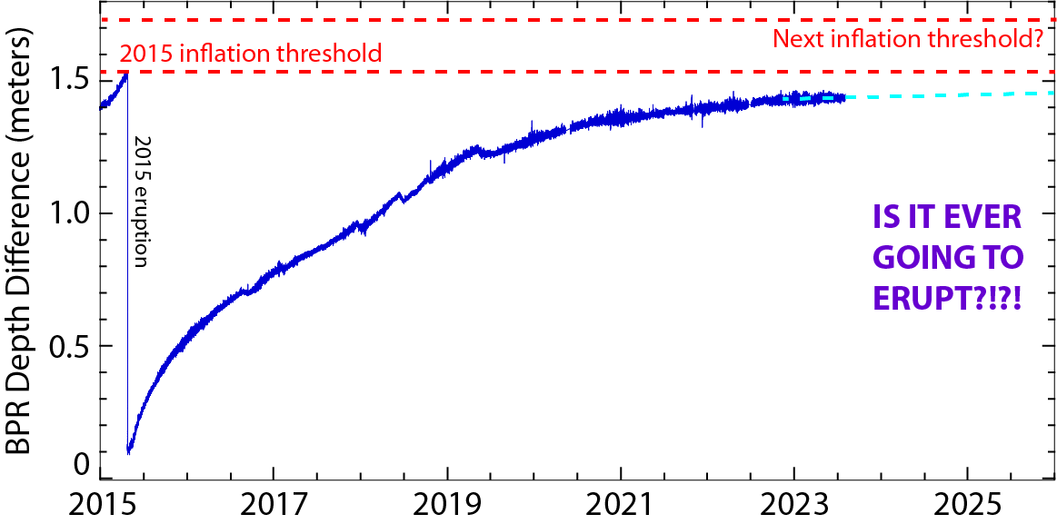
…but forecasts became impossible when inflation rate approached zero
Mid
2023
~1 cm/yr

Slide 18
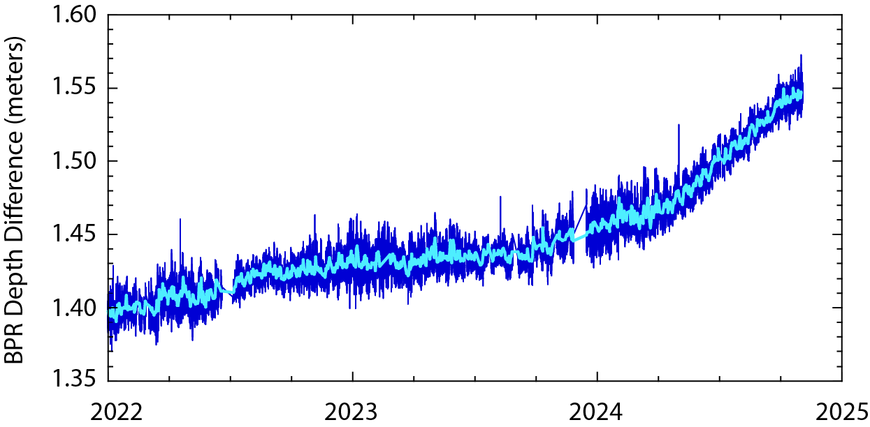
Then … inflation resumed in late-2023 to early-2024
Oct
2023
Jul
2024
~25 cm/yr
~1 cm/yr

Slide 19
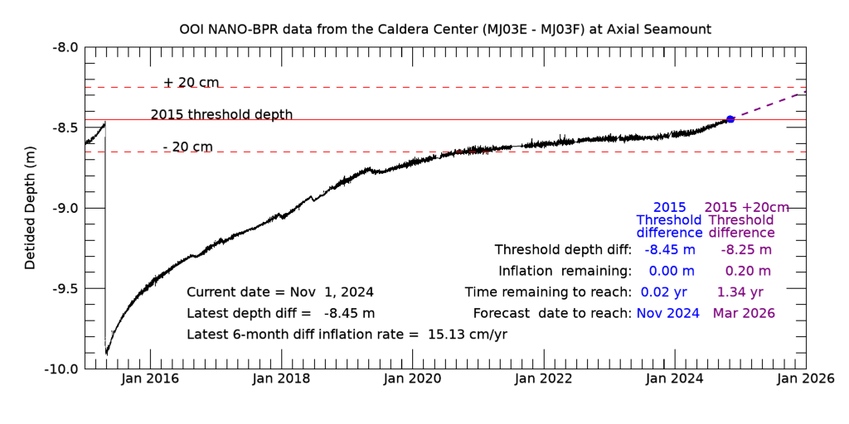

Slide 20
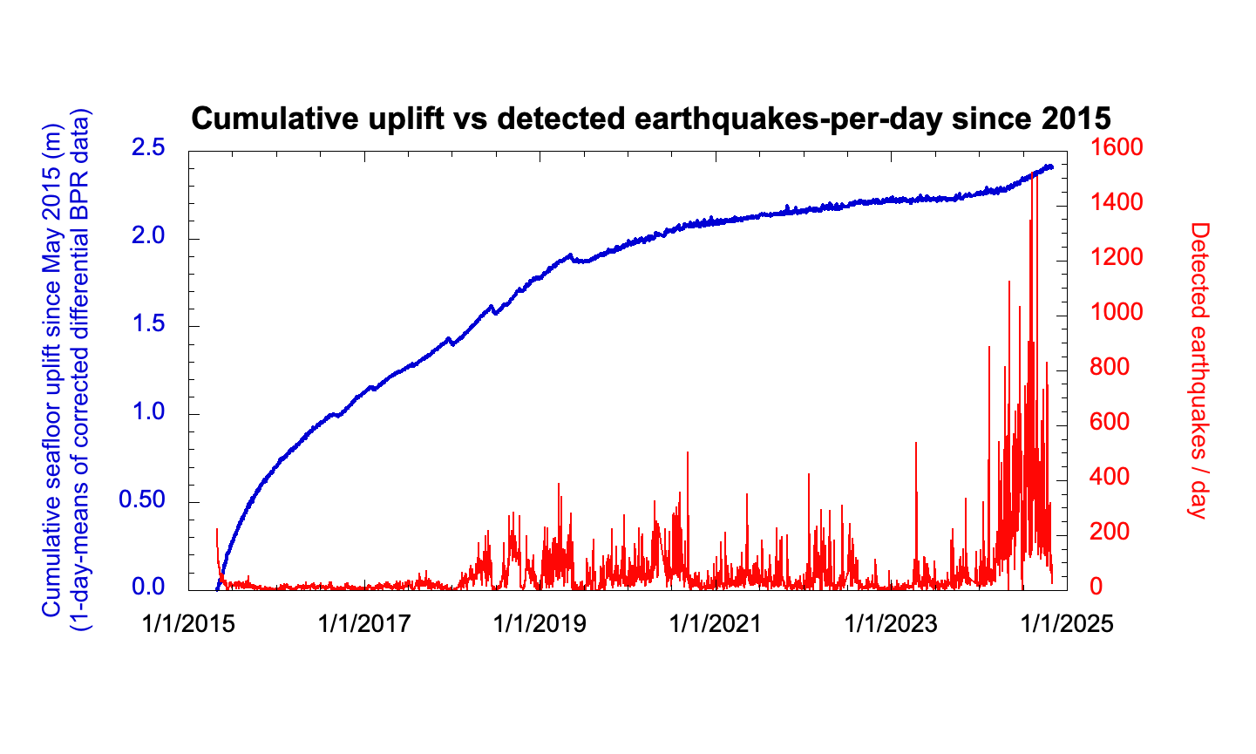
Comparing uplift with seismicity vs. time since 2015
2015 eruption
Earthquake data from catalog of William Wilcock & Maochuan Zhang, UW

Slide 21
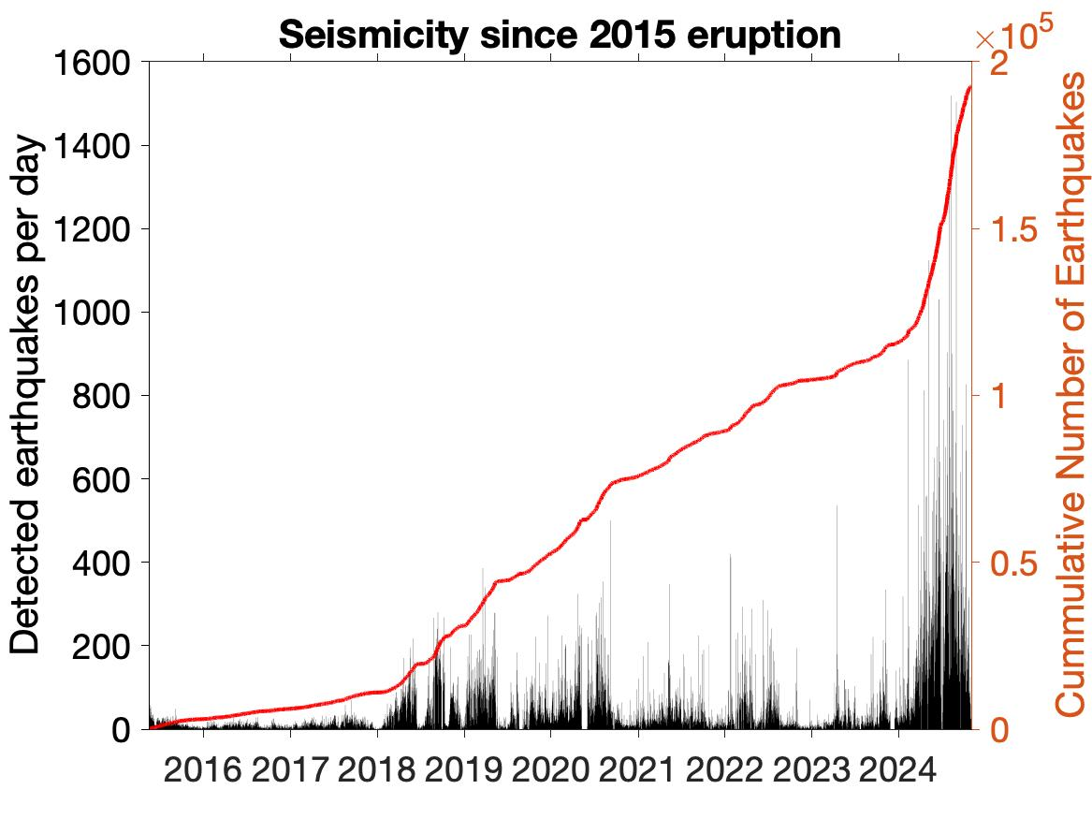
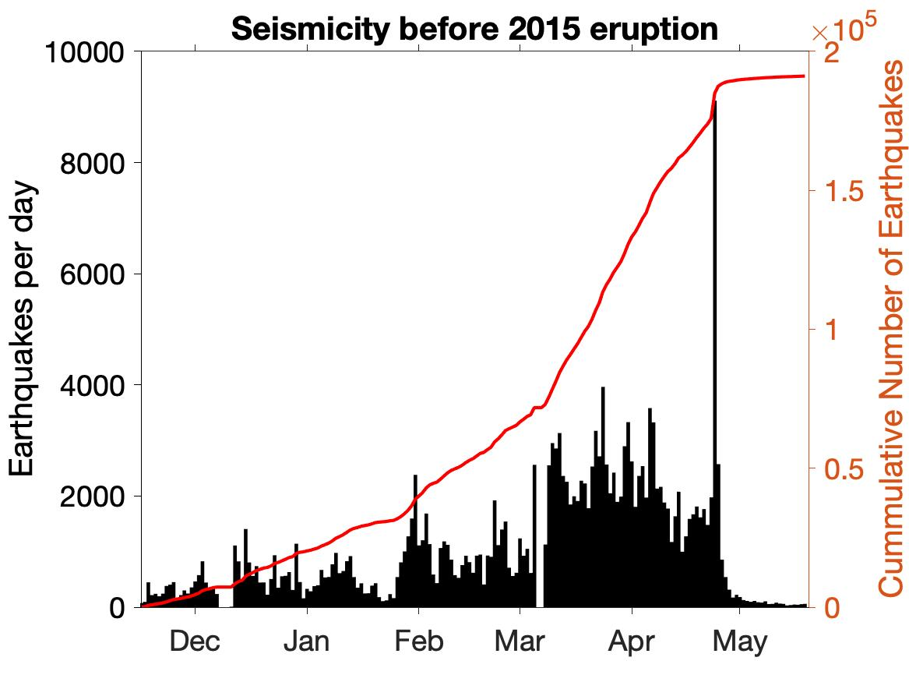
Comparing seismicity since the 2015 eruption vs. leading up to it
Earthquake data from catalog of William Wilcock & Maochuan Zhang, UW

Slide 22
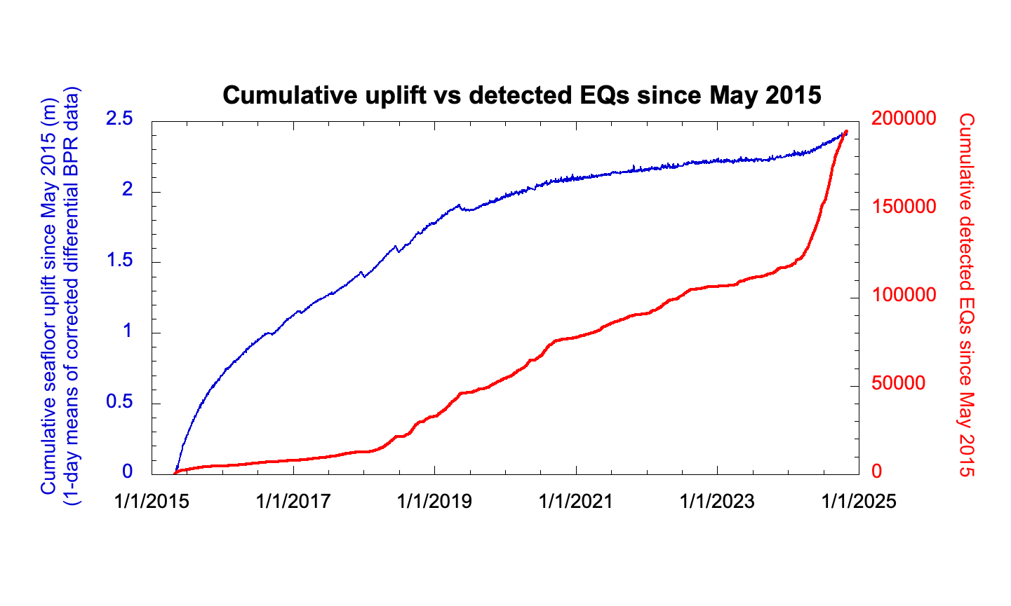
Uplift and seismicity are closely linked
Earthquake data from catalog of William Wilcock & Maochuan Zhang, UW

Slide 23
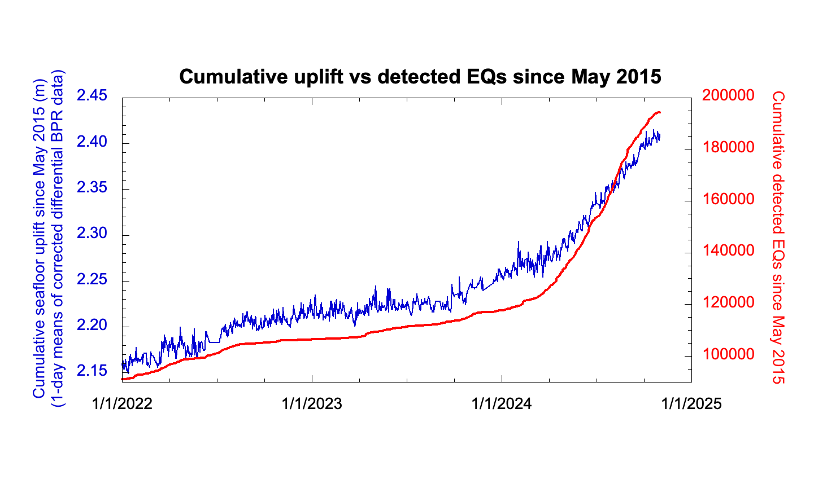
Uplift and seismicity are closely linked
Earthquake data from catalog of William Wilcock & Maochuan Zhang, UW

Slide 24
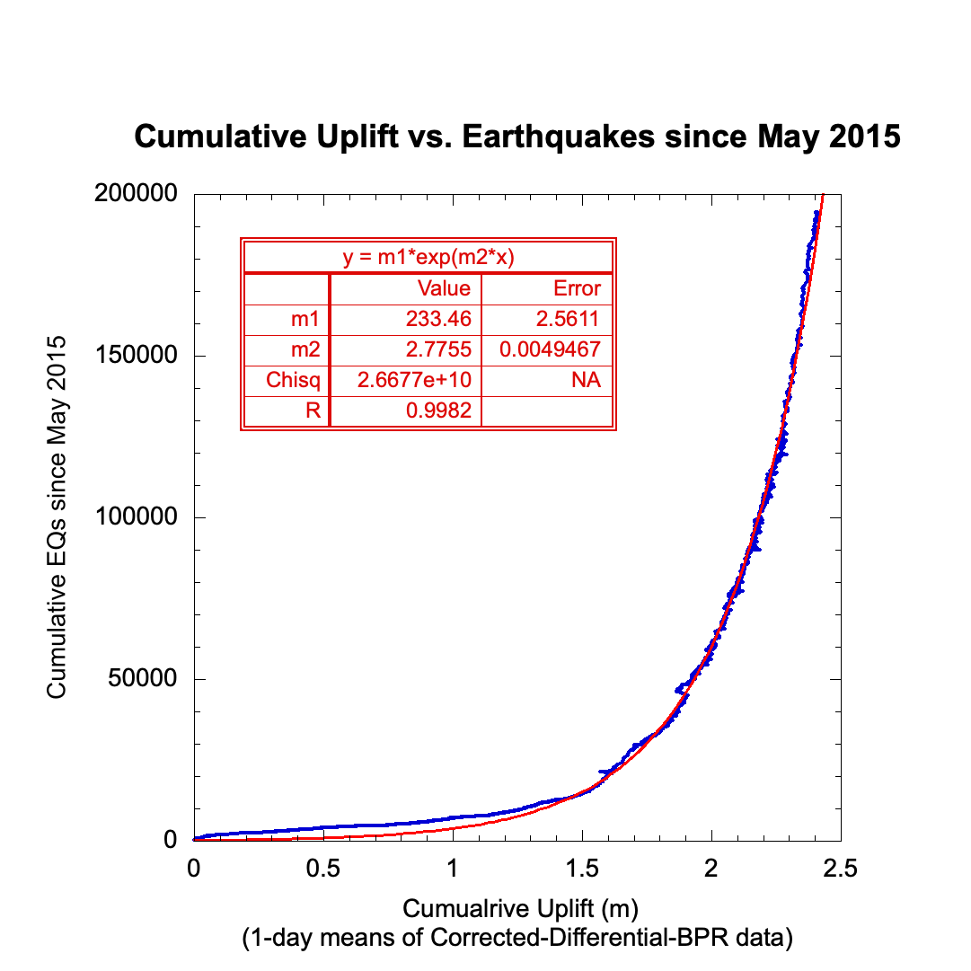
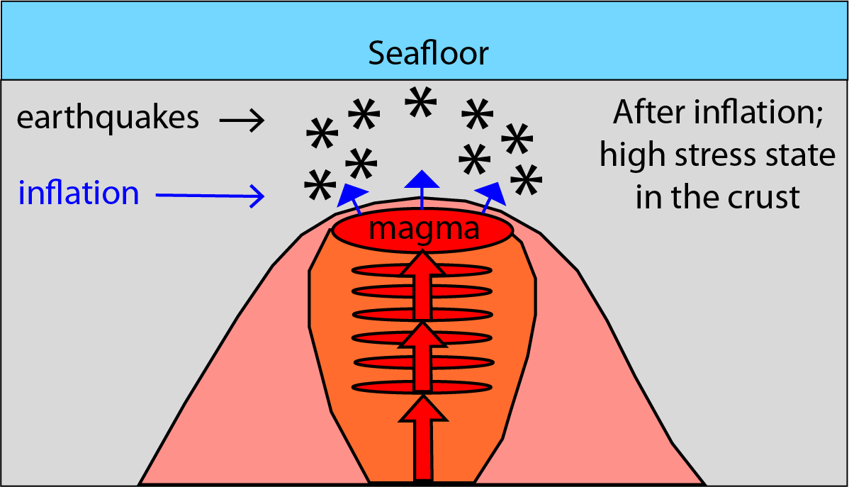
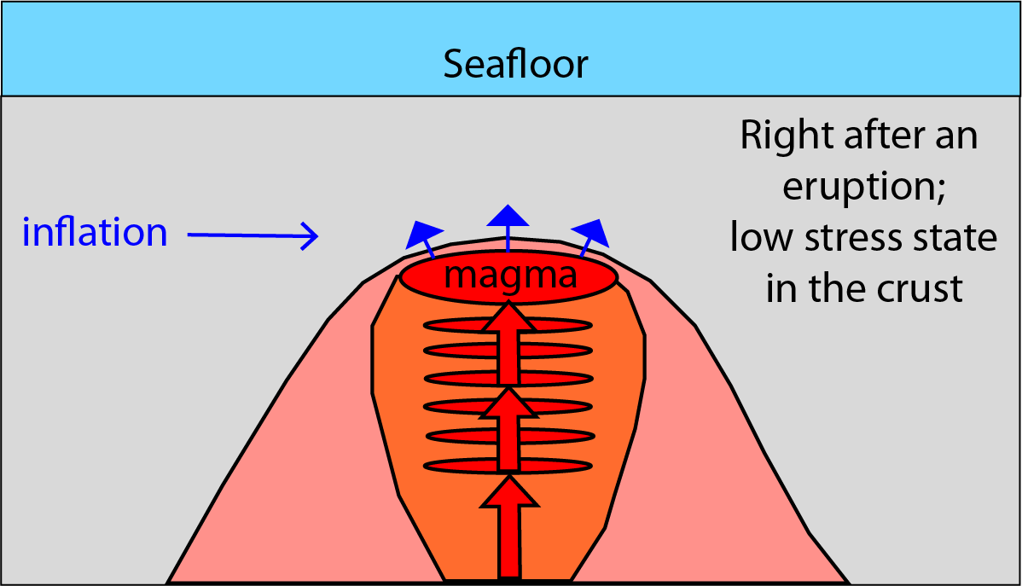
… and follow an exponential curve

Slide 25
SUMMARY
Using differential BPR data increases signal-to-noise of geophysical signals of interest
Axial Seamount has a repeatable deformation cycle that we are attempting to use for forecasting (along with seismicity rates)
… but since the 2015 eruption the rate of inflation has been highly variable, making simple forecasting difficult
Current forecast window is between now and the end of 2025
Cumulative uplift vs cumulative EQs follows an exponential curve (predicted by a forecast model published by Kilburn, 2018)

Slide 26
Axial Seamount monitoring data online:
• Displays of real-time BPR data: axial.ceoas.oregonstate.edu
• Eruption forecast blog: axial.ceoas.oregonstate.edu/axial_blog.html
• Displays of real-time seismic data: axial.ocean.washington.edu
(by William Wilcock and Maochuan Zhang at UW)
• OOI Data Portal: oceanobservatories.org

Slide 27
