Slide 1
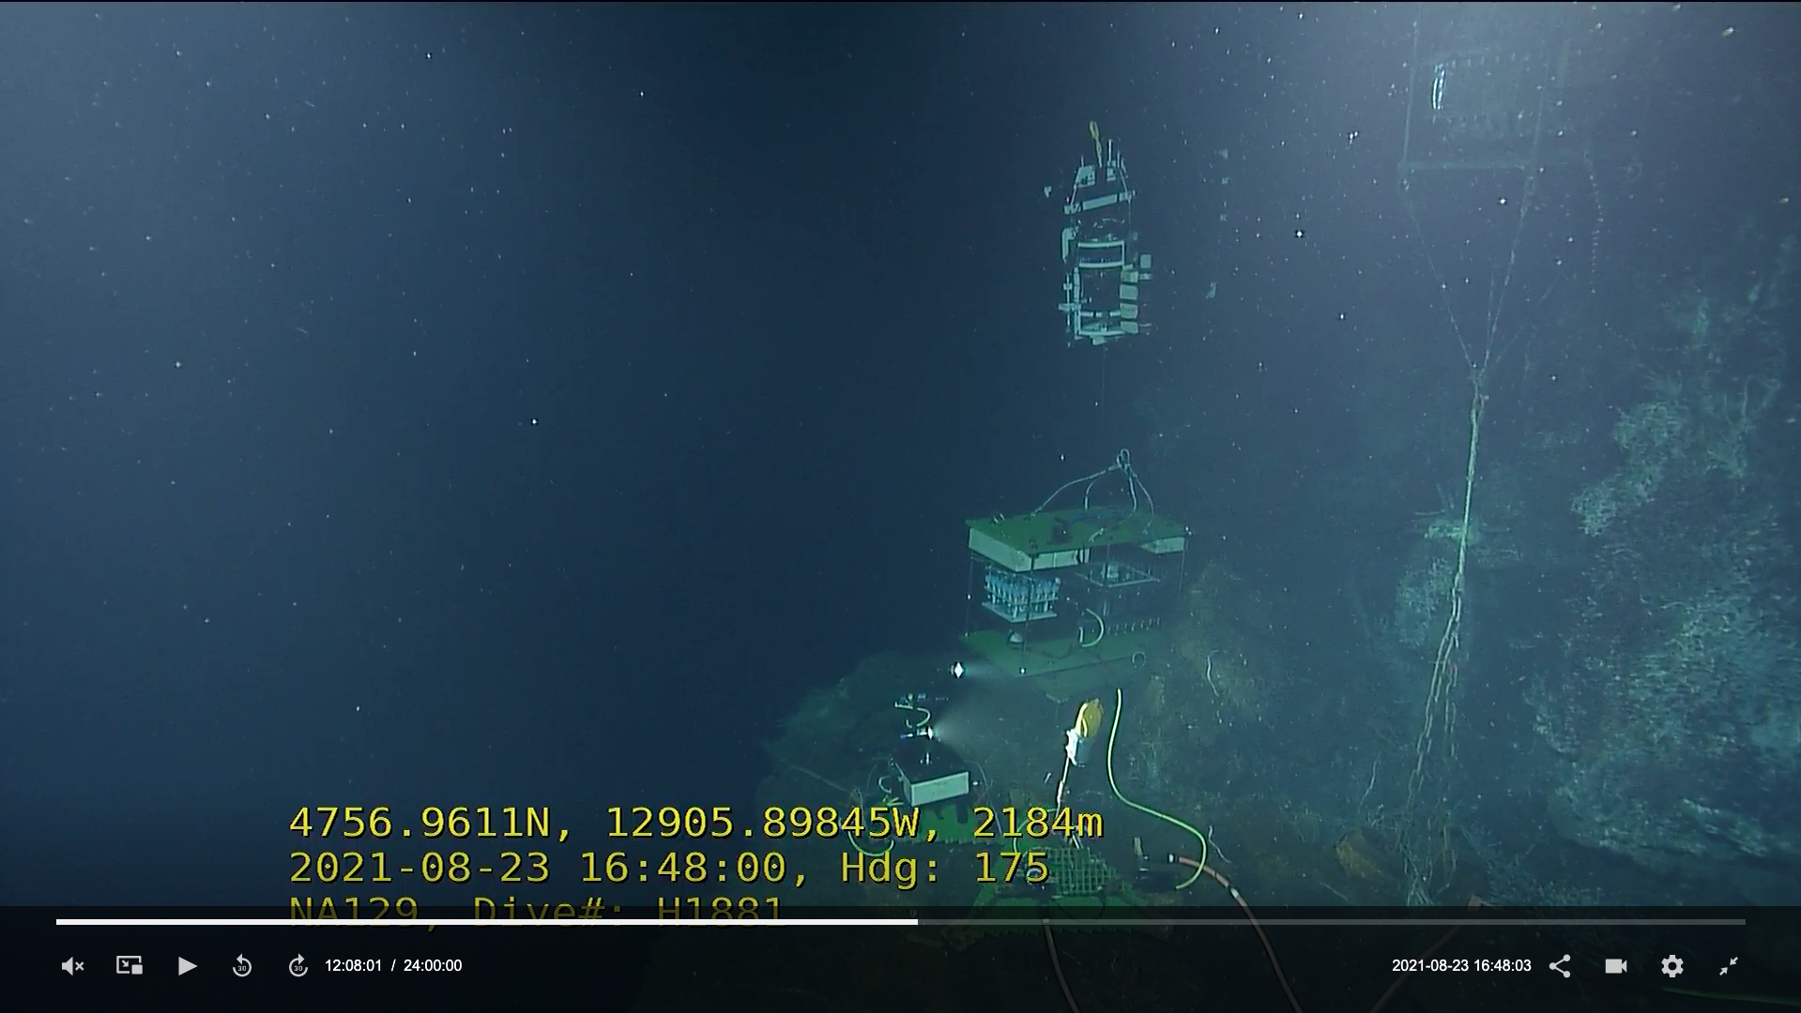
Changes in Venting and
Chimney Structures:
Growth and Collapse
Steve Mihaly
Notes:
Note: Toms previous talk and Brendan Smith’s (afternoon) talks

Slide 2
Maintenance of seafloor infrastructure enables (forces) repeat visits to specific sites
At the Endeavour segment there are now 14 years of repeat visits
I examine two cases of instrument deployments on the Grotto edifice to see what can be gleaned from the unsystematic video from the visits.
I try to take note of how video/lighting quality and ROV piloting technique changes over time. Water clarity is also variable and highly reflective bacterial mats that come and go also strongly effect visibility.
Close with a suggestion we dedicate some break-out discussion time to introduce systematic procedures to better quantify change and other techniques to document change.

Slide 3
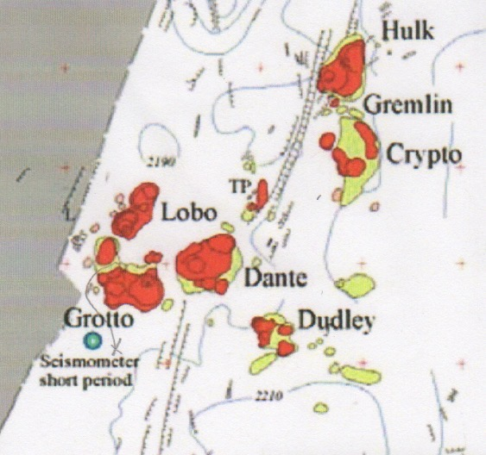
CASE STUDY - High Temp Focused Vent - Growth : BARS
Benthic and Resistivity Sensor, a probe inserted into a hot orifice to measure temperature, resistivity and redox potential (Eh)
First visit by ONC (NEPTUNE CANADA) in September of 2010 after laying cable to MEF and deployment of COVIS. Blue arrow points to the deployment location.
Northwest Corner of Grotto
From Delaney et al., 1992
Notes:
Figure constructed from 25 Alvin dives in 1988

Slide 4
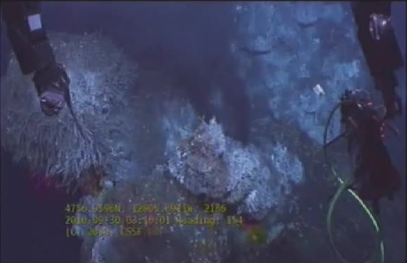
CASE STUDY - High Temp Focused Vent - Growth : BARS - 2010
View of the unoccupied site
Notes:
2010 Just after COVIS deployed, view is quite fuzzy, low res don’t know why.

Slide 5
CASE STUDY - High Temp Focused Vent - Growth : BARS - 2010
Note hairy “nub” and two hot vents
Notes:
2010

Slide 6
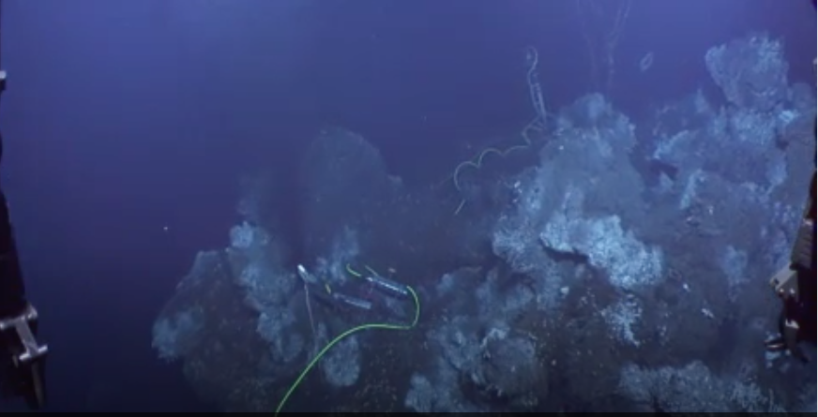
CASE STUDY - High Temp Focused Vent - Growth : BARS - 2010
Notes:
2010 overview, showing how different it can look from a slightly different angle

Slide 7
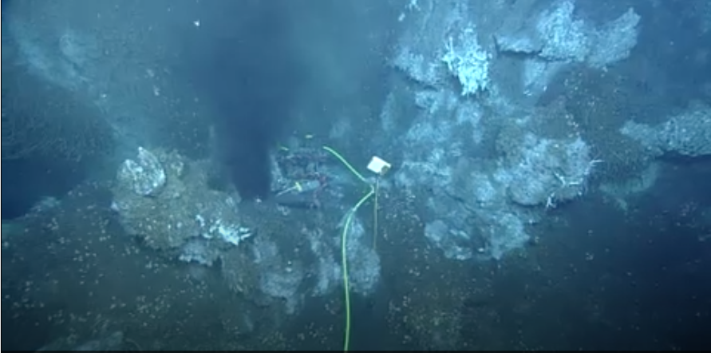
CASE STUDY - High Temp Focused Vent - Growth : BARS - 2010
Notes:
2010 deployed. You can see the visual variability of the same site in the same year with the same ROV

Slide 8
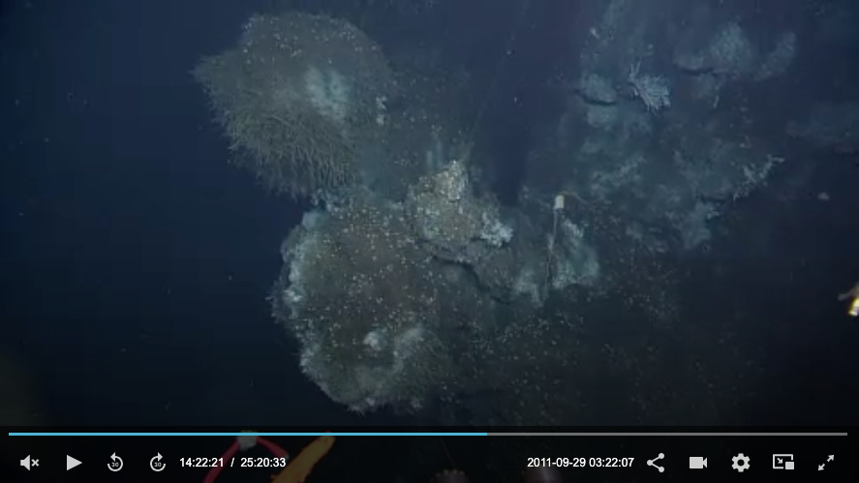
CASE STUDY - High Temp Focused Vent - Growth : BARS - 2011
Notes:
Return one year later in the fall after removing BARS in the spring – showing near identical terrain

Slide 9
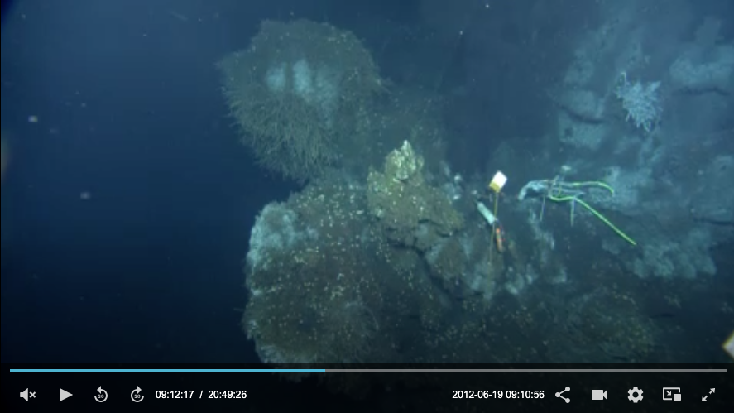
CASE STUDY - High Temp Focused Vent - Growth : BARS - 2012
Notes:
2012 – again near identical terrain

Slide 10
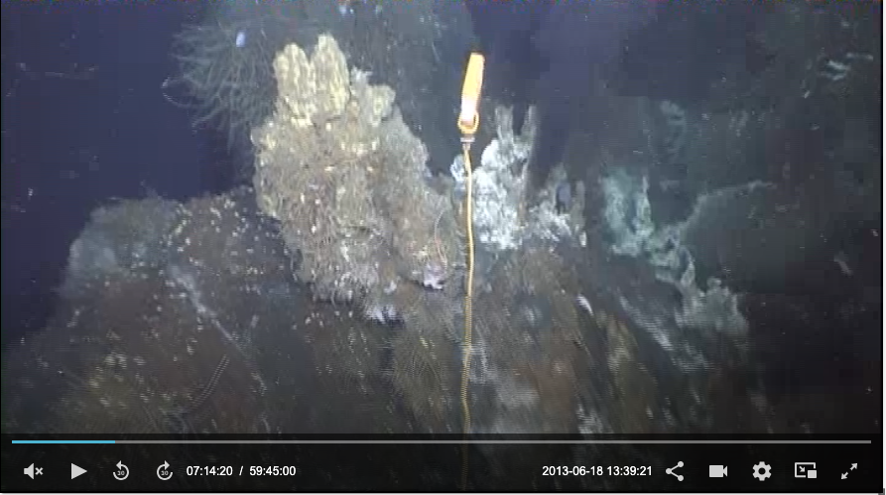
CASE STUDY - High Temp Focused Vent - Growth : BARS - 2013
Notes:
2013, slight change – maybe some more growth: had some problems with cable and wand, we try to float the wand cable, so maybe there is an increase in activity

Slide 11
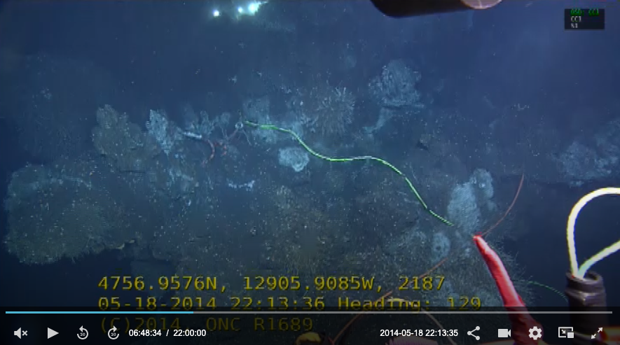
CASE STUDY - High Temp Focused Vent - Growth : BARS - 2014
Notes:
2014 could be filling in in the middle

Slide 12
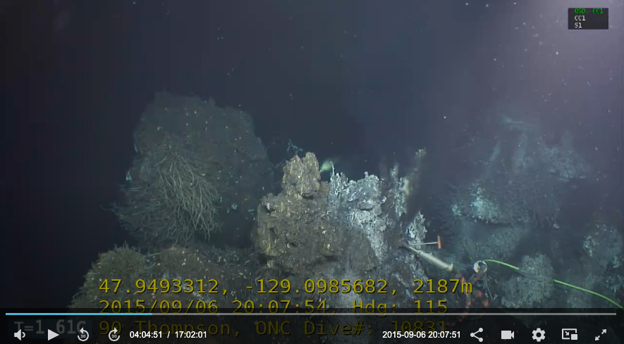
CASE STUDY - High Temp Focused Vent - Growth : BARS - 2015
Notes:
2015 – slightly balder ”nub”, growing in a little at the right

Slide 13
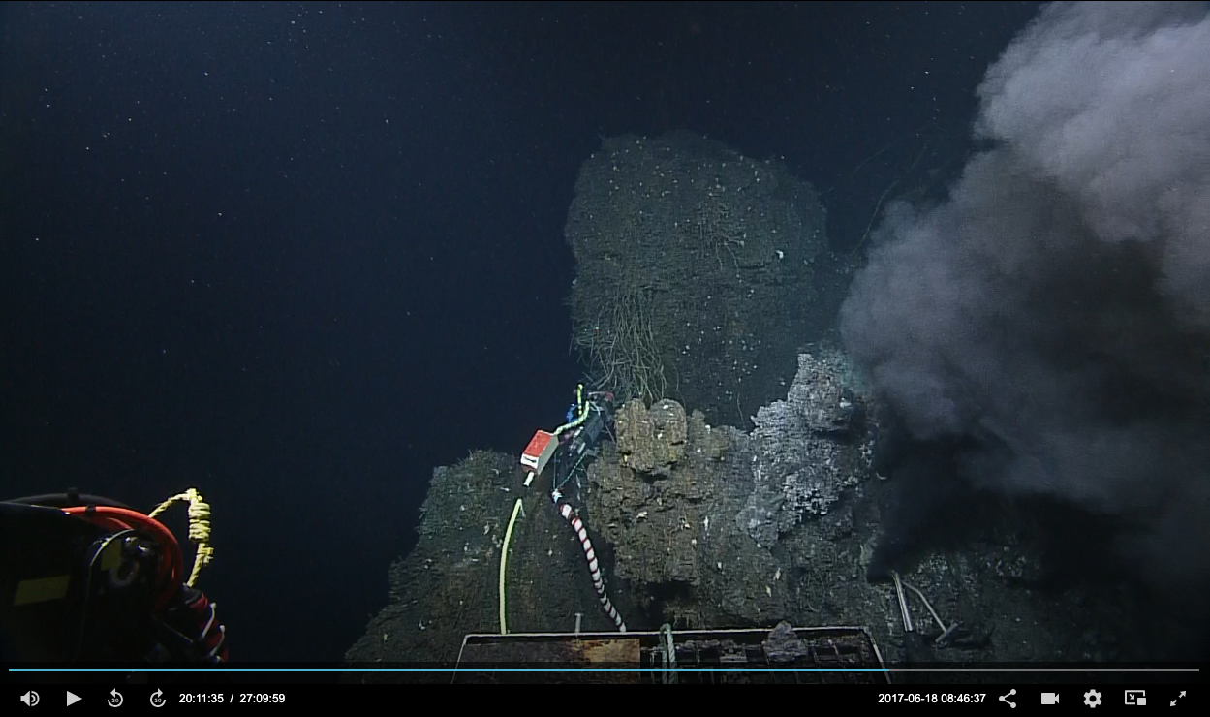
CASE STUDY - High Temp Focused Vent - Growth : BARS - 2017
Notes:
2017 BARS Did not visit BARS site in 2016. Not much change, maybe more vigorous

Slide 14
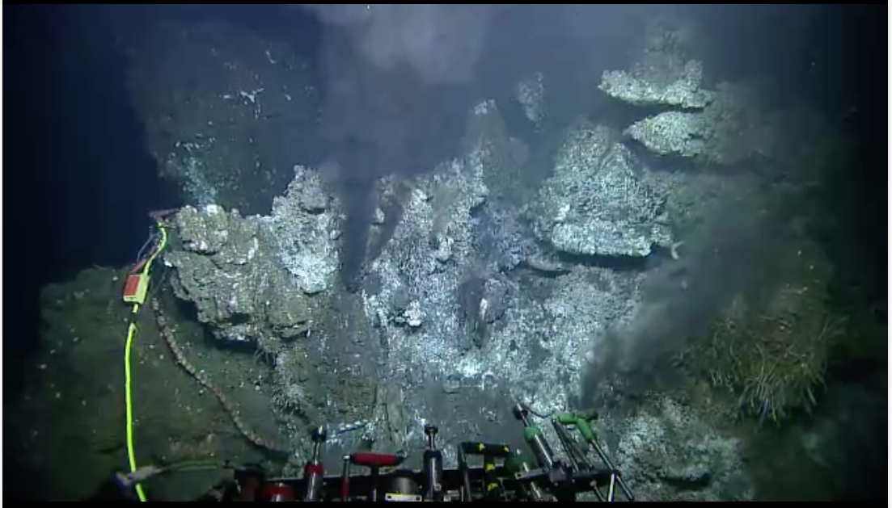
CASE STUDY - High Temp Focused Vent - Growth : BARS - 2018
Notes:
2018 – the mid section has now definitely grown in

Slide 15
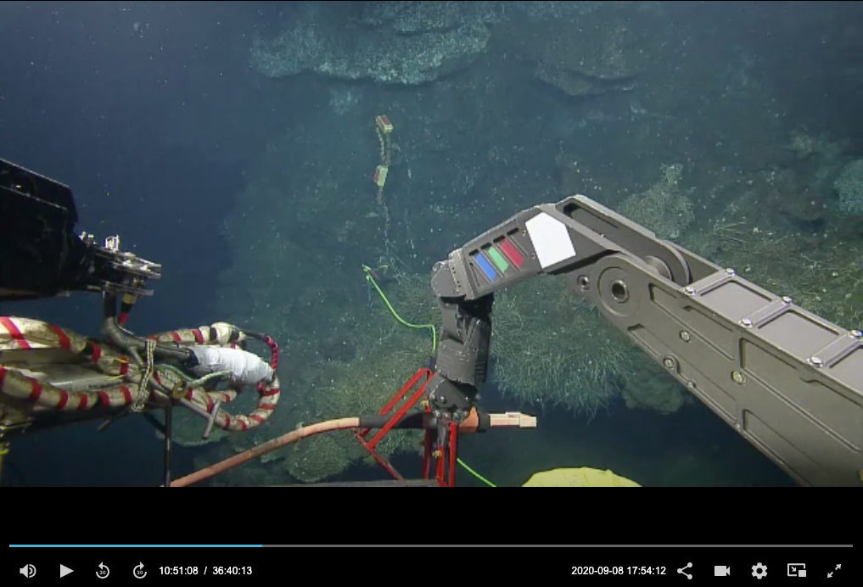
CASE STUDY - High Temp Focused Vent - Growth : BARS - 2020
2018
2020 – same BARS
BARS moved?
Radical change
Notes:
BARS appeared to have moved over this period, slid down, ot pulled by falmat. Coincides with a collapse at Tempo-mini

Slide 16
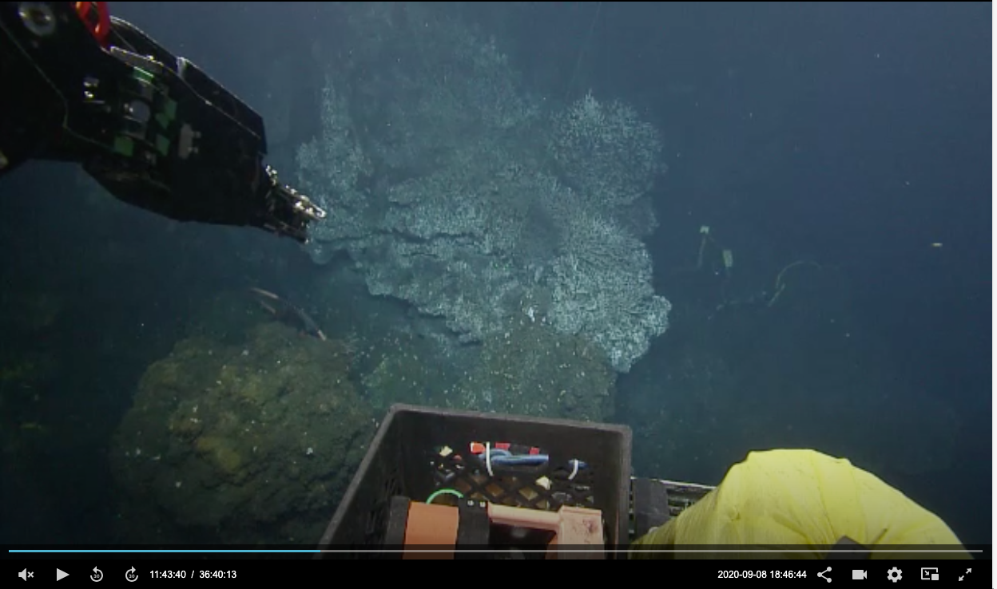
CASE STUDY - High Temp Focused Vent - Growth : BARS - 2020
Notes:
2020 the outer edges are dying and the middle is growing, but it is more diffuse with not much black smoker

Slide 17
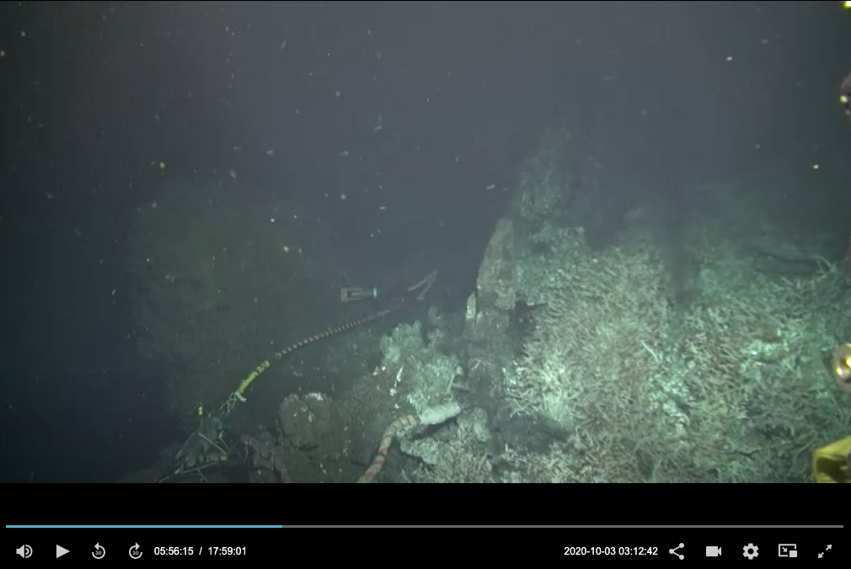
CASE STUDY - High Temp Focused Vent - Growth : BARS - 2020
Notes:
2020 deployment. Had a hard time finding a suitable hot vent.

Slide 18
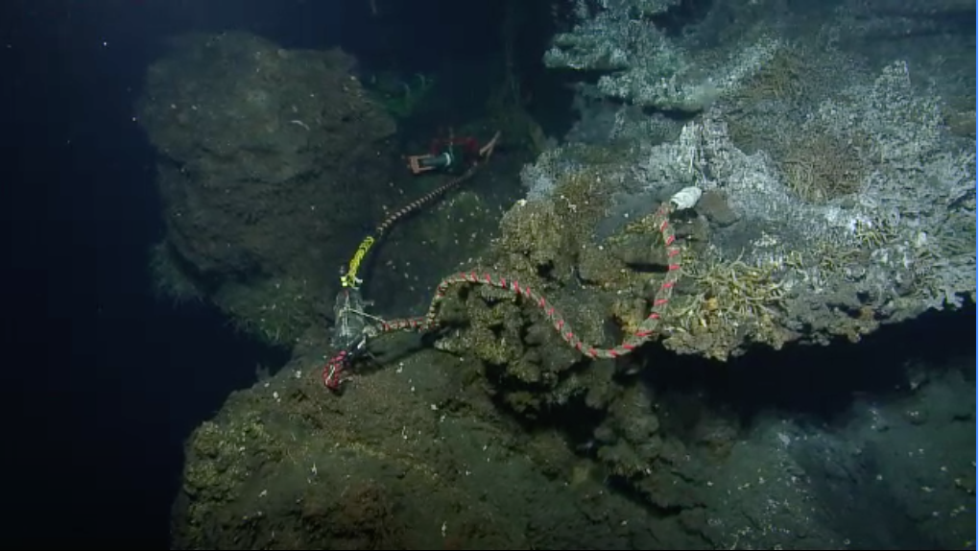
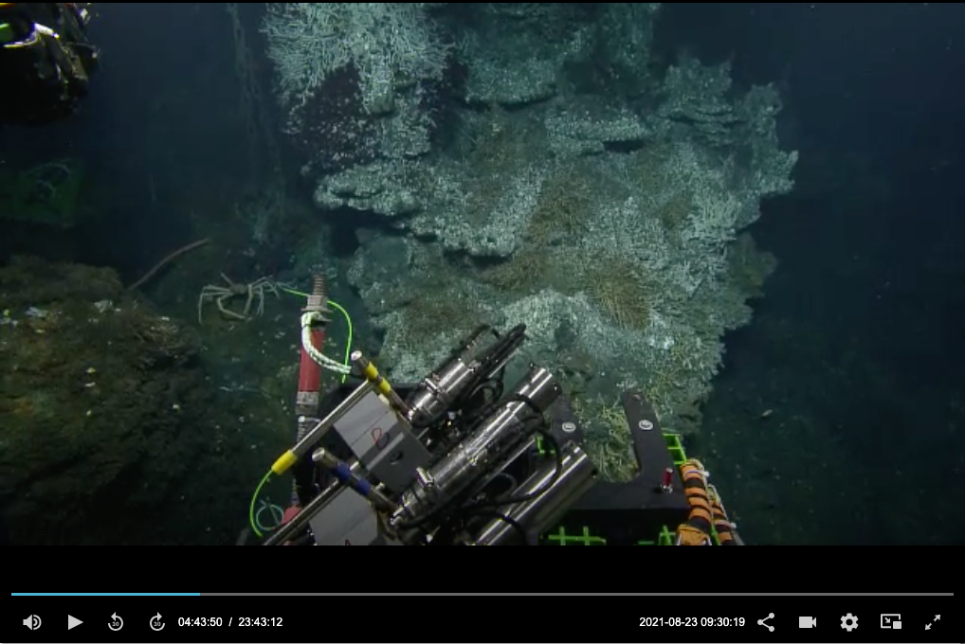
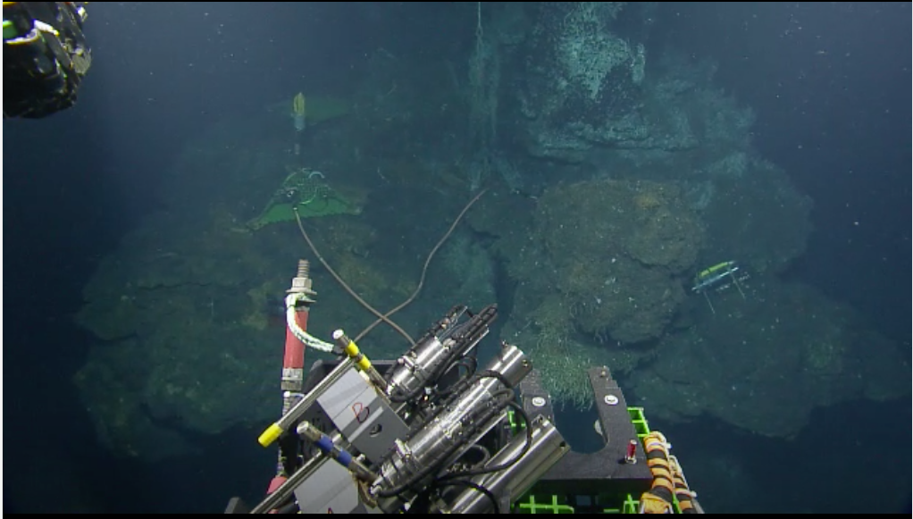
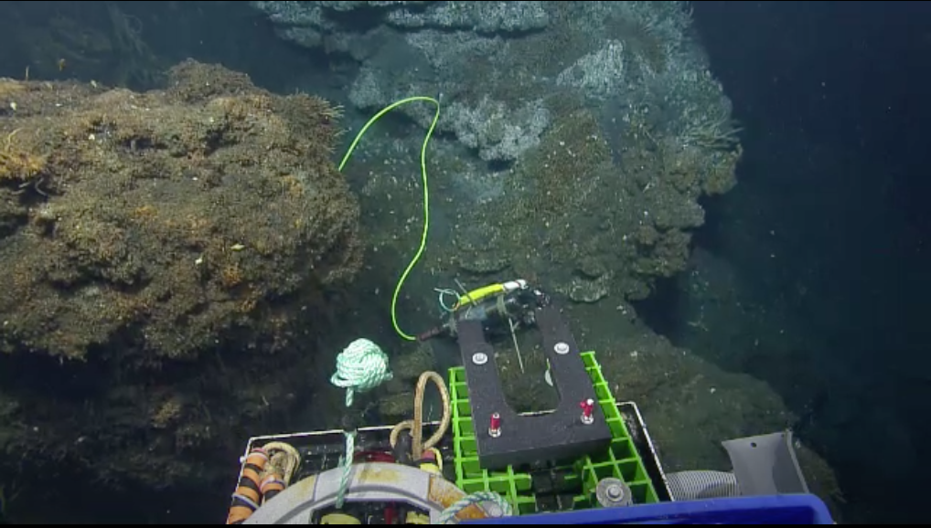
CASE STUDY - High Temp Focused Vent - Growth : BARS - 2021
Notes:
2021 old BARS recovery. Nub is still there, if it is the same nub, return looks identical

Slide 19
CASE STUDY - High Temp Focused Vent - Growth : BARS - 2021
Notes:
2021 Nub is still there, but big growth behind it.
Installing the wand in the new growth was not easy, no strong smokers with straight pipes

Slide 20
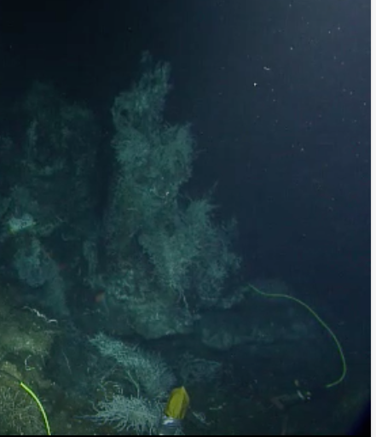
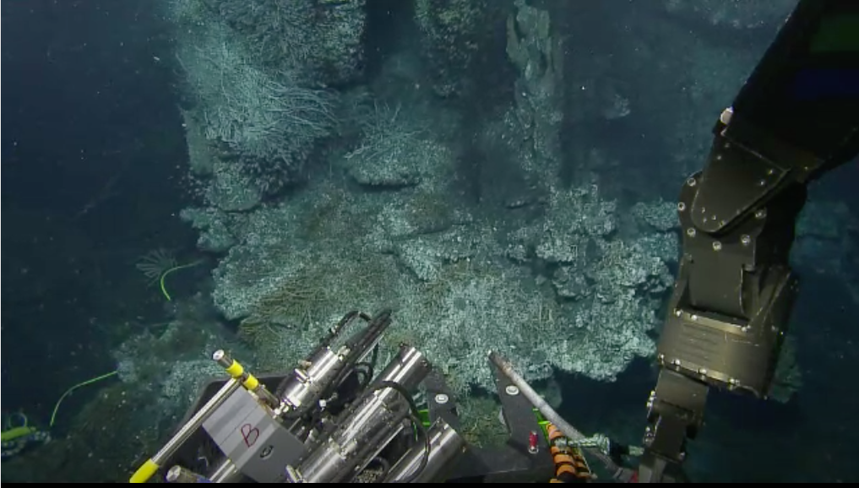
CASE STUDY - High Temp Focused Vent - Growth : BARS - 2021
Notes:
2021 deployment. Installing the wand in the new growth was not easy, no strong smokers with straight pipes

Slide 21
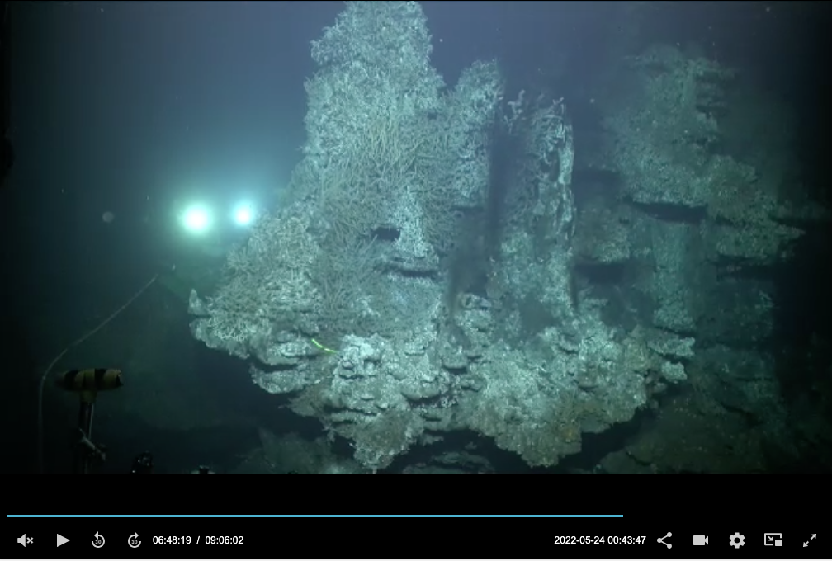
CASE STUDY - High Temp Focused Vent - Growth : 2022 BARS Eaten
Notes:
2022. 2021 BARS eaten no sign of the nub no good place to install BARS

Slide 22
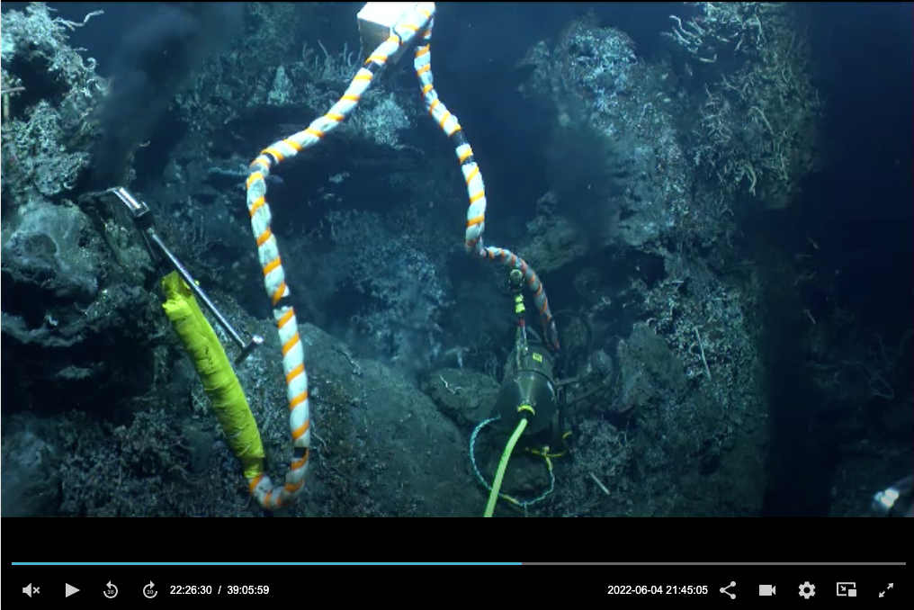
CASE STUDY - High Temp Focused Vent - Growth : BARS – new site 2022
Notes:
Have to move 2022 BARS deployment to a new site around the east side of the new growth.

Slide 23
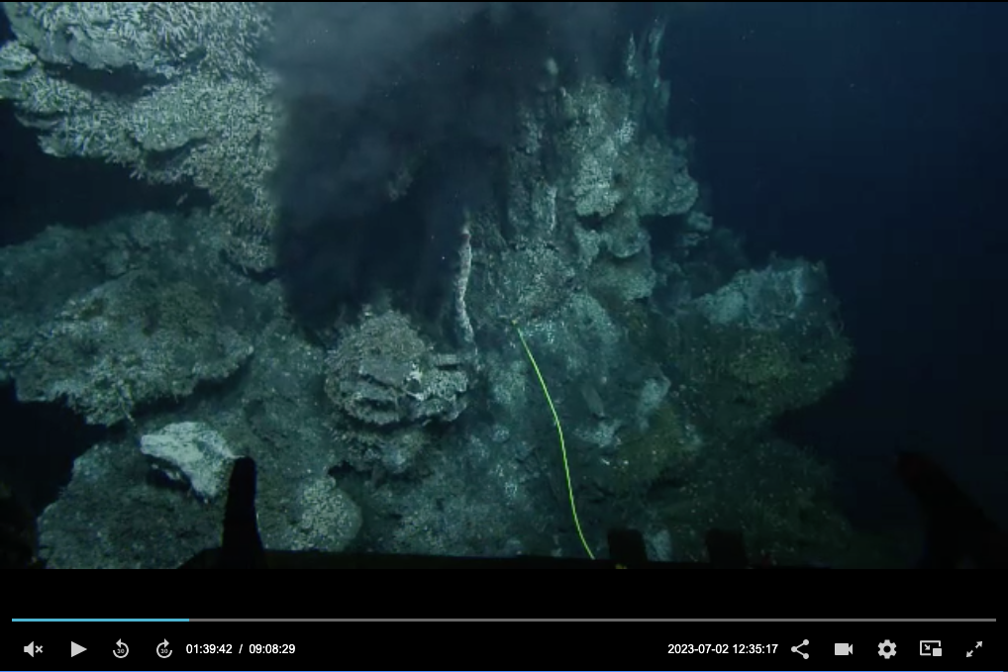
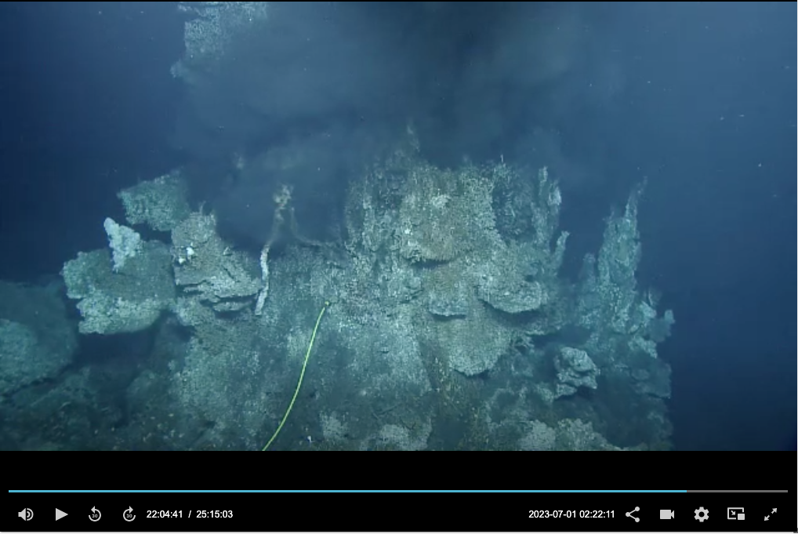
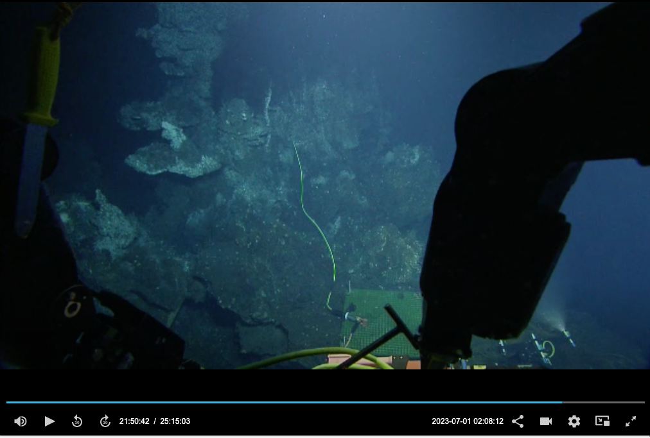
CASE STUDY - High Temp Focused Vent - Growth : BARS – 2023 eaten
Notes:
2023. 2022 deployed BARS on the back side of growth is also eaten

Slide 24
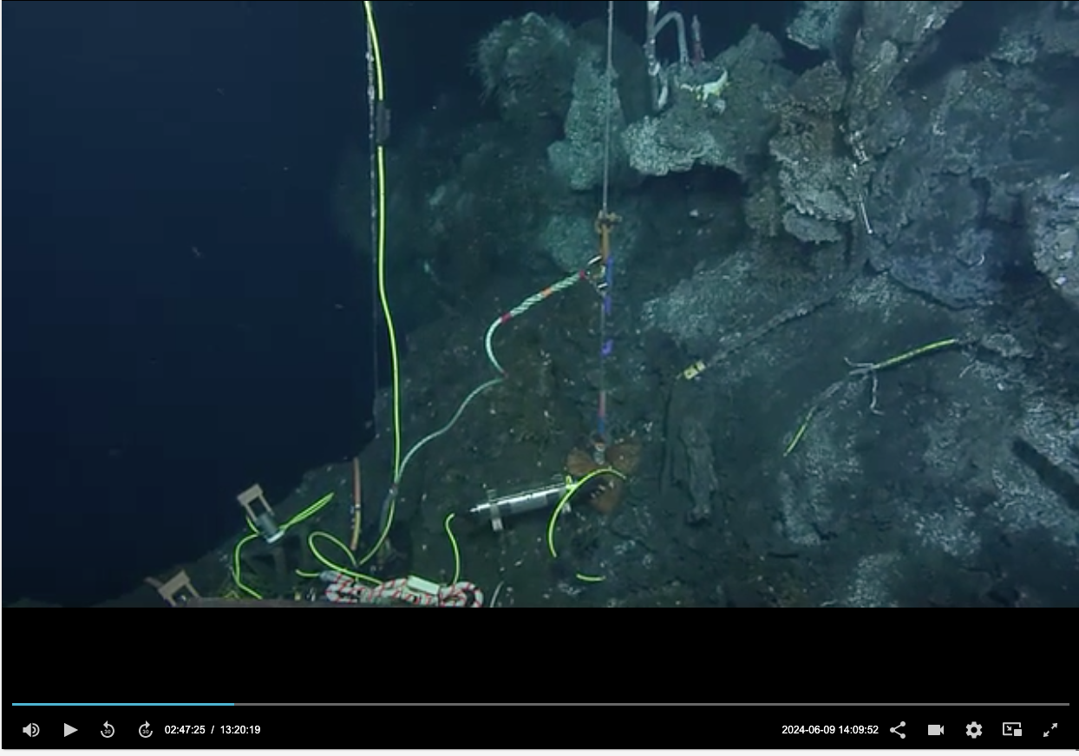
CASE STUDY - High Temp Focused Vent - Growth : BARS – new stable site 2023 -2024
Notes:
Old 2023 BARS view will occupy the same orifice with the new BARS

Slide 25
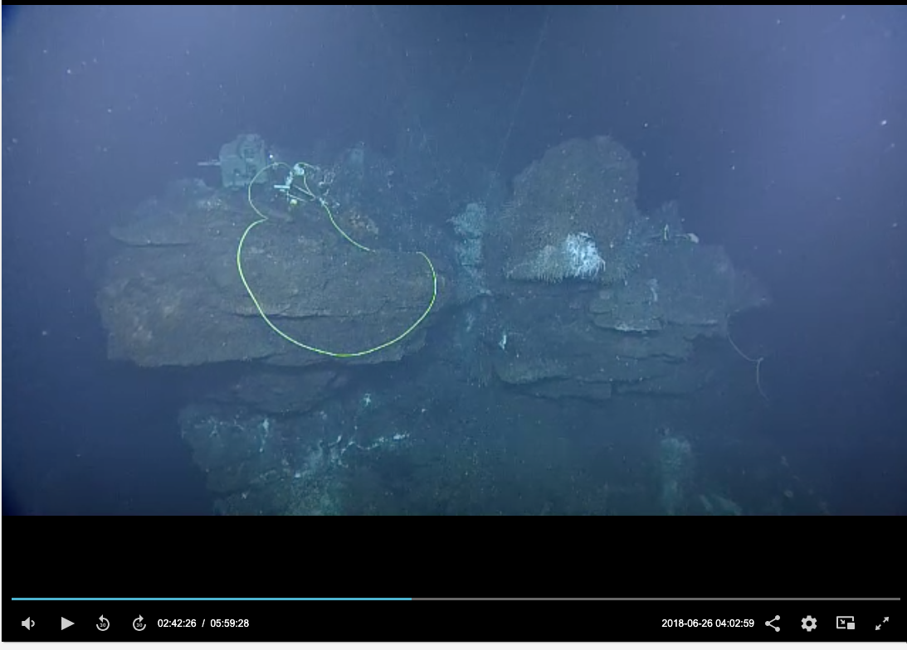
CASE STUDY - Diffuse Venting Site - Collapse: TEMPO-Mini – 2018 note ledge structure of Grotto
Notes:
Note ledges in 2018 and the BARS nub. Also this is ROPOS and they are confident to fly away from the site not worried as much into backing into anything. We needs to ask for these overview shots when things are clear. Jun 2018 R2081 Tully. No visit to this area in the two cruises in 2019.

Slide 26
CASE STUDY - Diffuse Venting Site - Collapse: TEMPO-Mini – 2022 ledge structure
Notes:
Note ledges being built in 2022 to eat BARS

Slide 27
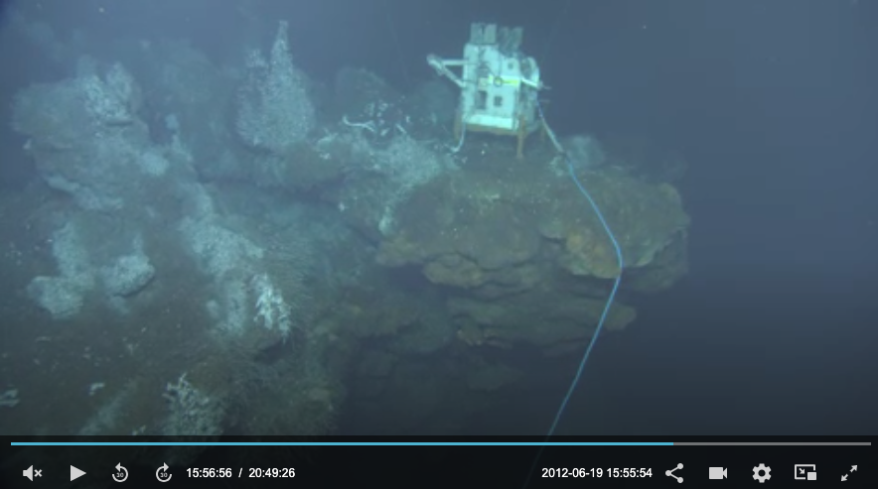
CASE STUDY - Diffuse Venting Site - Collapse: TEMPO-Mini
Deployed continually on this ledge from 2011 to 2019
Notes:
Deployed almost continually from 2011 to 2019

Slide 28
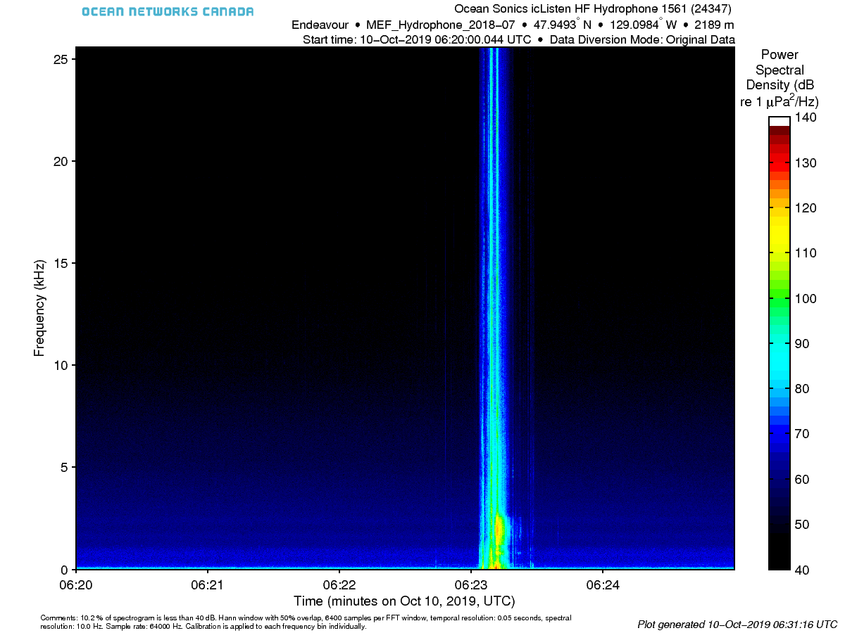
CASE STUDY - Diffuse Venting Site - Collapse: TEMPO-Mini – 2019
Hydrophone deployed next to TEMPO-Mini on the ledge in 2018
5 min spectrogram, Oct 10th, 2019
Notes:
5 minute spectrogram Oct 10th, 2019
MEF Hydrophone first deployed July 25th, 2018

Slide 29
CASE STUDY - Diffuse Venting Site - Collapse: TEMPO-Mini – 2019
Temperature at Grotto BARS
300
200
100
Oct, 10th, 2019
Notes:
5 minute spectrogram Oct 10th, 2019

Slide 30
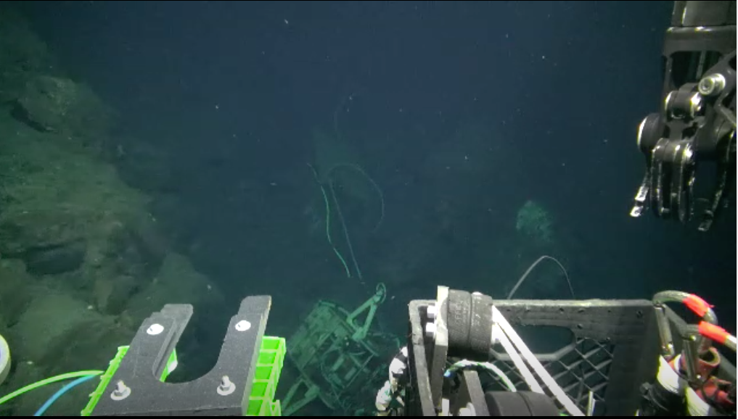
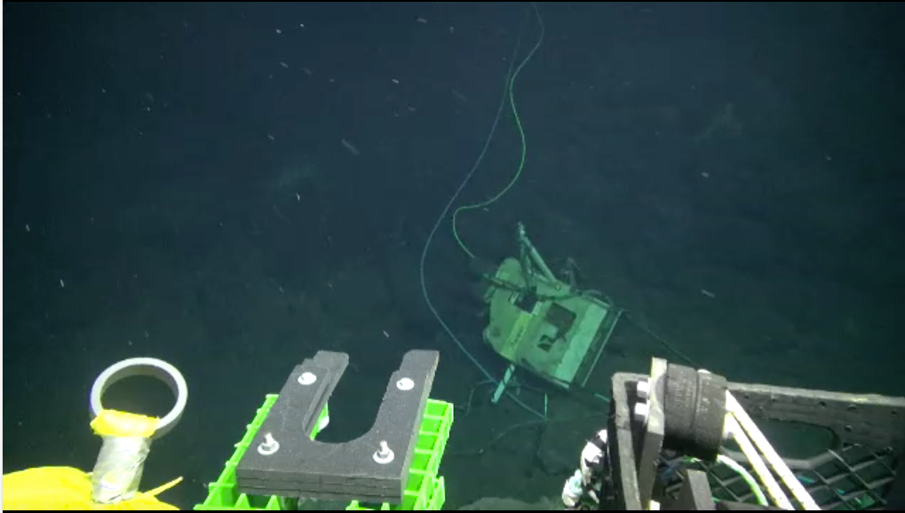
CASE STUDY - Diffuse Venting Site - Collapse: TEMPO-Mini - 2020
TEMPO-Mini at the base of the north side of Grotto
Notes:
No shots of the cliff, can’t tell if the nub also fell at this time.
OY052 2020-06-13 00:46:17

Slide 31
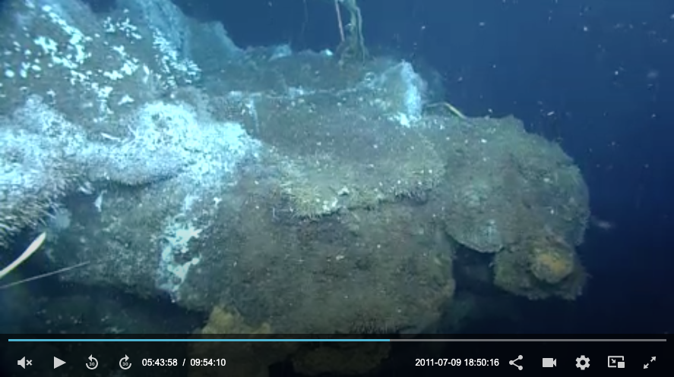
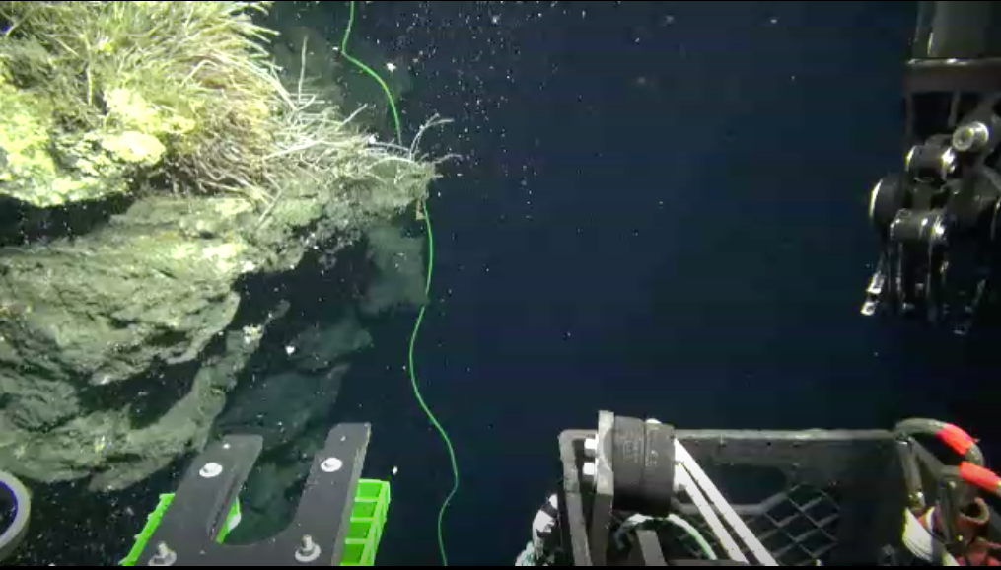
CASE STUDY - Diffuse Venting Site: TEMPO-Mini - 2020
2020
2011
Notes:
Compare original cliff with 2020 cliff
OY052 2020-06-13 00:46:17

Slide 32
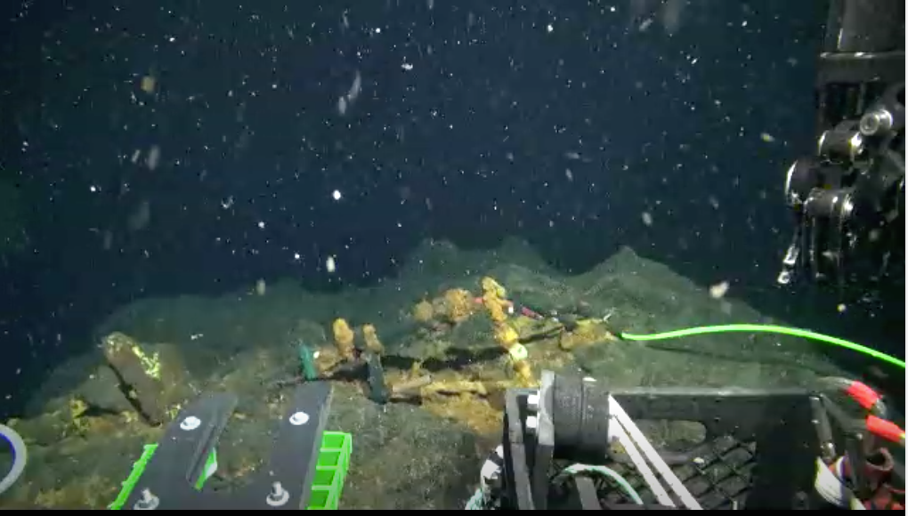
CASE STUDY - Diffuse Venting Site: TEMPO-Mini - 2020
Hydrophone stand turned into rust. Nominally hard objects can grow or disintegrate in this environment.
Notes:
Top of cliff with hydrophone and stand turned into rust
OY052 2020-06-13 00:46:17

Slide 33
Visual changes at Grotto were very minimal for the first 7 years.
In 2018, signs of the start of growth at the BARS location.
In 2019 Tempo-mini ledge and possibly BARS “nub” broke off
By 2022 original BARS location had to be abandoned because hot orifices were melding with diffuse venting and intense growth of the structure would encase a BARS within a year
The compiling and interpretation of these images was much more labour intensive than expected.
Need to devise a systematic procedures. Break-out topic? Photogrammetry, Hi-res multibeam?

Slide 34
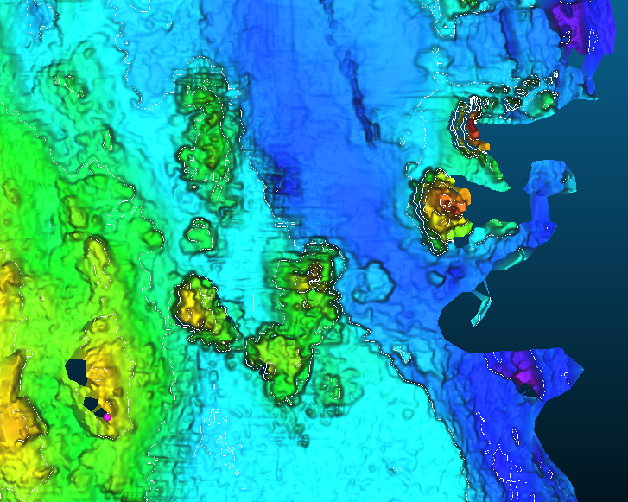
END
Notes:
Delaney et al 1992 from 25 Alvin dives in 1988, Norbit from

