Slide 1
The evolution of vent fluid temperature and chemistry
Marv Lilley
University of Washington
With thanks to Steve Mihaly, A.J. Baron, Jeb Dexter, and Morgan Charlton

Slide 2
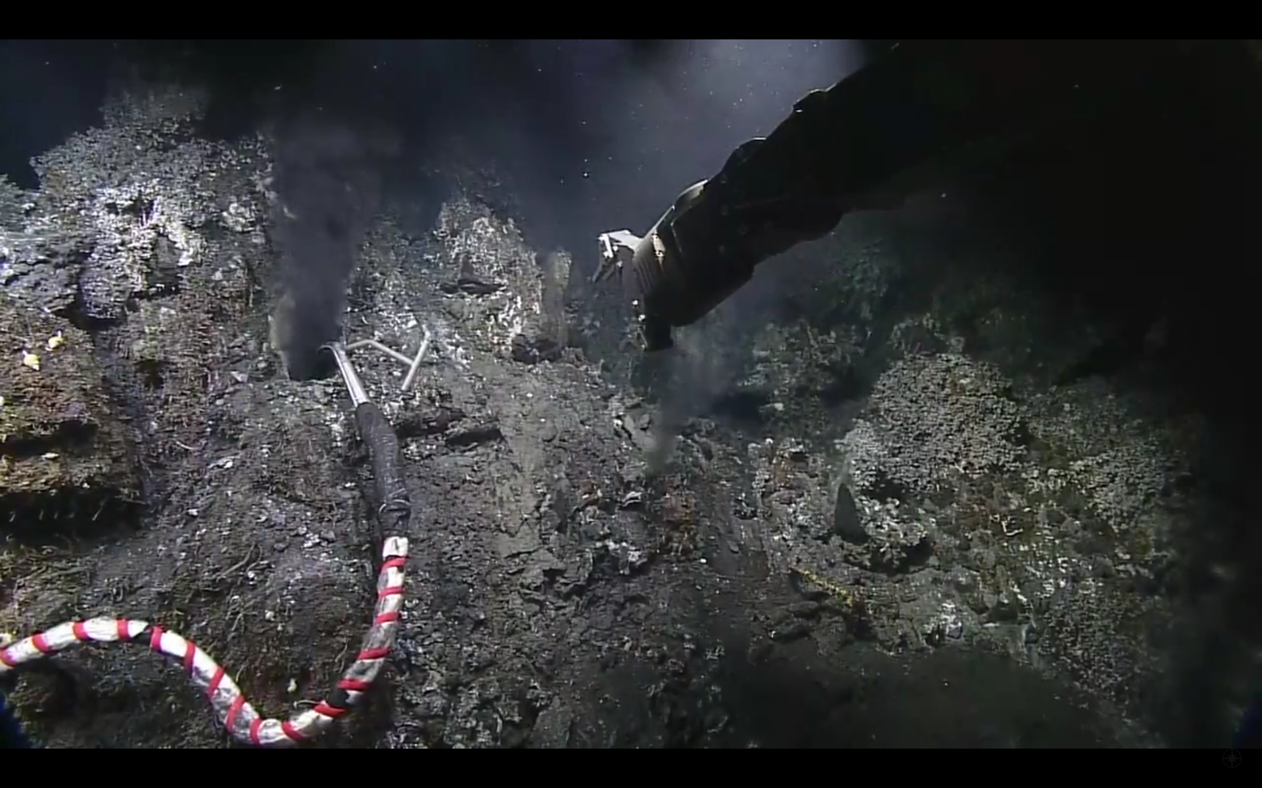
Grotto 2018

Slide 3
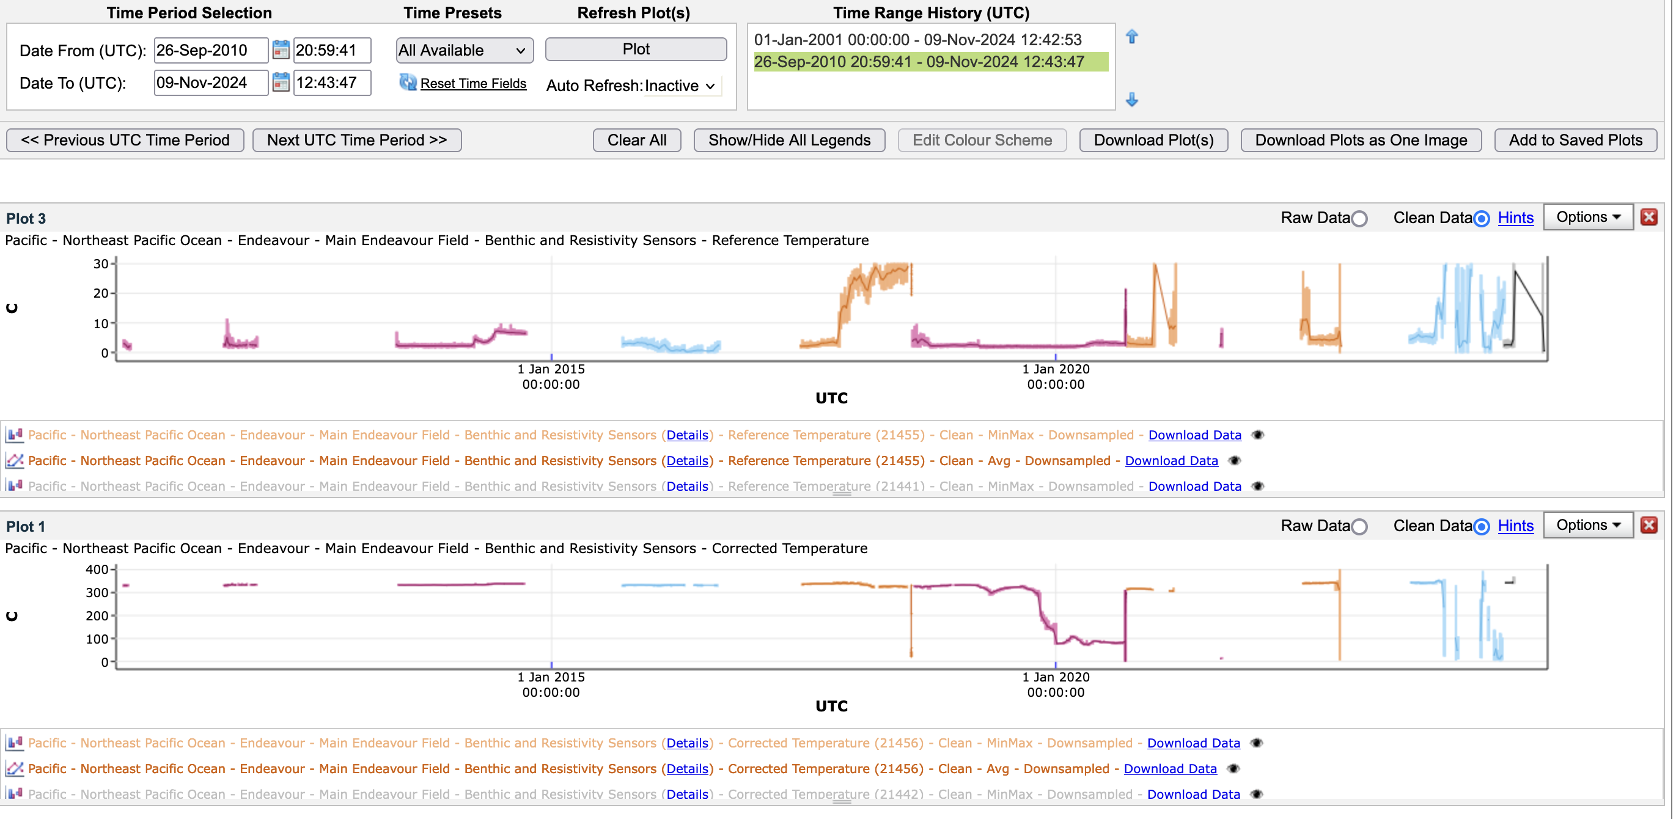
Grotto

Slide 4
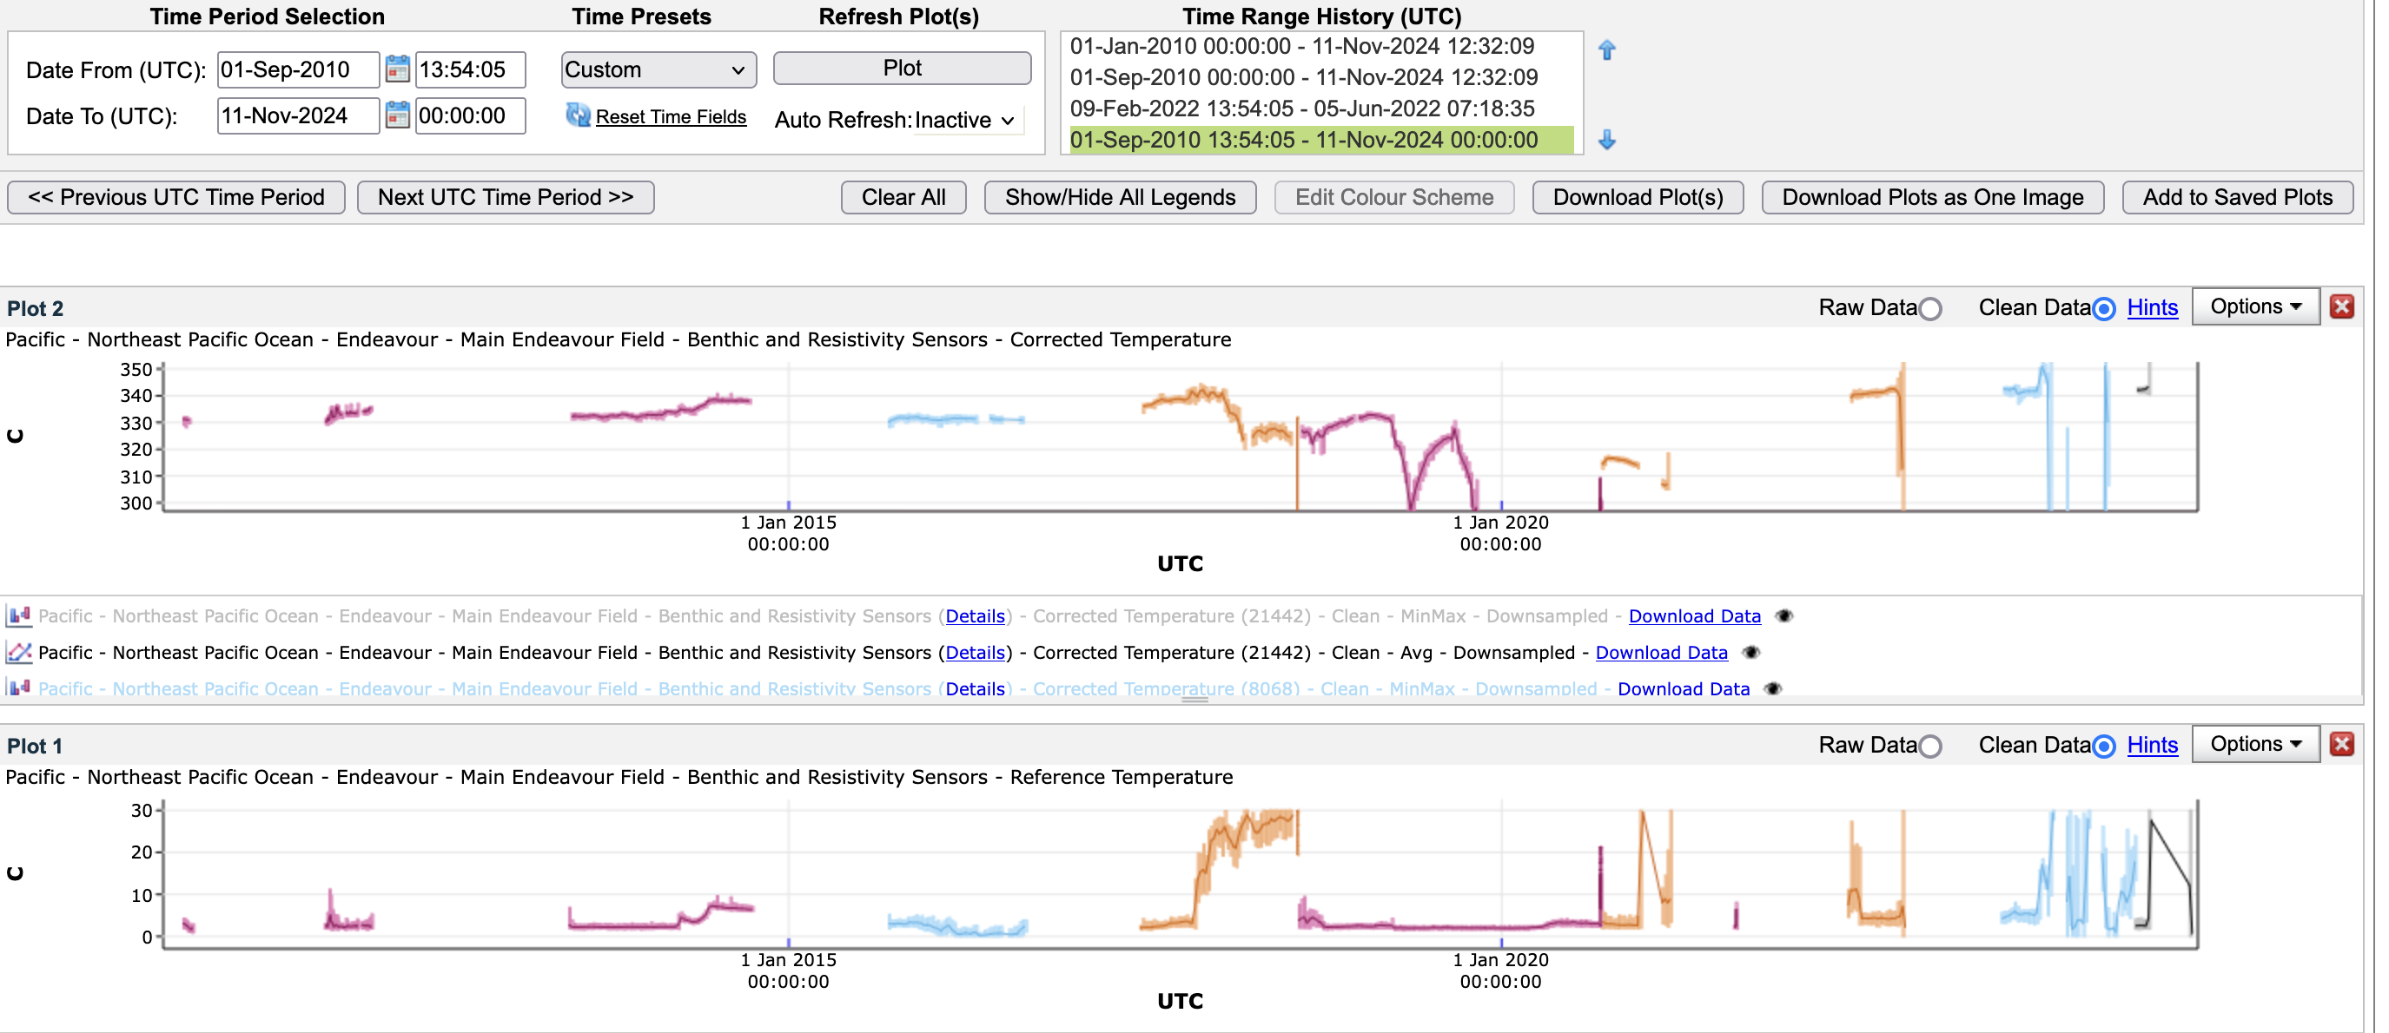
Grotto

Slide 5
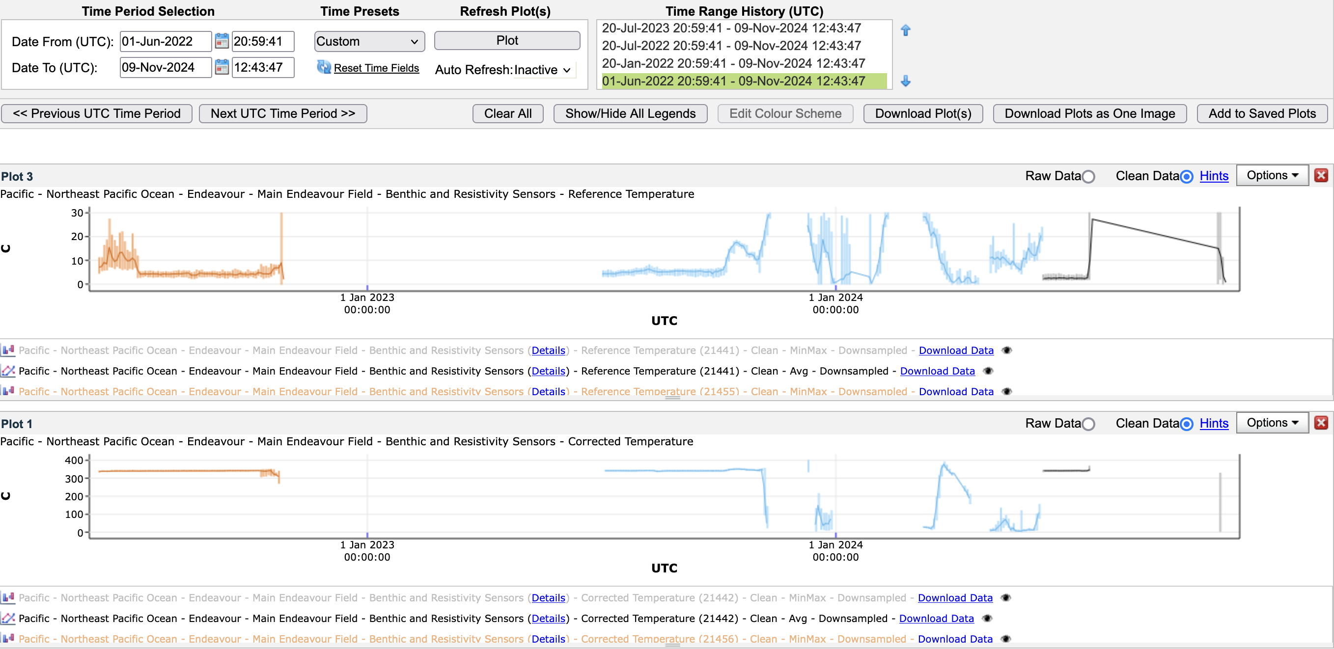
Grotto

Slide 6
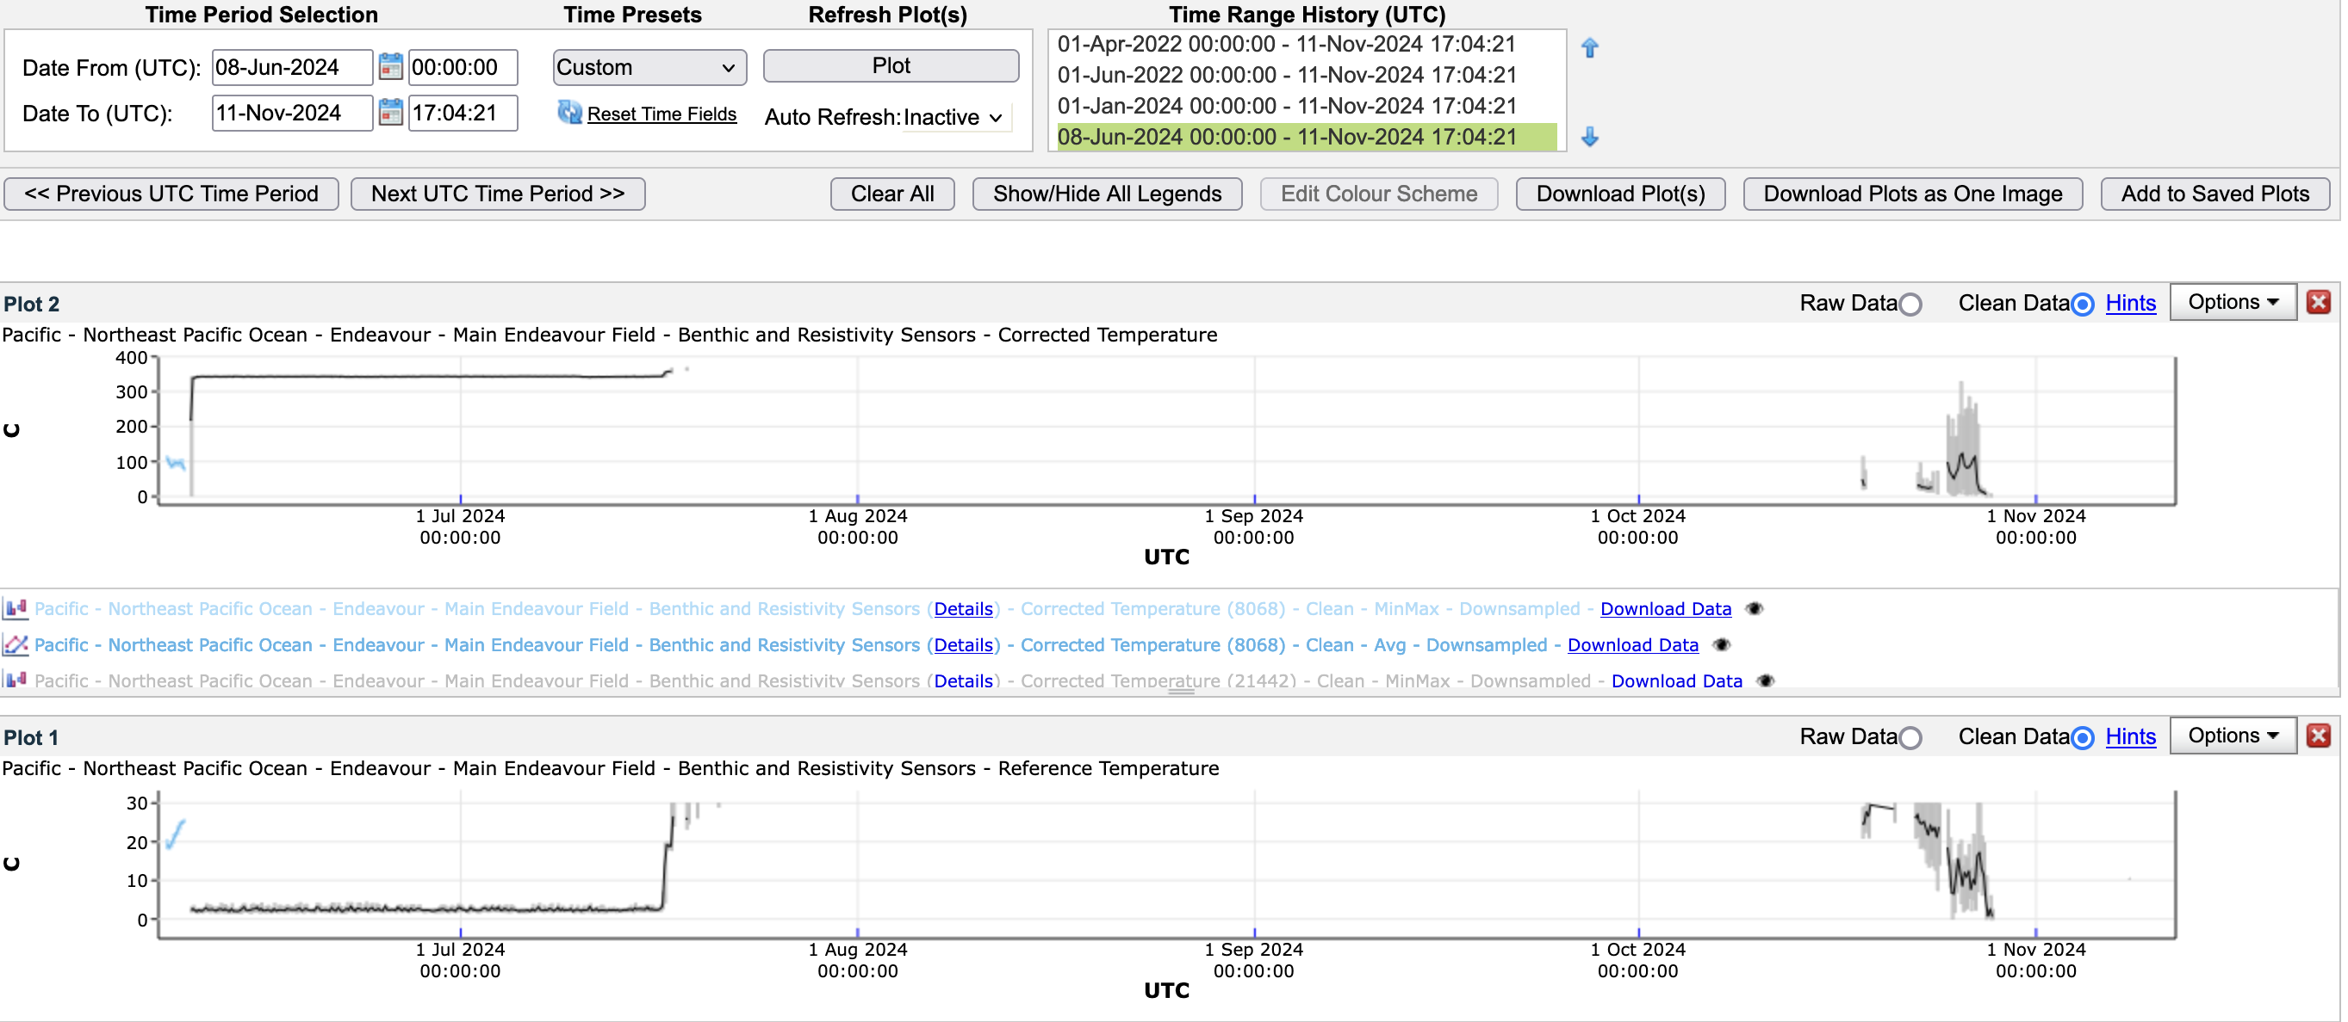
Grotto

Slide 7
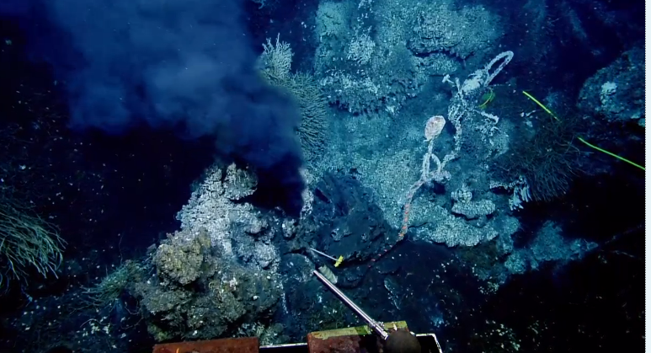
Grotto 2016

Slide 8
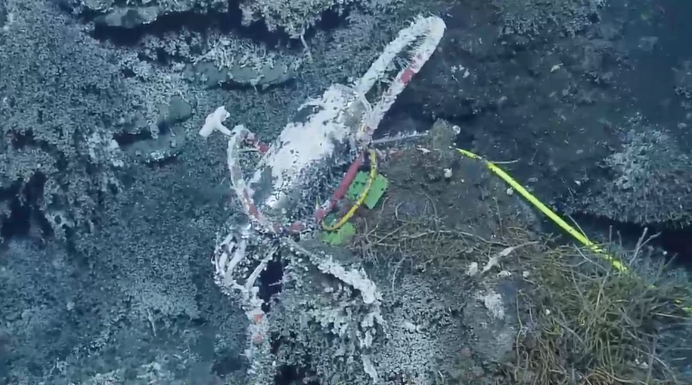
Grotto 2016

Slide 9
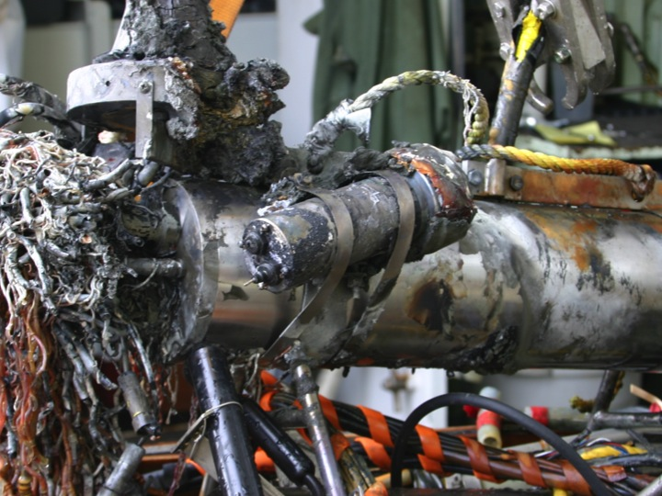

Slide 10
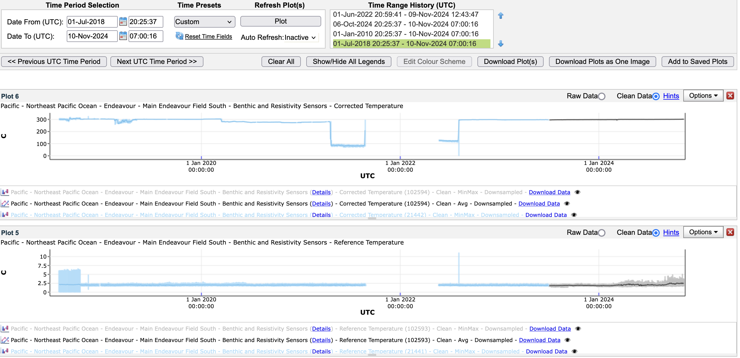
Sanya Village

Slide 11
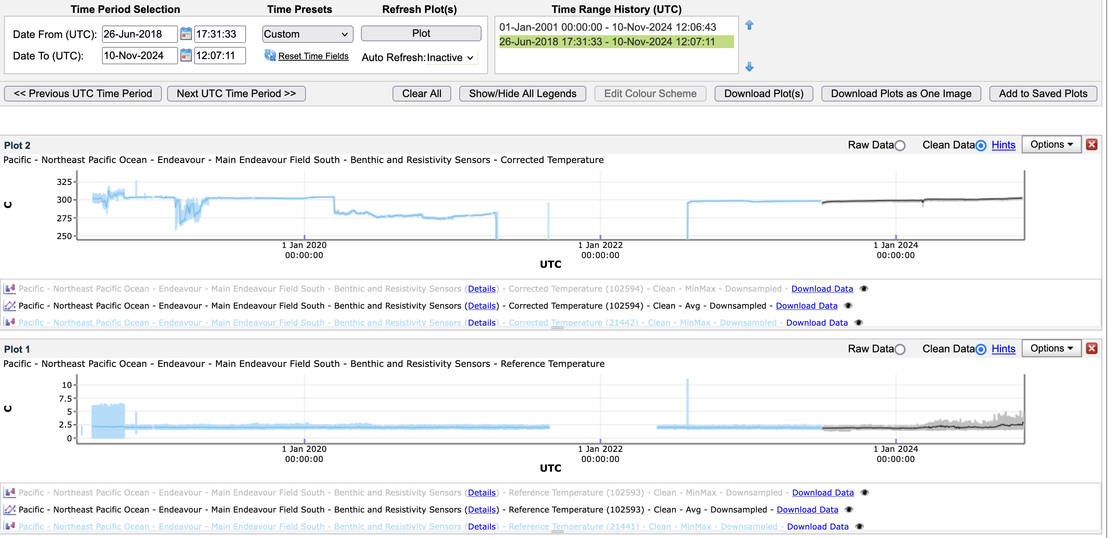
Sanya Village

Slide 12
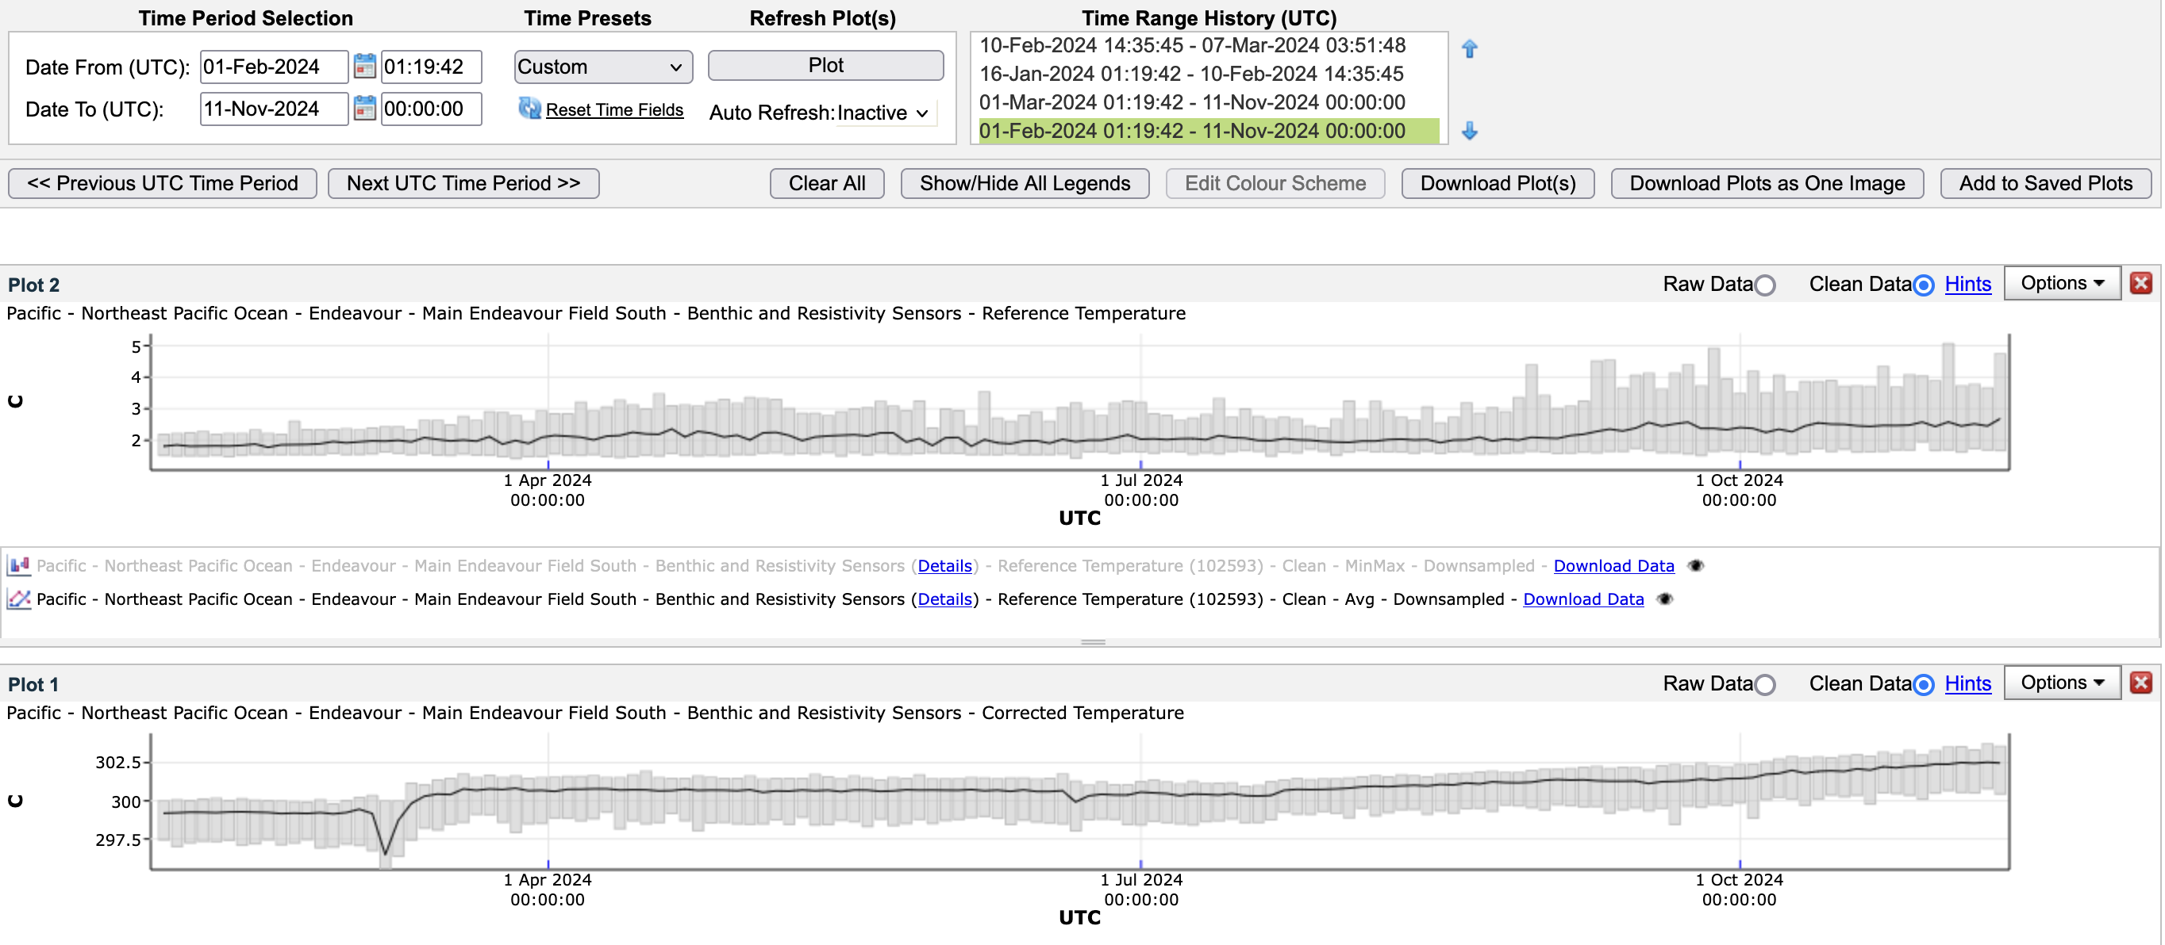
Sanya Village

Slide 13
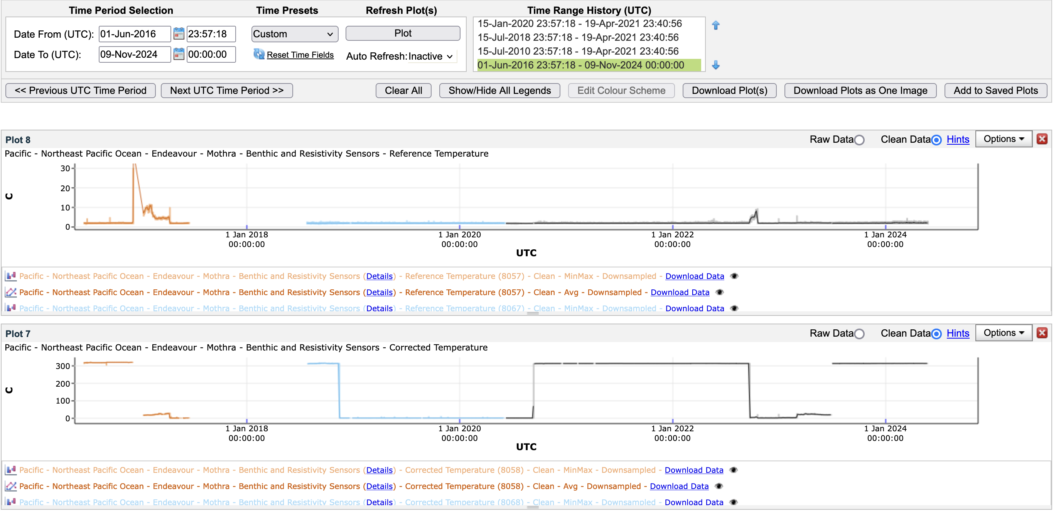
Hot Harold

Slide 14
Grotto CO₂
Year | CO₂ (mmol/kg) | 𝛿¹³CO₂ ‰
1995 | 20.1 | -8.2
2000 | 22.8 | -7.0
2006 | 14.5 | -7.0
2014 | 13.4 | -8.4
2017 | 11.4 | -9.7
2022 | 14.1 | -7.9
2024 | (12.9) | (-8.3)
Park Place CO₂
Year | CO₂ (mmol/kg) | 𝛿¹³CO₂ ‰
1995 | 21.7 | -8.3
2011 | 22.6 | -8.0
2024 | (20.2) | (-7.6)

Slide 15
Conclusions
We do see changes in vent fluid chemistry associated with seismic activity
as shown in Bill and Guy’s papers on Sanya Village. However, there is no
evidence in either vent temperatures or gas chemistry that the recent
increase in seismic activity has affected the Main Endeavour, High Rise,
or Mothra vent fields in a major way.
There has been a temperature increase of roughly 10ºC at Grotto in the
last few years and transient perturbations at Sanya Village. Mothra
temperatures have been quite stable.
What would we see if there was magma involvement?

Slide 16
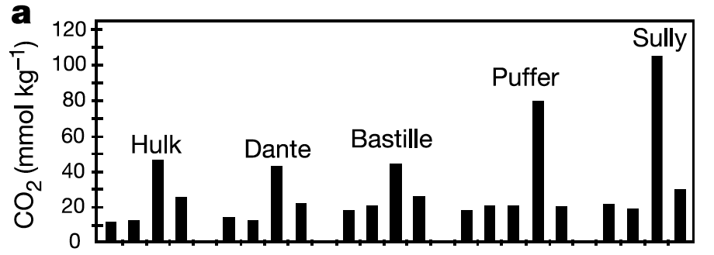
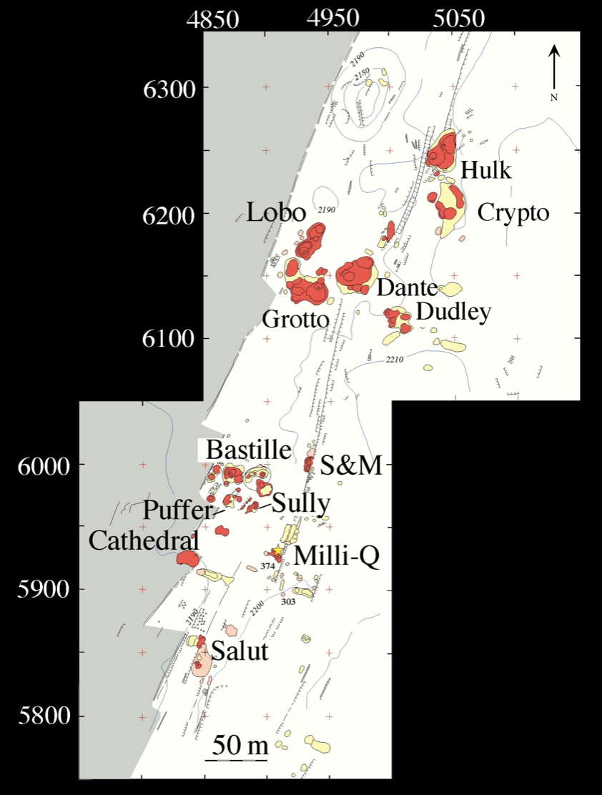
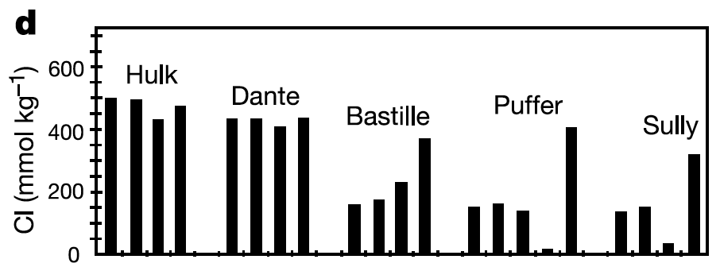
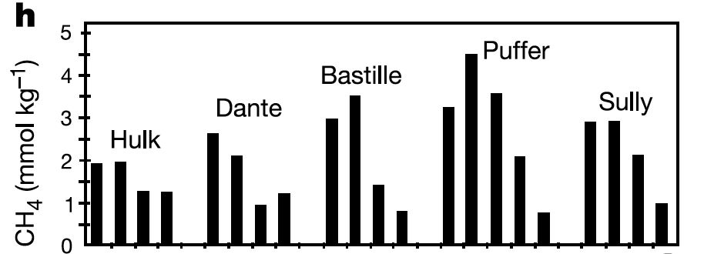
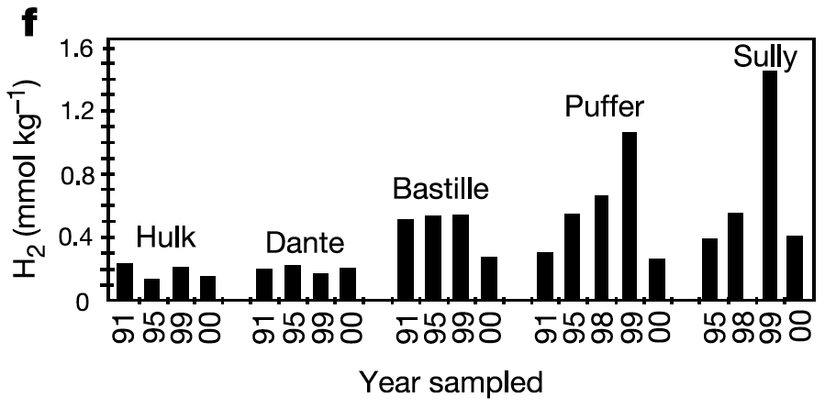
Impact of 1999 Magmatic Activity
Lilley et al., 2003

Slide 17
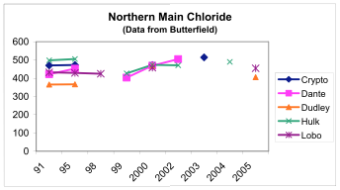
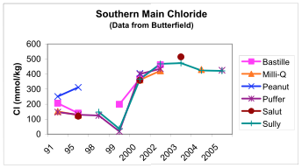

Slide 18
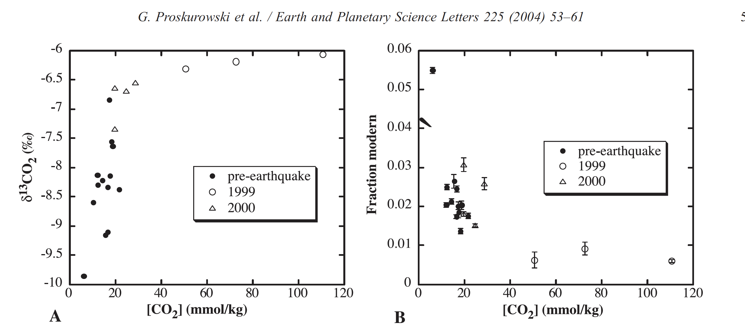
Stable and Radiocarbon Isotopes
23,000 yrs
28,000 yrs
43,000 yrs

